Slide 1
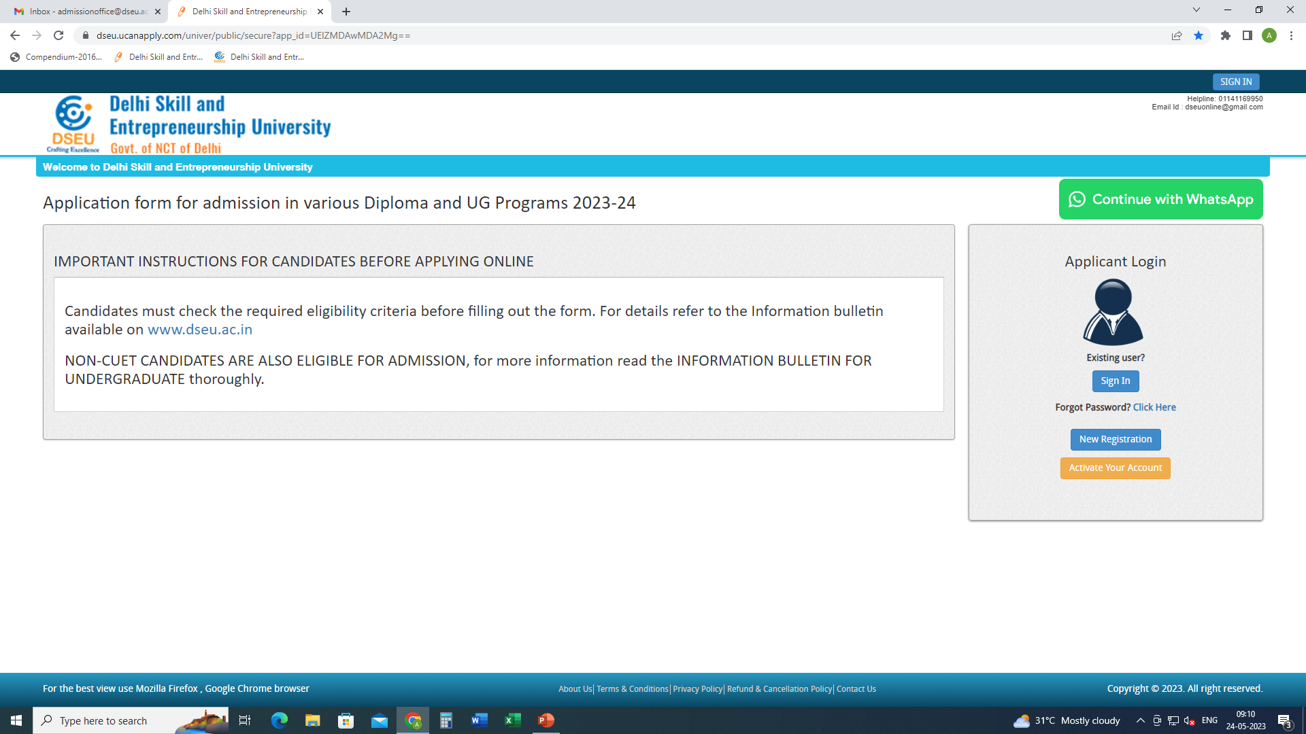
Step 1- Registration.
Enter Details.
Confirm
Step 2
Activate account.

Slide 2
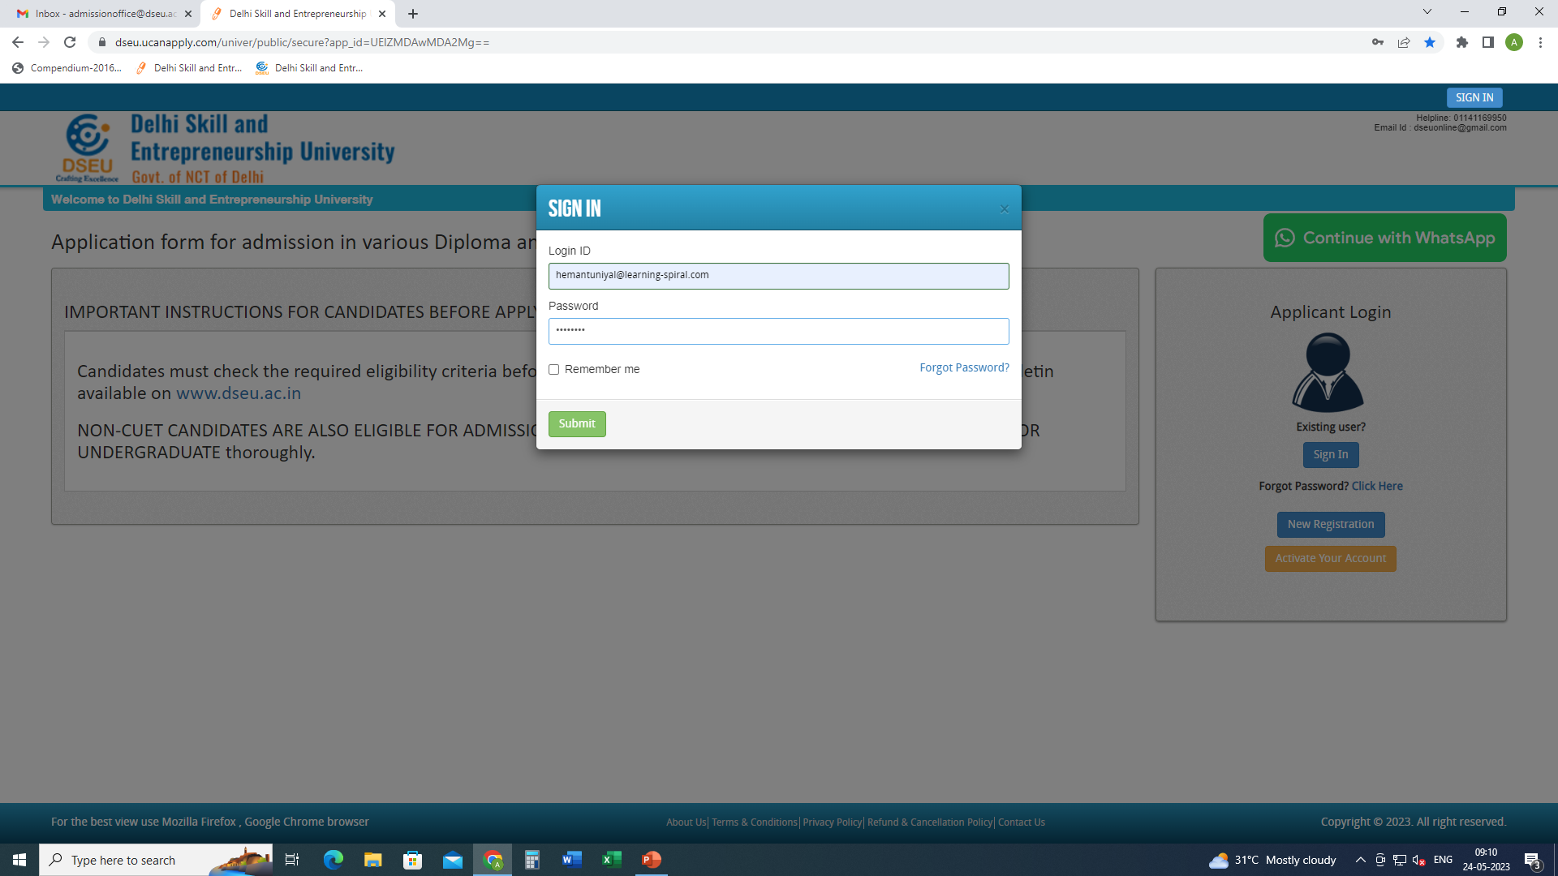
Step 3- Sign In.

Slide 3
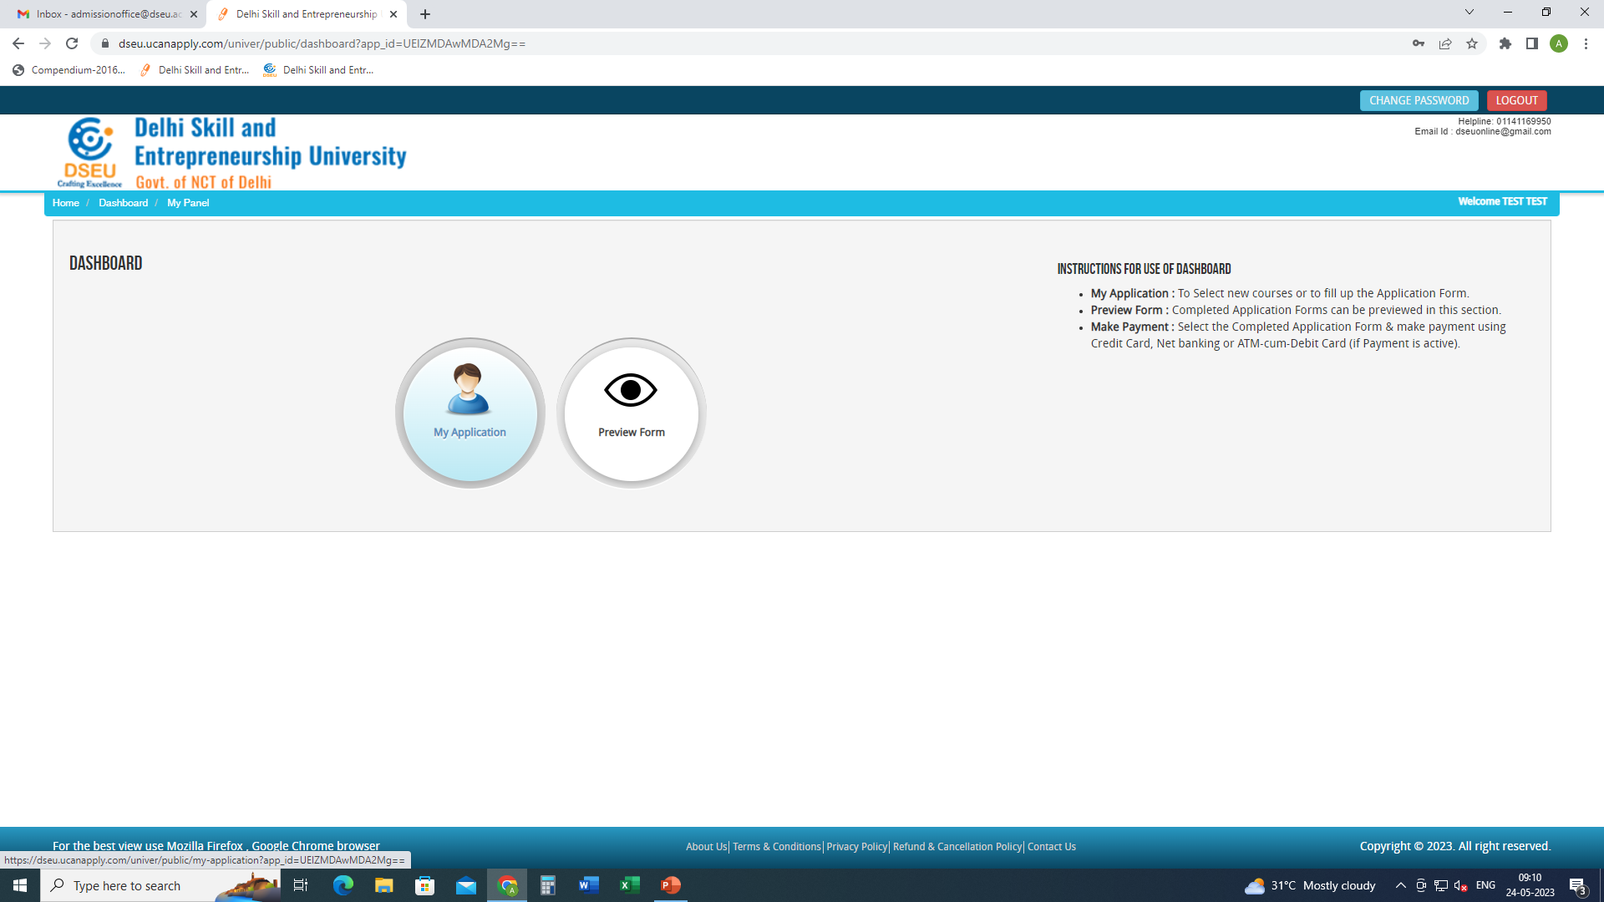
Step 4- My application

Slide 4
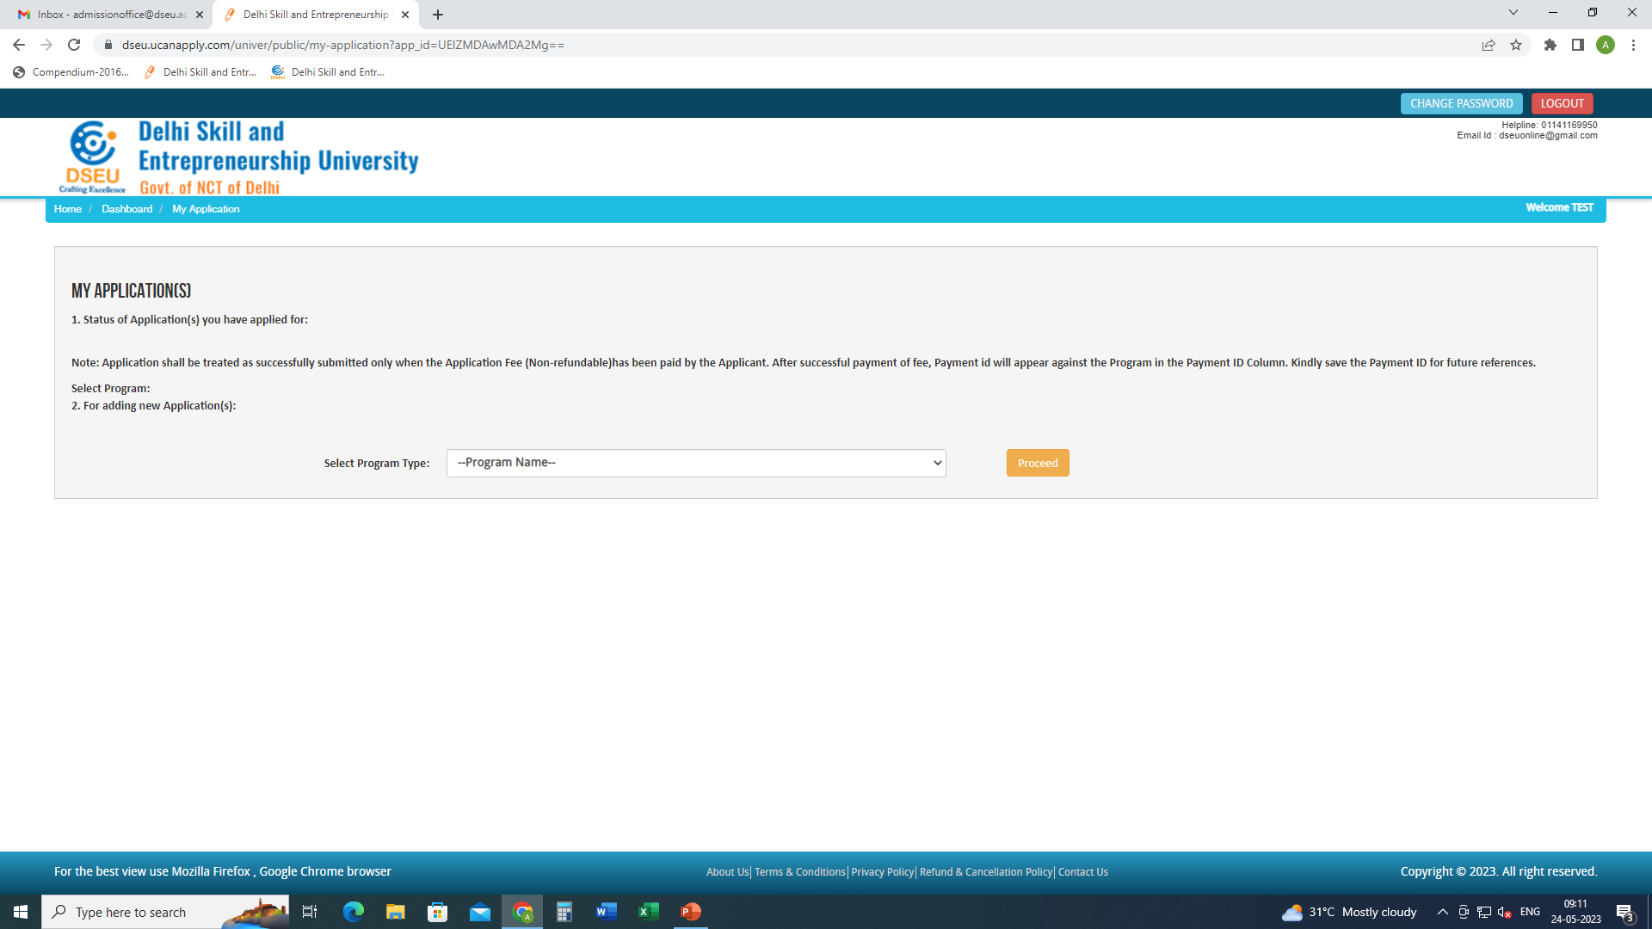
Select Program

Slide 5
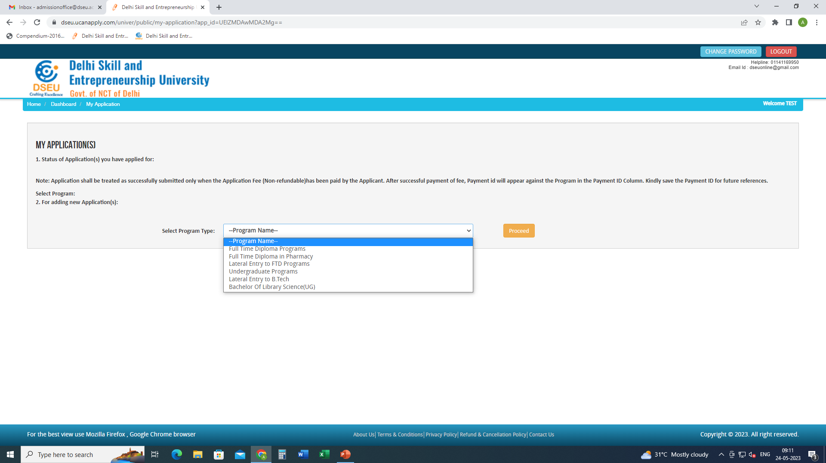

Slide 6
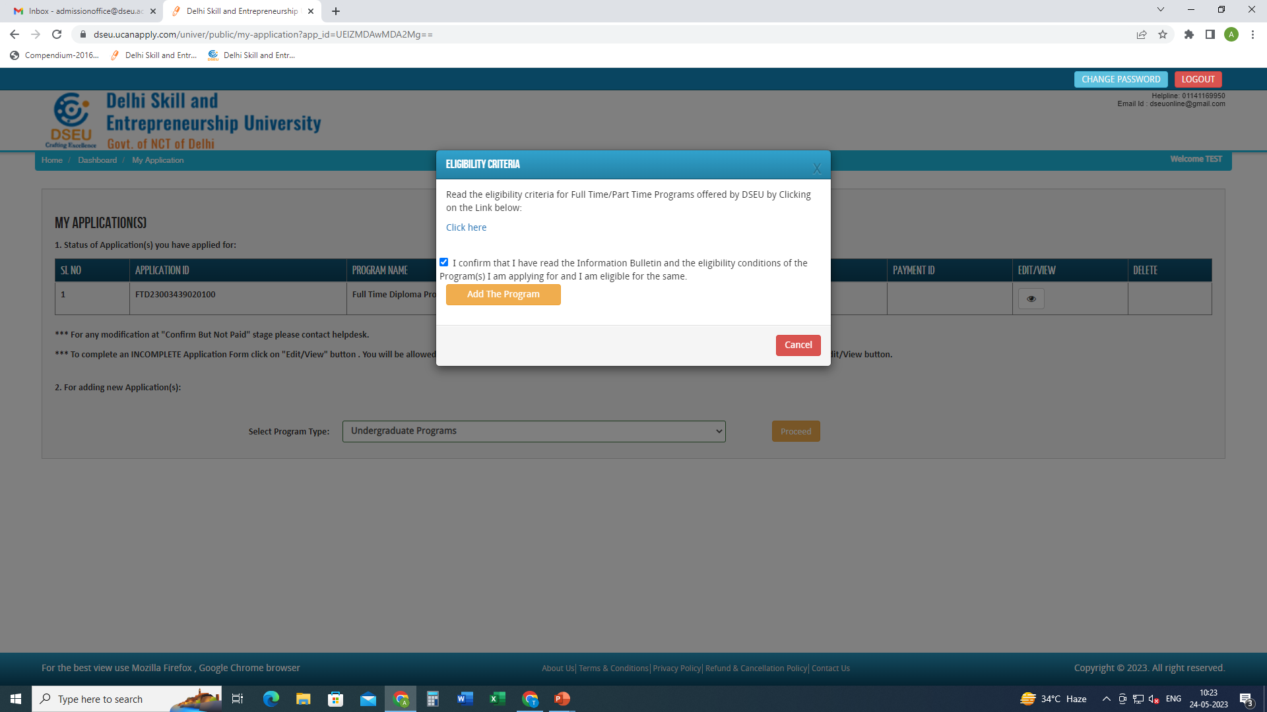
Click to check the eligibility conditions for the program selected.
Check the box
And
Add the program

Slide 7
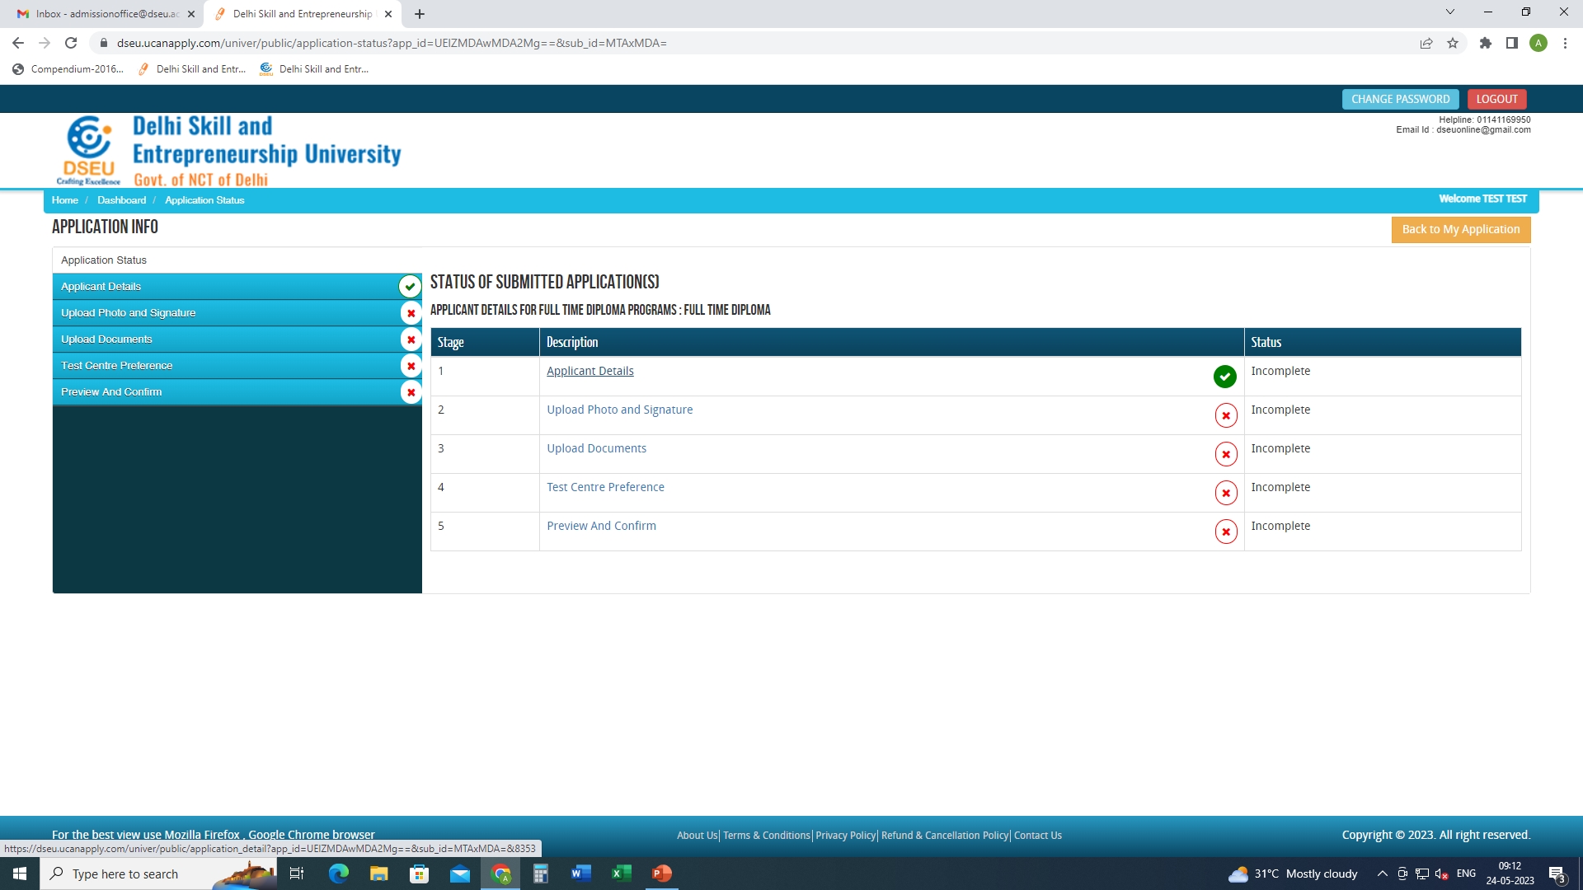
Click applicant details and fill the required information.

Slide 8
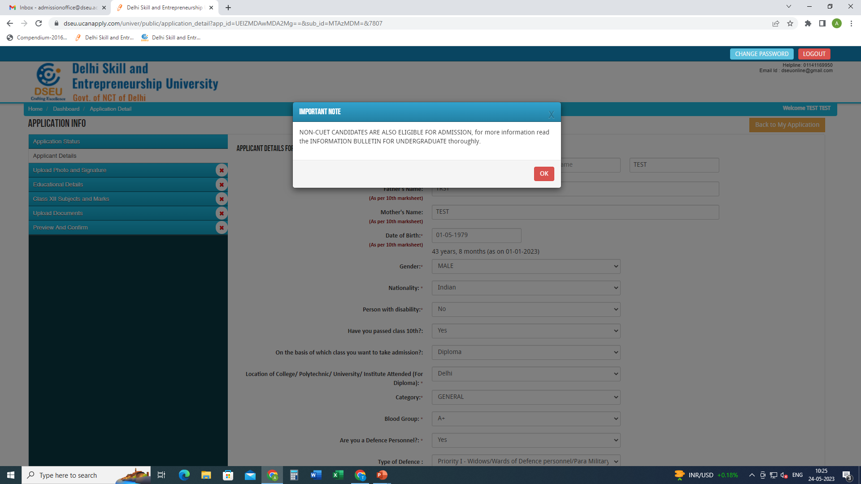
When click on Applicant Details pop up will show up.
Fill the required information

Slide 9
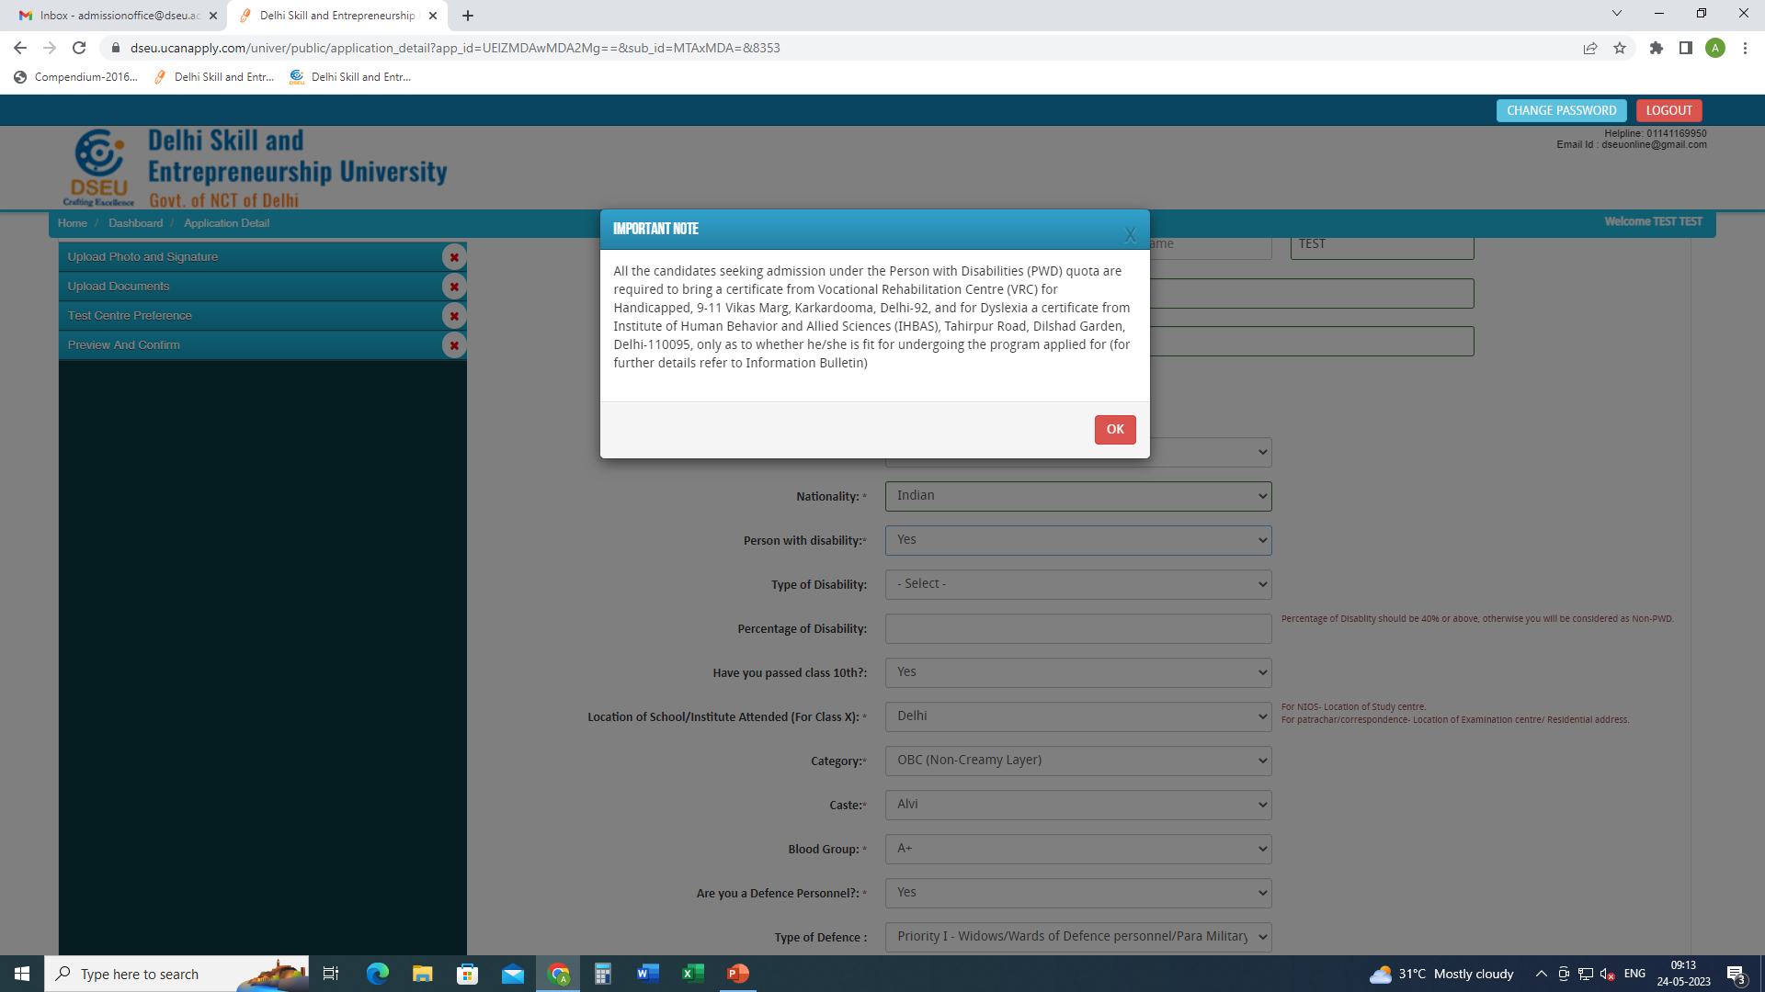
If selected ‘Yes’ in Person with Disability

Slide 10
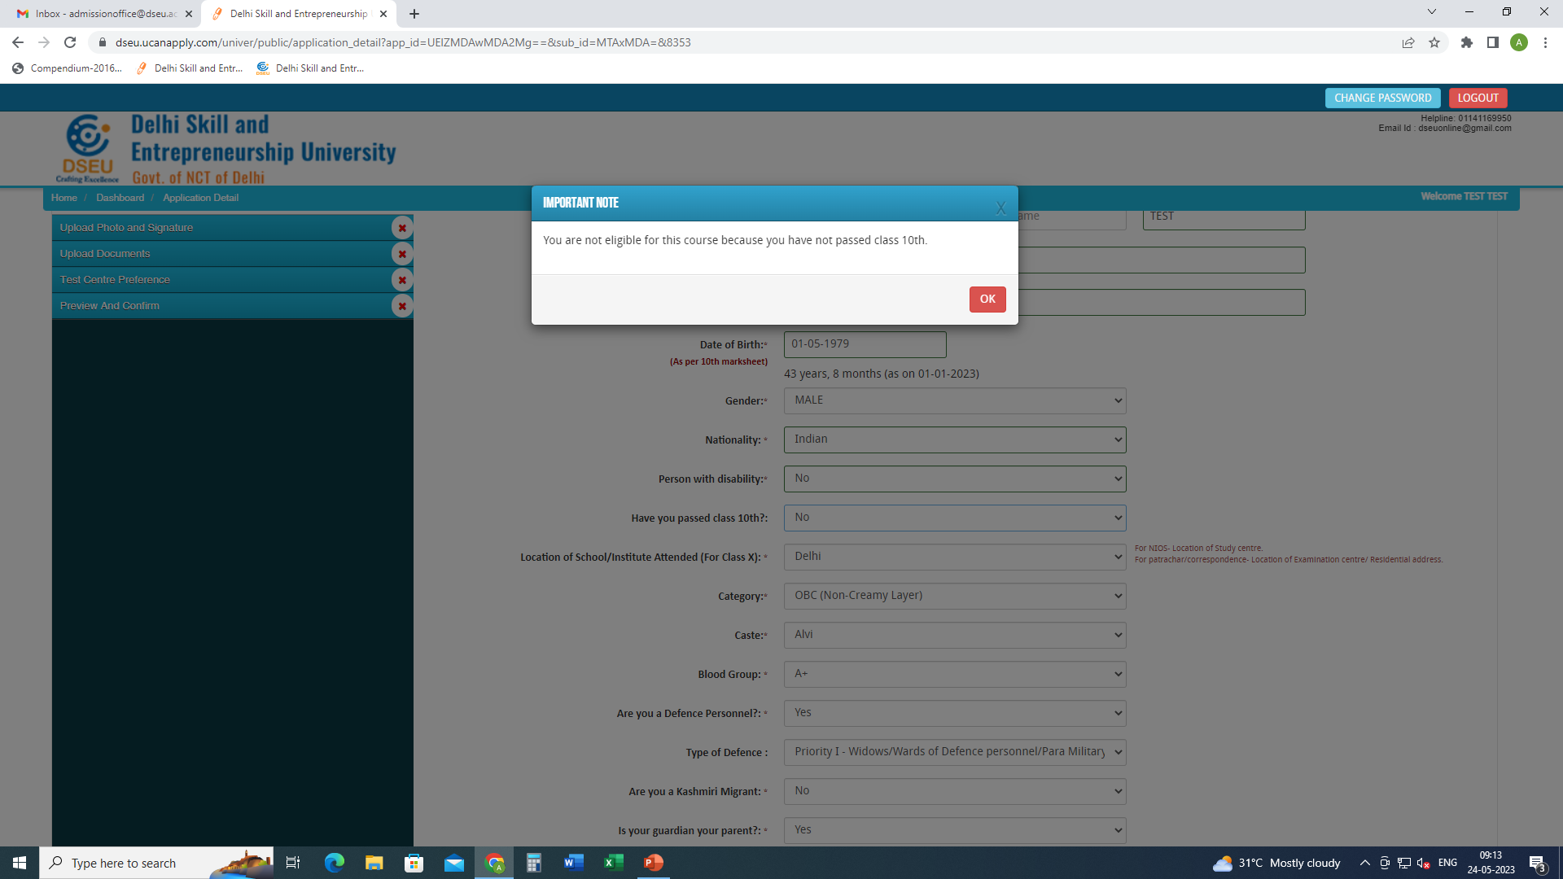
If selected ‘NO’ in Have you passed class 10th

Slide 11
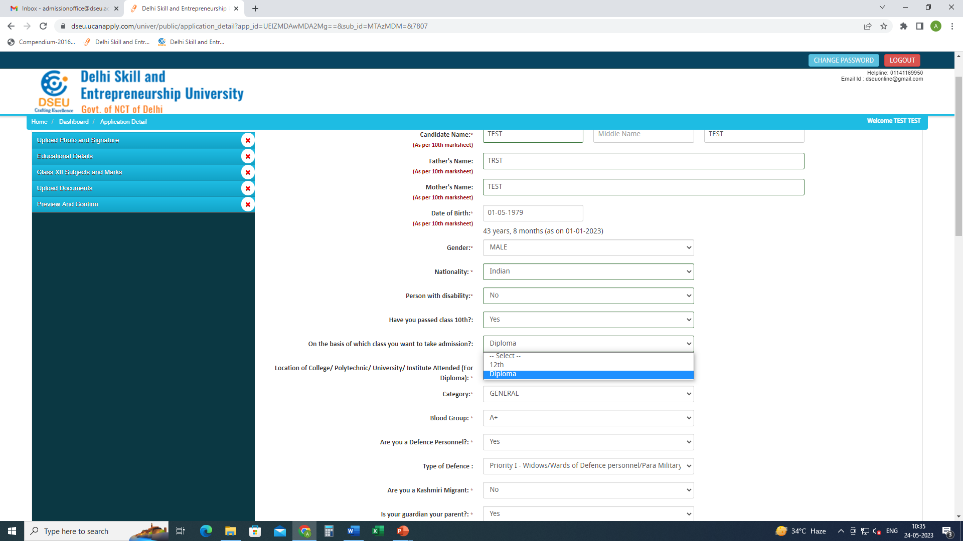
Select the qualifying examination.
“12th or Diploma”
Then select location of college etc. attended

Slide 12
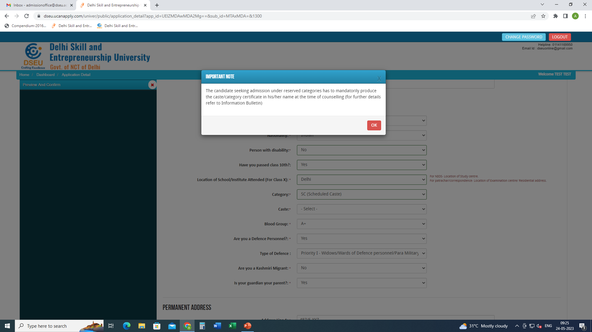
For Delhi SC candidate
Choose caste from the Drop Down

Slide 13
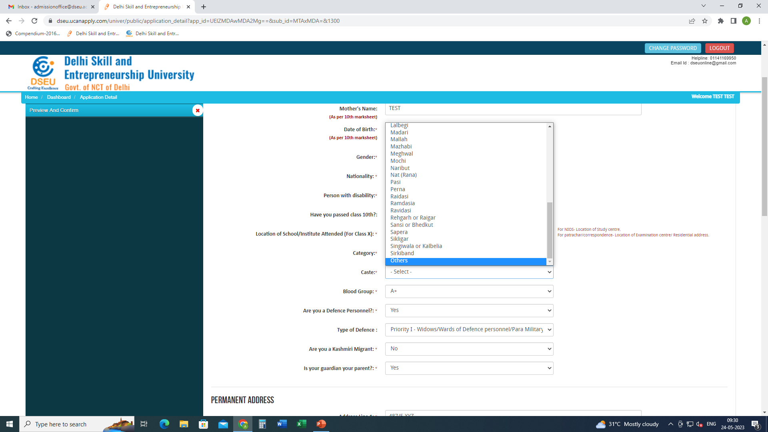
If caste is selected as others

Slide 14
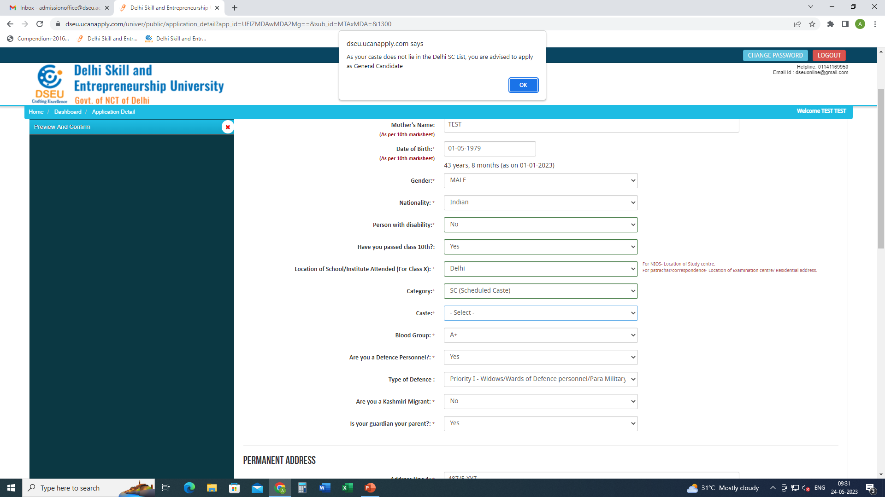
Pop up will ask the candidate to apply as General Candidate

Slide 15
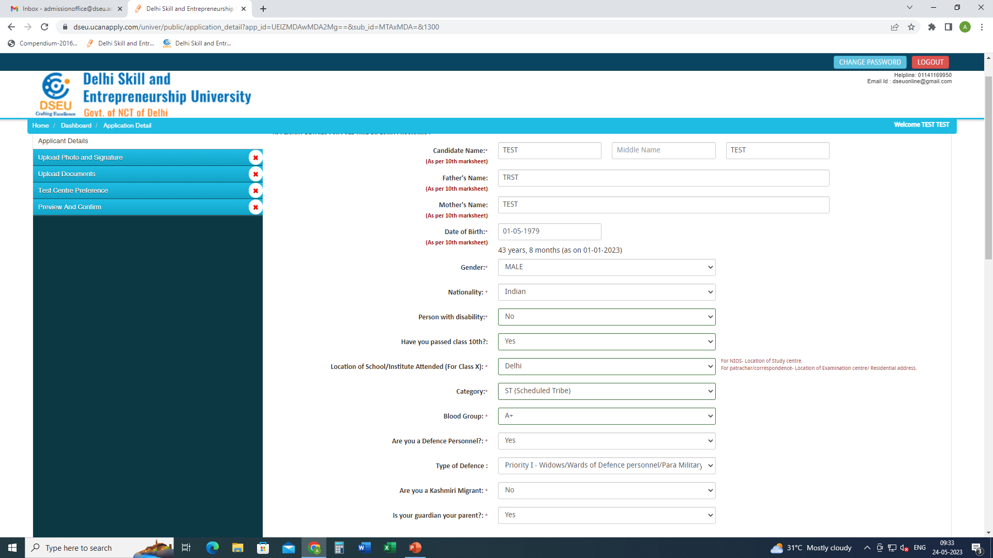
For ST Candidate there will be no pop up and the system will allow him to proceed further.

Slide 16
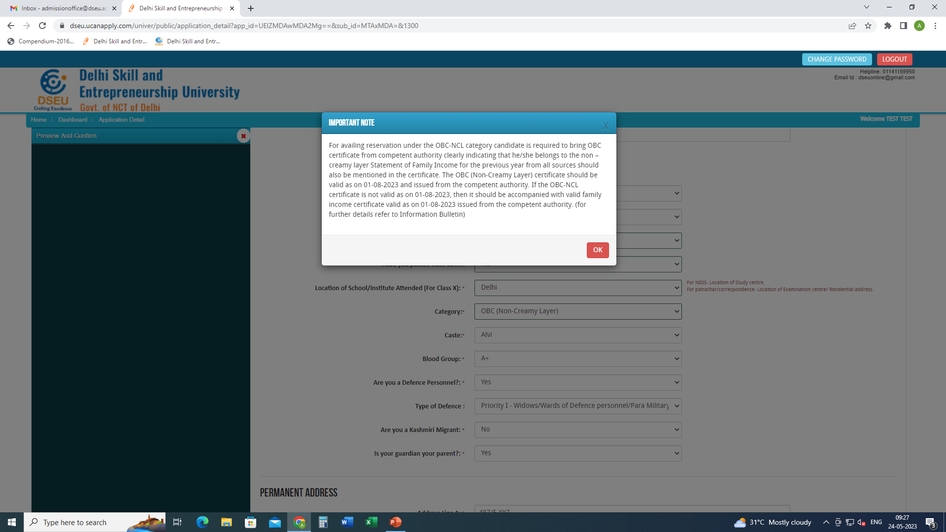
For Delhi- OBC Candidate
Choose caste from the Drop Down

Slide 17
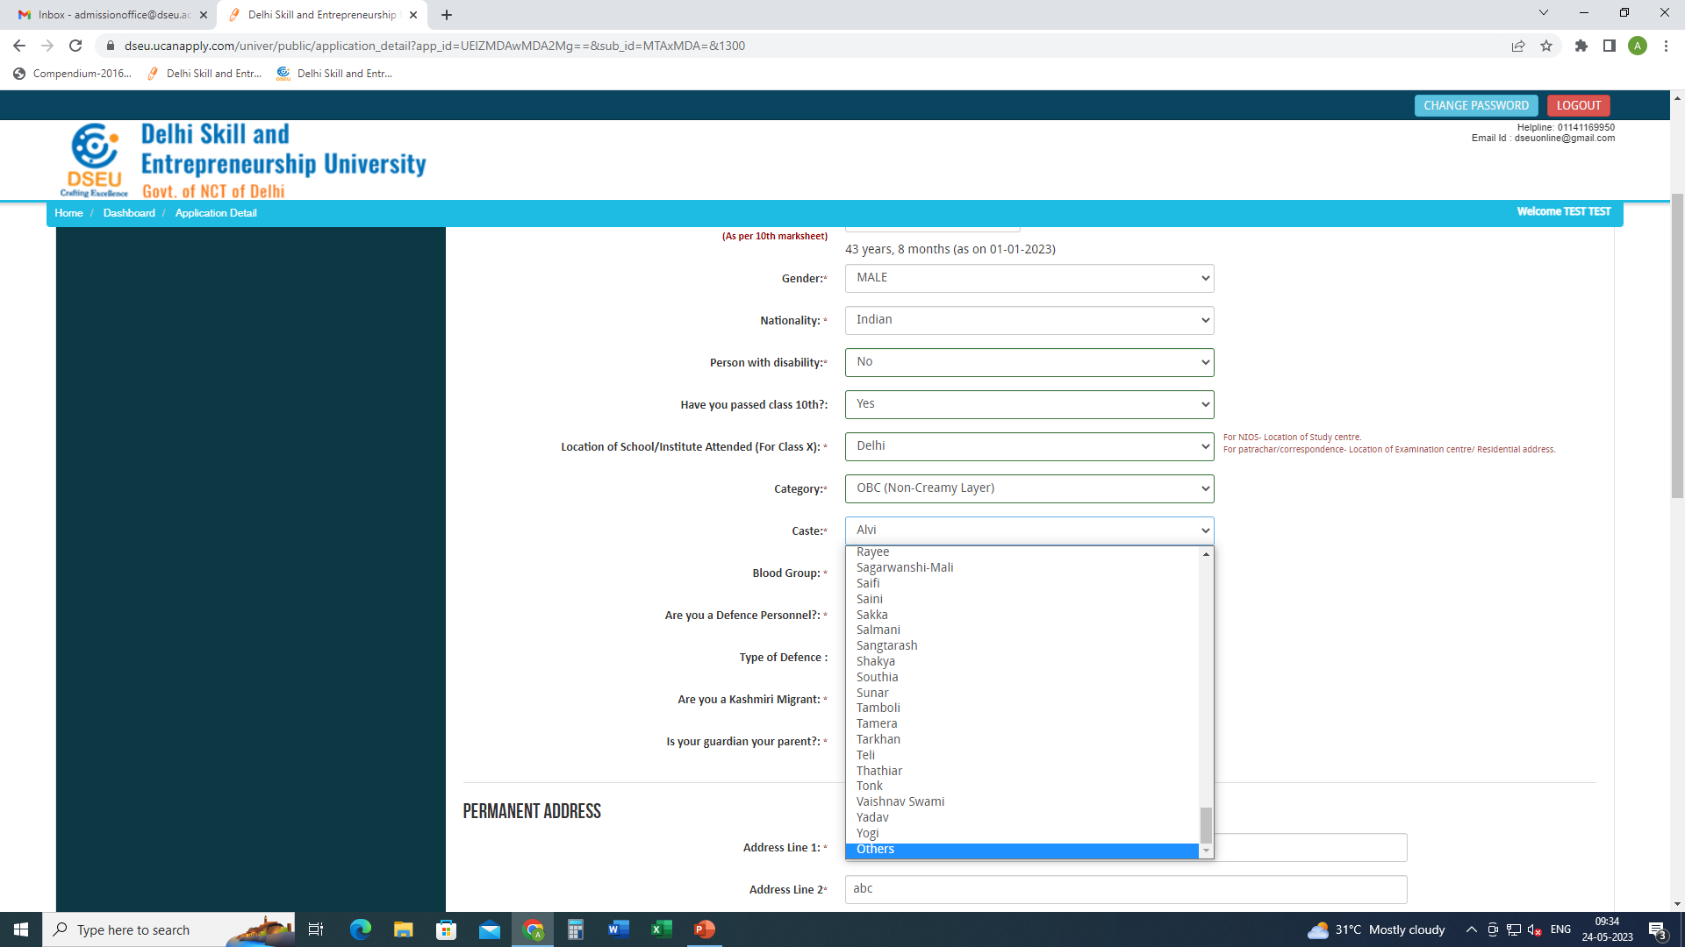
If caste is selected as others then

Slide 18
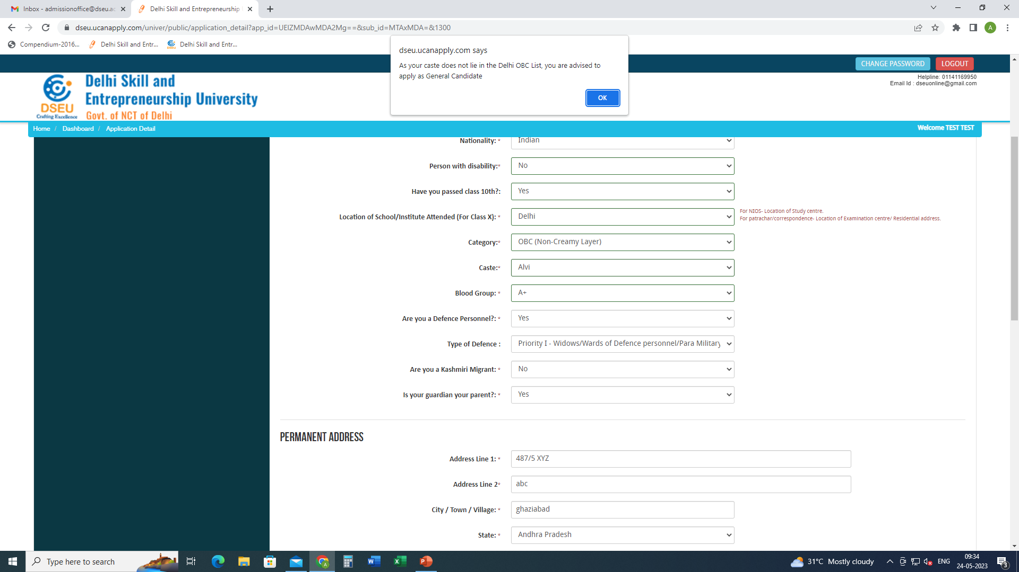
Pop up will ask the candidate to apply as General Candidate

Slide 19
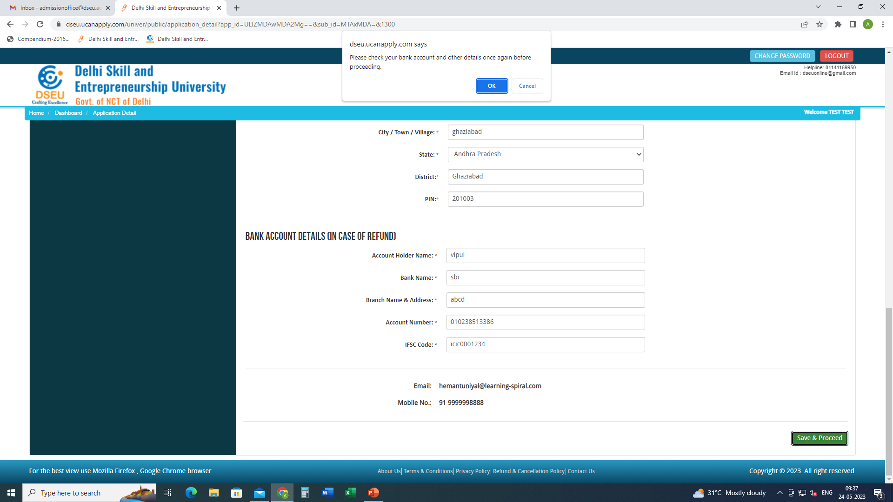
Fill in the other required information. Save and proceed
Click save and proceed

Slide 20
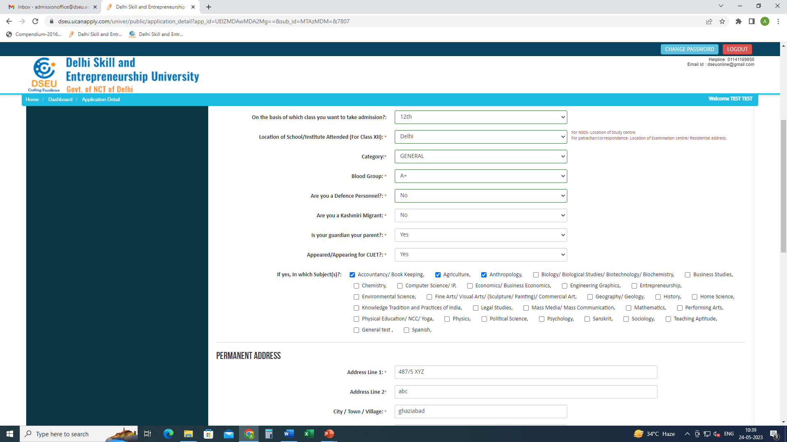
Give details about CUET. If appeared give the subjects of CUET. If not appeared, no problem, proceed ahead.

Slide 21
Fill in the other required information. Save and proceed
Fill other required information.
Fill bank details
Save and proceed.
Click save and proceed

Slide 22
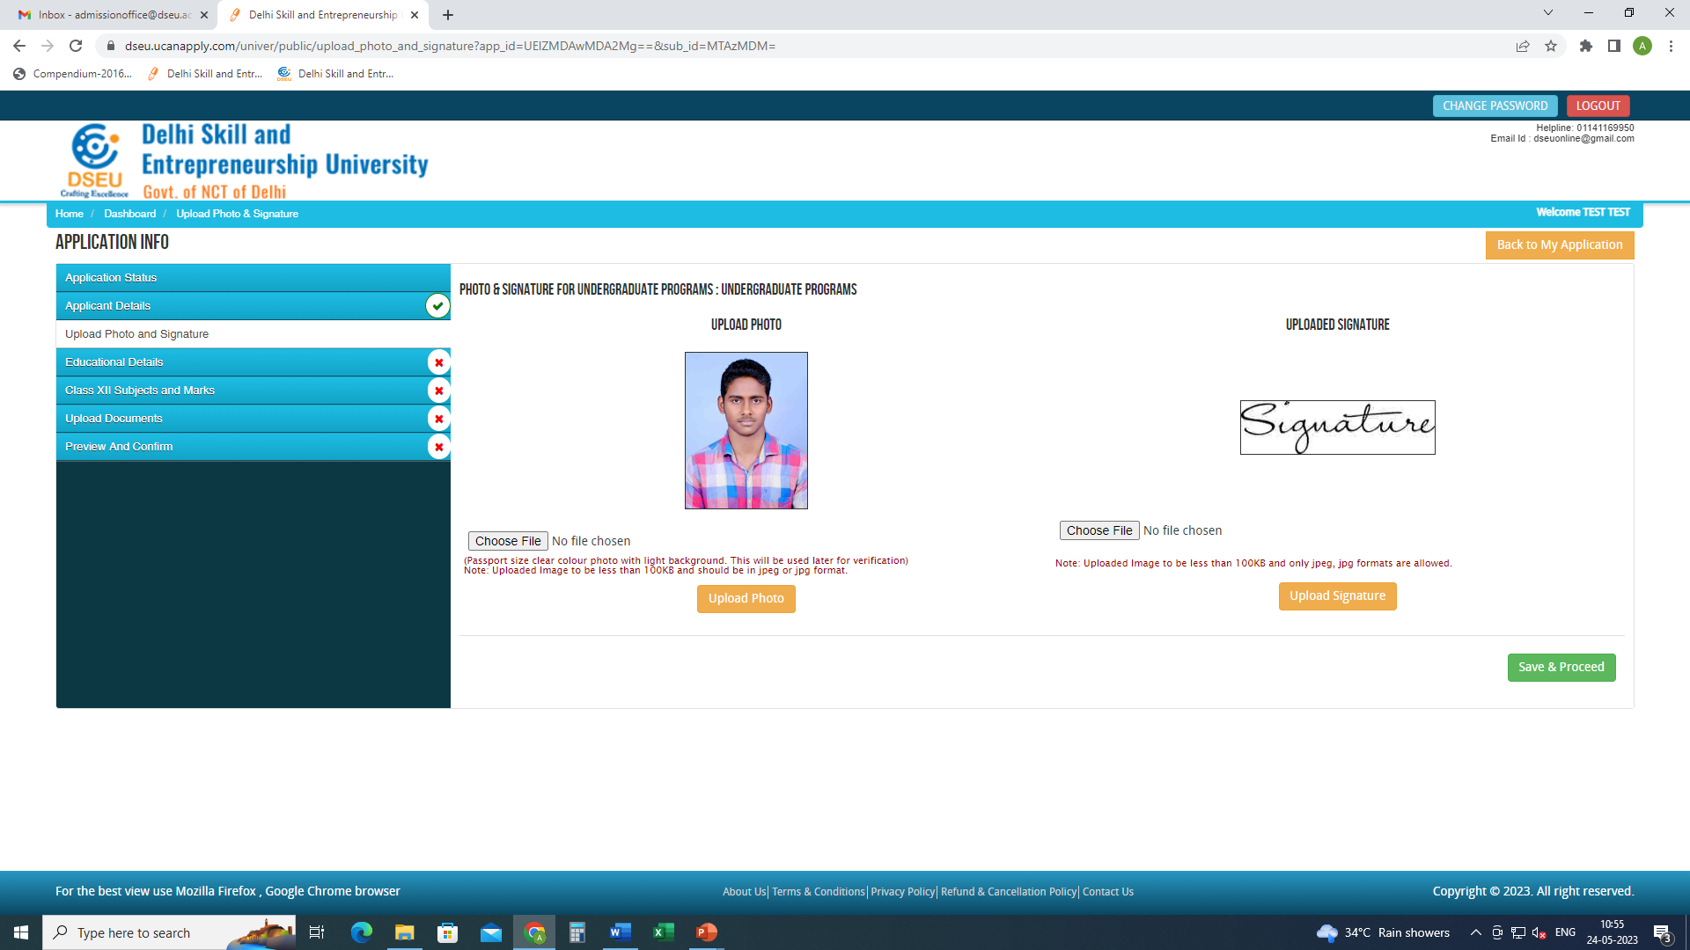
Upload photo and signature
Save and proceed.

Slide 23
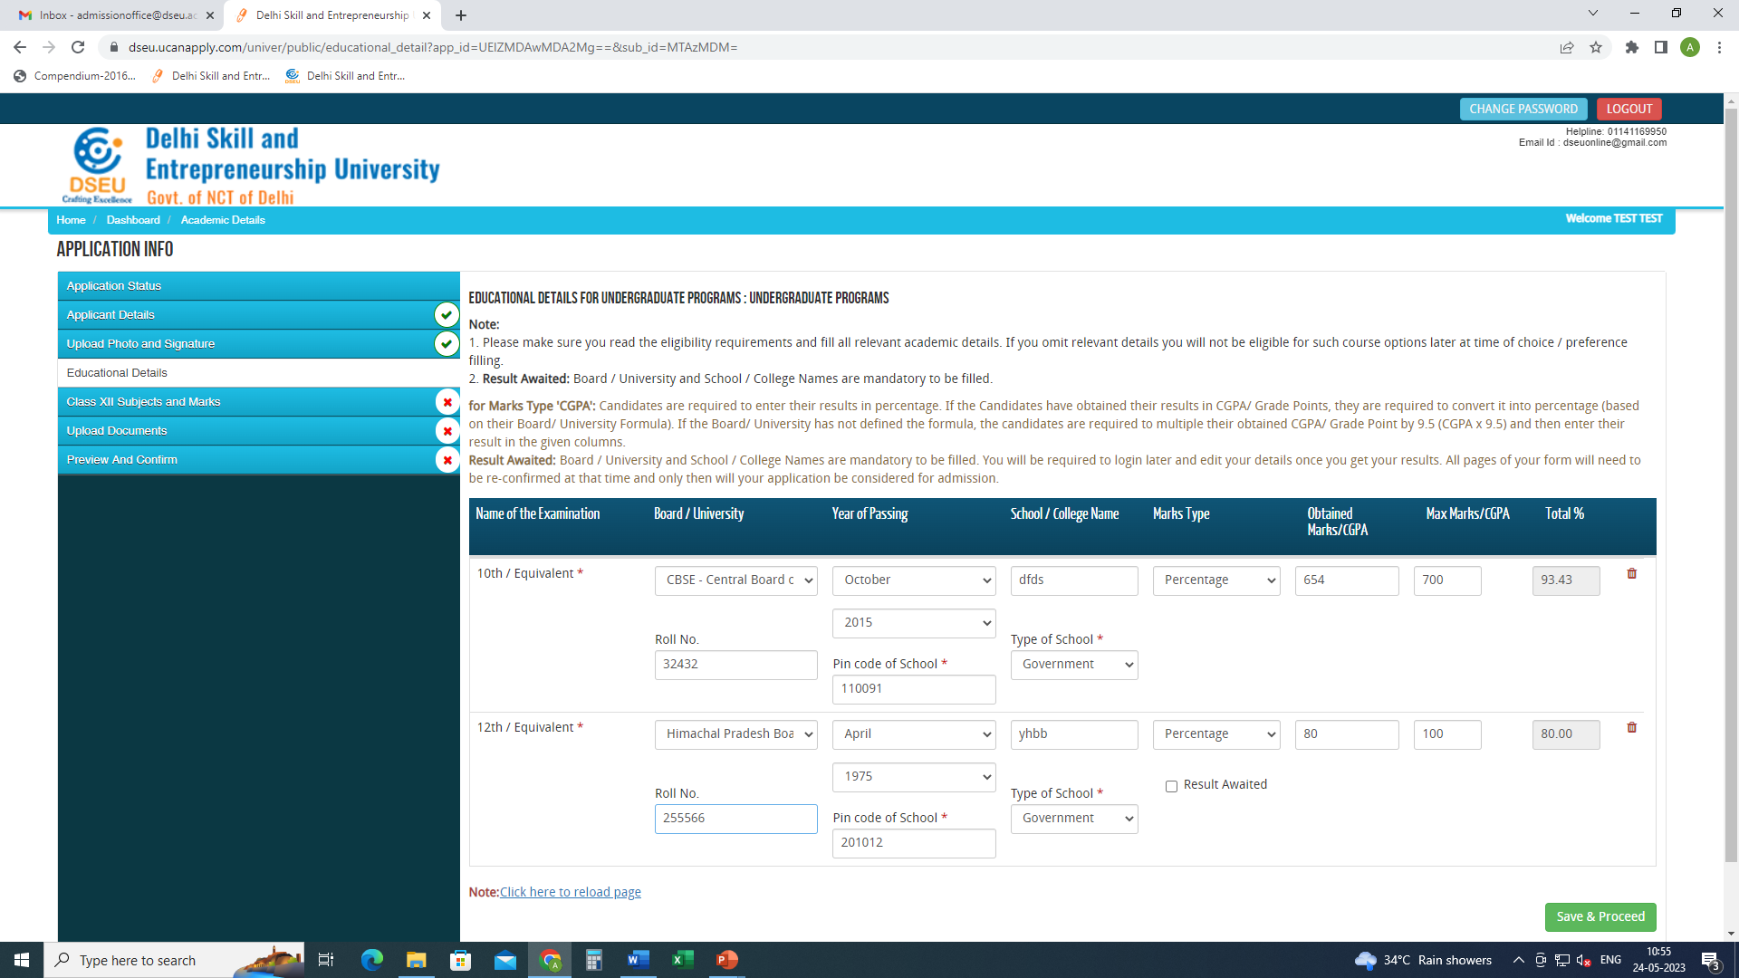
Fill your educational details
Save and proceed

Slide 24
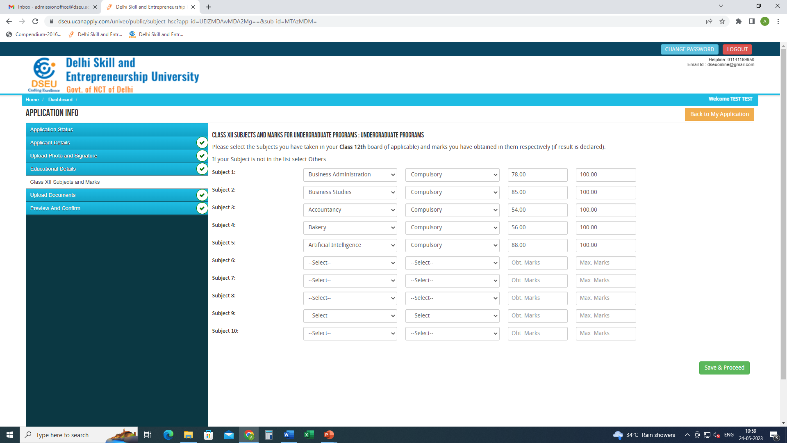
Fill in the required information
Save and proceed

Slide 25
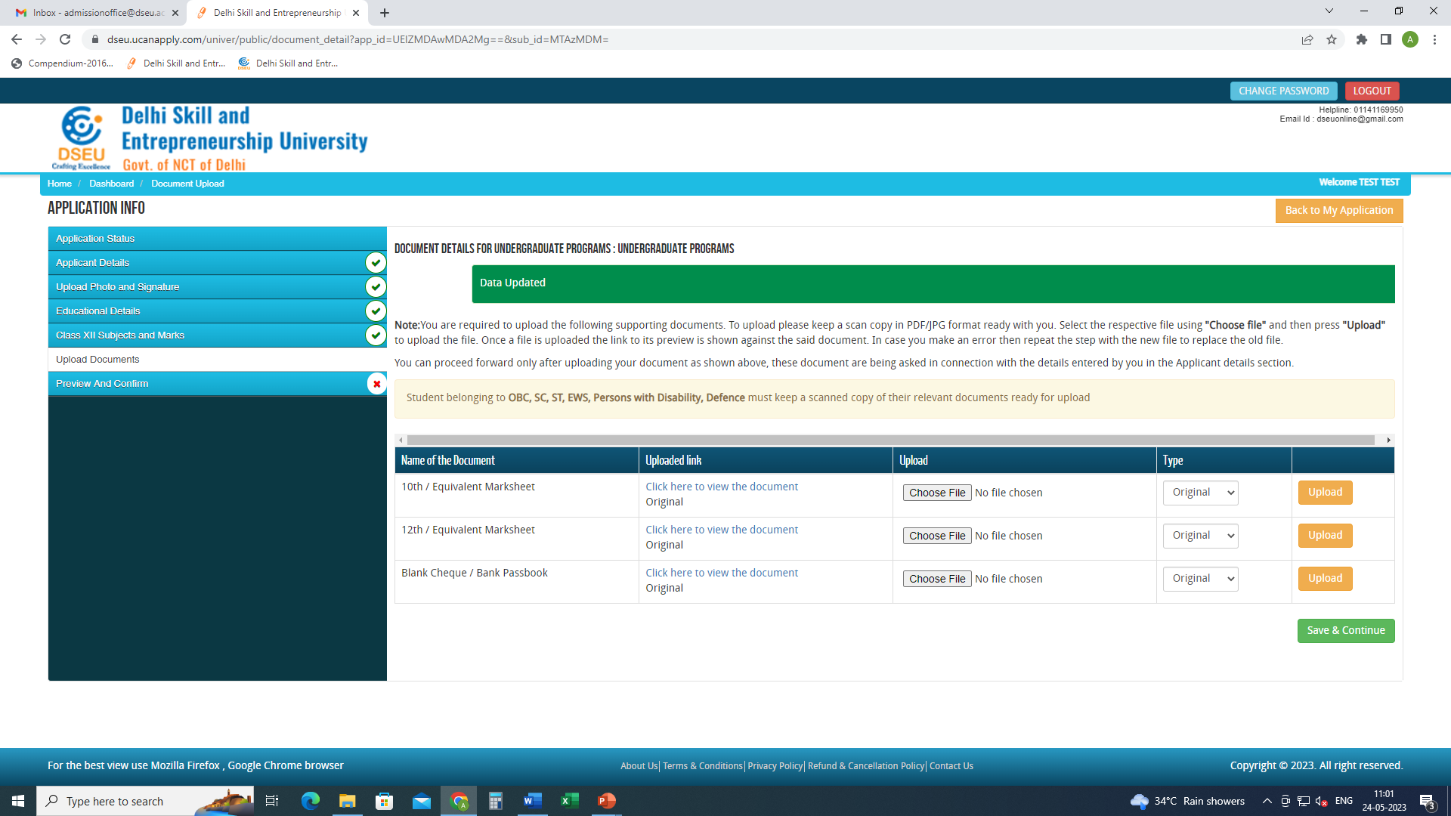
Upload the required documents
Save and continue

Slide 26
preview and confirm( check details carefully) -pay registration fee -print final application form for future reference.

