Slide 1
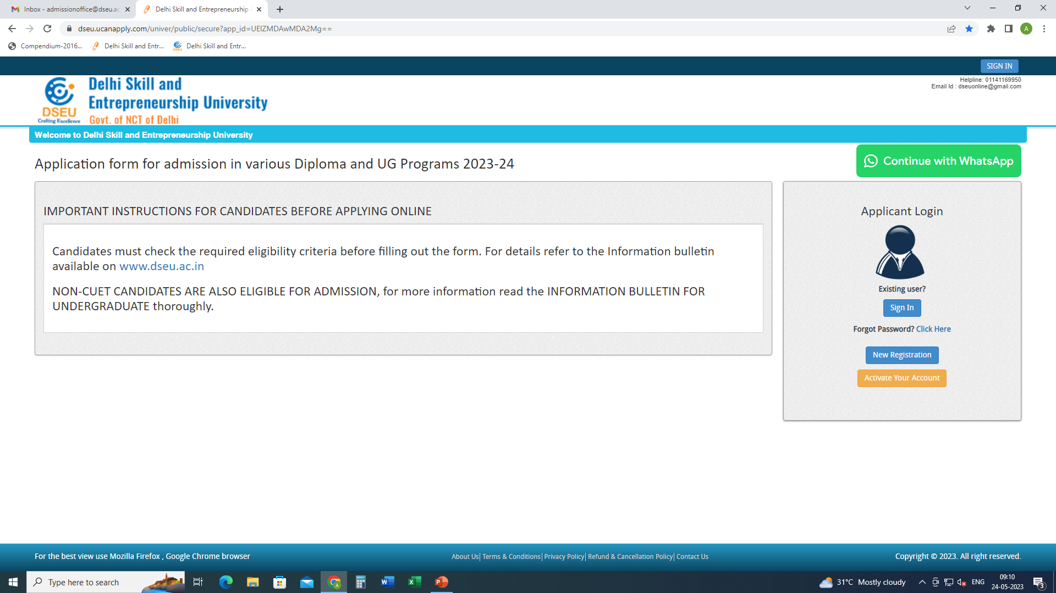
Step 1- Registration.
Enter Details.
Confirm
Step 2
Activate account.

Slide 2
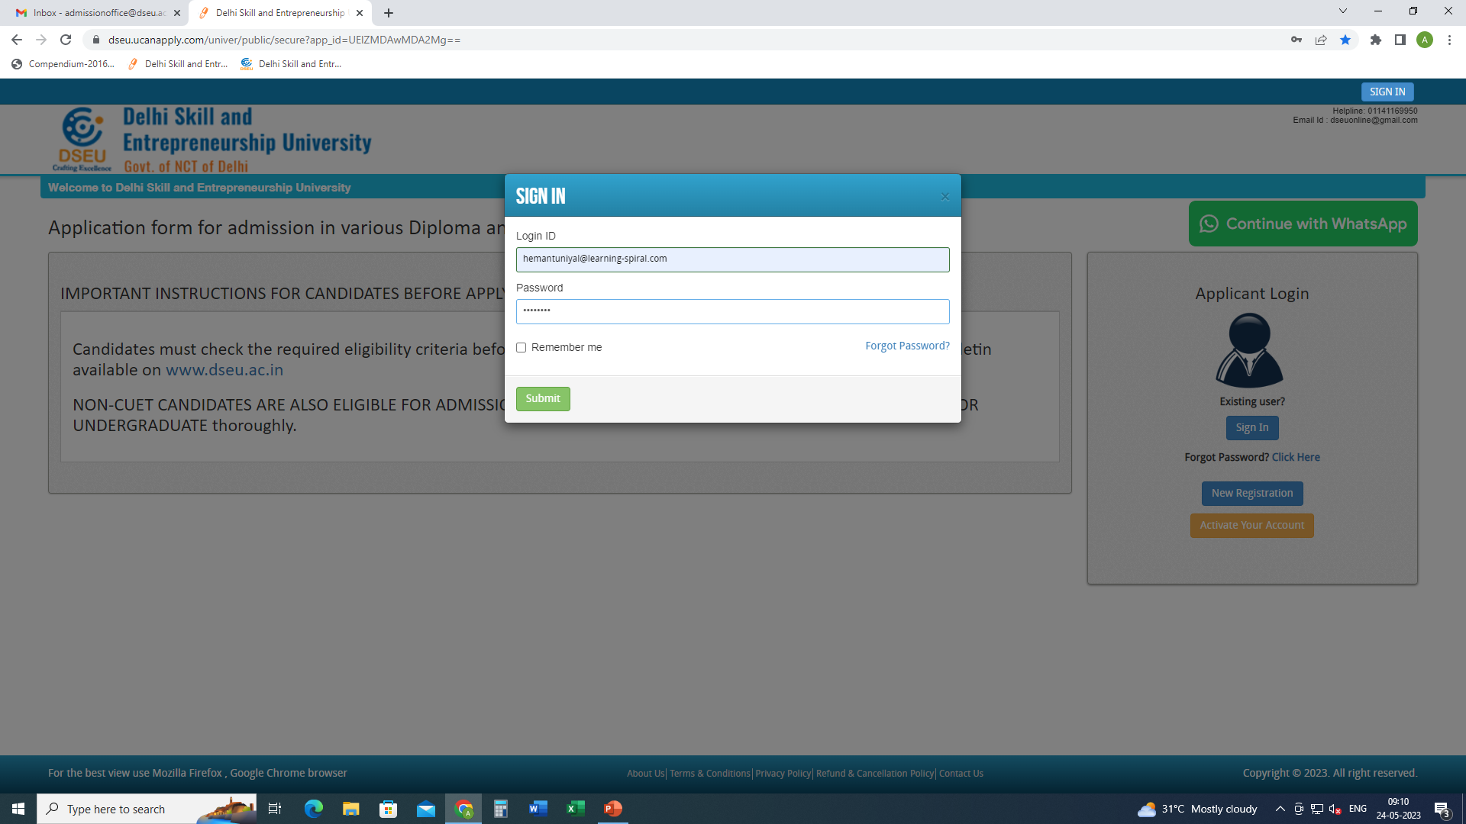
Step 3- Sign In.

Slide 3
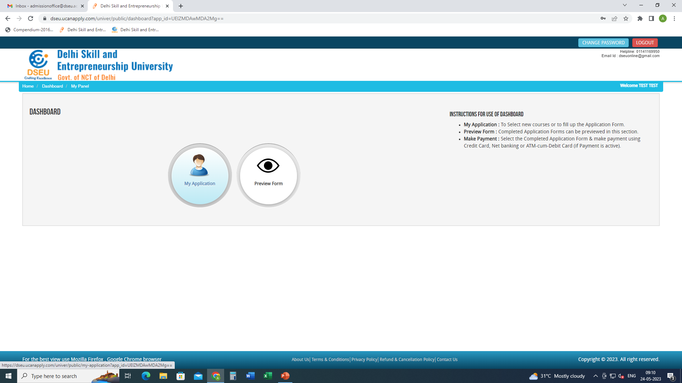
Step 4- My application

Slide 4
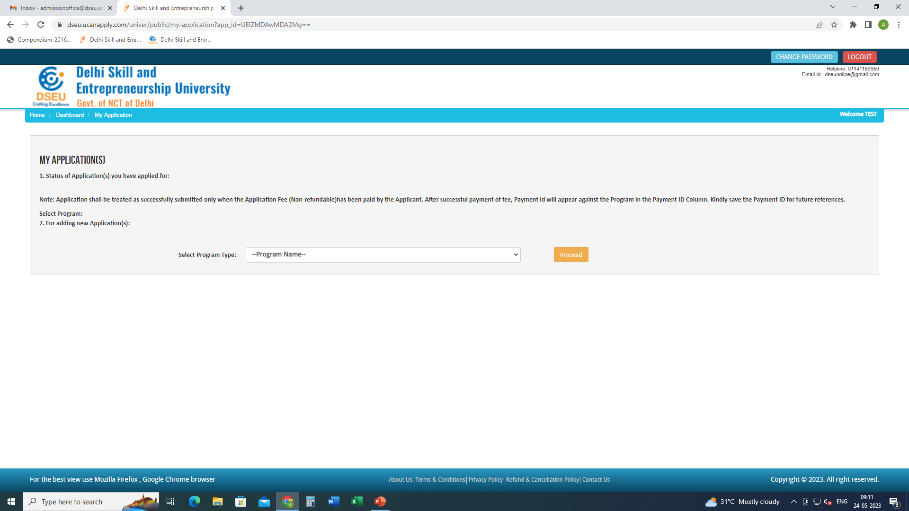
Select Program

Slide 5
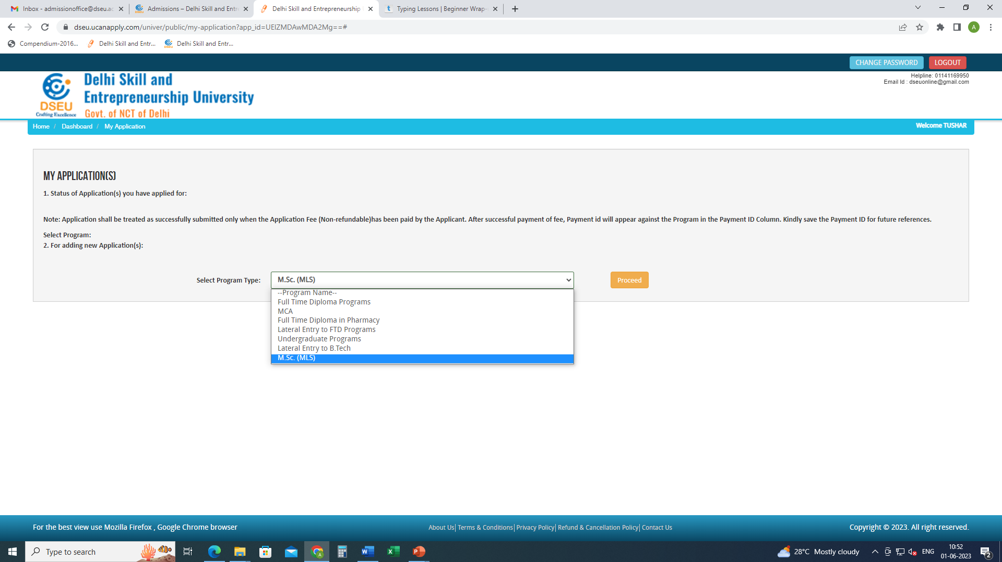
Add the program
Proceed

Slide 6
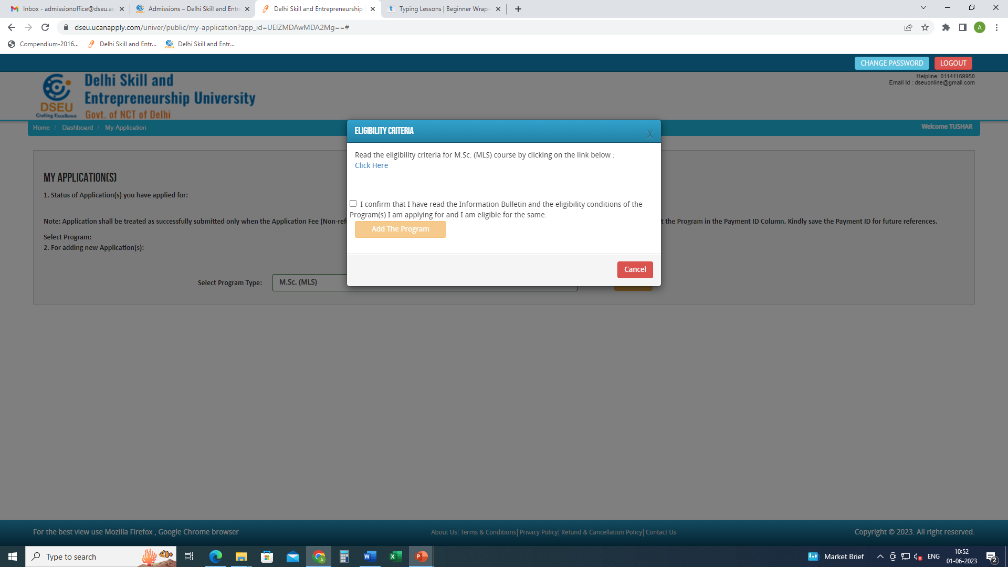
Check this box
Click on Add the Program
Click here to check the eligibility of MCA

Slide 7
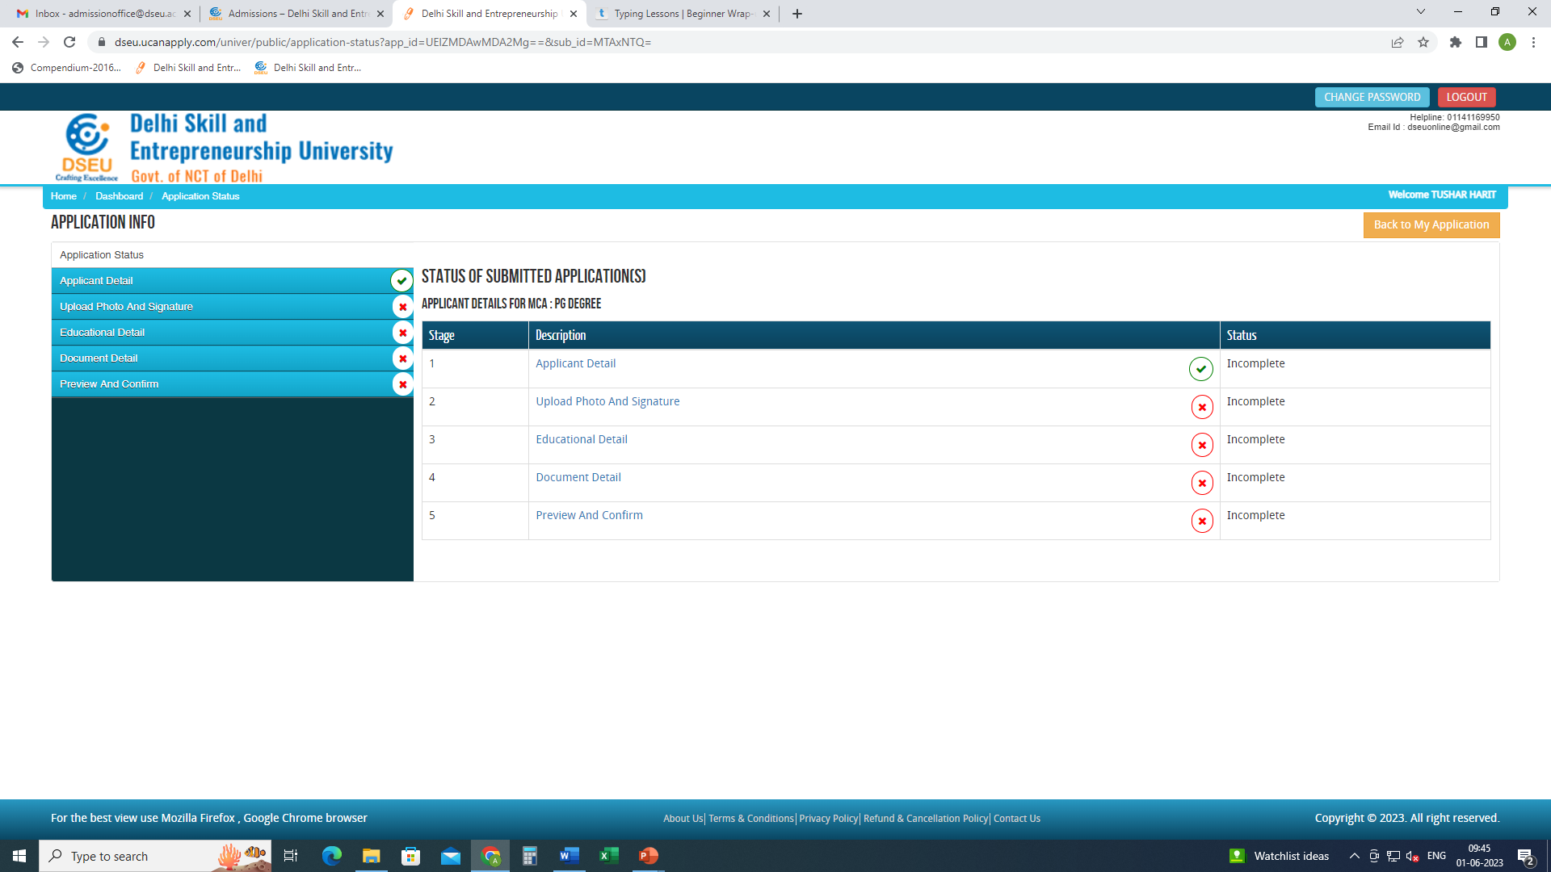
Click on applicant detail and fill the required information

Slide 8
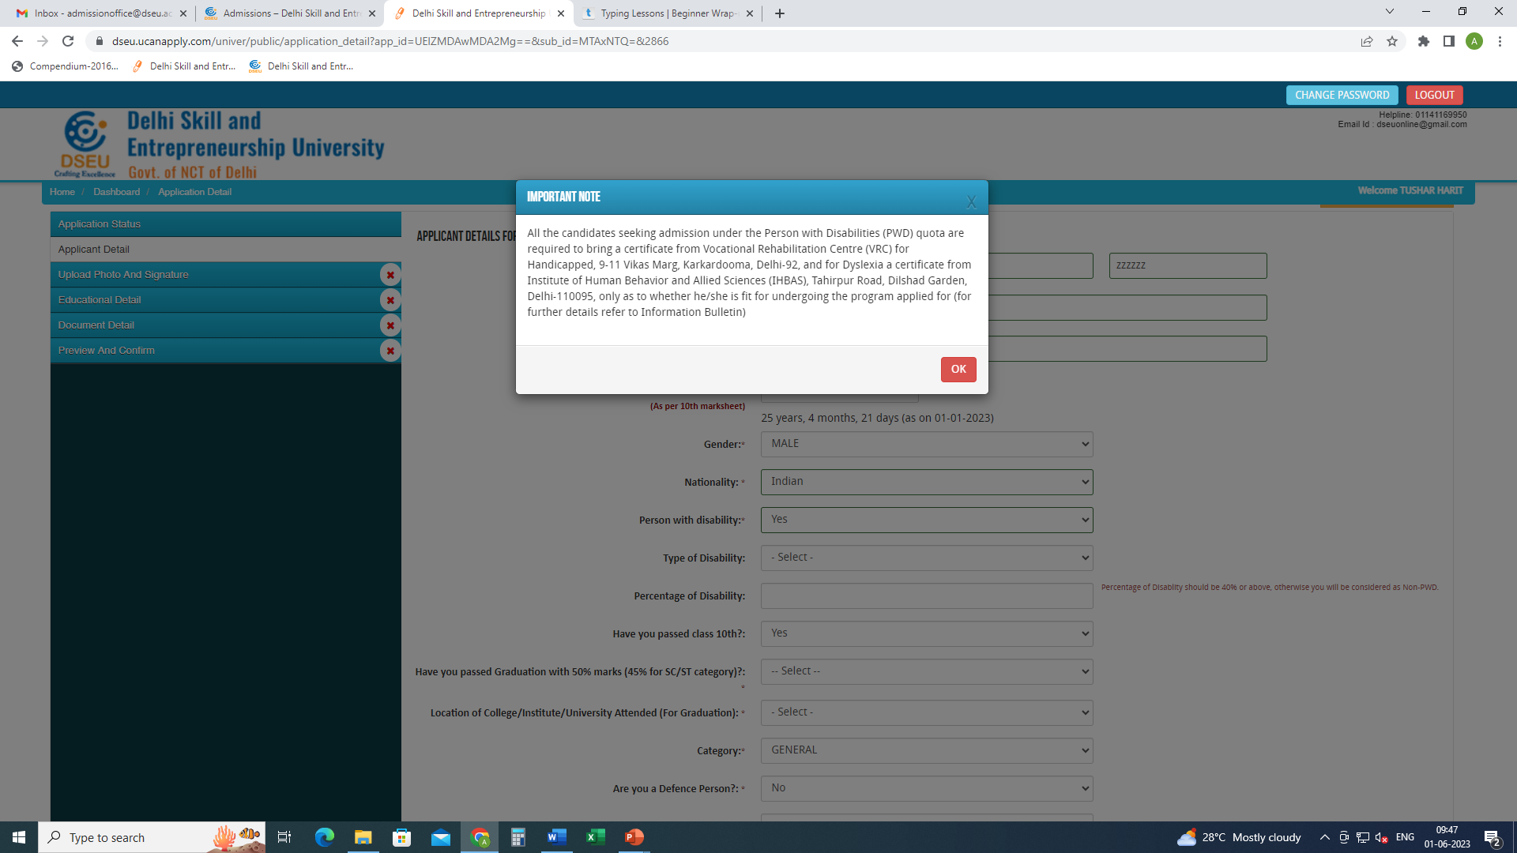
If selected ‘Yes’ a pop up will show up.
Make sure you have the required documents ready
Enter the type of disability

Slide 9
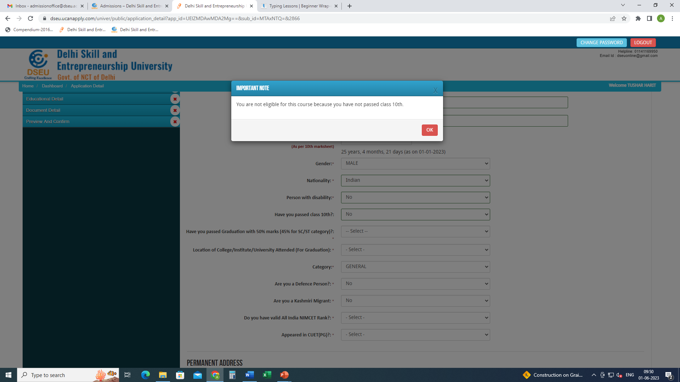
If selected ‘No’ a POP appears.
You are not eligible since you do meet the minimum eligibility criteria.

Slide 10
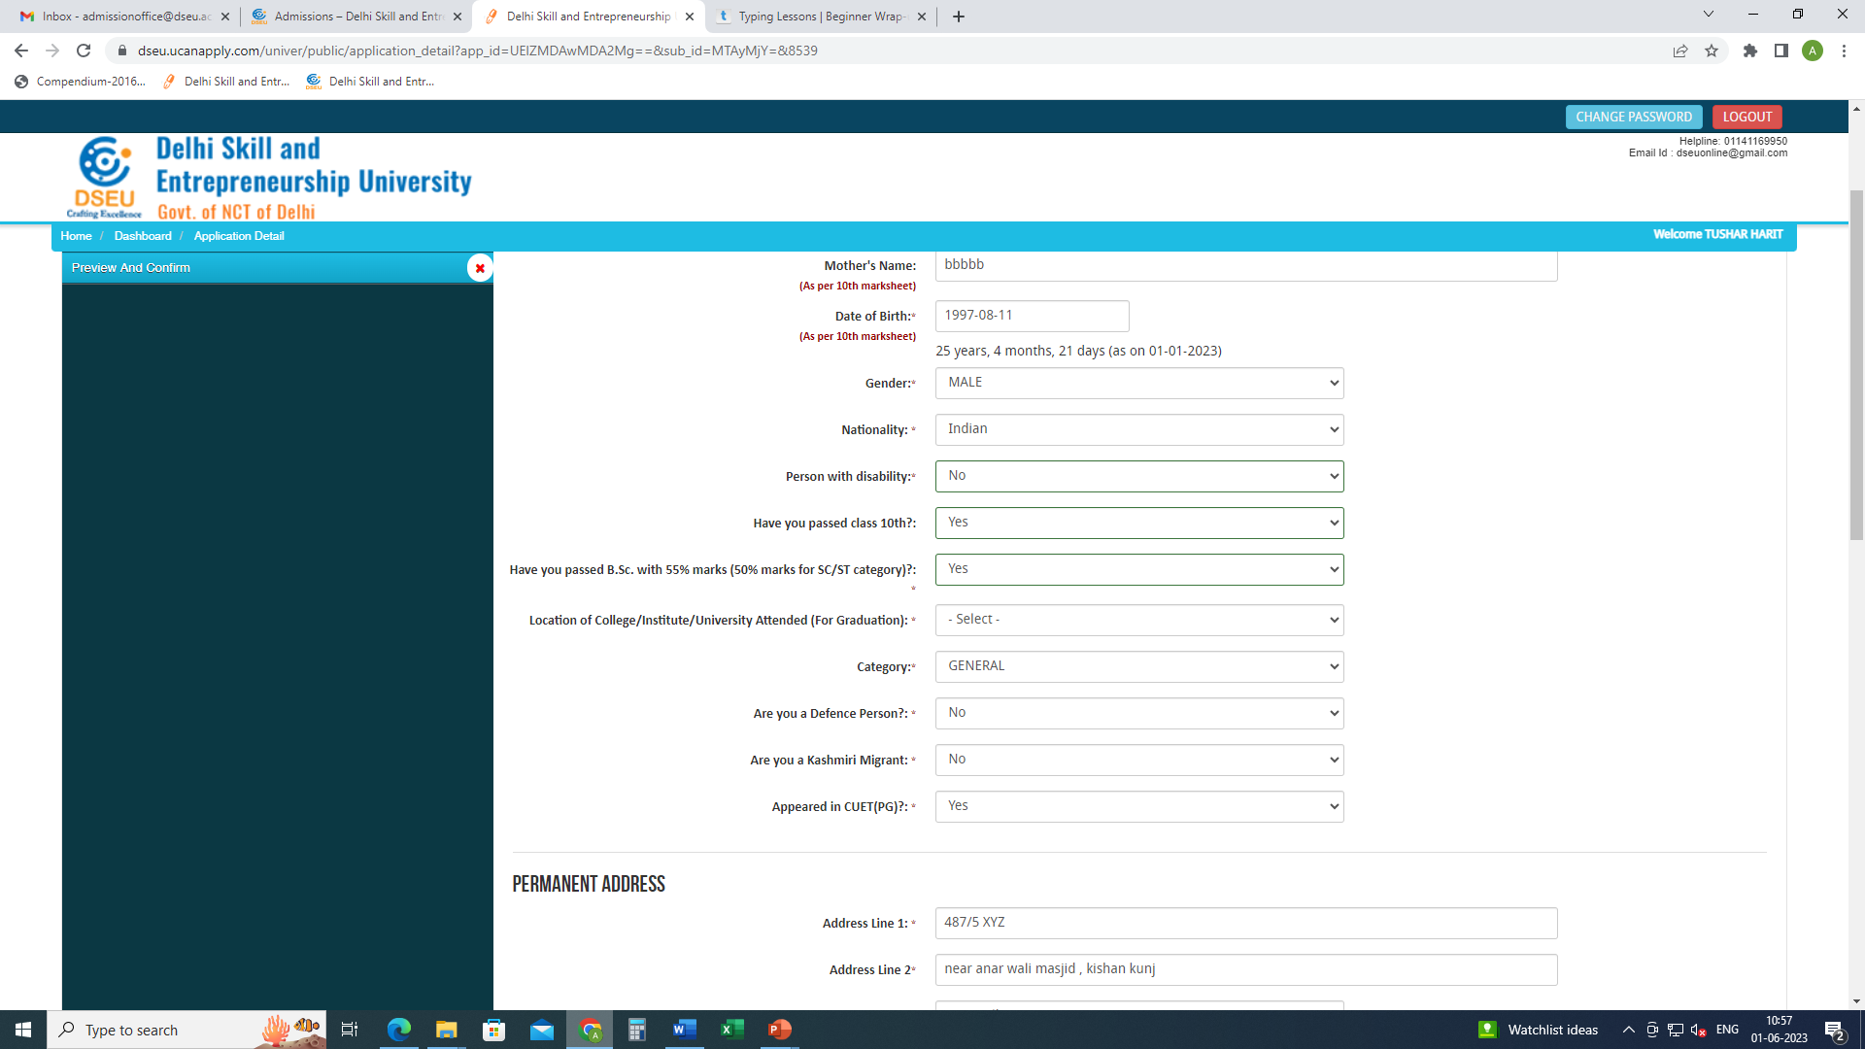
If selected ‘No’ a POP will appear.
You are not eligible since you do meet the minimum eligibility criteria.

Slide 11
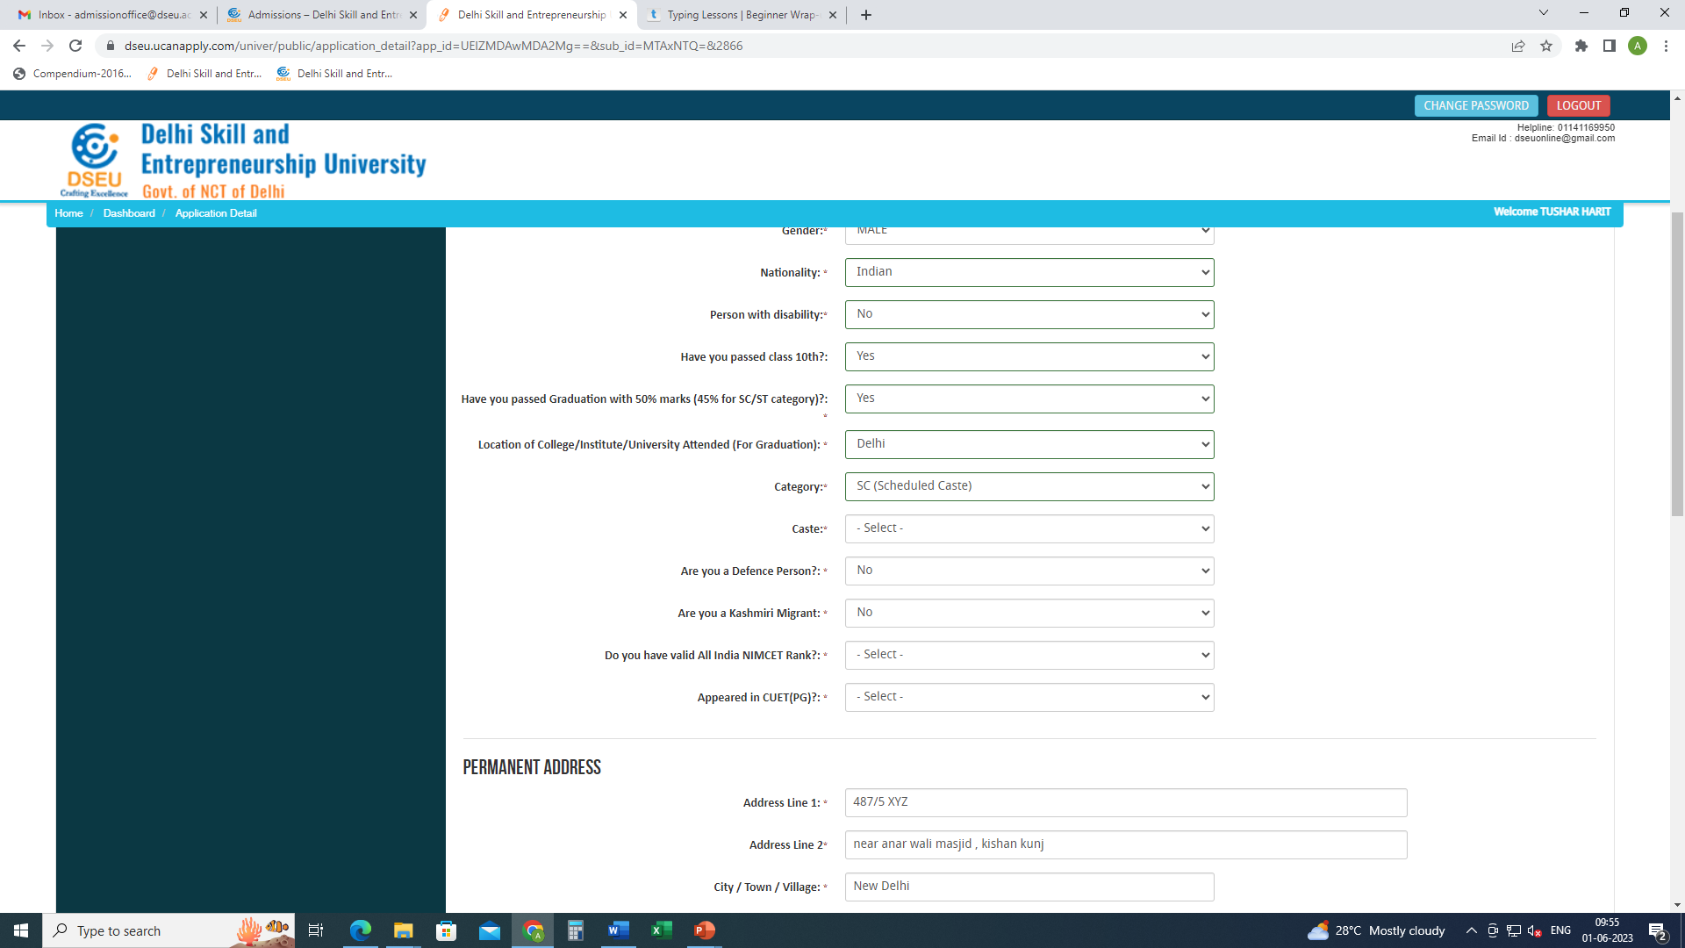
Choose location of institute of graduation.
If delhi.
Choose Category.
In case of SC and OBC, choose caste from the drop down menu which is Delhi SC and Delhi OBC list respectively for SC and OBC.

Slide 12
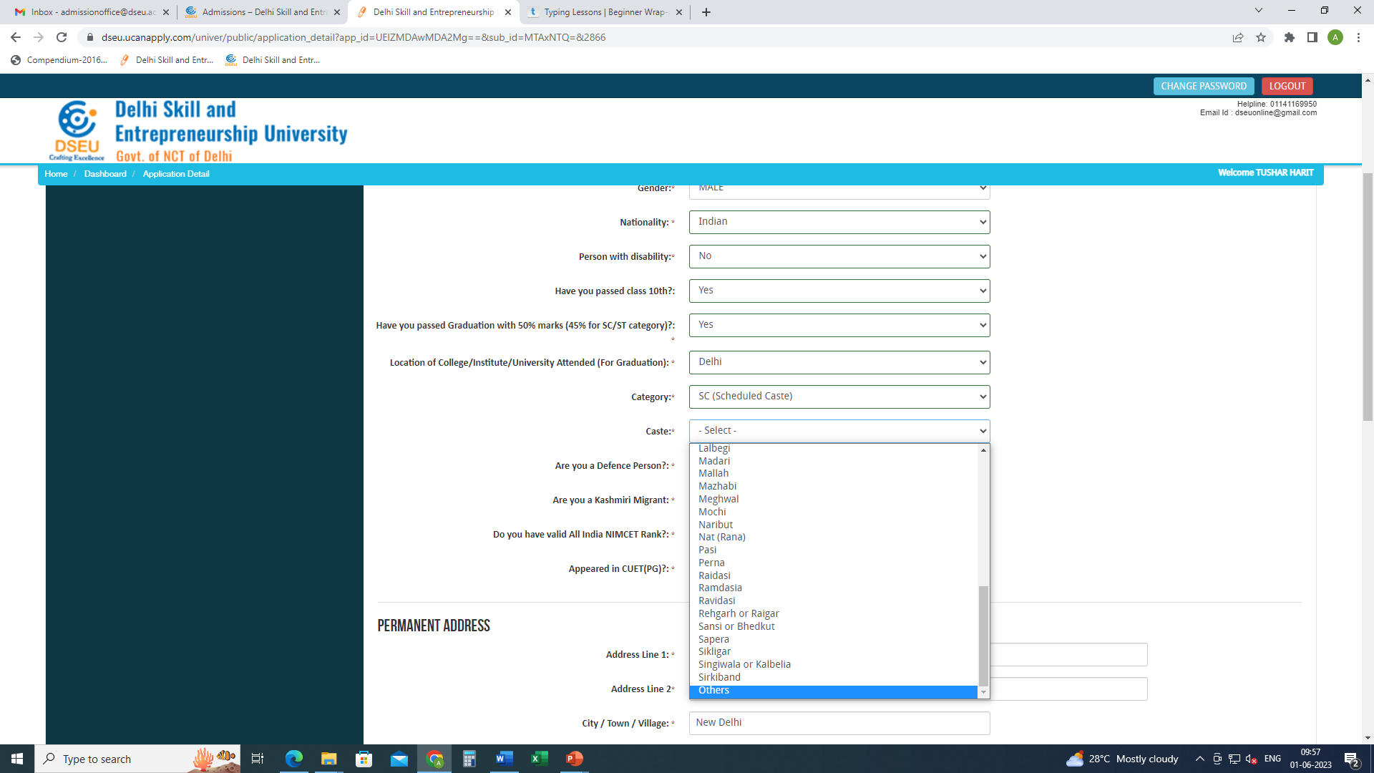
If your caste does not appear in the list, choose others
And pop will appear.

Slide 13
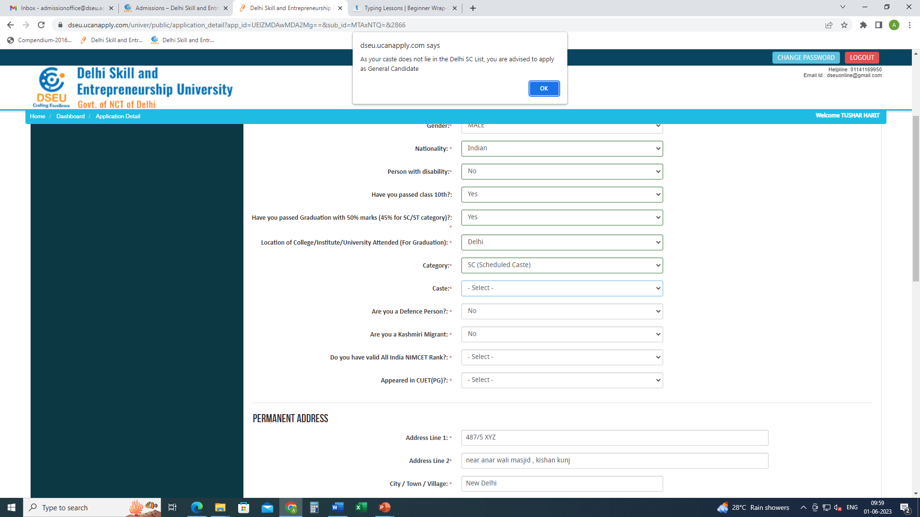
Pop up will ask the candidate to apply as General Candidate
Please refer to Information bulletin for information.
Similarly , if a candidate selects OBC

Slide 14
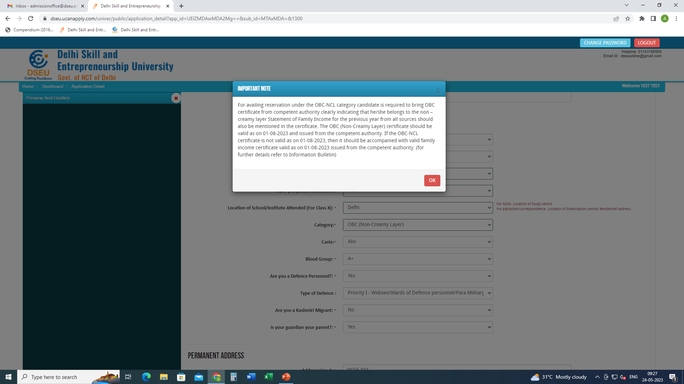
For Delhi- OBC Candidate
Choose caste from the Drop Down

Slide 15
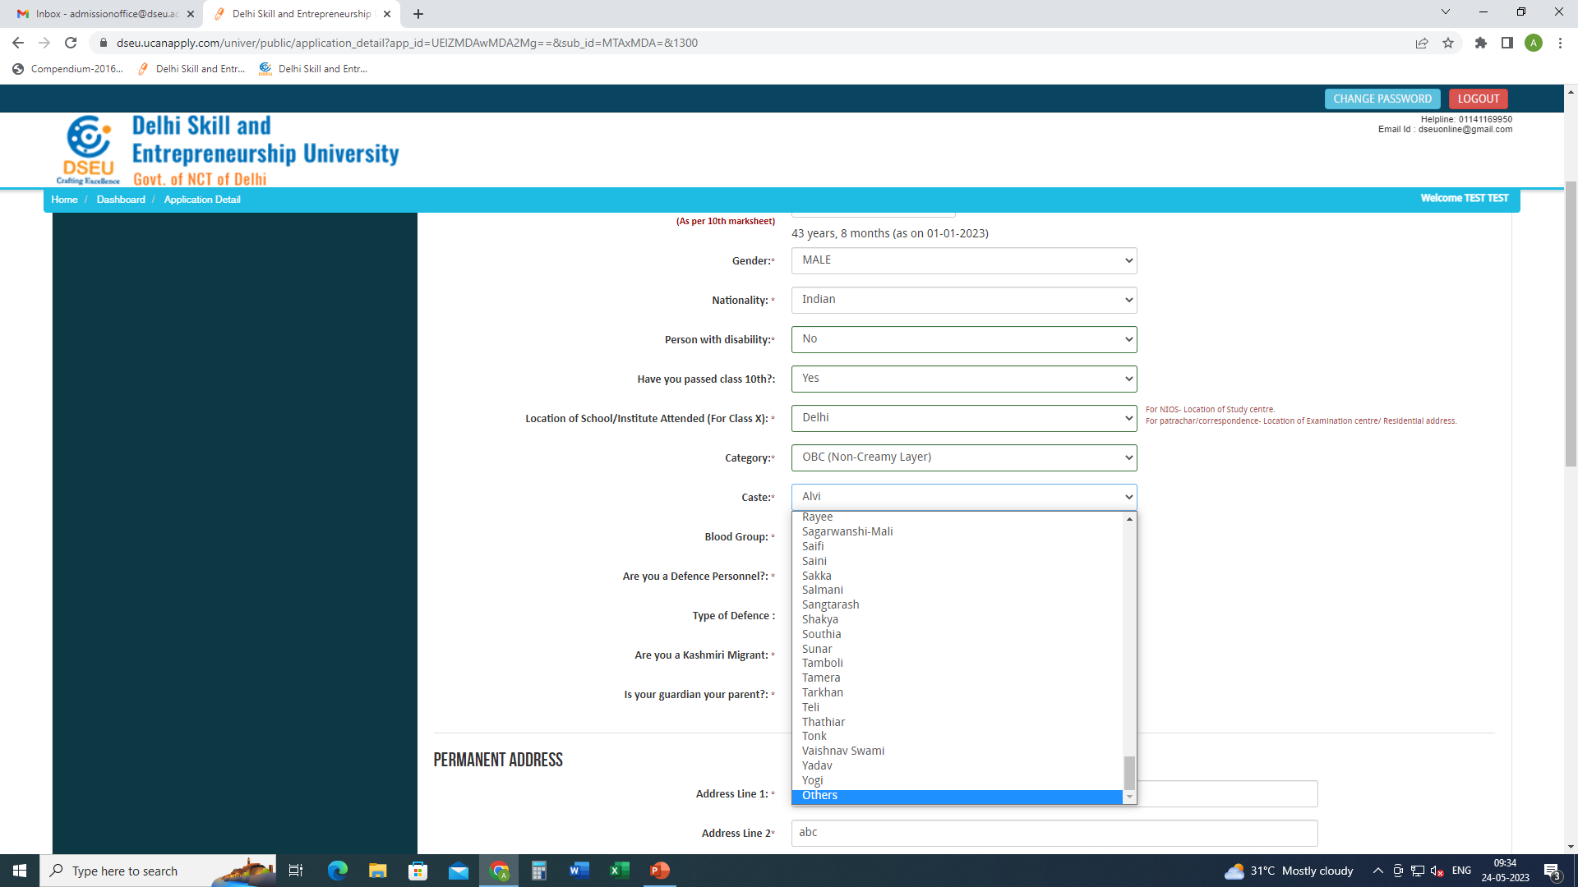
If caste is selected as others then

Slide 16
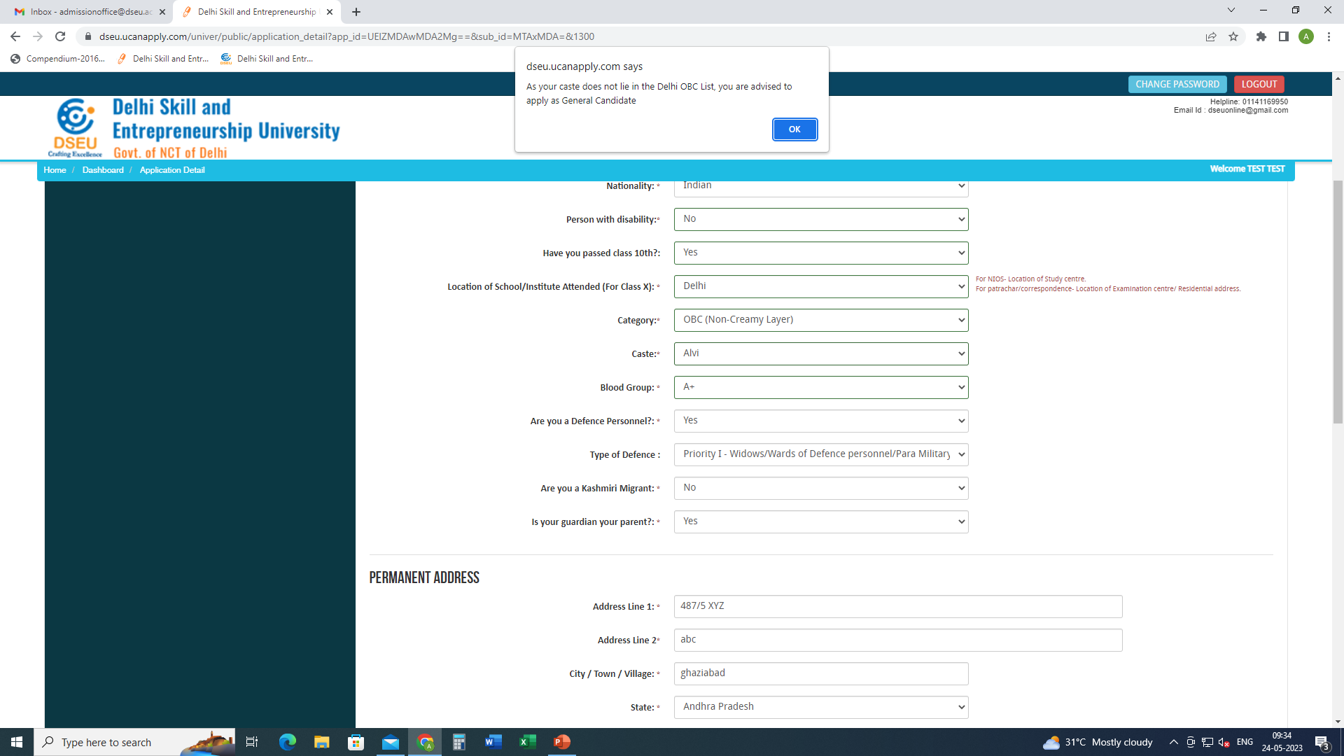
Pop up will ask the candidate to apply as General Candidate

Slide 17
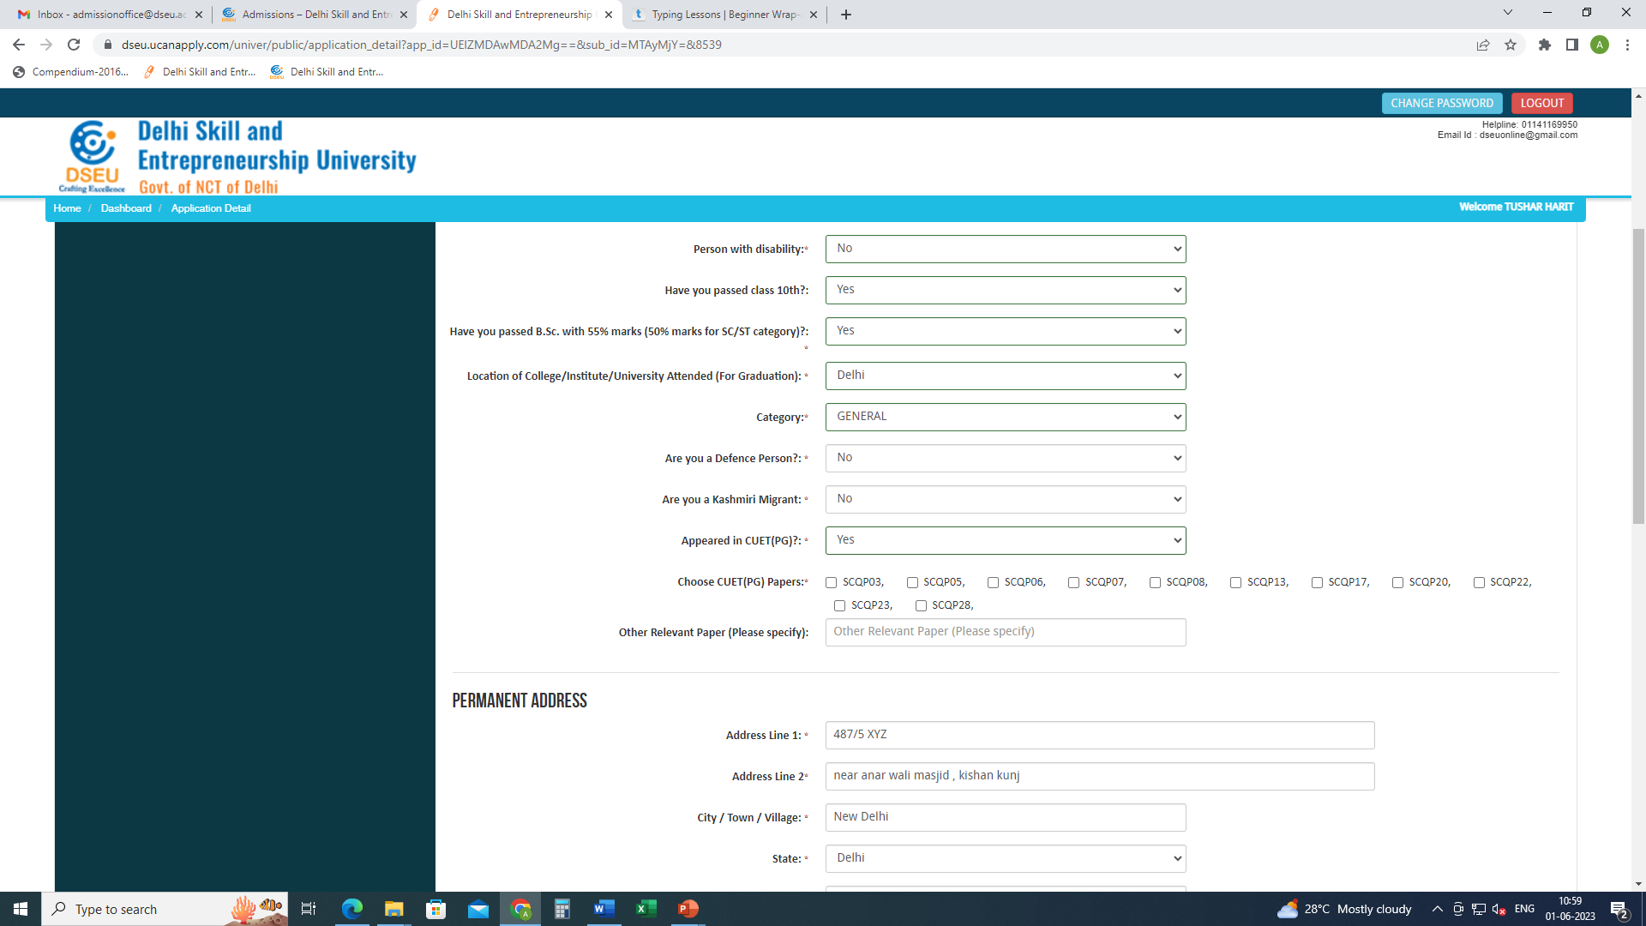
Give other required information.
Give CUET (PG ) Details (if applicable)
Choose paper codes

Slide 18
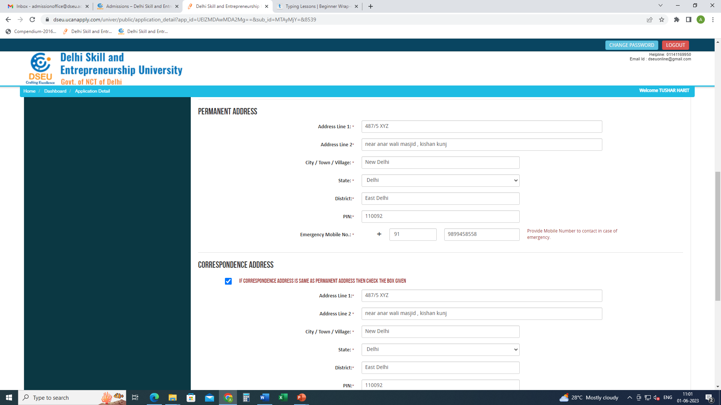
Give address and bank account details.
Save and Proceed

Slide 19
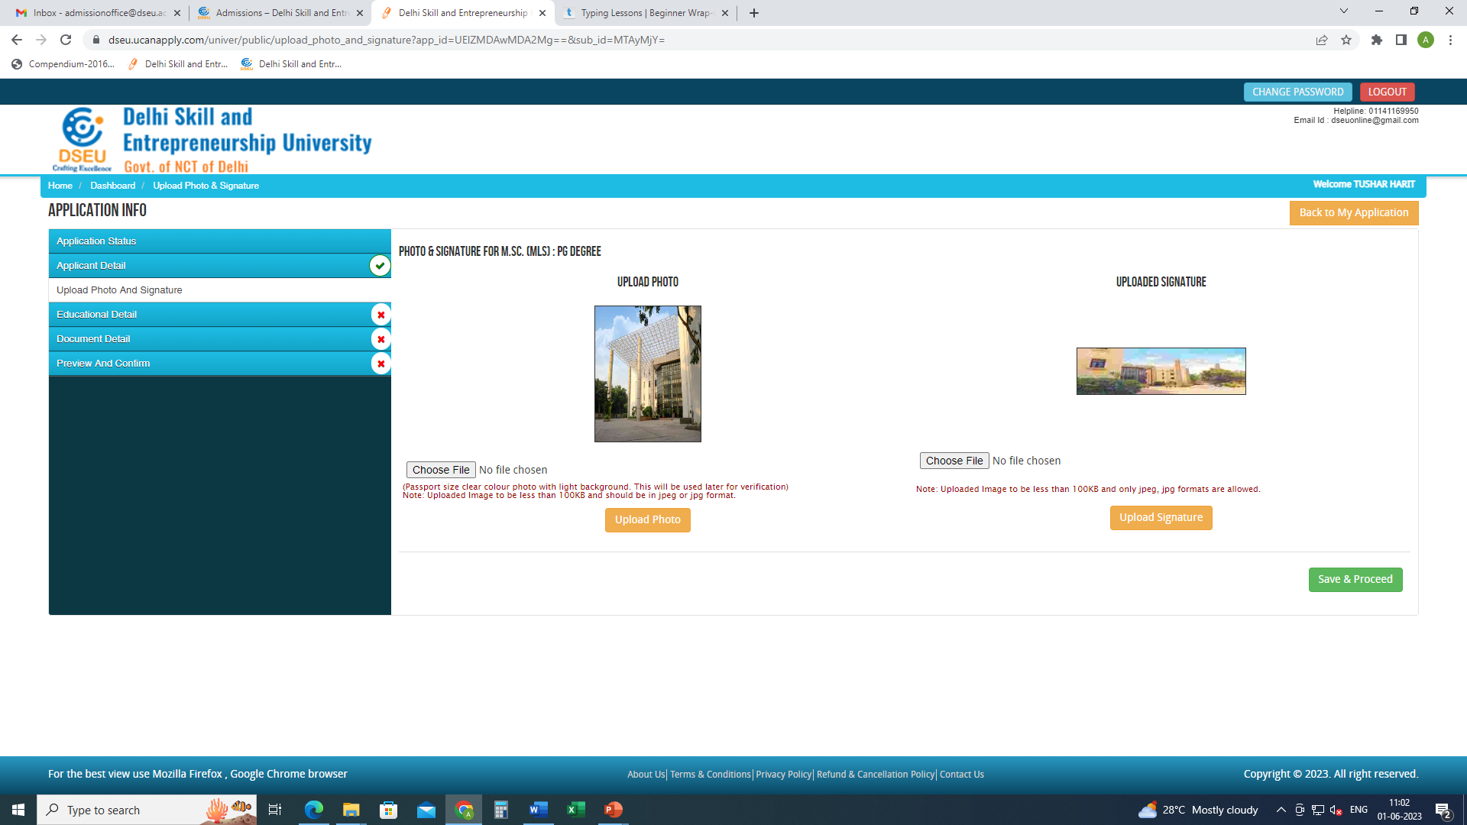
Upload photograph and signature.

Slide 20
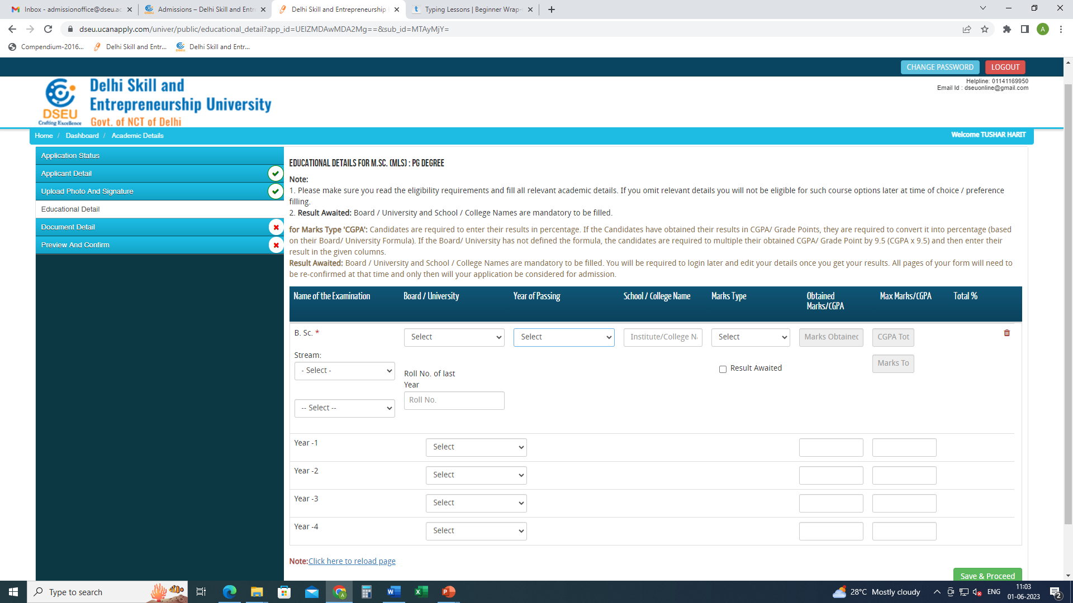
Give your education details

Slide 21
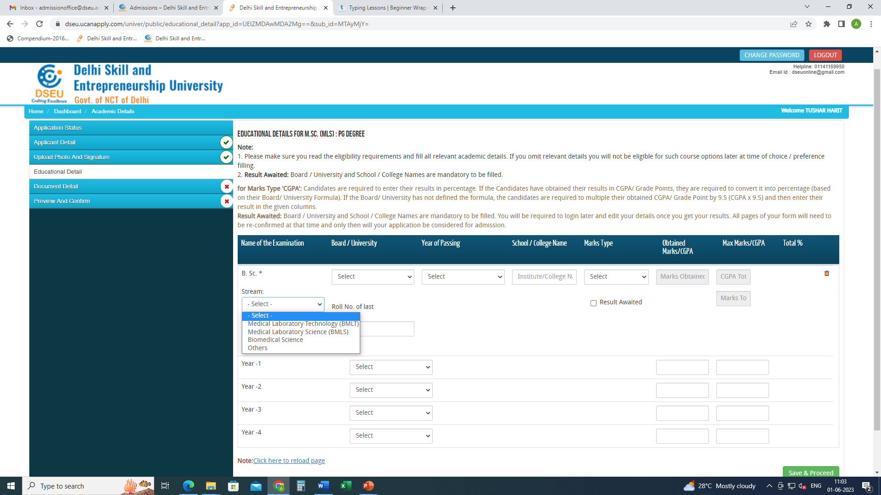
.choose stream from the drop down , please specify if others

Slide 22
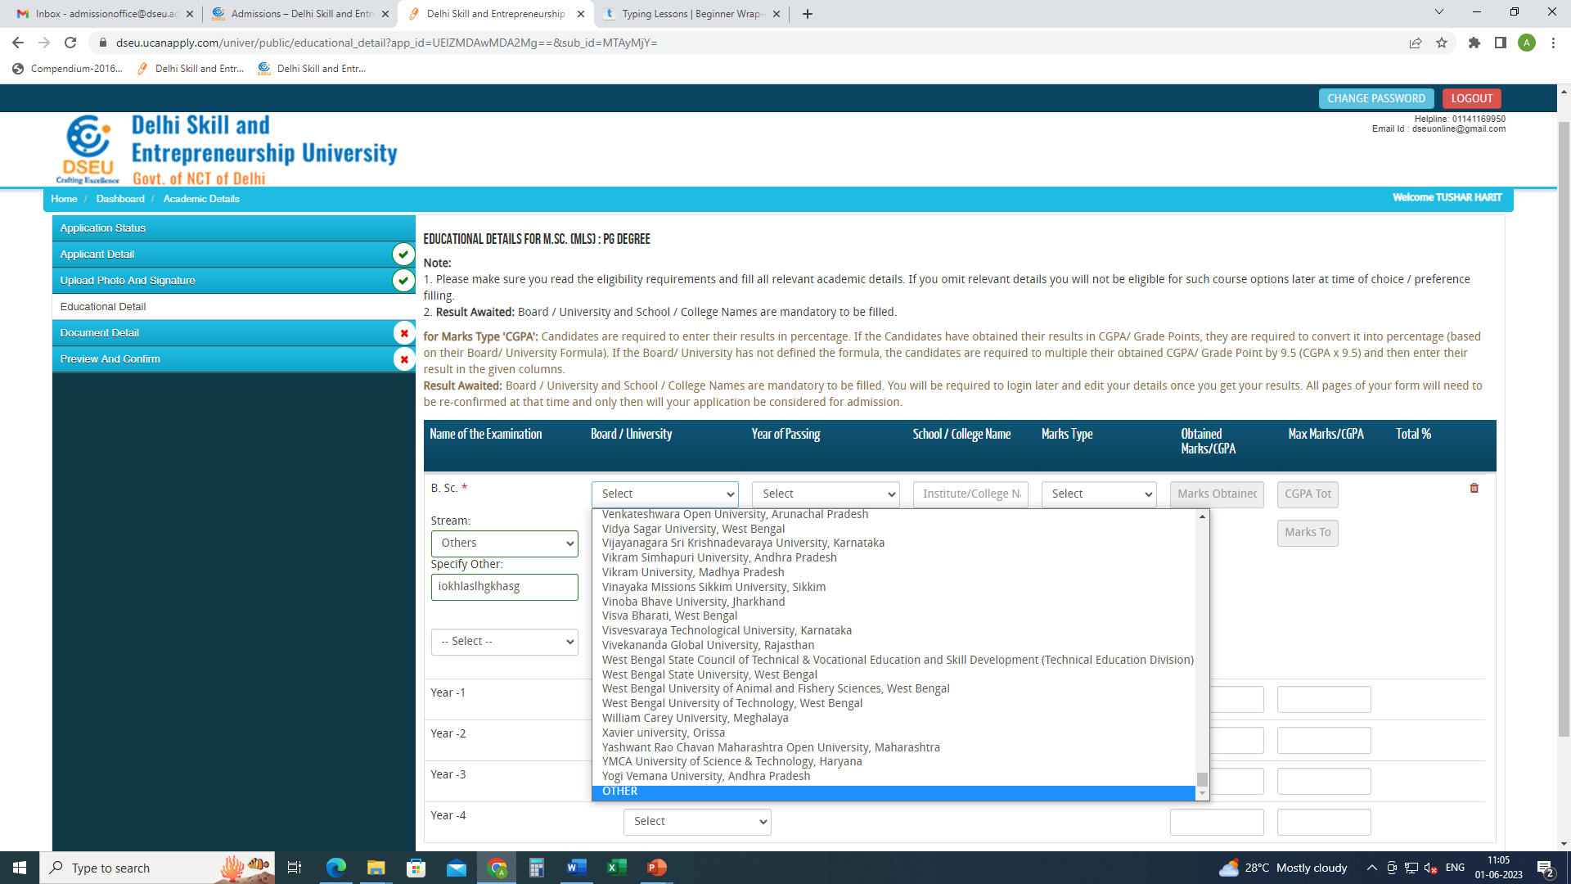
Select board/university from the drop down. Please specify if others
Insert other details

Slide 23
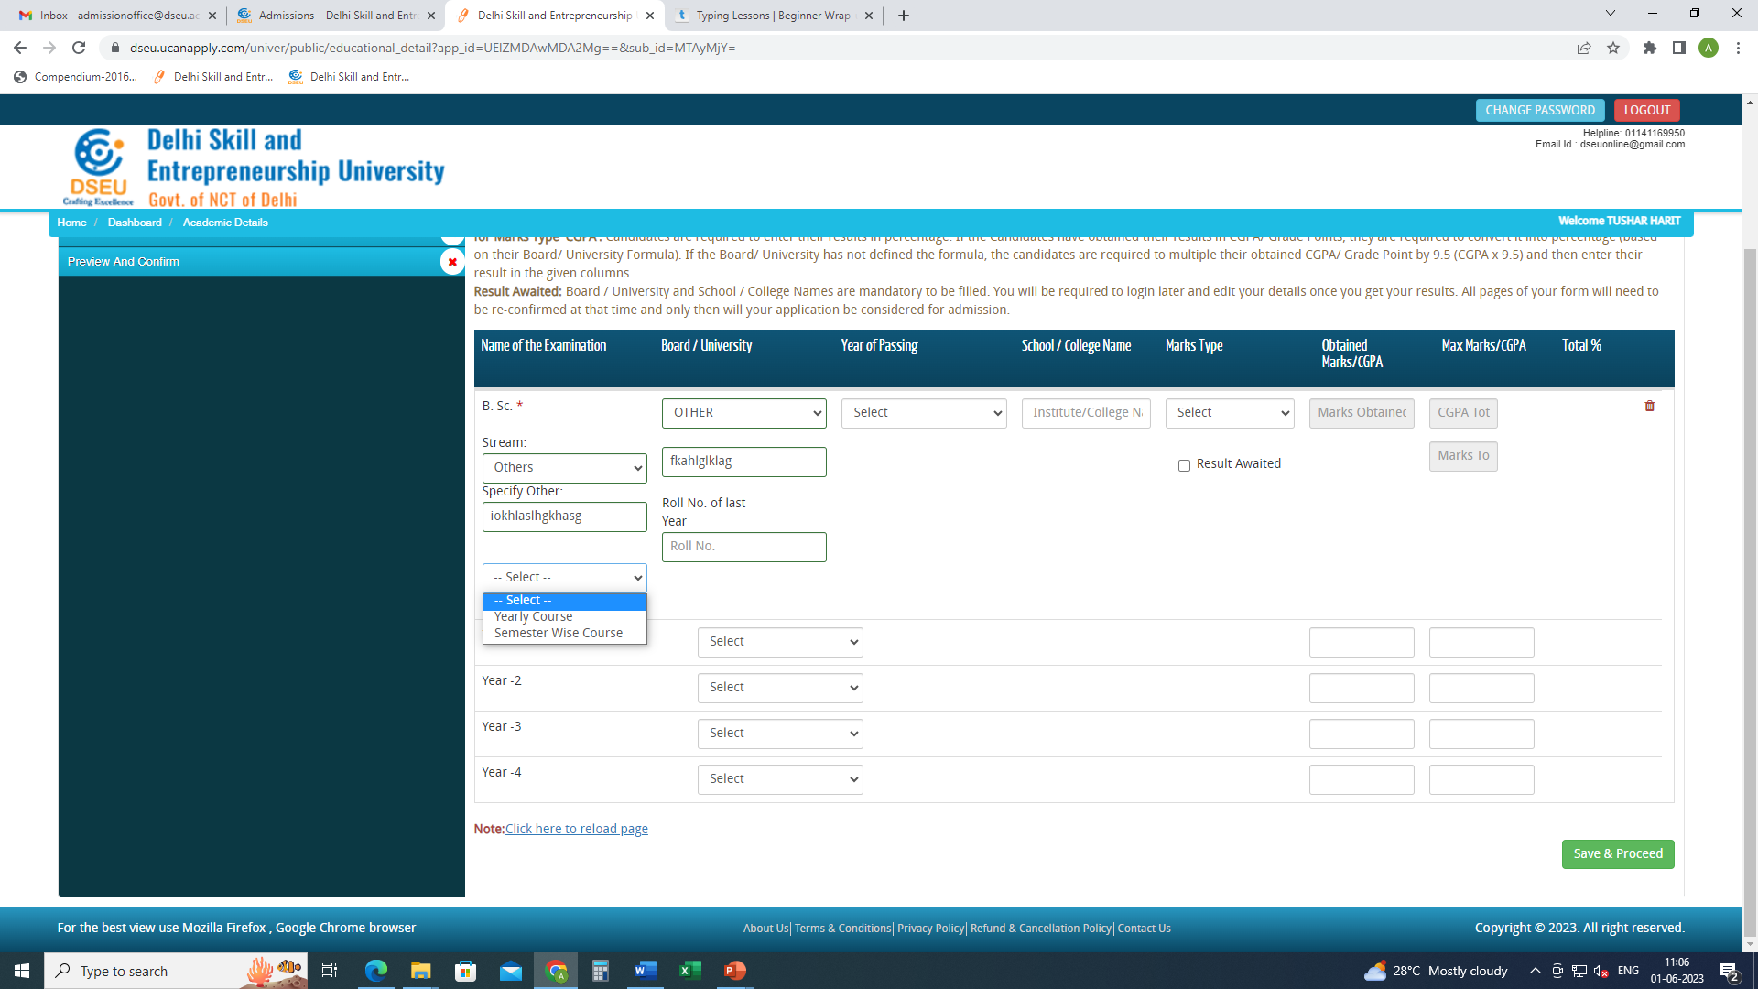
Select type of course from the drop down
Yearly or semester wise and enter the details accordingly

Slide 24
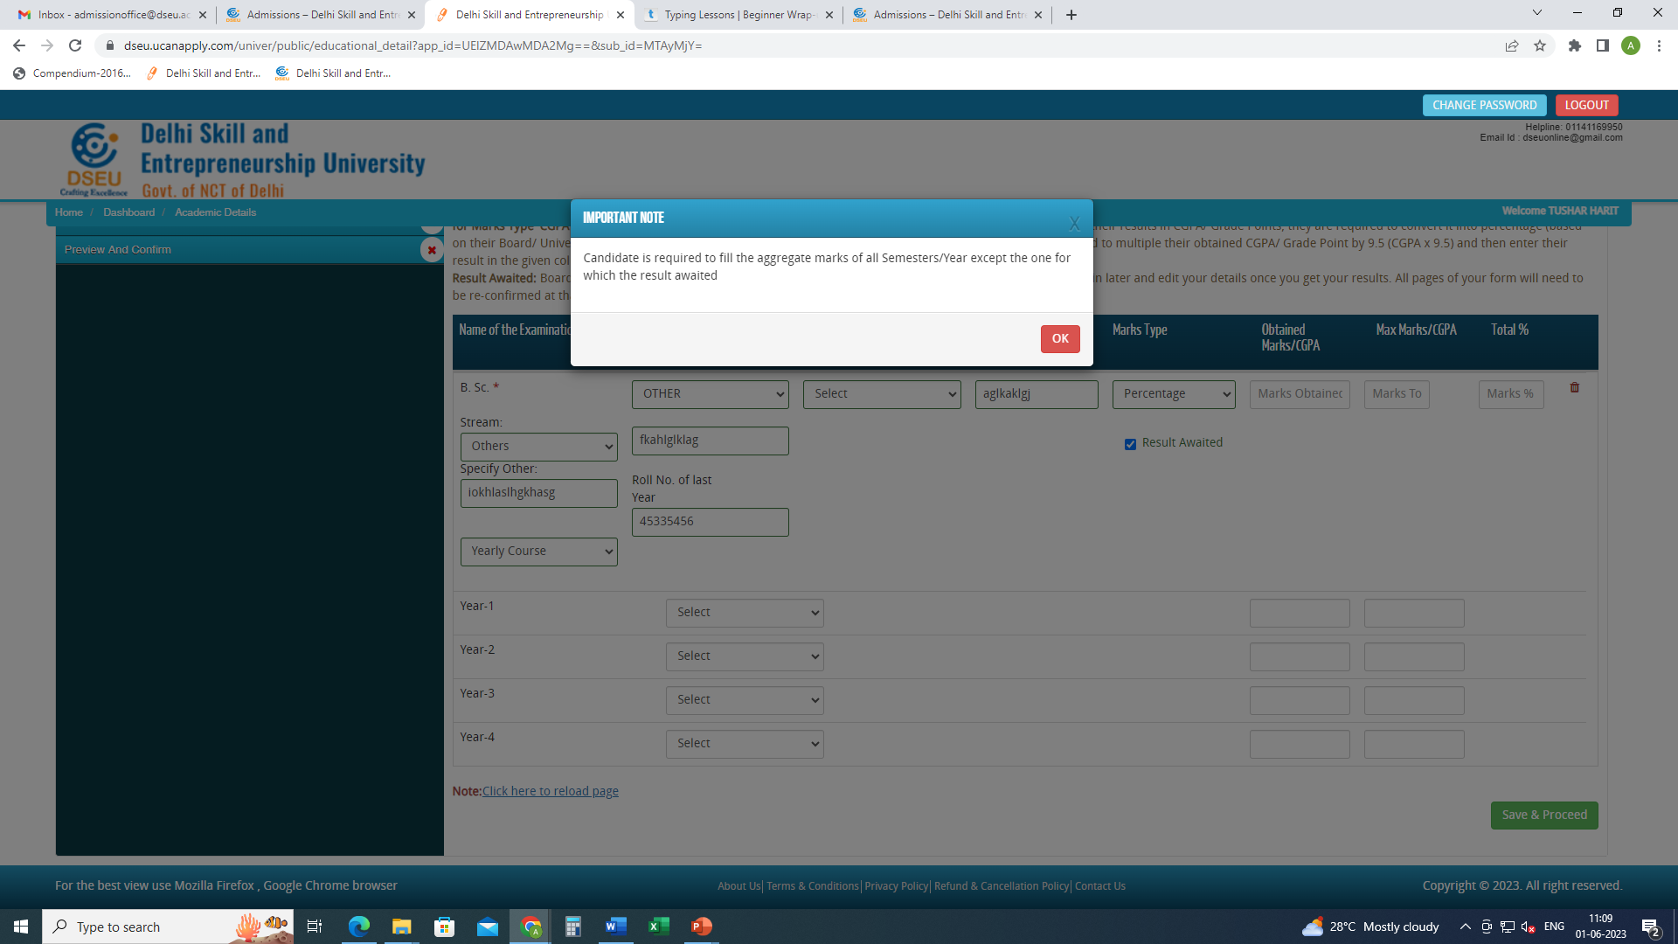
If result is awaited enter marks details as per the pop up

Slide 25
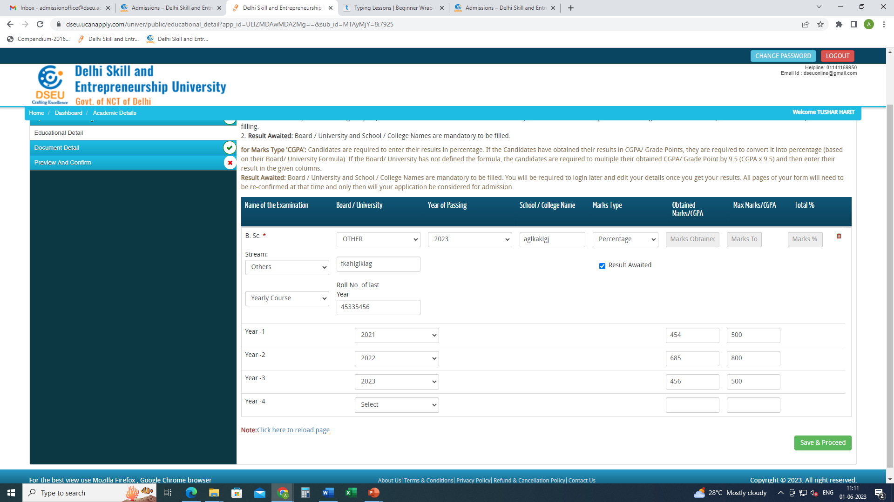
Enter details and save and proceed

Slide 26
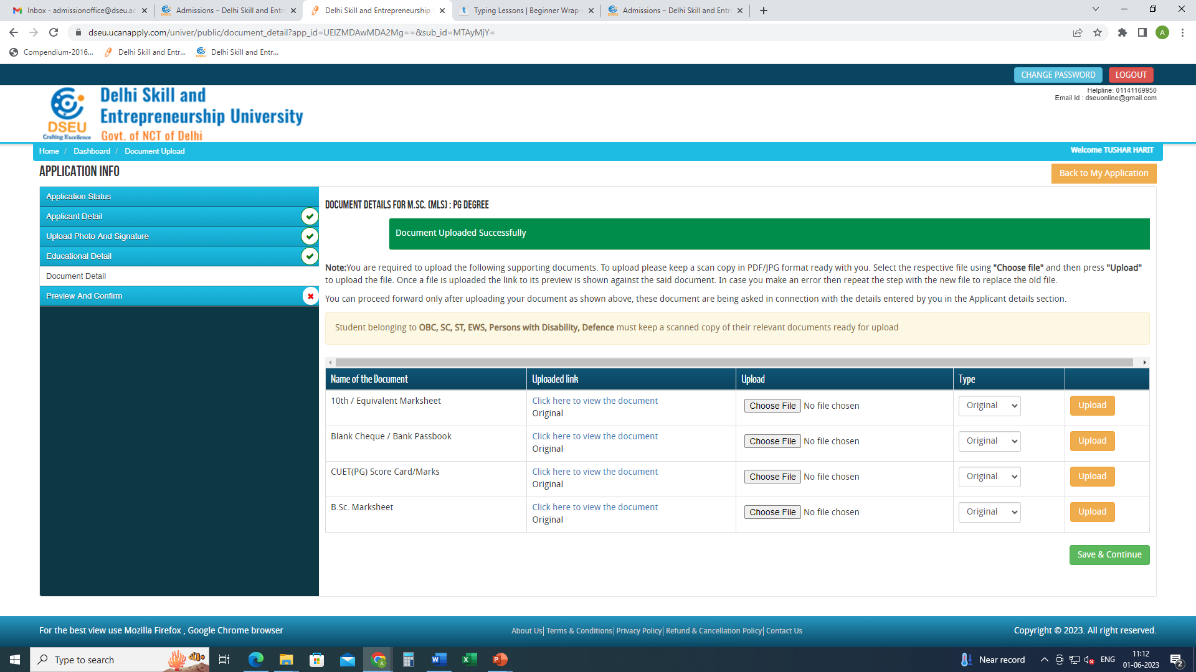
Upload all required documents
Save and proceed

Slide 27
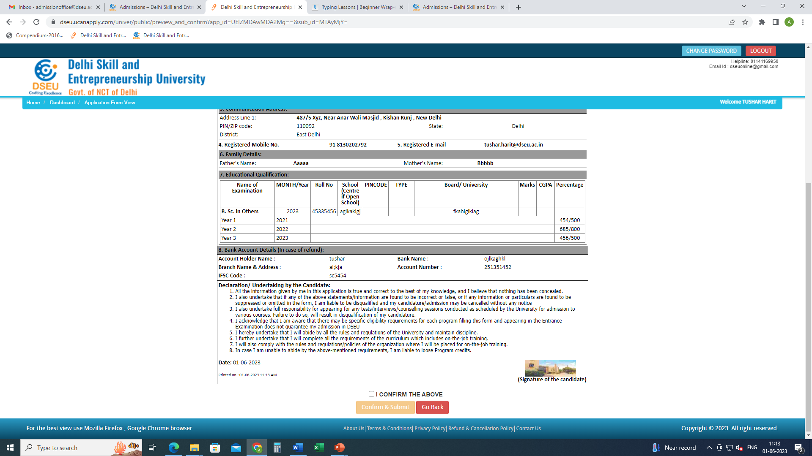
Preview the application form carefully.
Click on I confirm the above
Confirm and submit
Pay the registration fee
Take a printout of the final application form after payment and keep it handy for future reference

