Slide 1
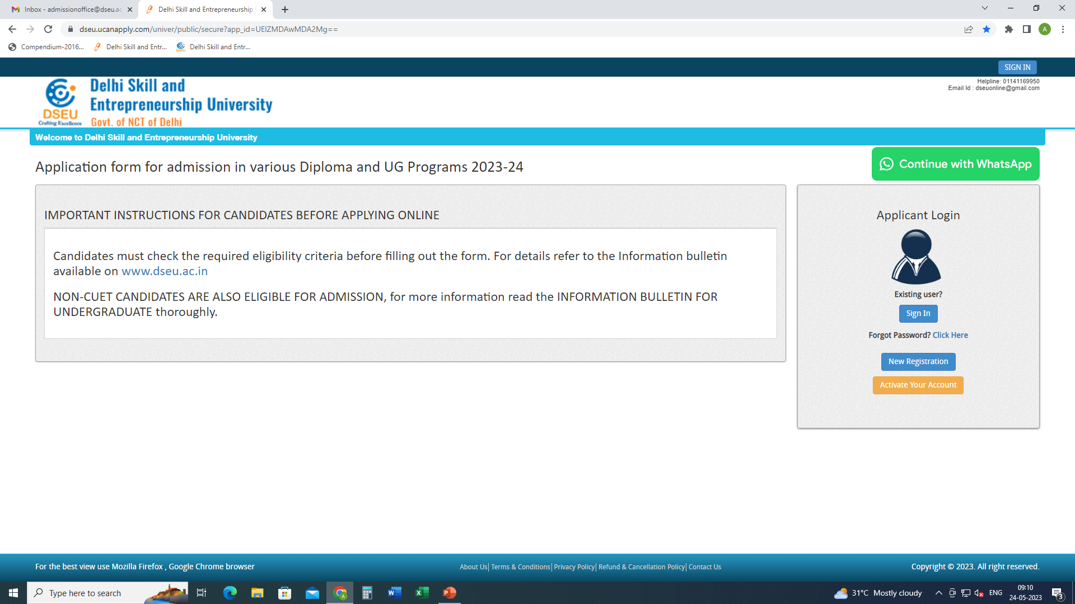
Step 1- Registration.
Enter Details.
Confirm
Step 2
Activate account.

Slide 2
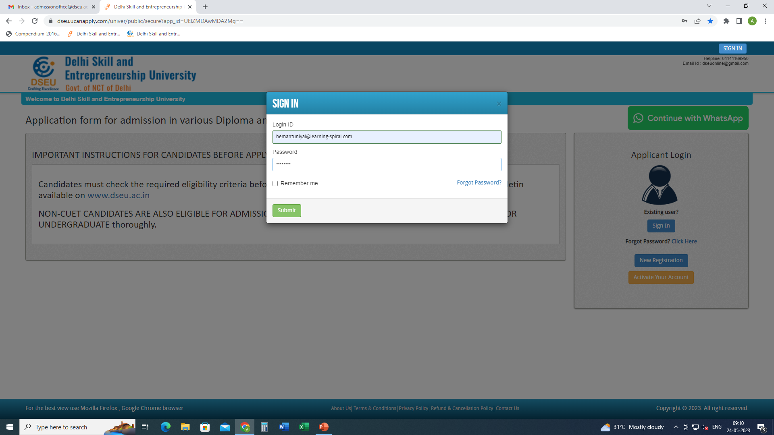
Step 3- Sign In.

Slide 3
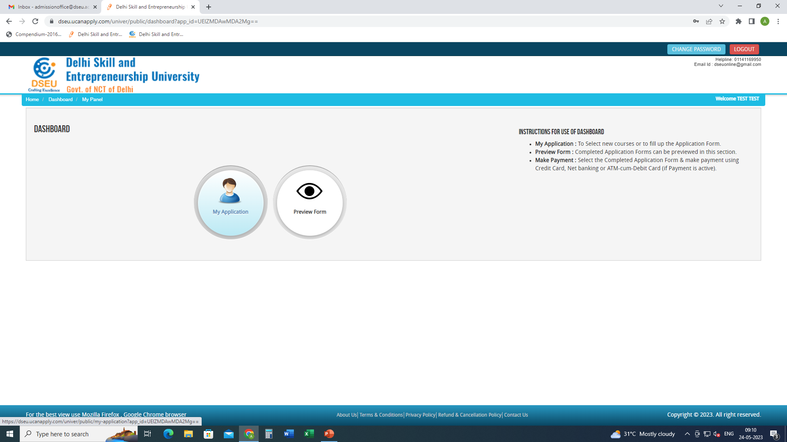
Step 4- My application

Slide 4
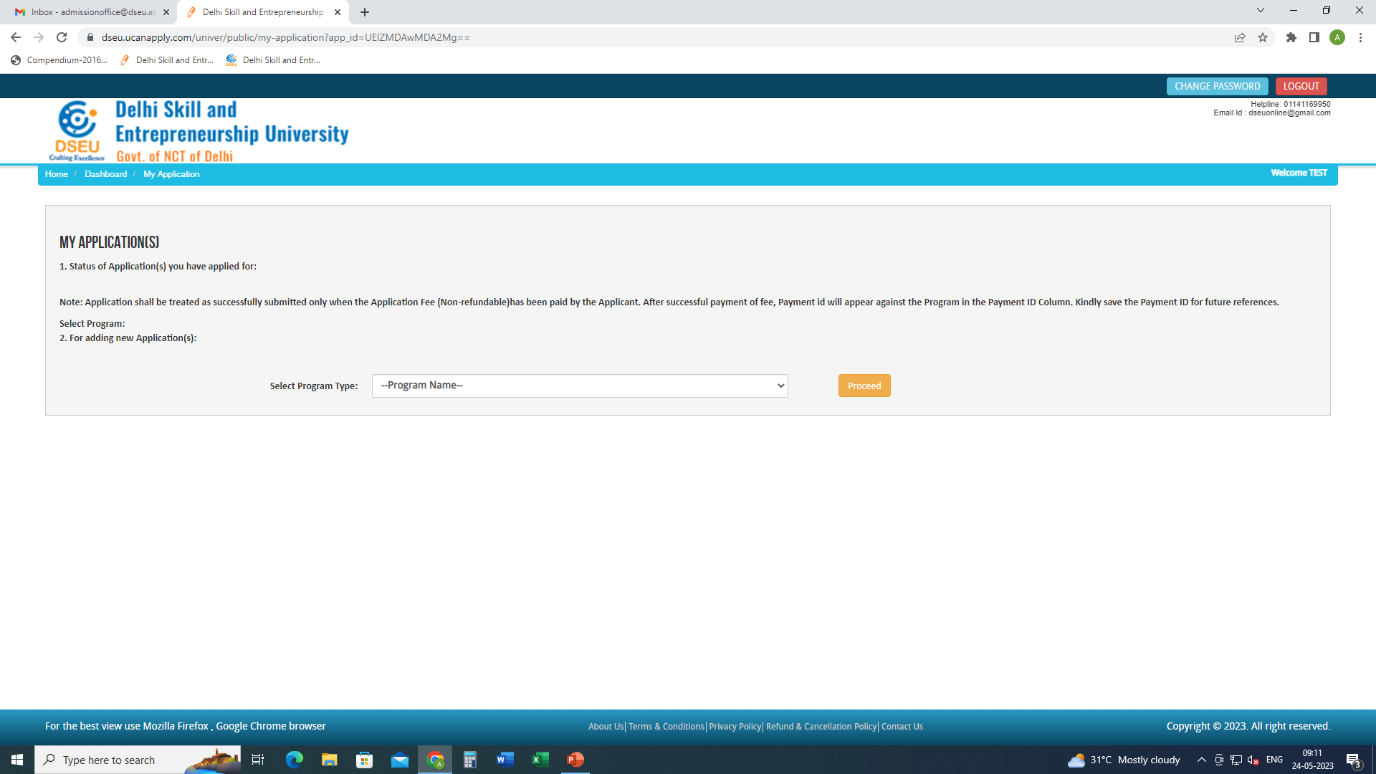
Select Program

Slide 5
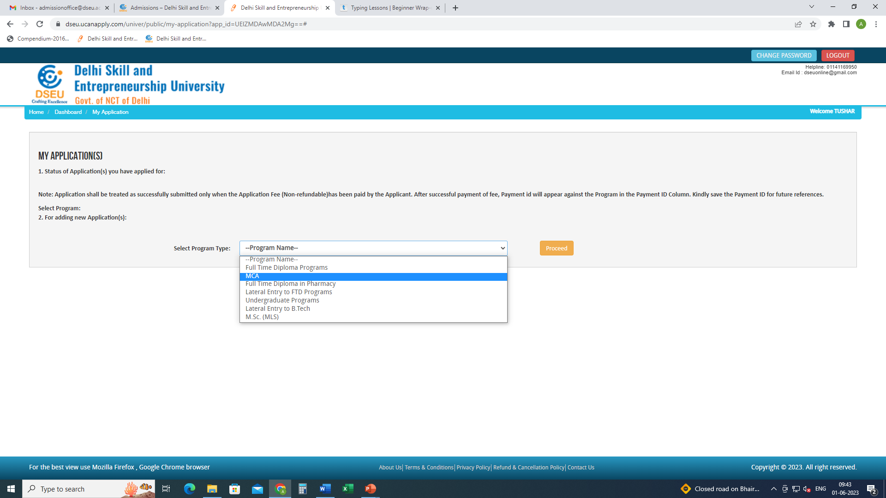
Add the program
Proceed

Slide 6
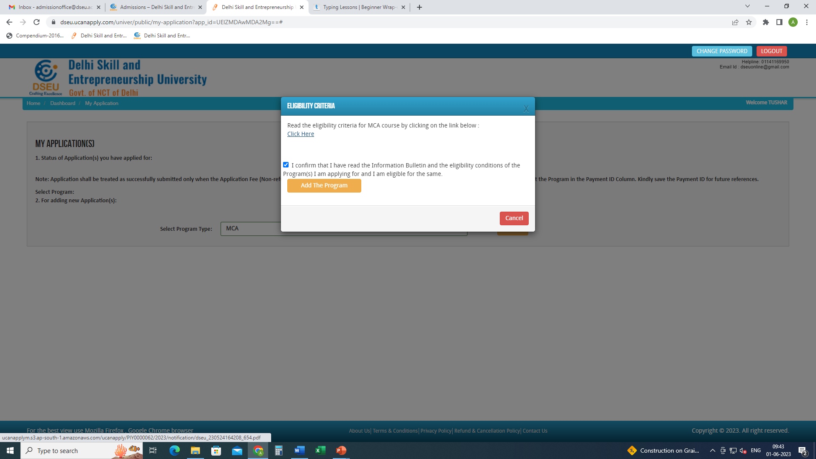
Check this box
Click on Add the Program
Click here to check the eligibility of MCA

Slide 7
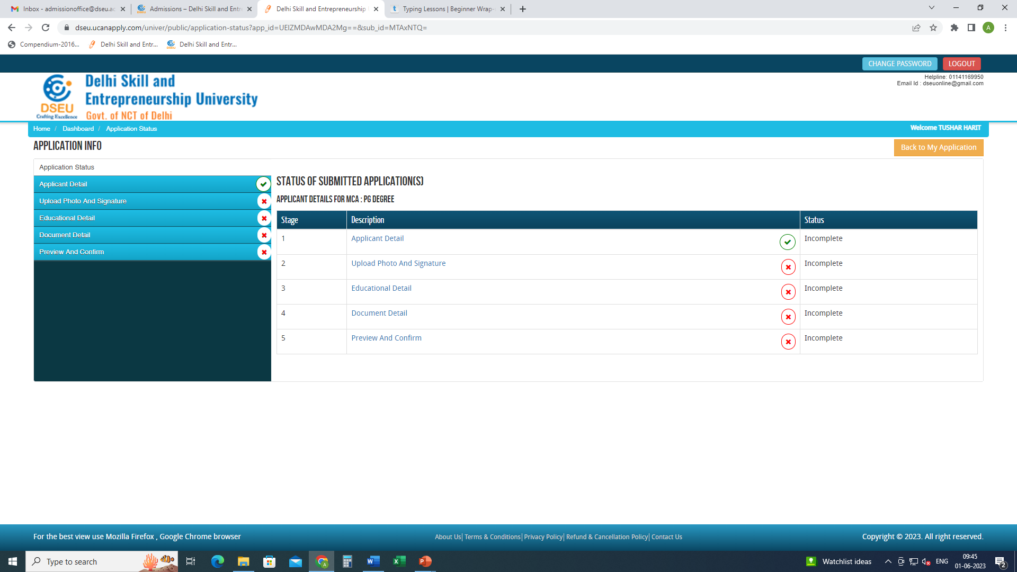
Click on applicant detail and fill the required information

Slide 8
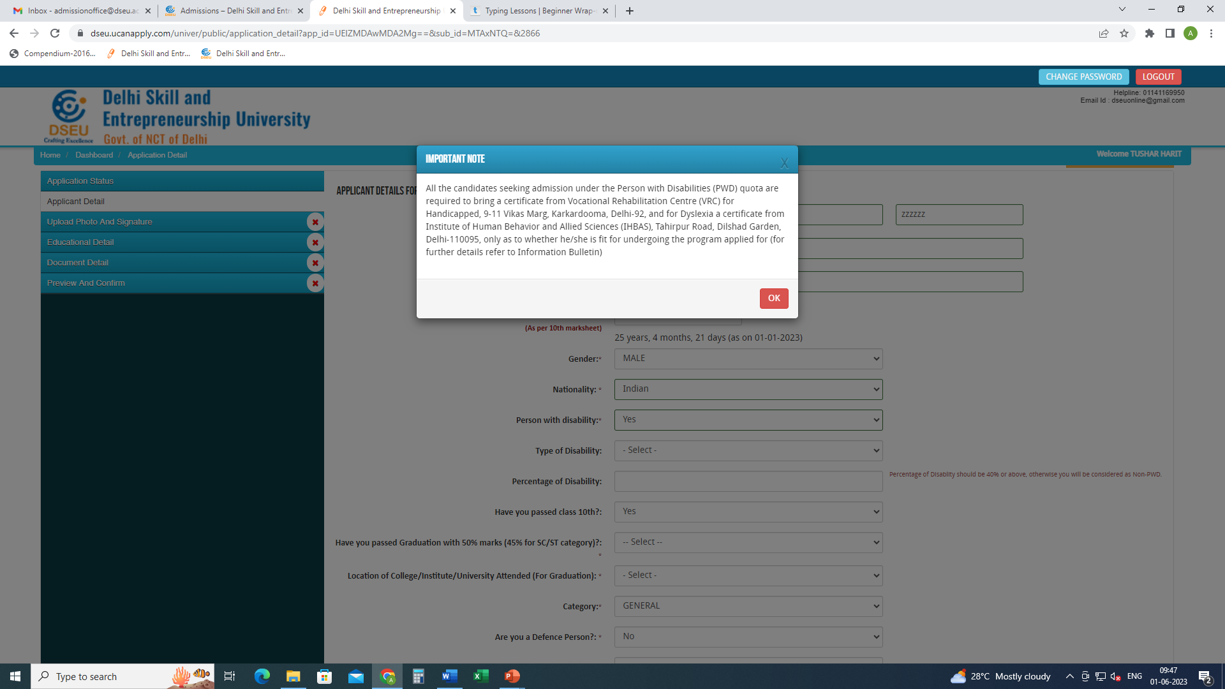
If selected ‘Yes’ a pop up will show up.
Make sure you have the required documents ready
Enter the type of disability

Slide 9
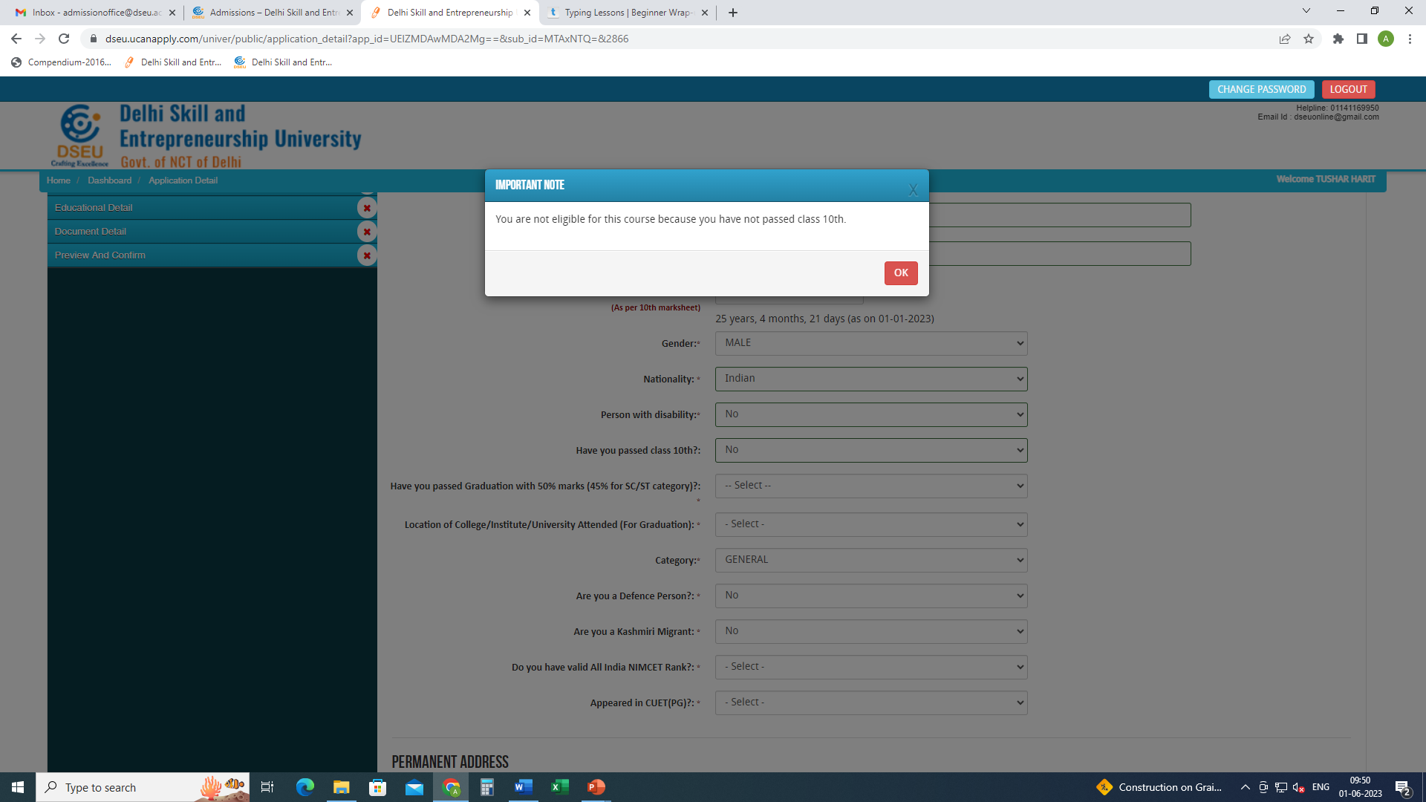
If selected ‘No’ a POP appears.
You are not eligible since you do meet the minimum eligibility criteria.

Slide 10
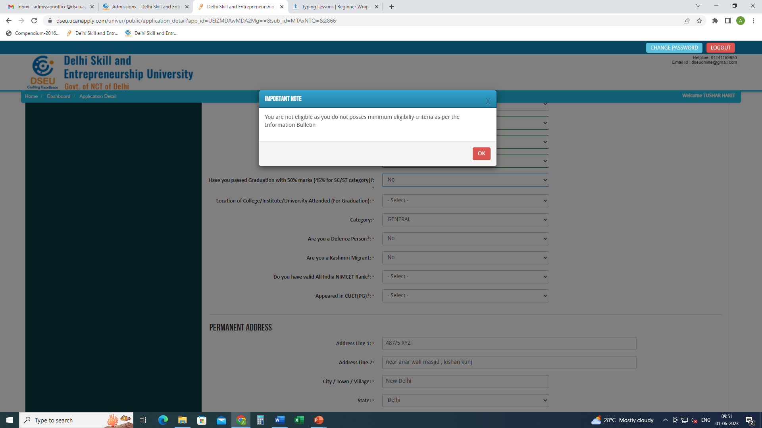
If selected ‘No’ a POP appears.
You are not eligible since you do meet the minimum eligibility criteria.

Slide 11
If selected ‘Yes’
please refer to Information Bulletin for eligibility criteria.

Slide 12
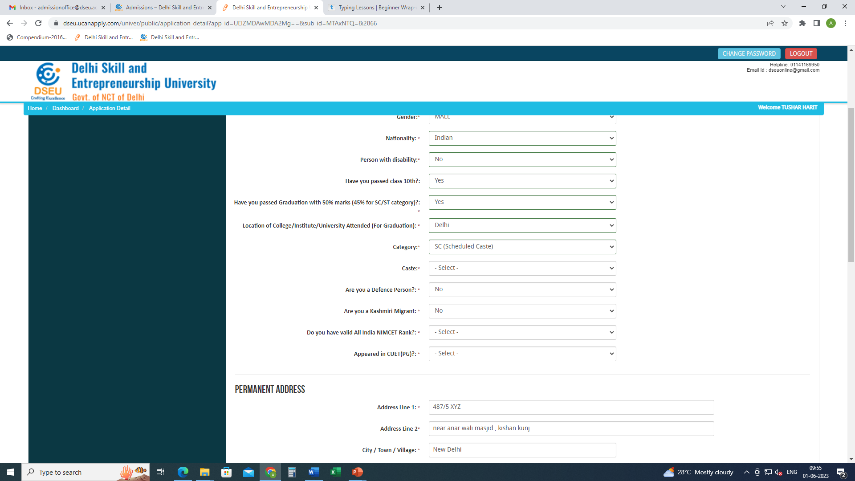
Choose location of institute of graduation.
If delhi.
Choose Category.
In case of SC and OBC, choose caste from the drop down menu which is Delhi SC and Delhi OBC list respectively for SC and OBC.

Slide 13
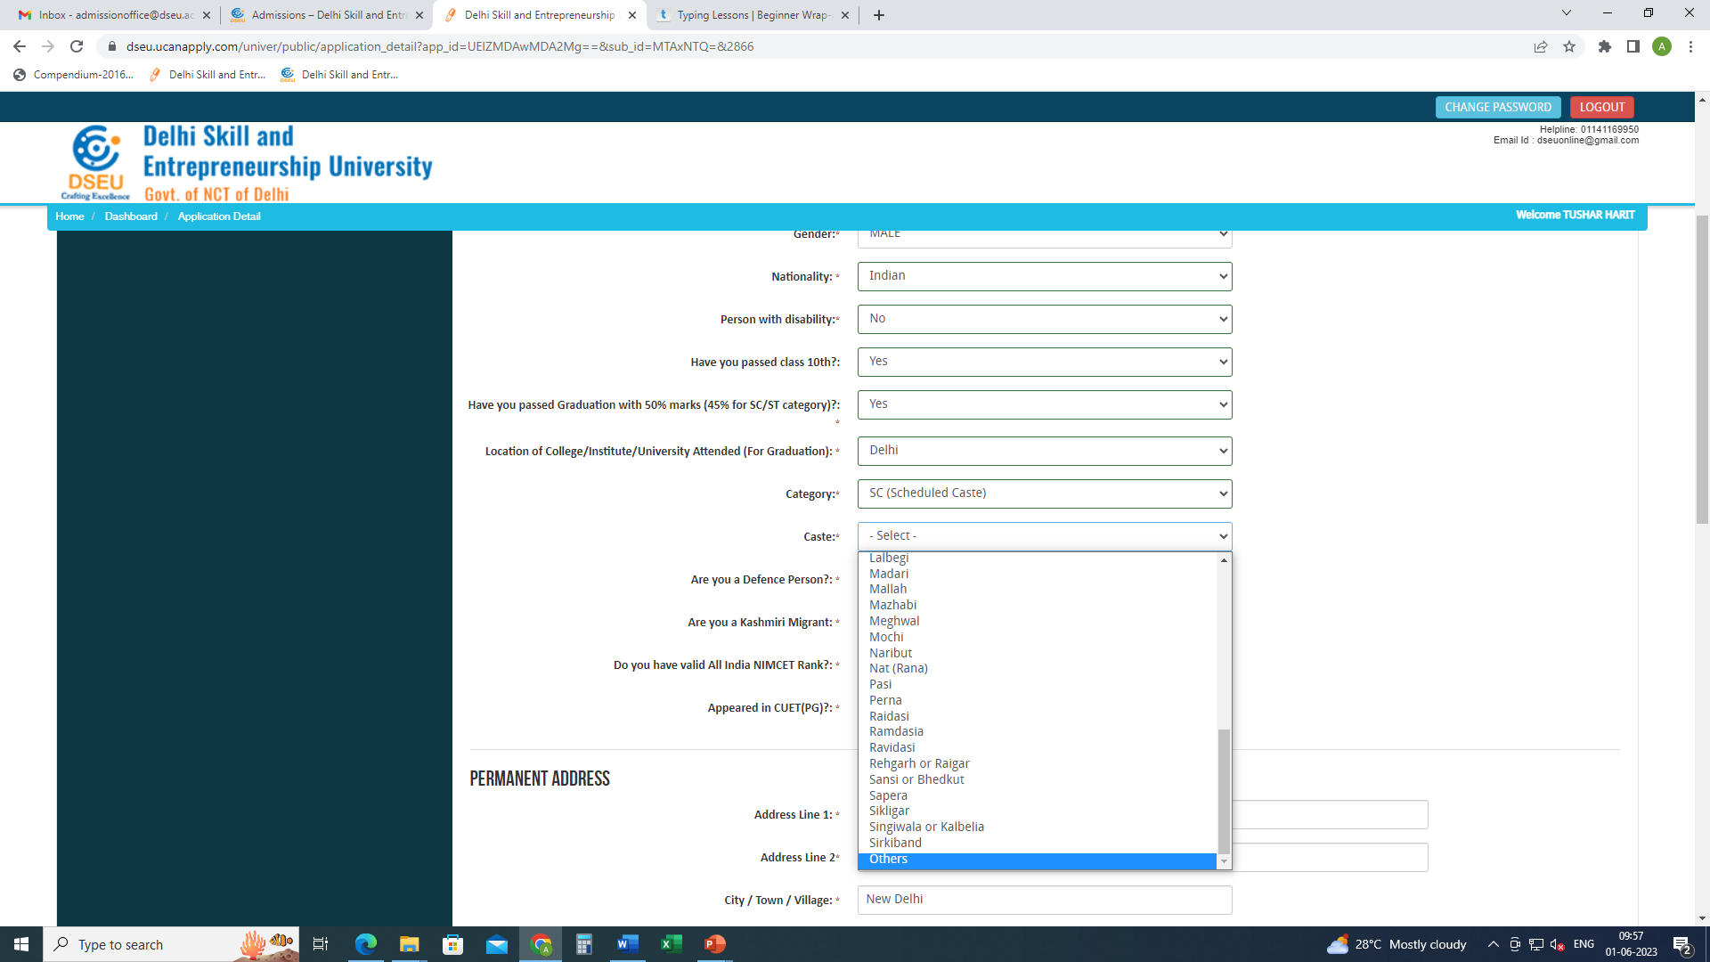
If your caste does not appear in the list, choose others
And pop will appear.

Slide 14
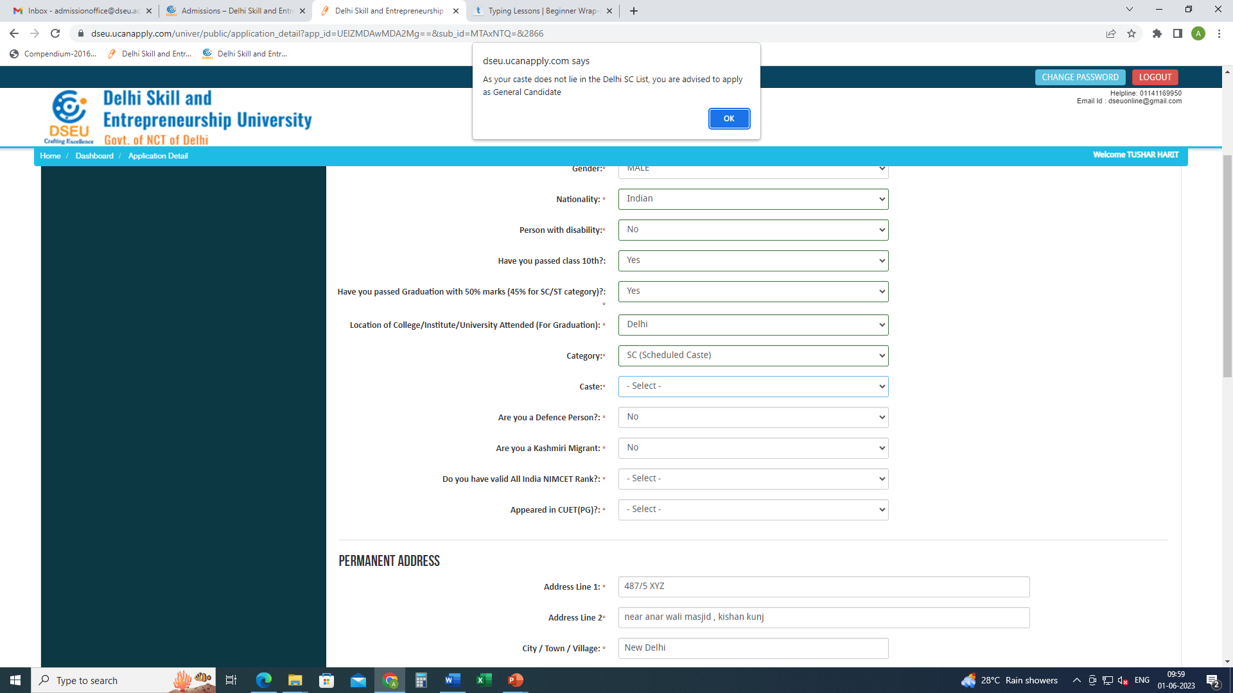
Pop up will ask the candidate to apply as General Candidate
Please refer to Information bulletin for information.
Similarly , if a candidate selects OBC

Slide 15
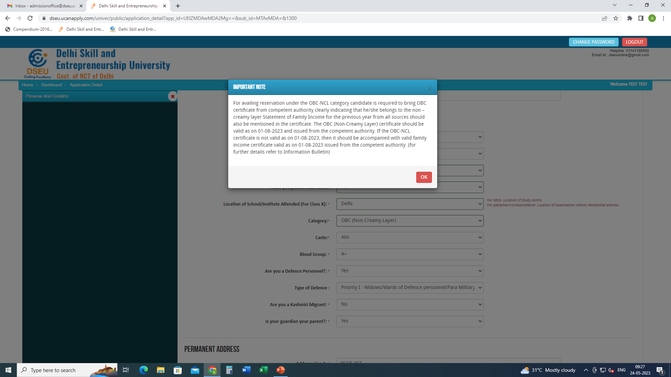
For Delhi- OBC Candidate
Choose caste from the Drop Down

Slide 16
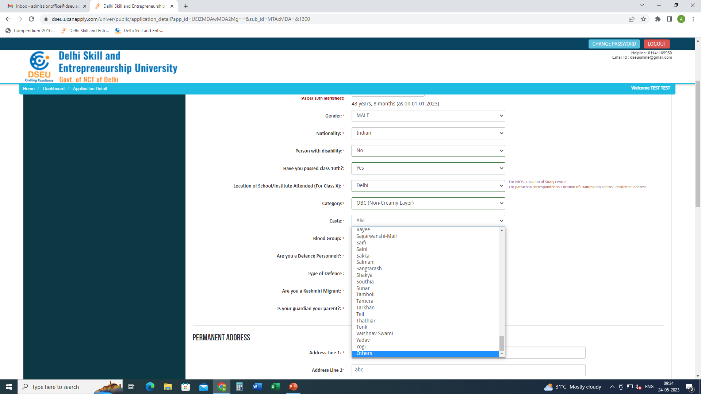
If caste is selected as others then

Slide 17
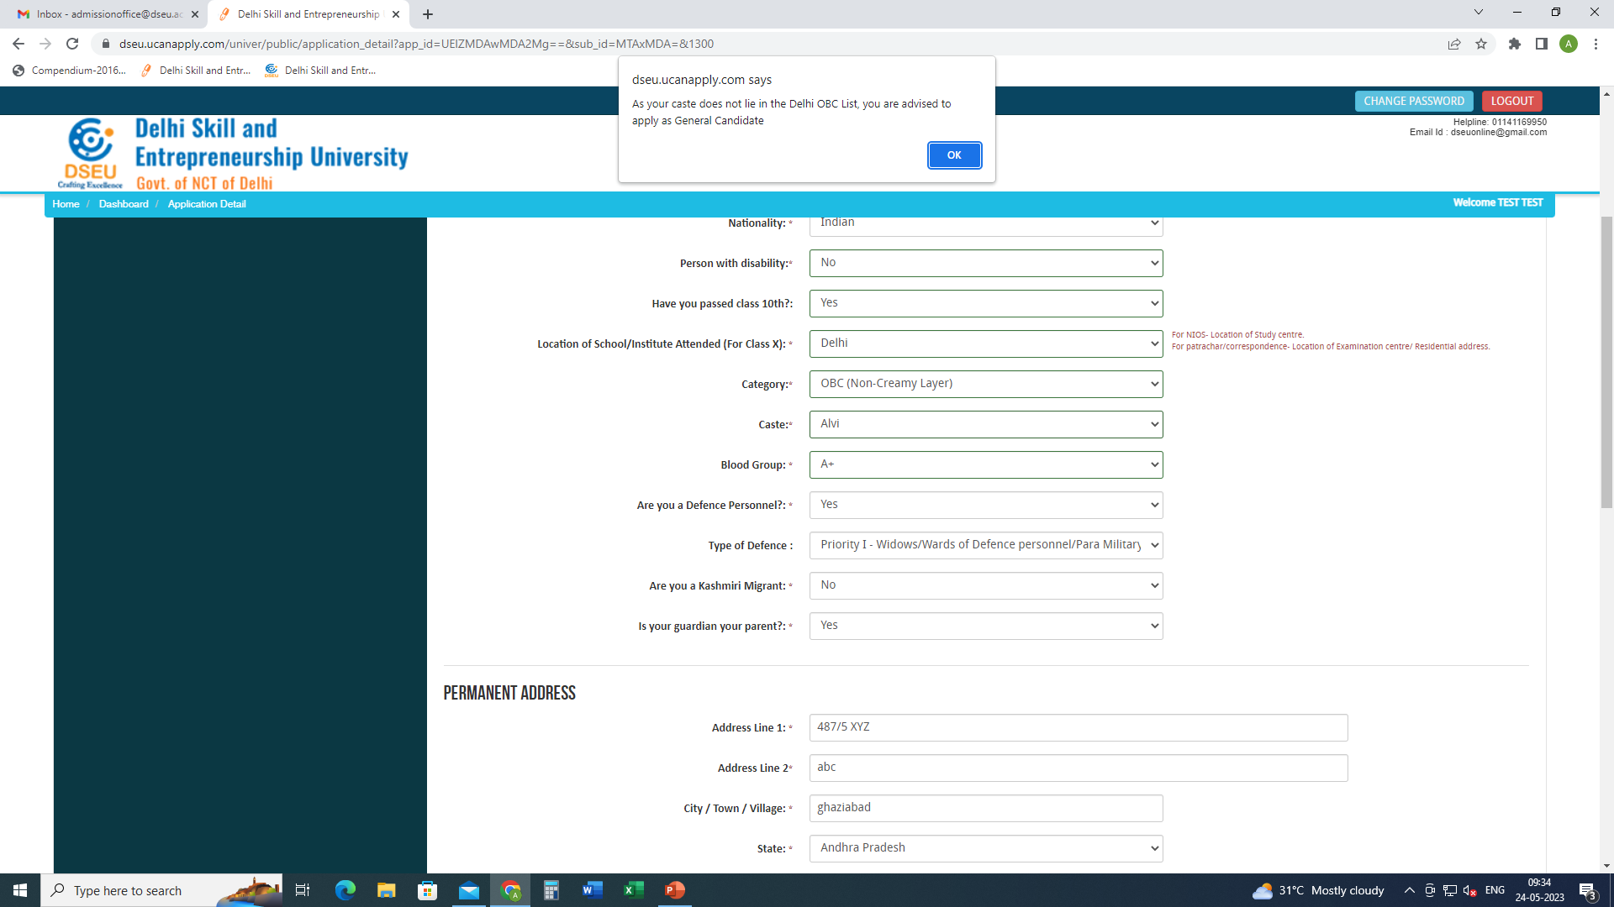
Pop up will ask the candidate to apply as General Candidate

Slide 18
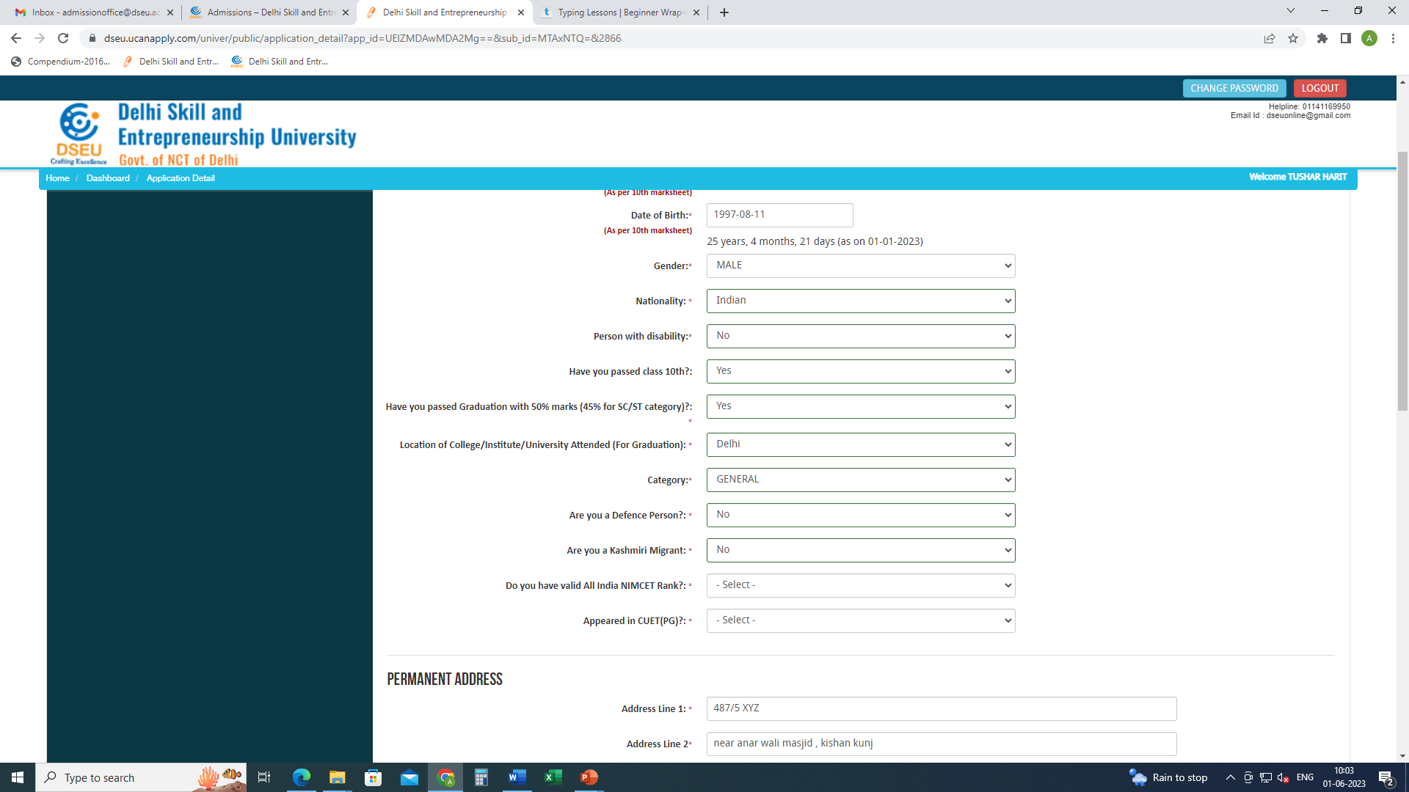
Fill in rest of the details.
Give your NIMCET and CUET (Pg) details (if applicable).
Give other required information.

Slide 19
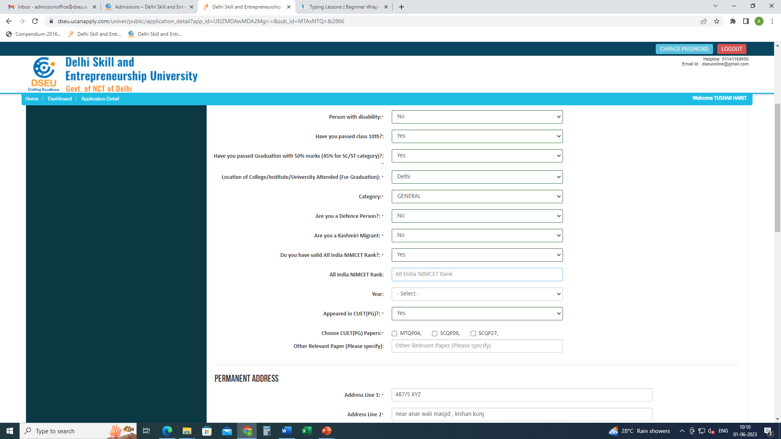
Give NIMCET Details.

Slide 20
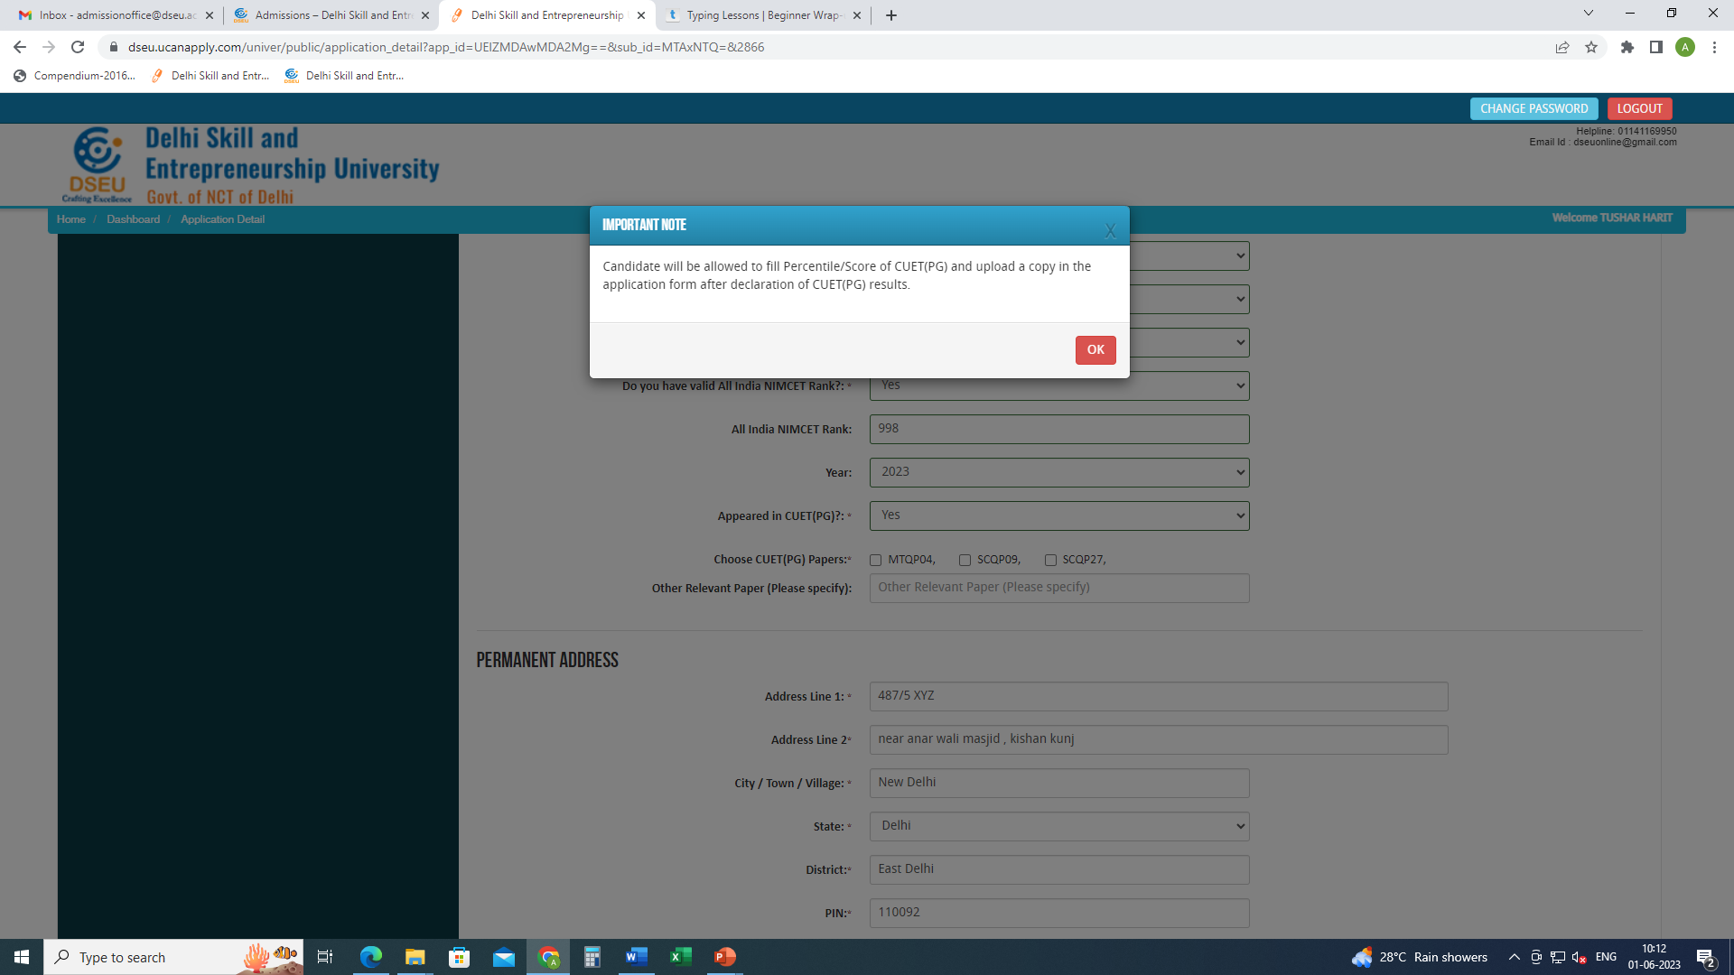
Give CUET Detaills , choose CUET (PG) papers code and give other relevant papers details (if any)

Slide 21
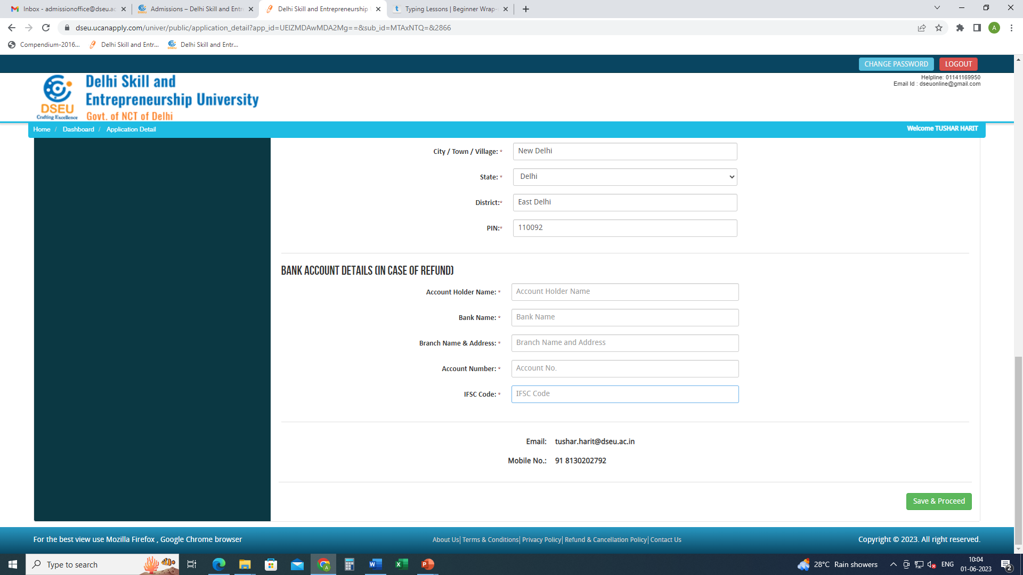
Carefully fill your bank details.
Refund (if any) will be done to this account.

Slide 22
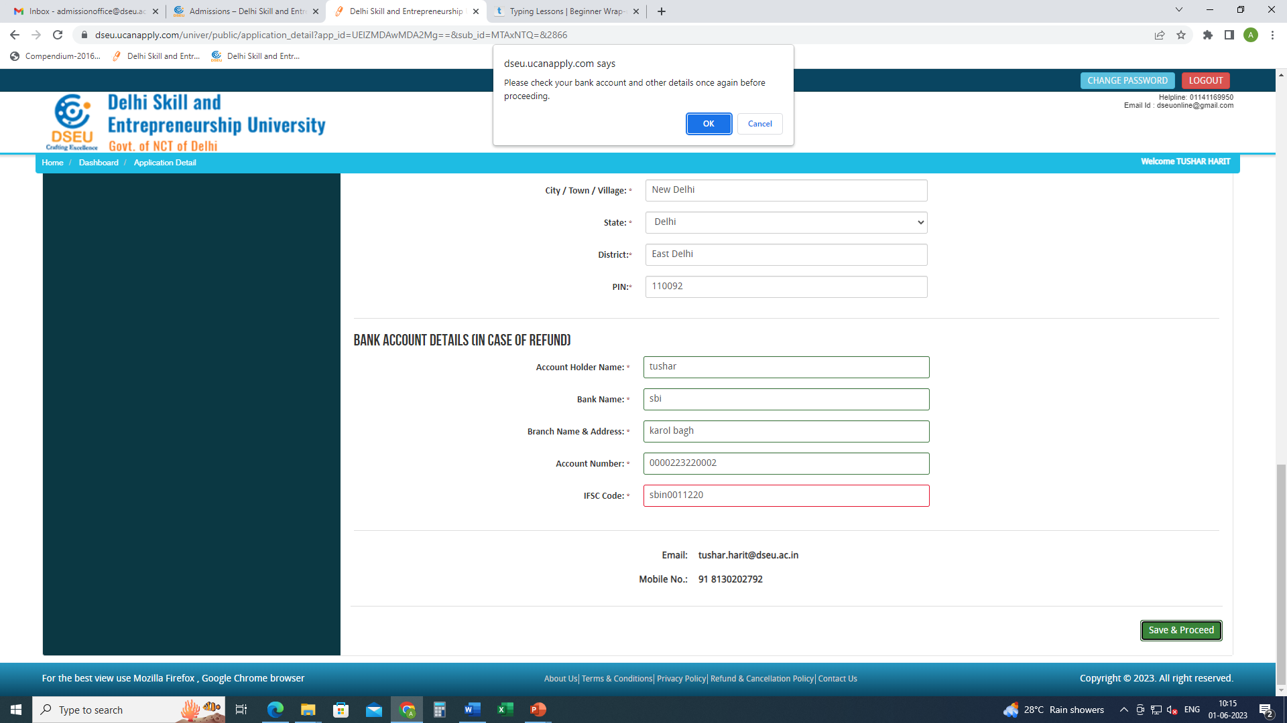
Save and proceed

Slide 23
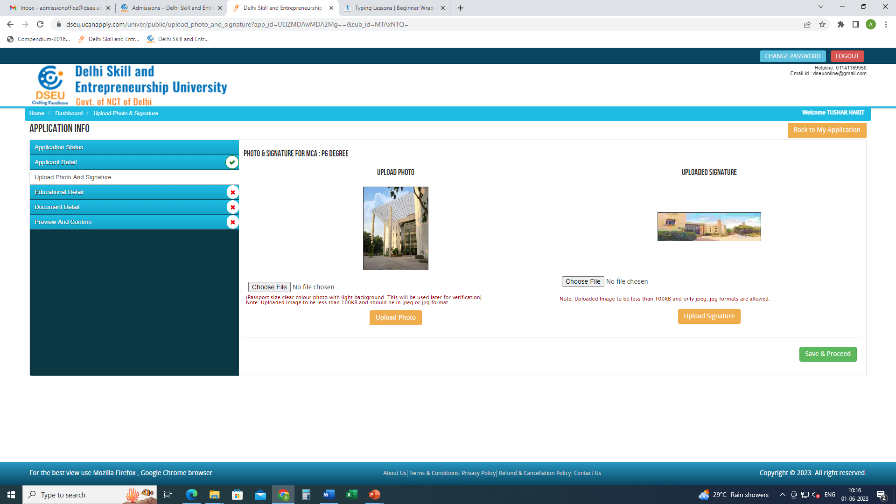
Upload photograph and signature
Save and proceed

Slide 24
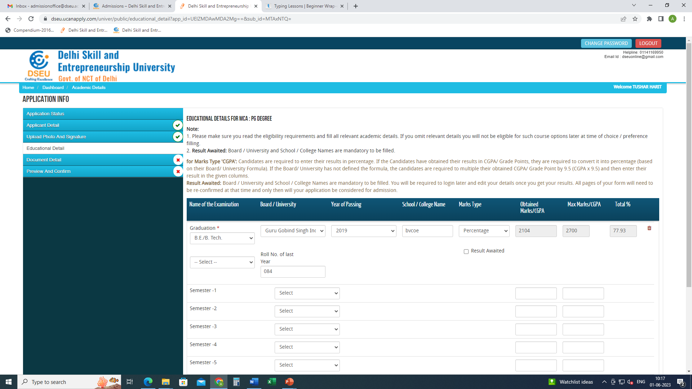
Choose university from the drop down, if not found in the list, please select others and specify
Give your education details
Choose from the drop down, if others, please specify

Slide 25
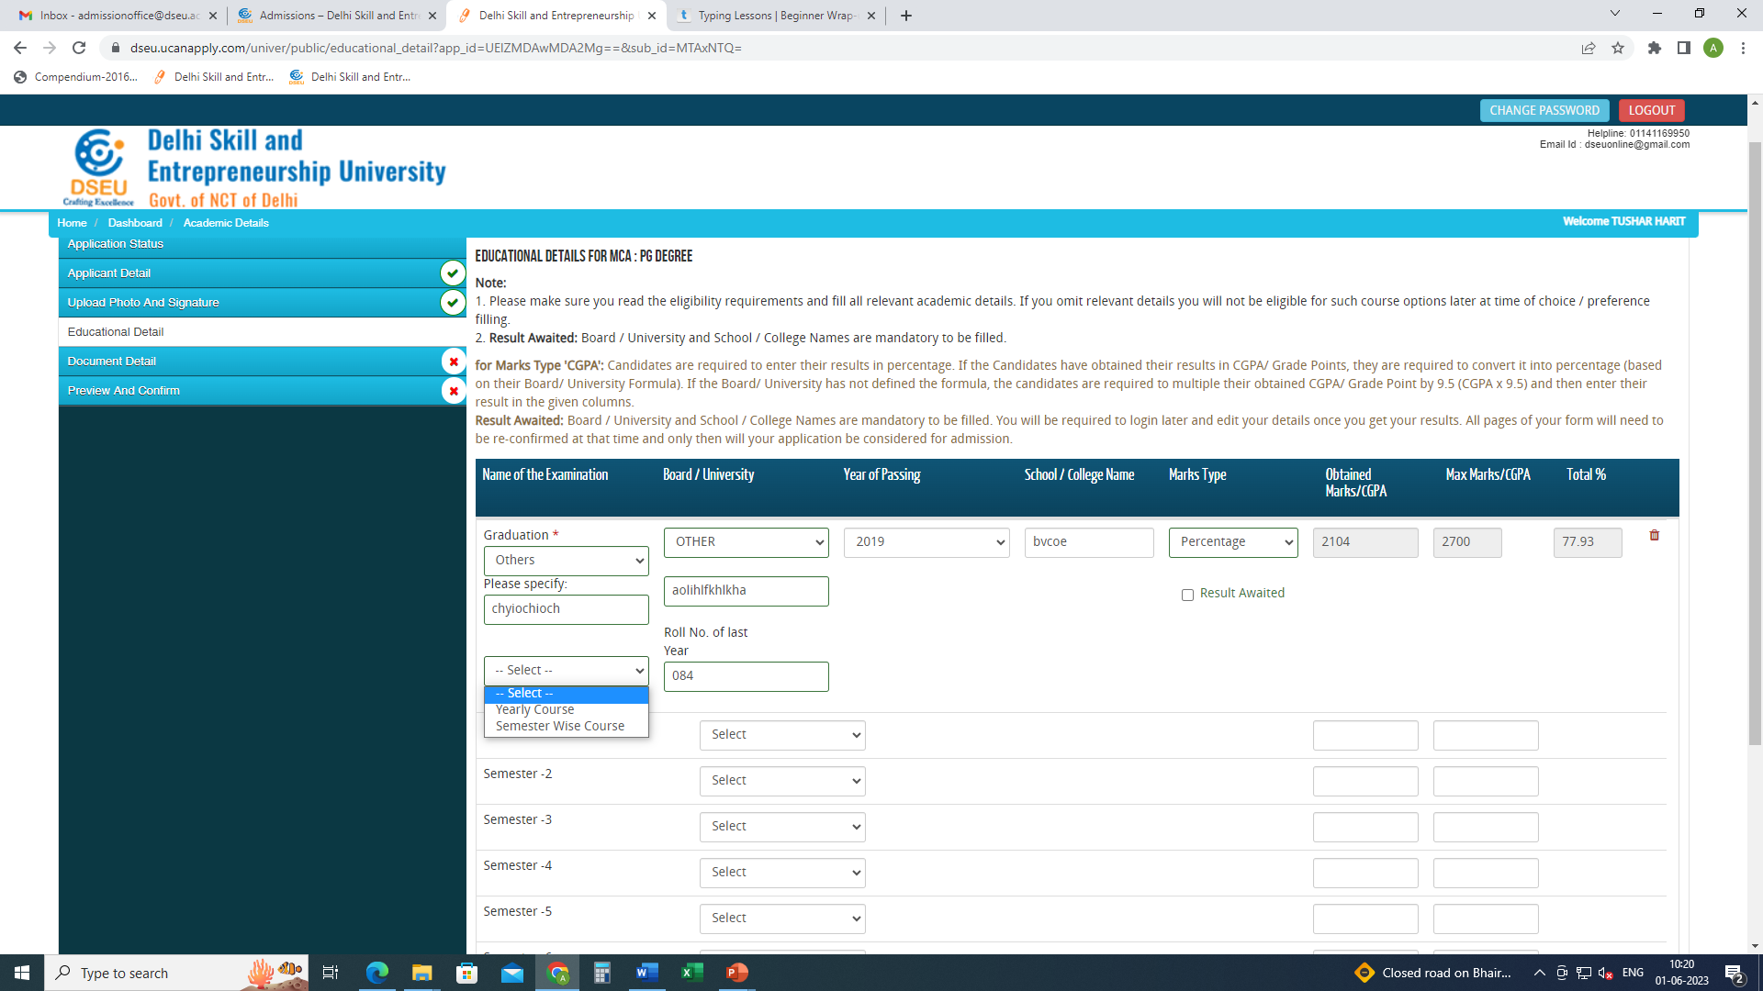
Insert type of course, yearly or semester wise course from the drop down
and give the details

Slide 26
Enter your marks and save and proceed
If result of final year is awaited, please enter the marks details of all the semester/ year except the final semester and save and proceed
Click on save and proceed.

Slide 27
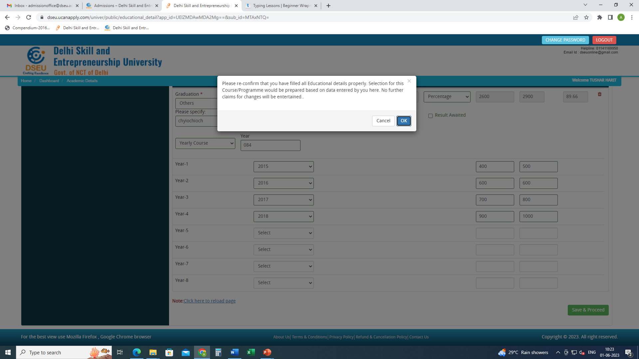

Slide 28
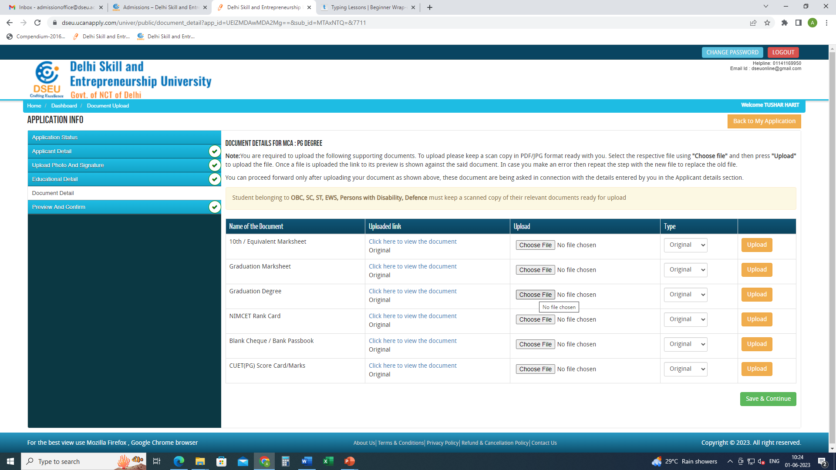
Upload clear and legible required documents
Save and proceed

Slide 29
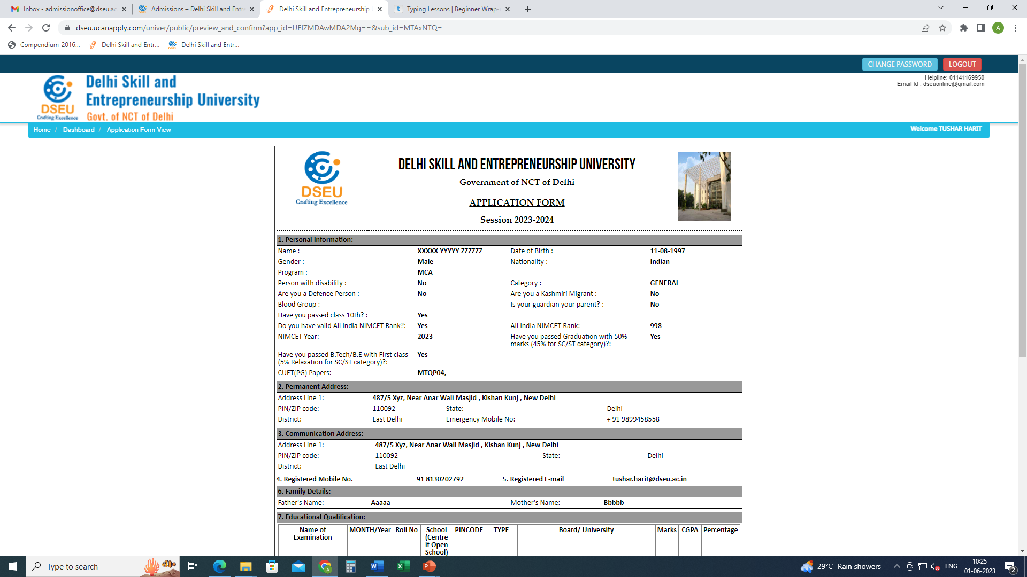
Preview the form carefully.
Check your details and Click on I confirm at the bottom of the page.
And pay the fee.
Take the printout of the final application form after payment and keep it handy for future reference.

