Slide 1
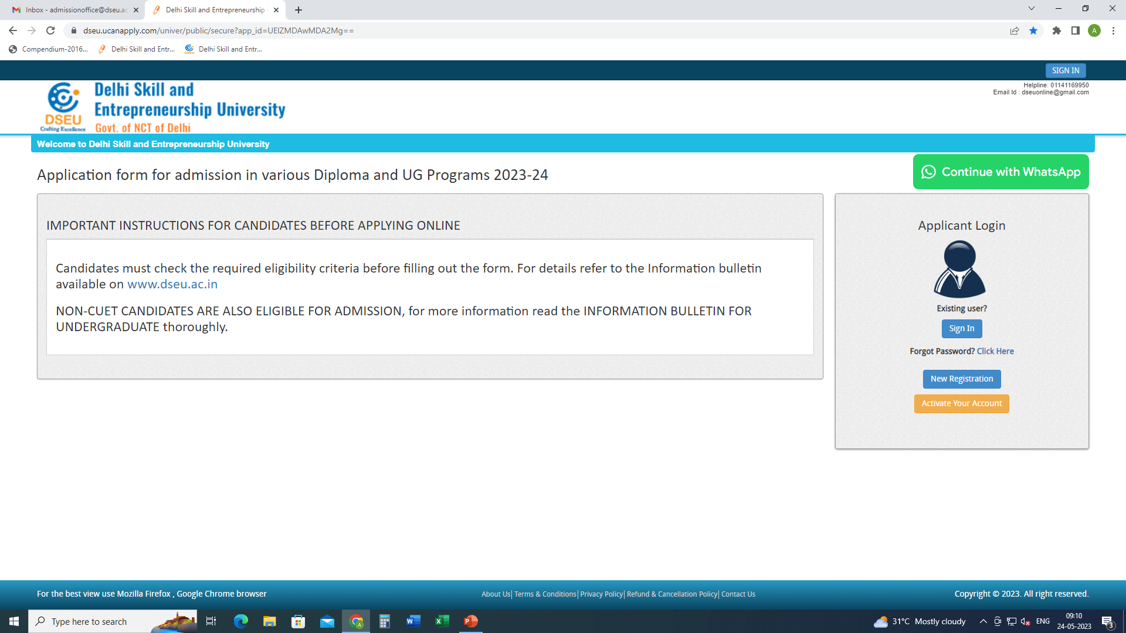
Step 1- Registration.
Enter Details.
Confirm
Step 2
Activate account.

Slide 2
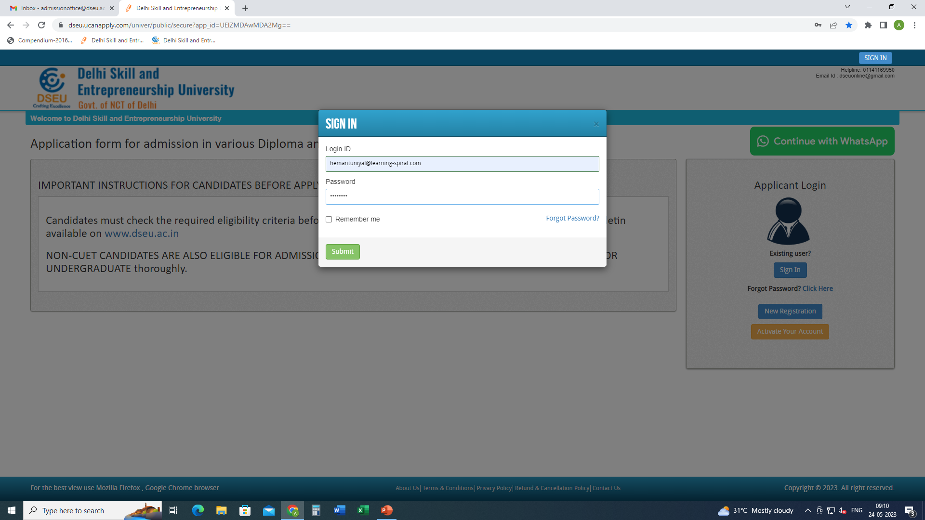
Step 3- Sign In.

Slide 3
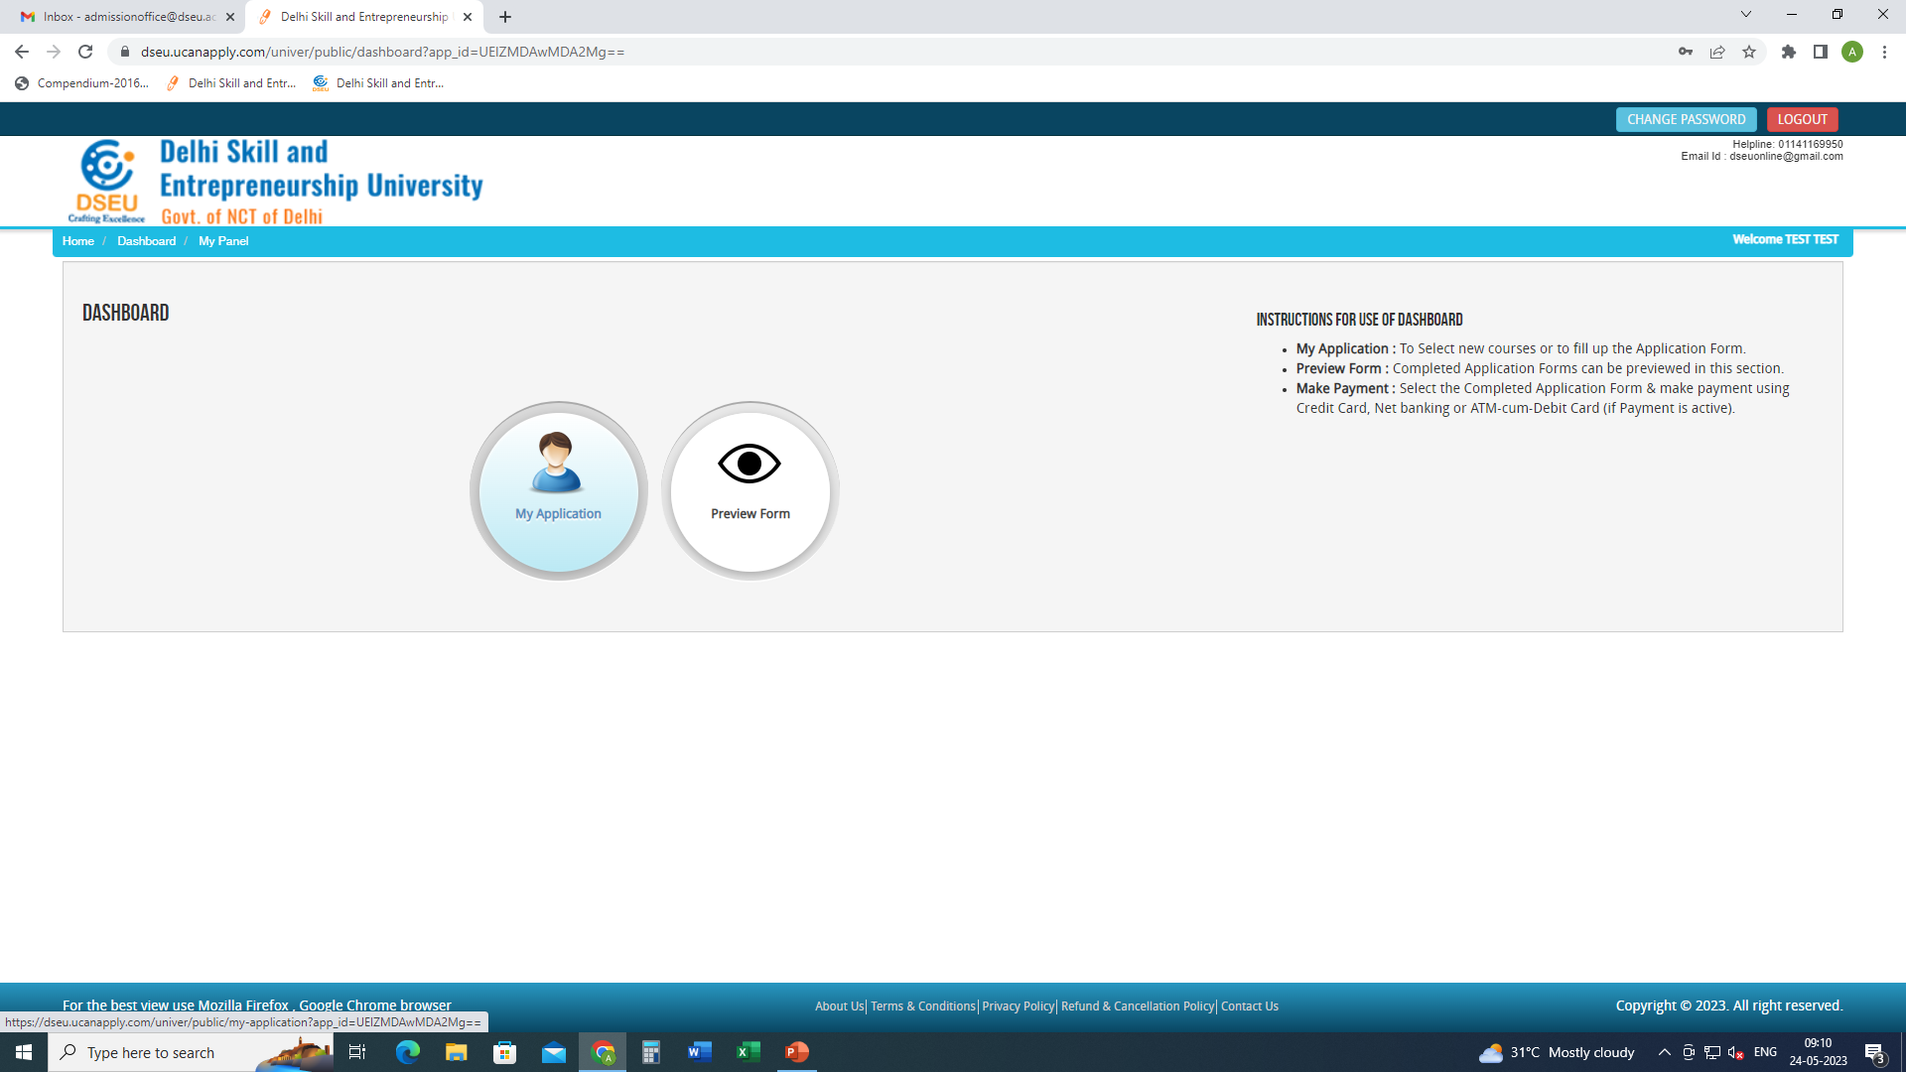
Step 4- My application

Slide 4
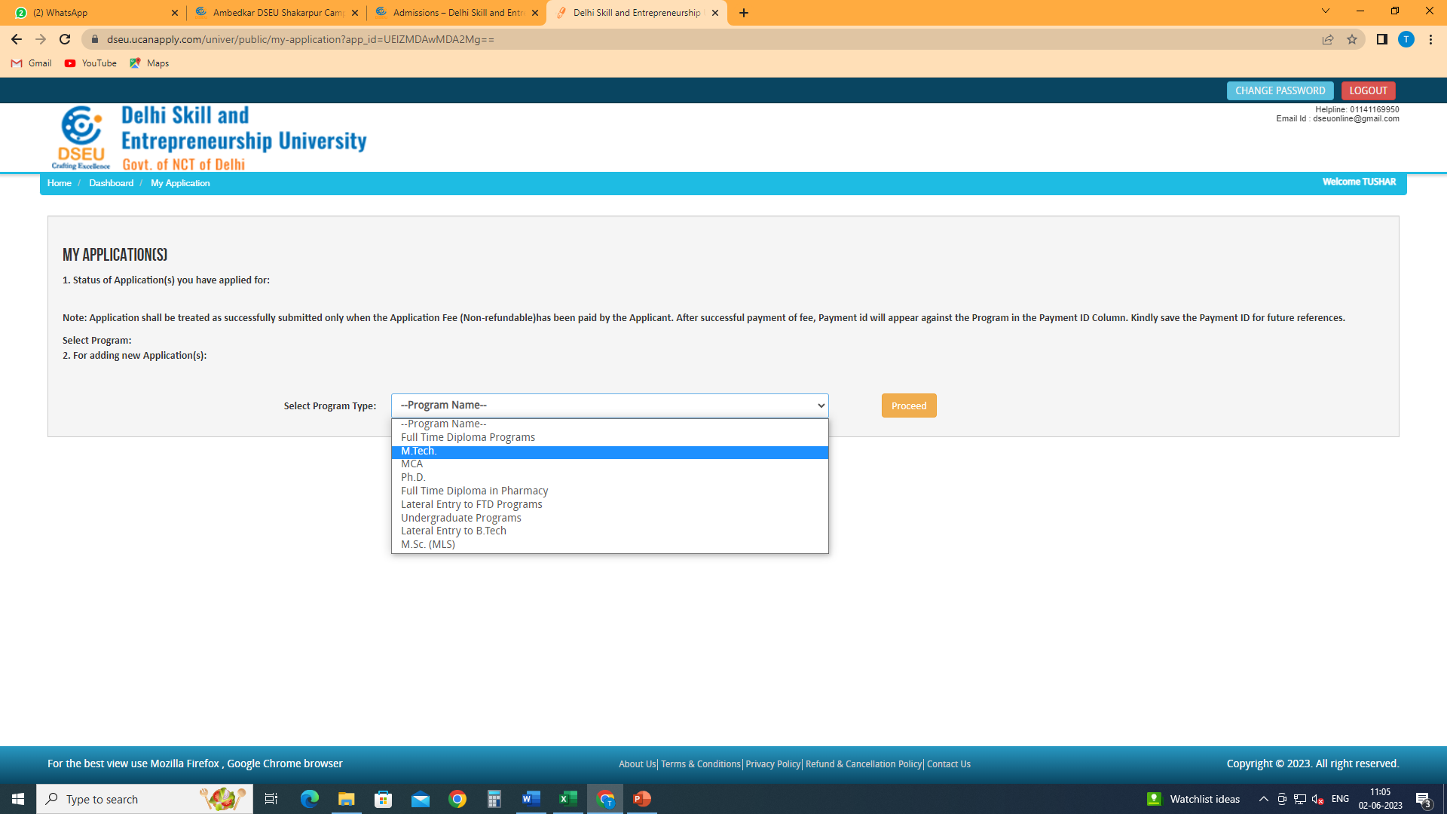
Select Program

Slide 5
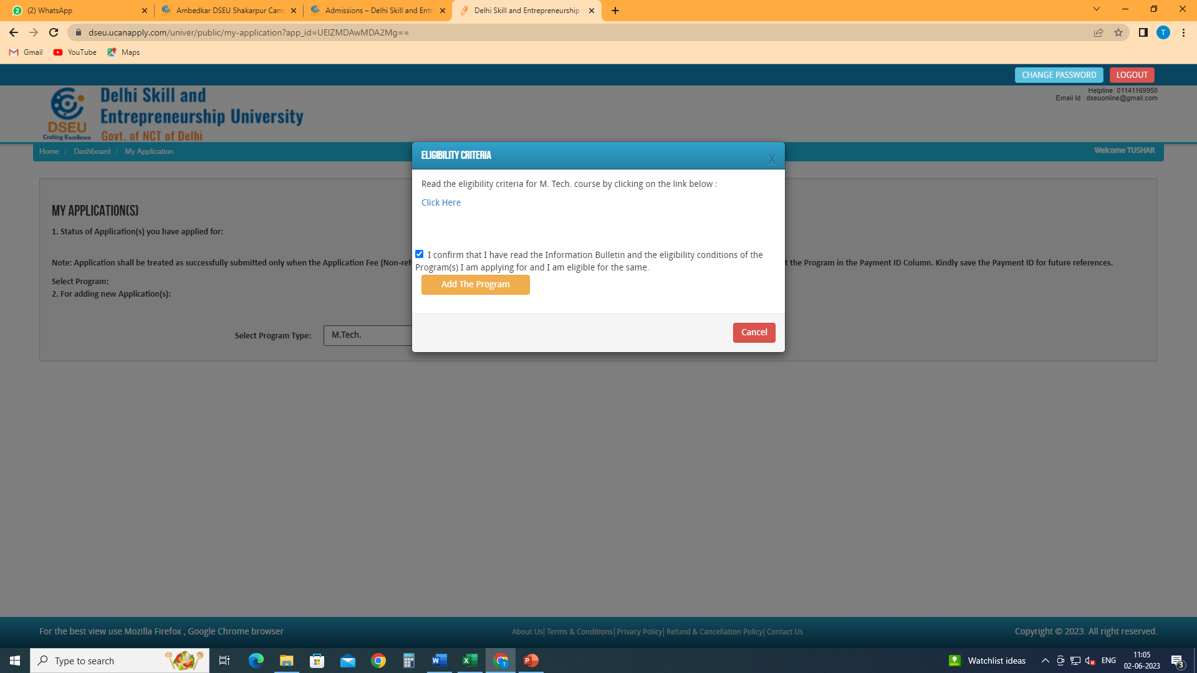
Check this box
Click on Add the Program
Click here to check the eligibility of MCA

Slide 6
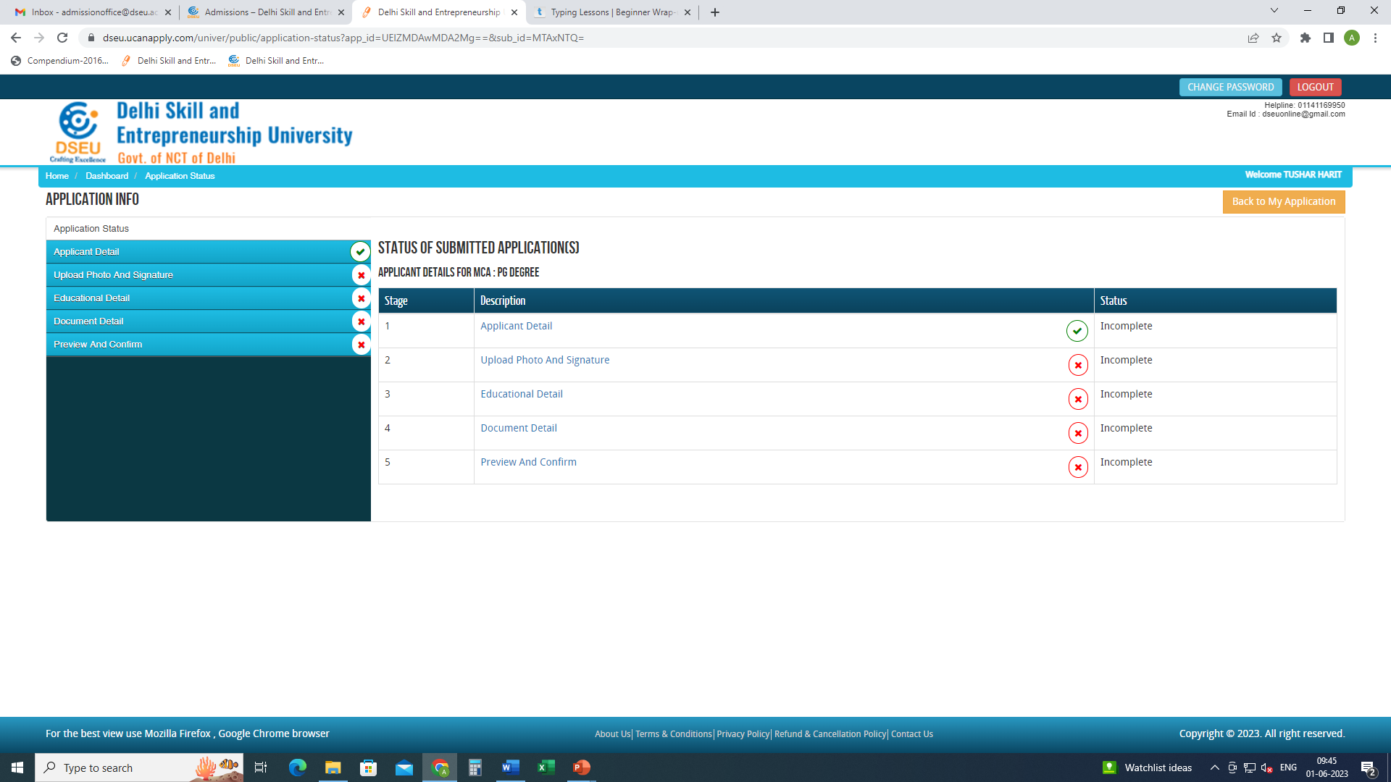
Click on applicant detail and fill the required

Slide 7
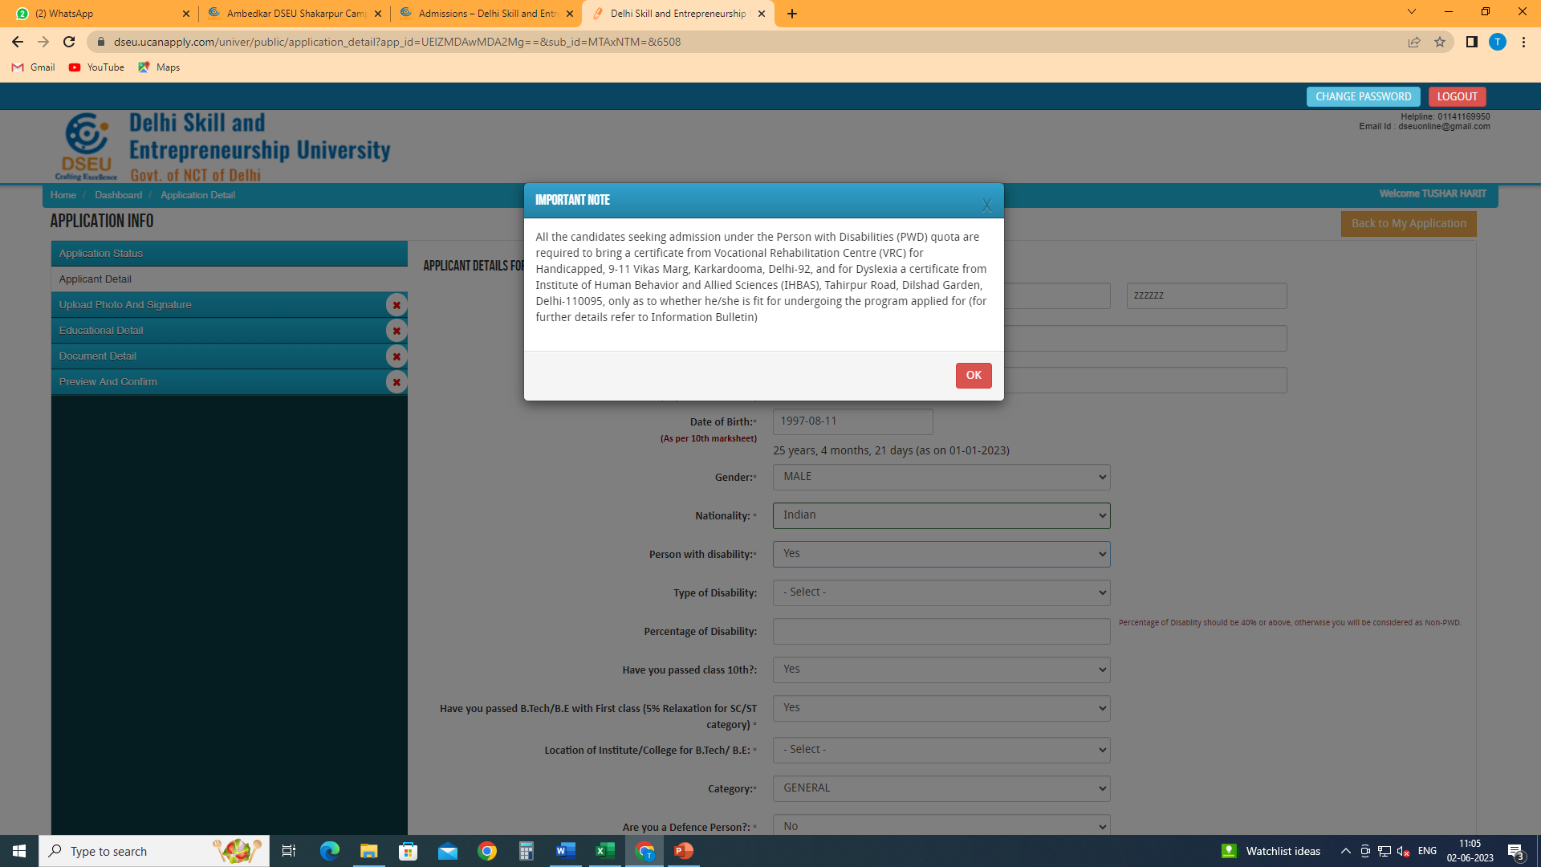
If selected ‘Yes’ a pop up will show up.
Make sure you have the required documents ready
Enter the type of disability

Slide 8
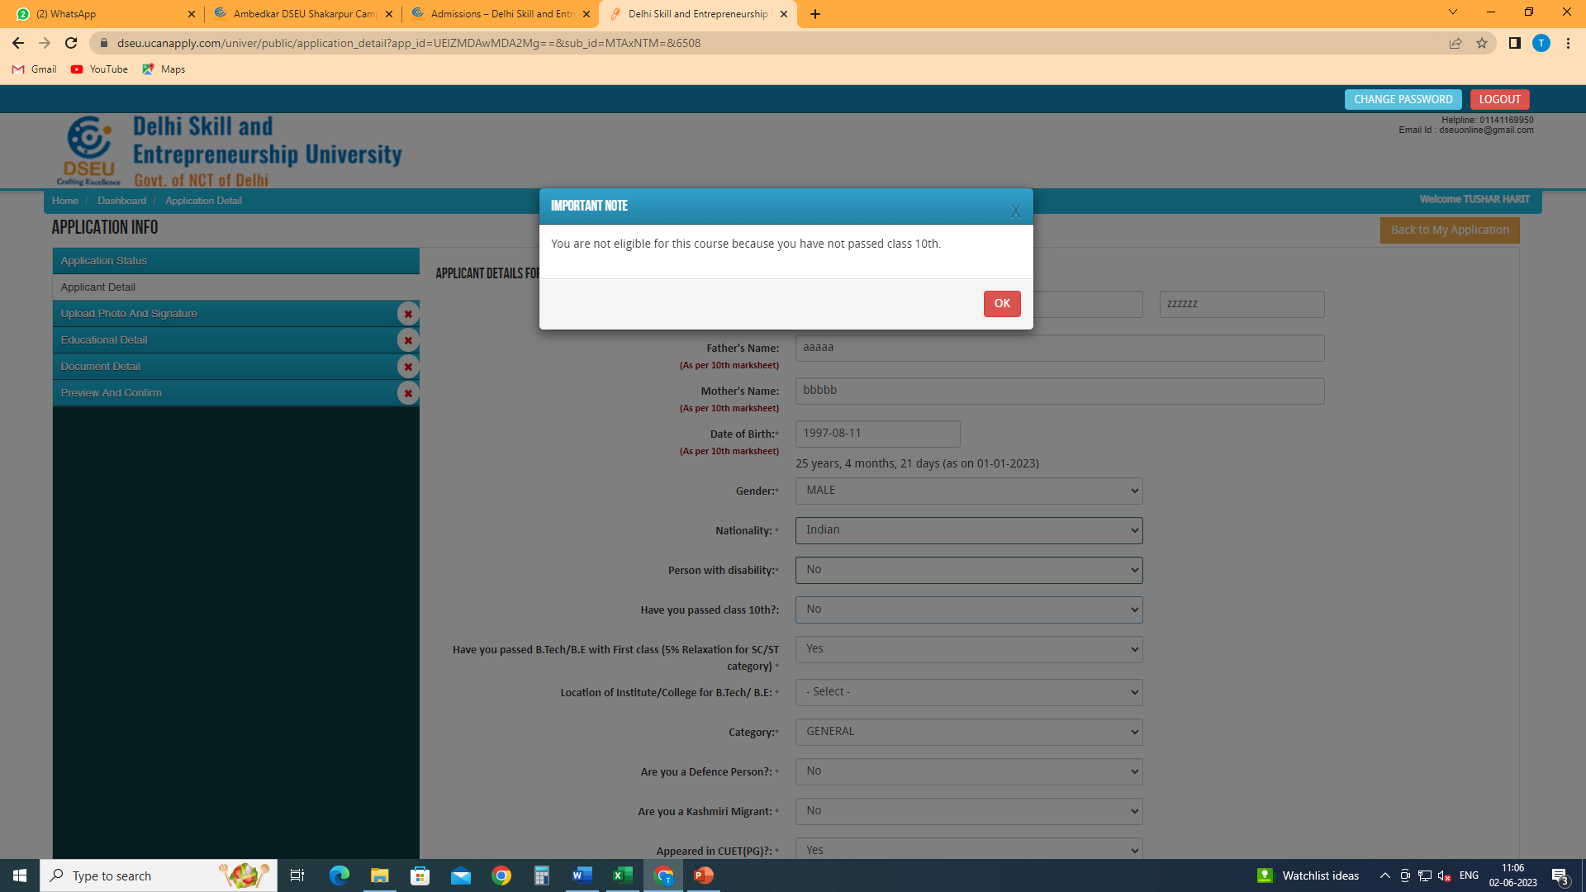
If selected ‘No’ a POP appears.
You are not eligible since you do meet the minimum eligibility criteria.

Slide 9
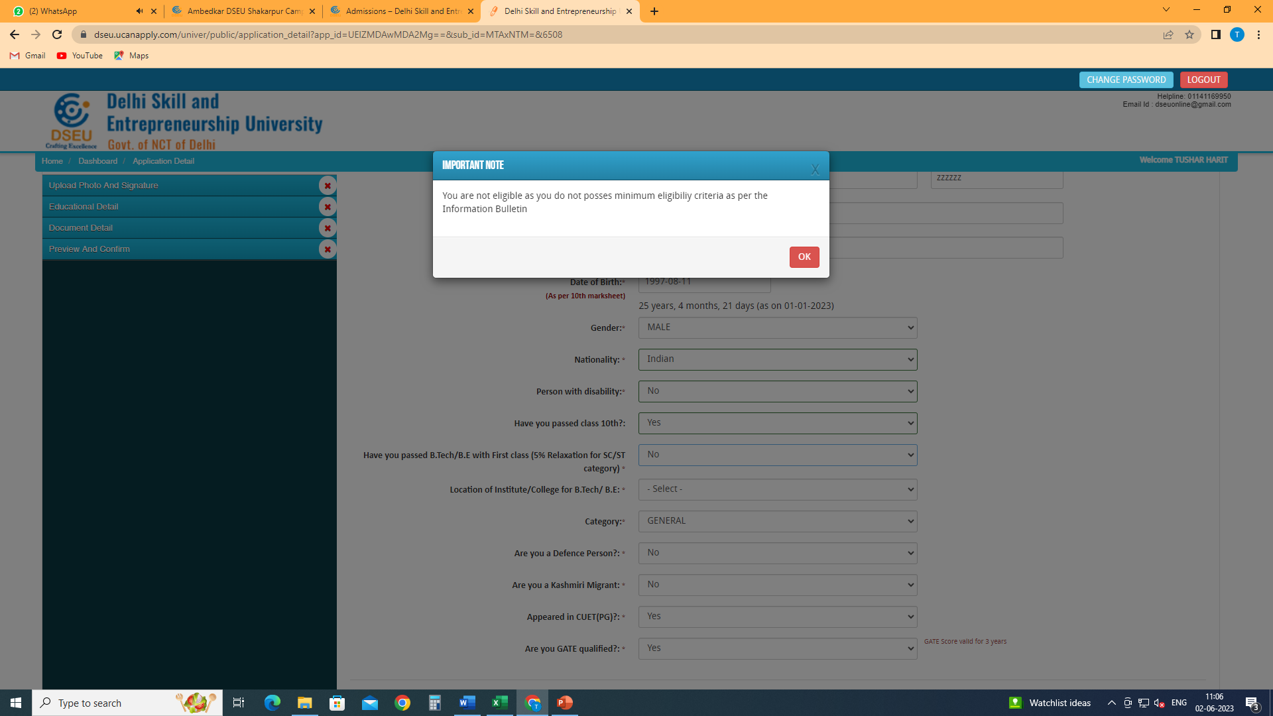
If selected ‘No’ a POP appears.
You are not eligible since you do meet the minimum eligibility criteria.

Slide 10
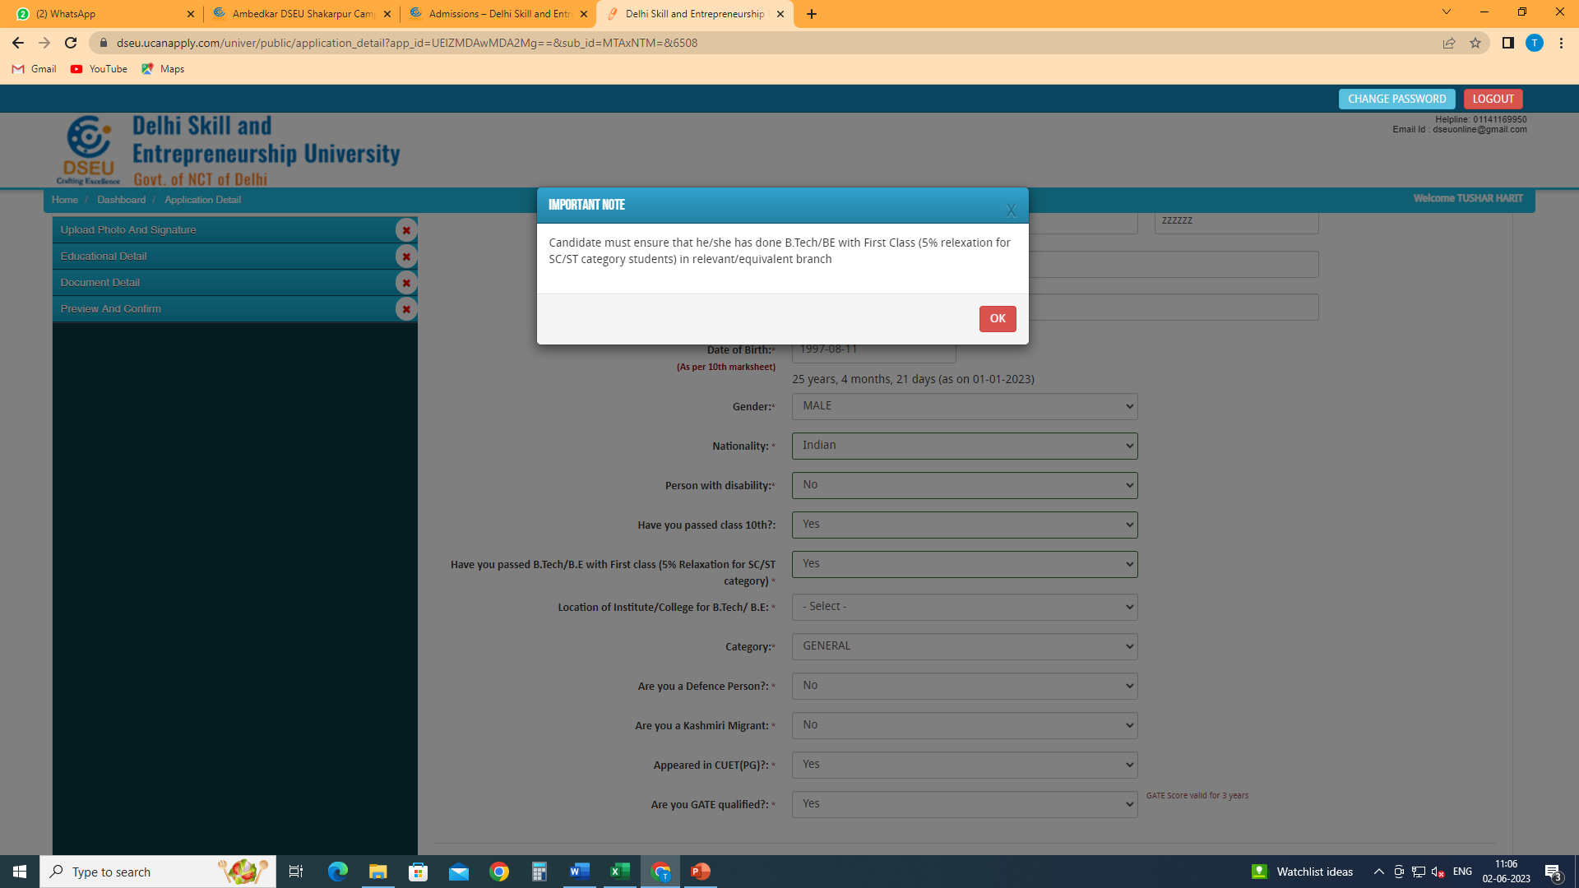
If selected ‘Yes’ a POP appears.
Refer Information Bulletin for eligibility criteria

Slide 11
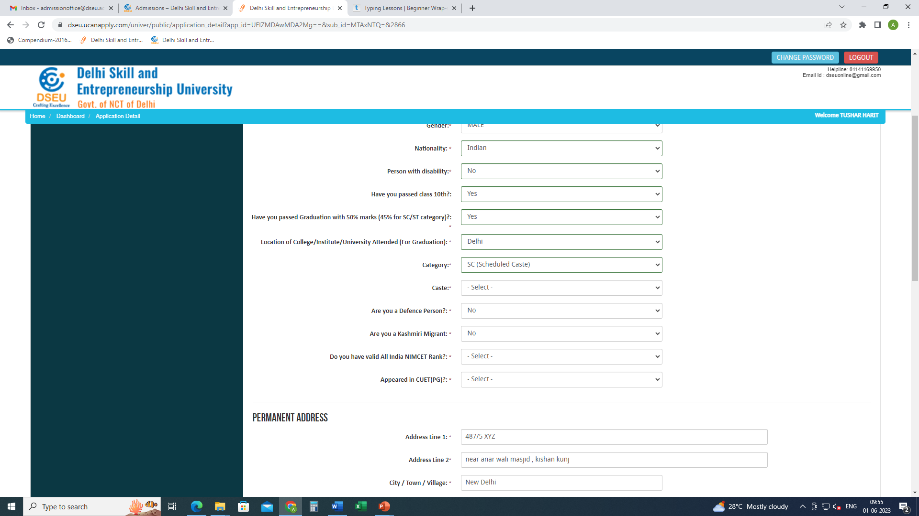
Choose location of institute of graduation.
If delhi.
Choose Category.
In case of SC and OBC, choose caste from the drop down menu which is Delhi SC and Delhi OBC list respectively for SC and OBC.

Slide 12
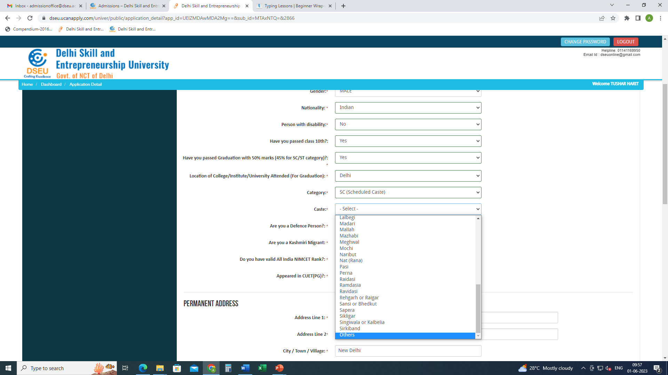
If your caste does not appear in the list, choose others
And pop will appear.

Slide 13
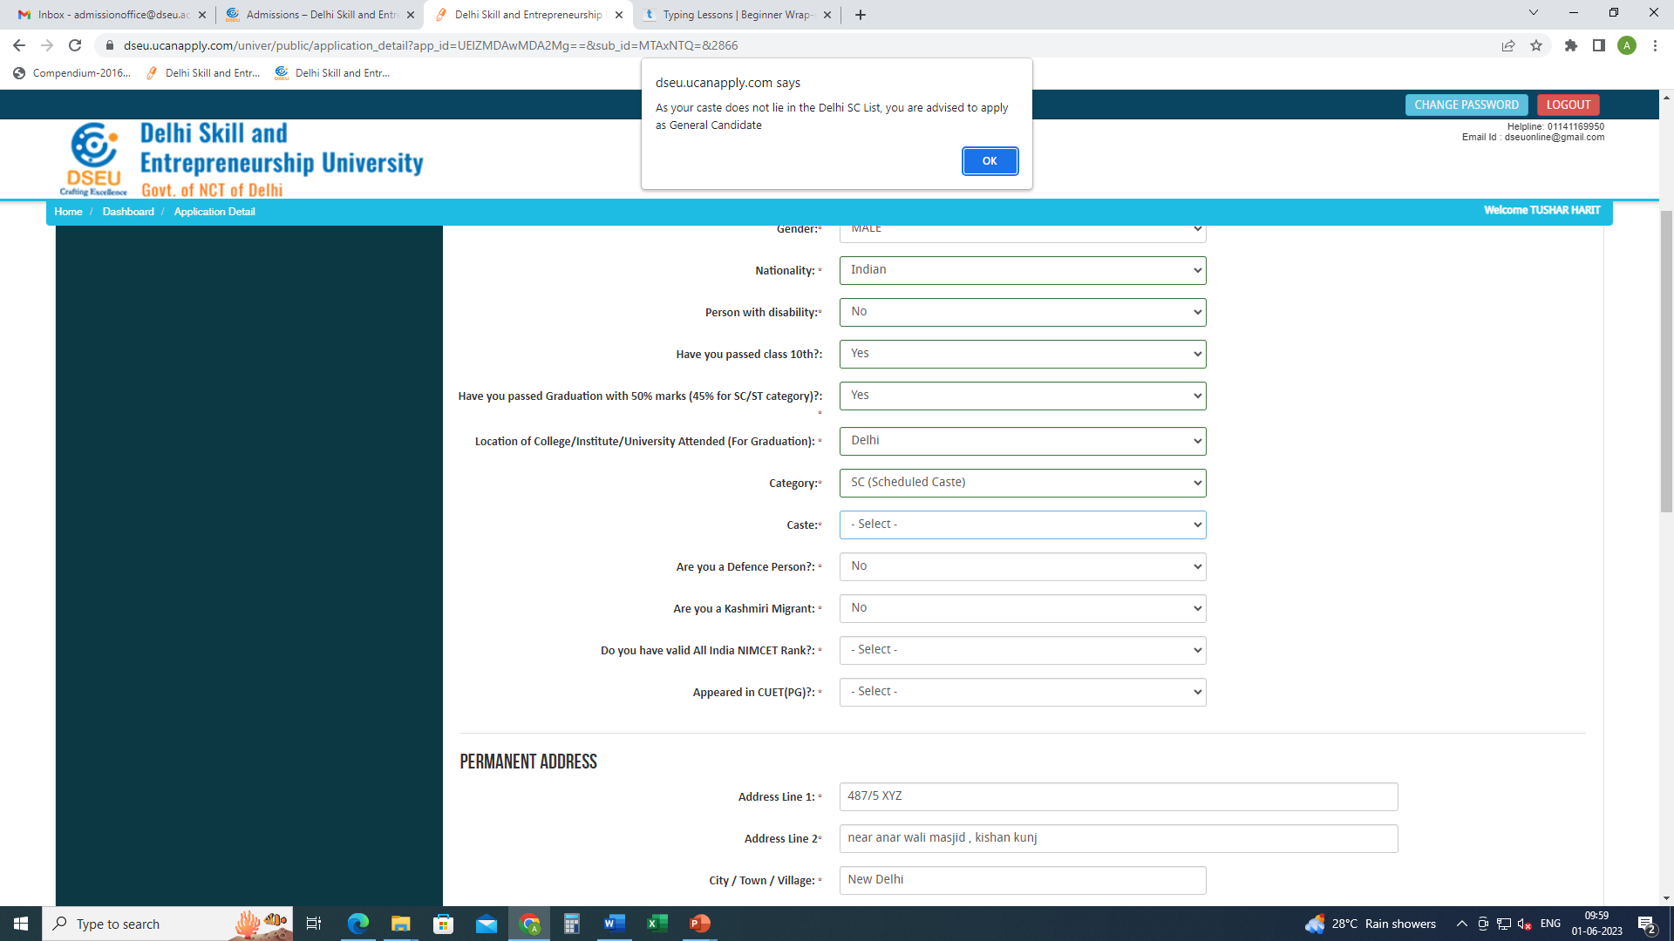
Pop up will ask the candidate to apply as General Candidate
Please refer to Information bulletin for information.
Similarly , if a candidate selects OBC

Slide 14
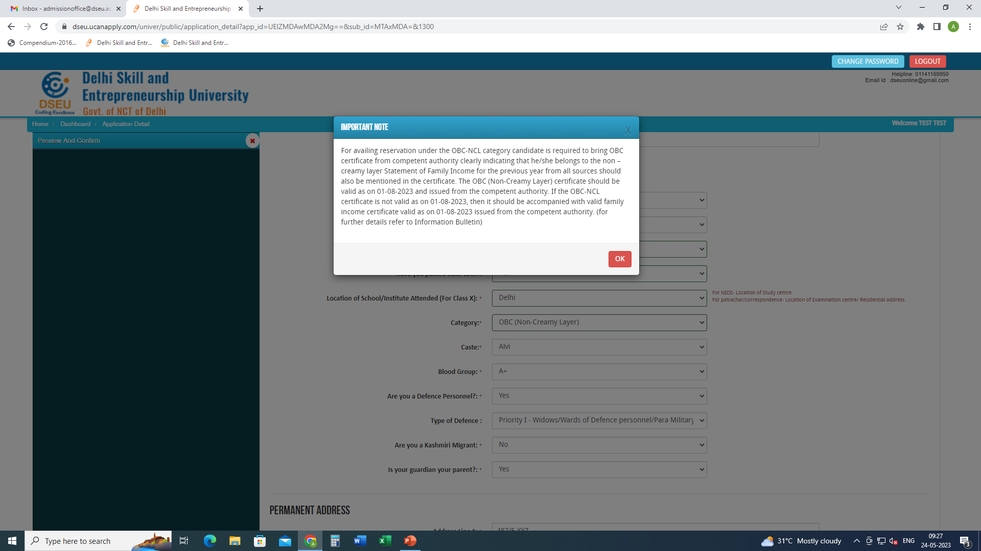
For Delhi- OBC Candidate
Choose caste from the Drop Down

Slide 15
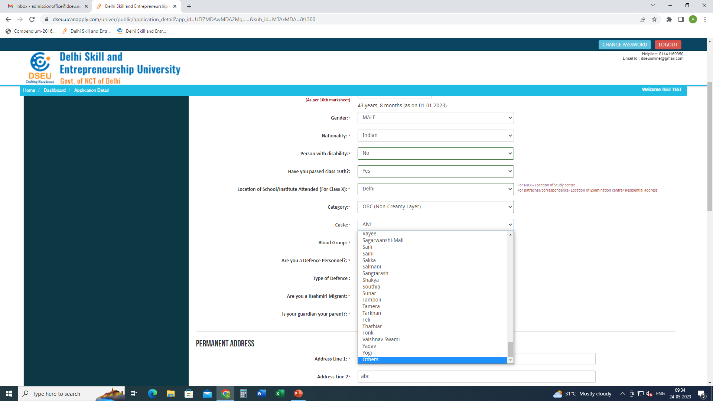
If caste is selected as others then

Slide 16
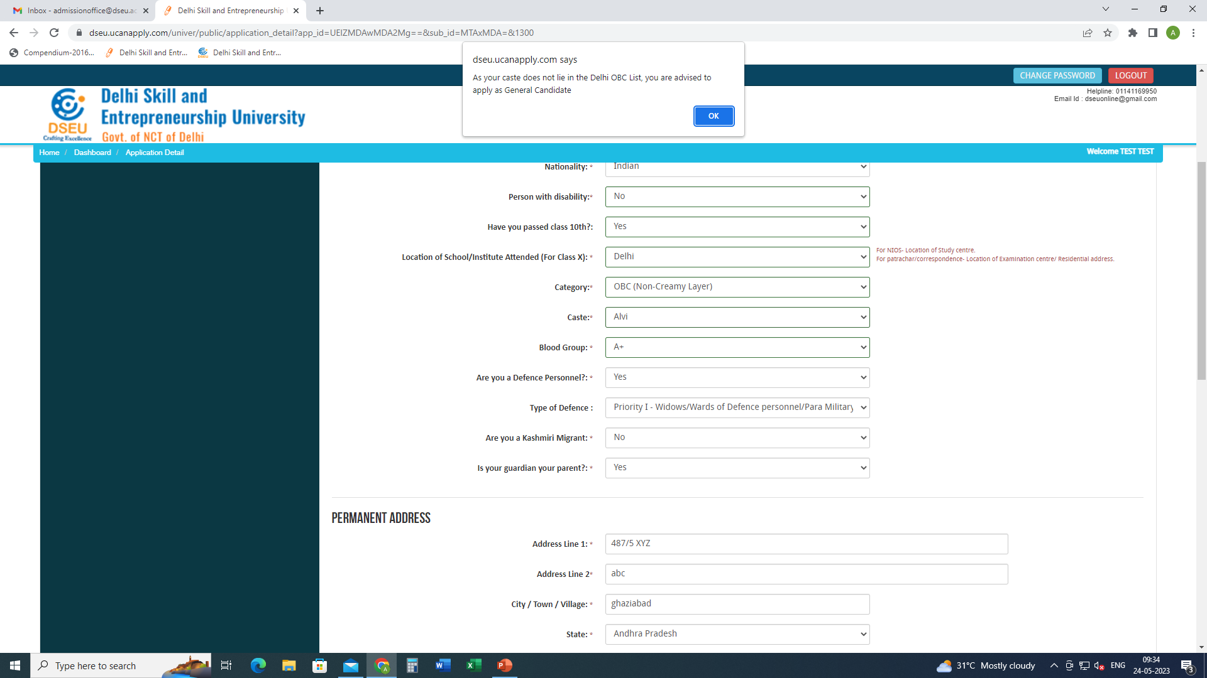
Pop up will ask the candidate to apply as General Candidate
Refer information Bulletin for more details.

Slide 17
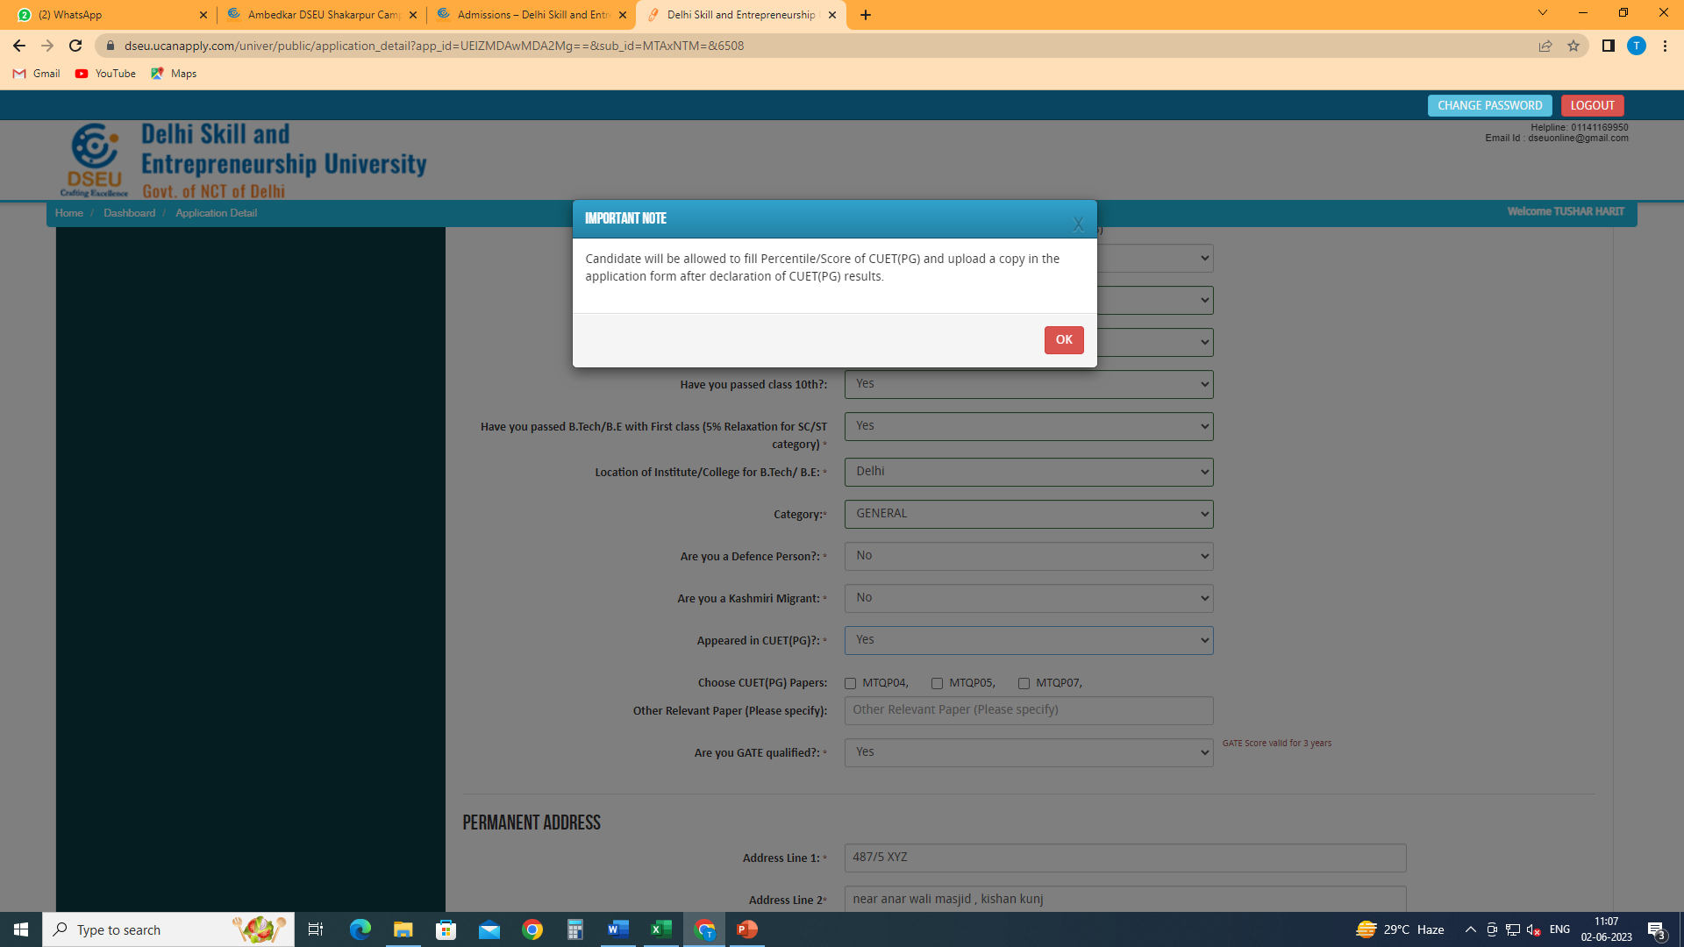
Give cuet details (if applicable)
Choose subject codes
Give other relevant papers details (if any)

Slide 18
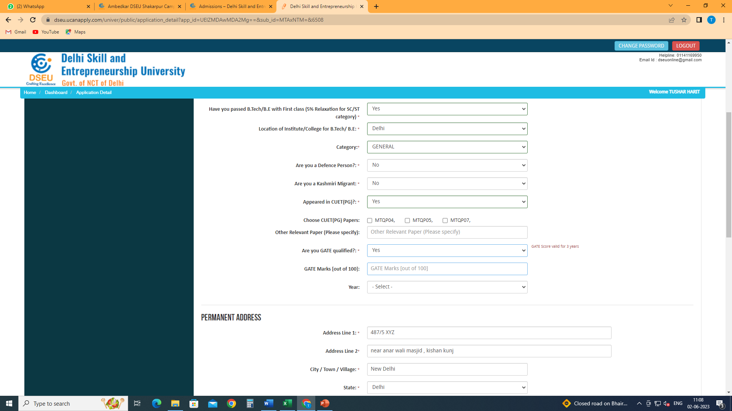
Give GATE details (if applicable)
Enter your marks
And choose year

Slide 19
Fill other required information
And then click on save and proceed

Slide 20
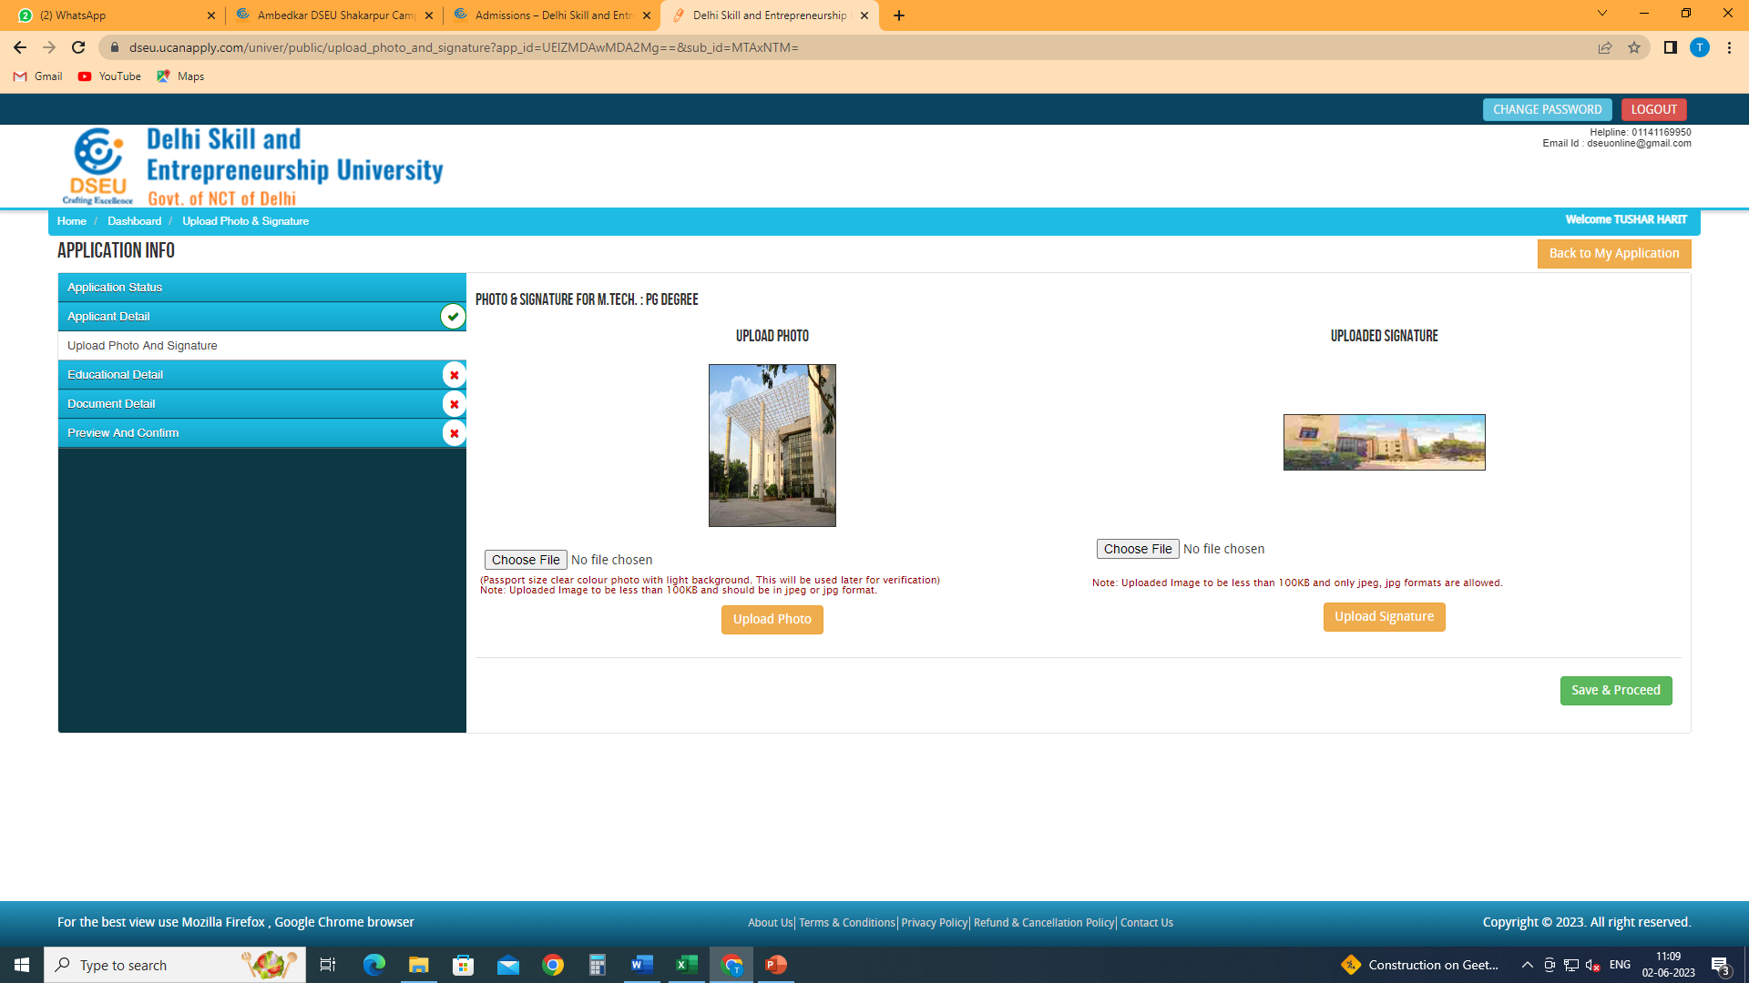
Upload your clear photograph and signature

Slide 21
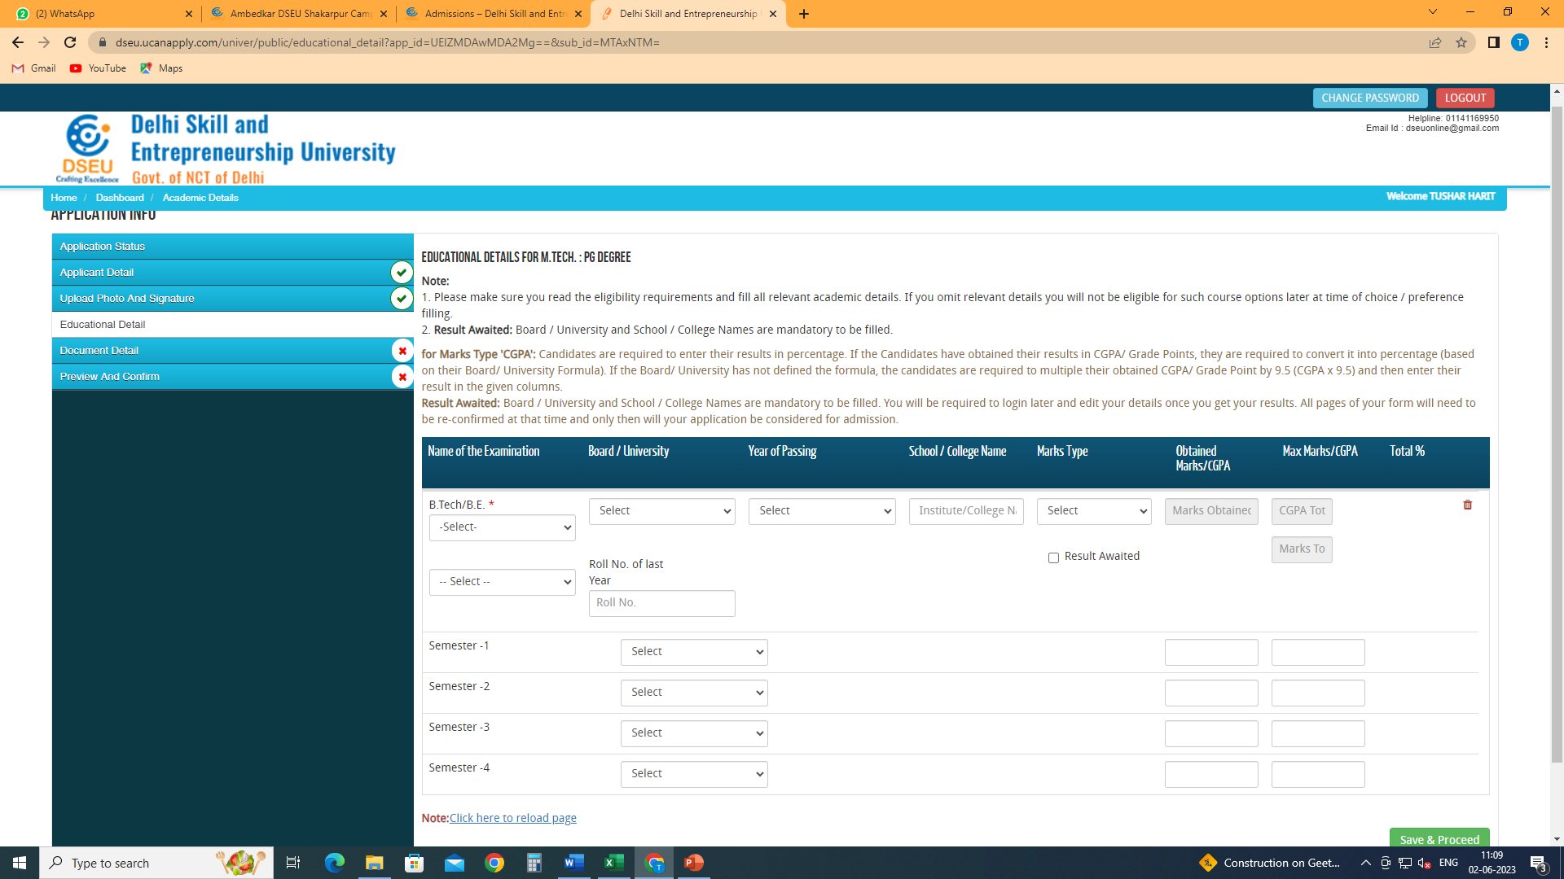

Slide 22
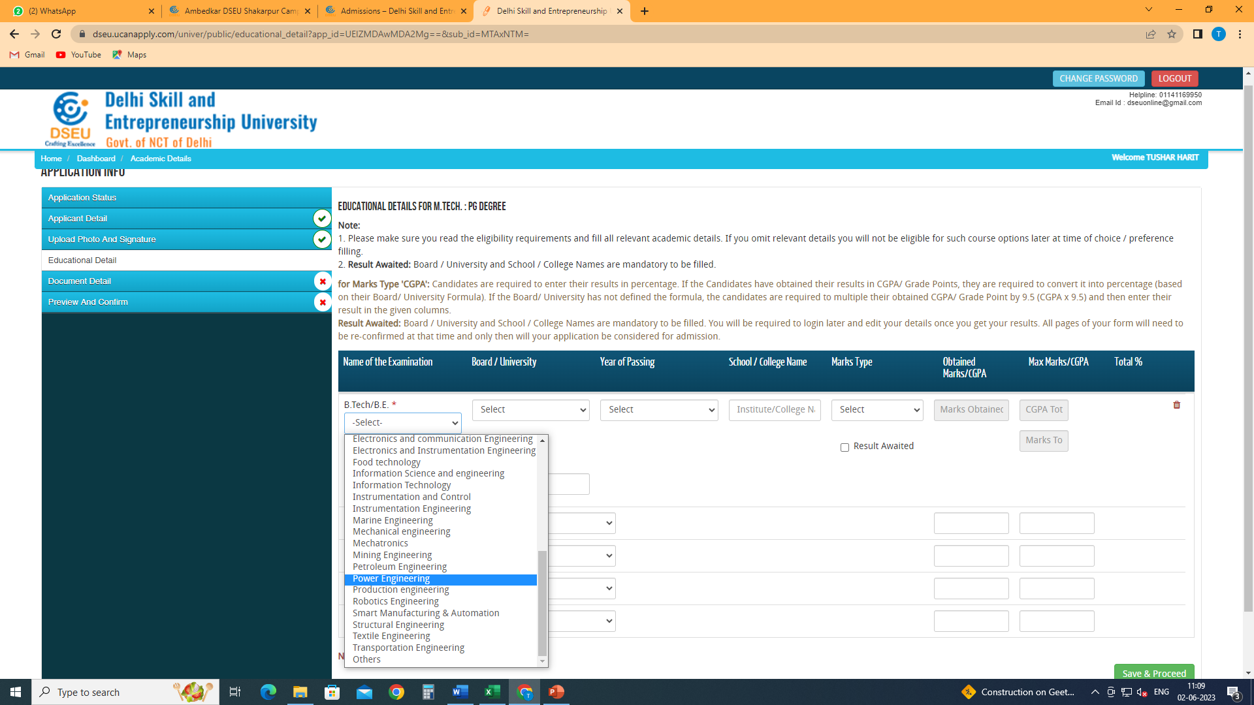
Give your educational details
Choose your degree discipline/branch from the drop down, if not found, please select others and specify

Slide 23
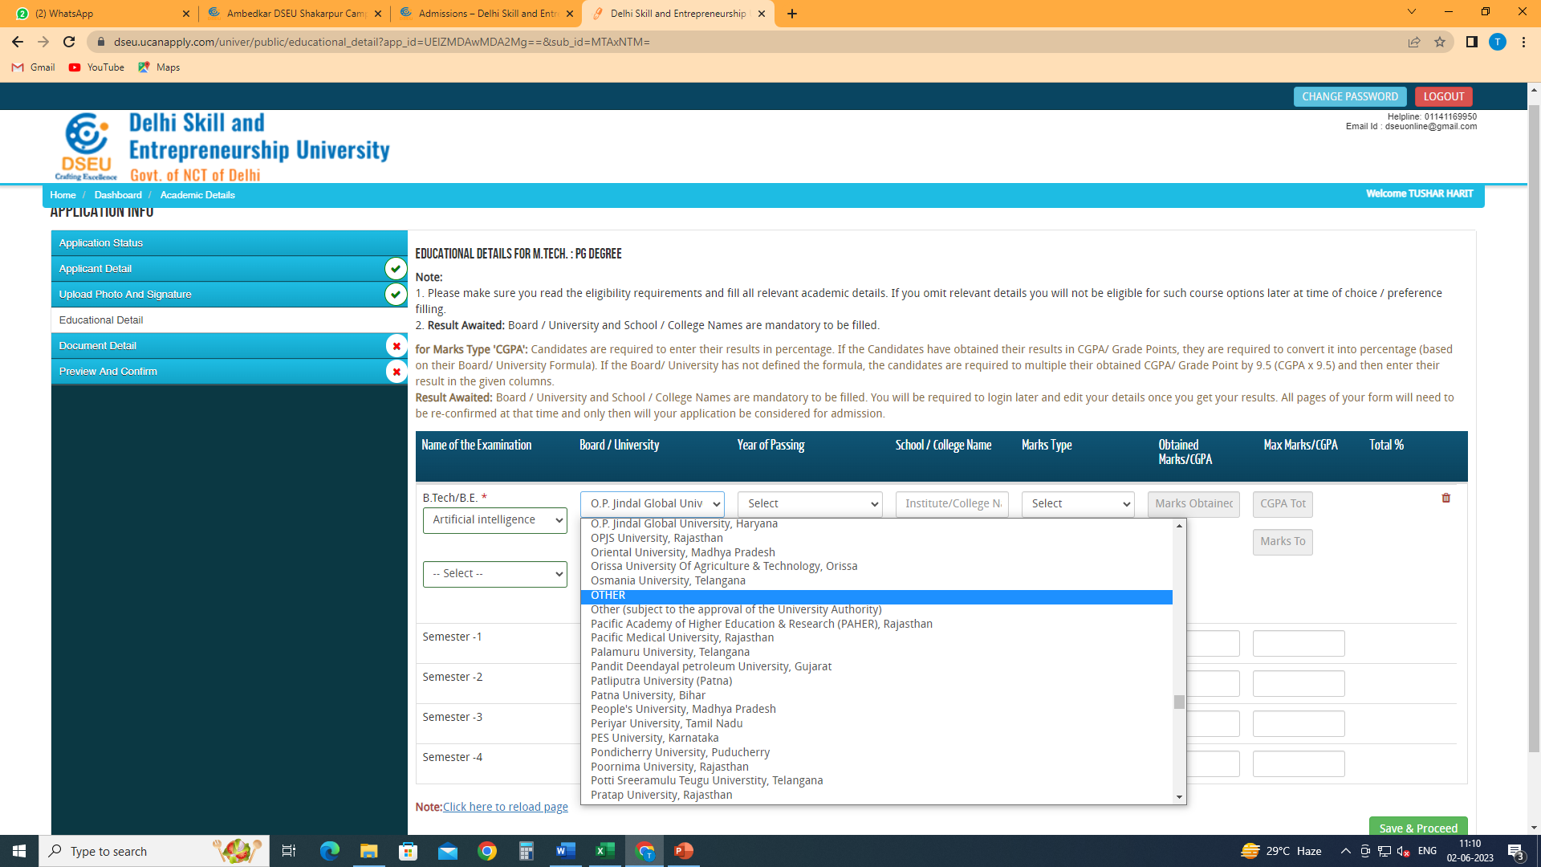
Select your university from the drop down , if not found in the list, please select other and specify
Fill in year of passing, school/college name etc.

Slide 24
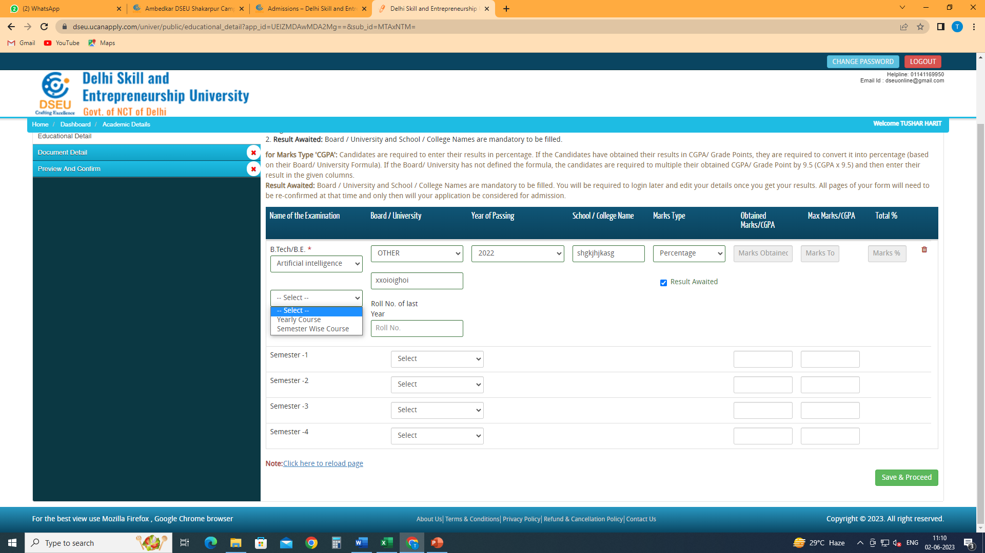
Select type of course from the drop down- Yearly/ Semester wise.
If yearly course , please fill in the details.
If semester wise course, select the no. of semesters from the drop down
If your result is awaited check this box

Slide 25
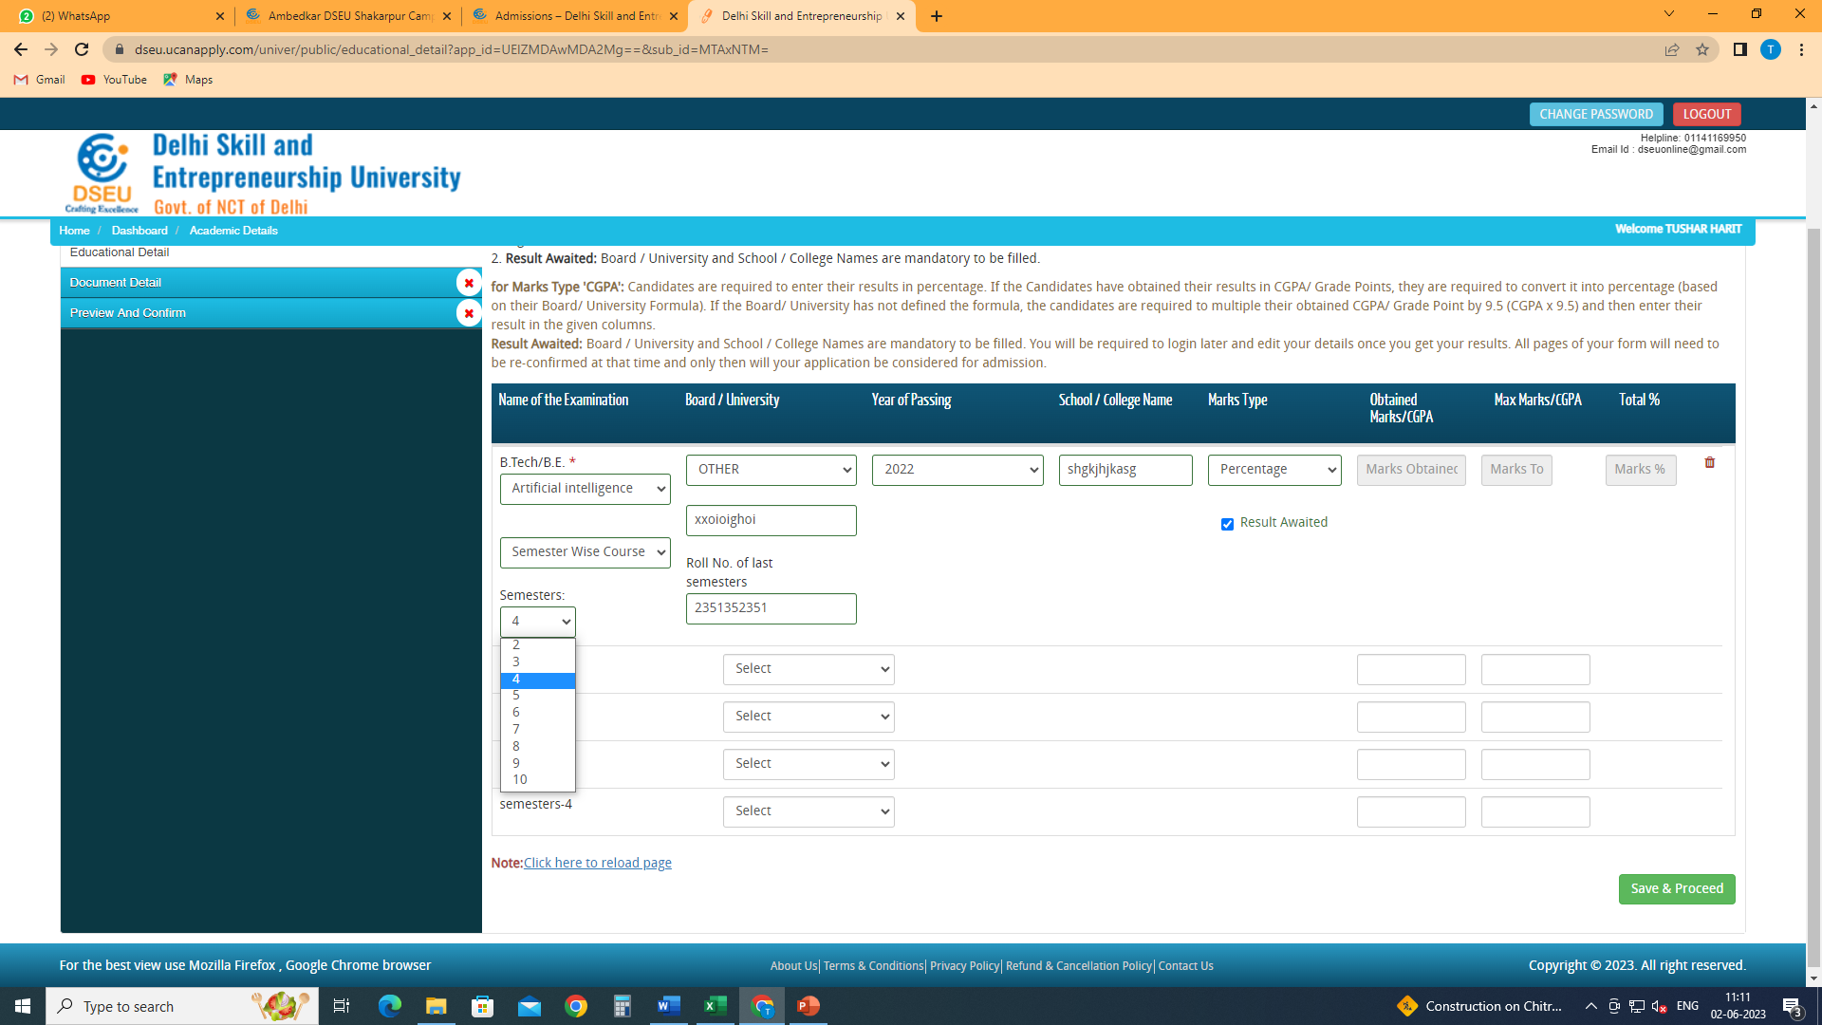
Select semesters from the drop down

Slide 26
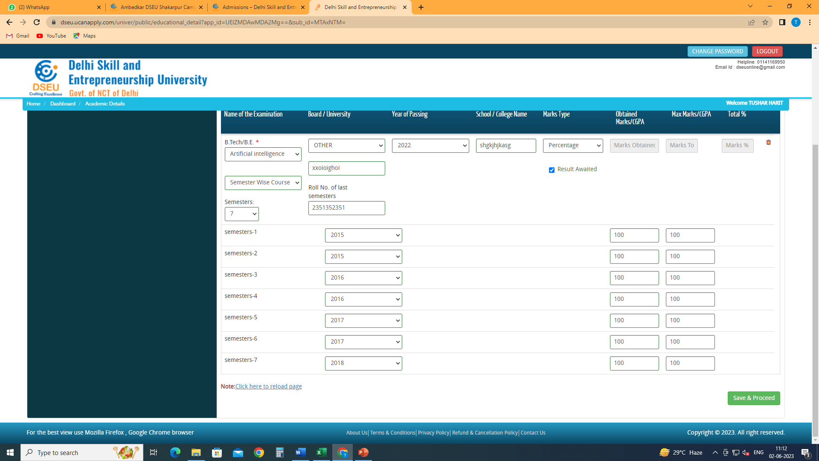
Enter all the details and save and proceed

Slide 27
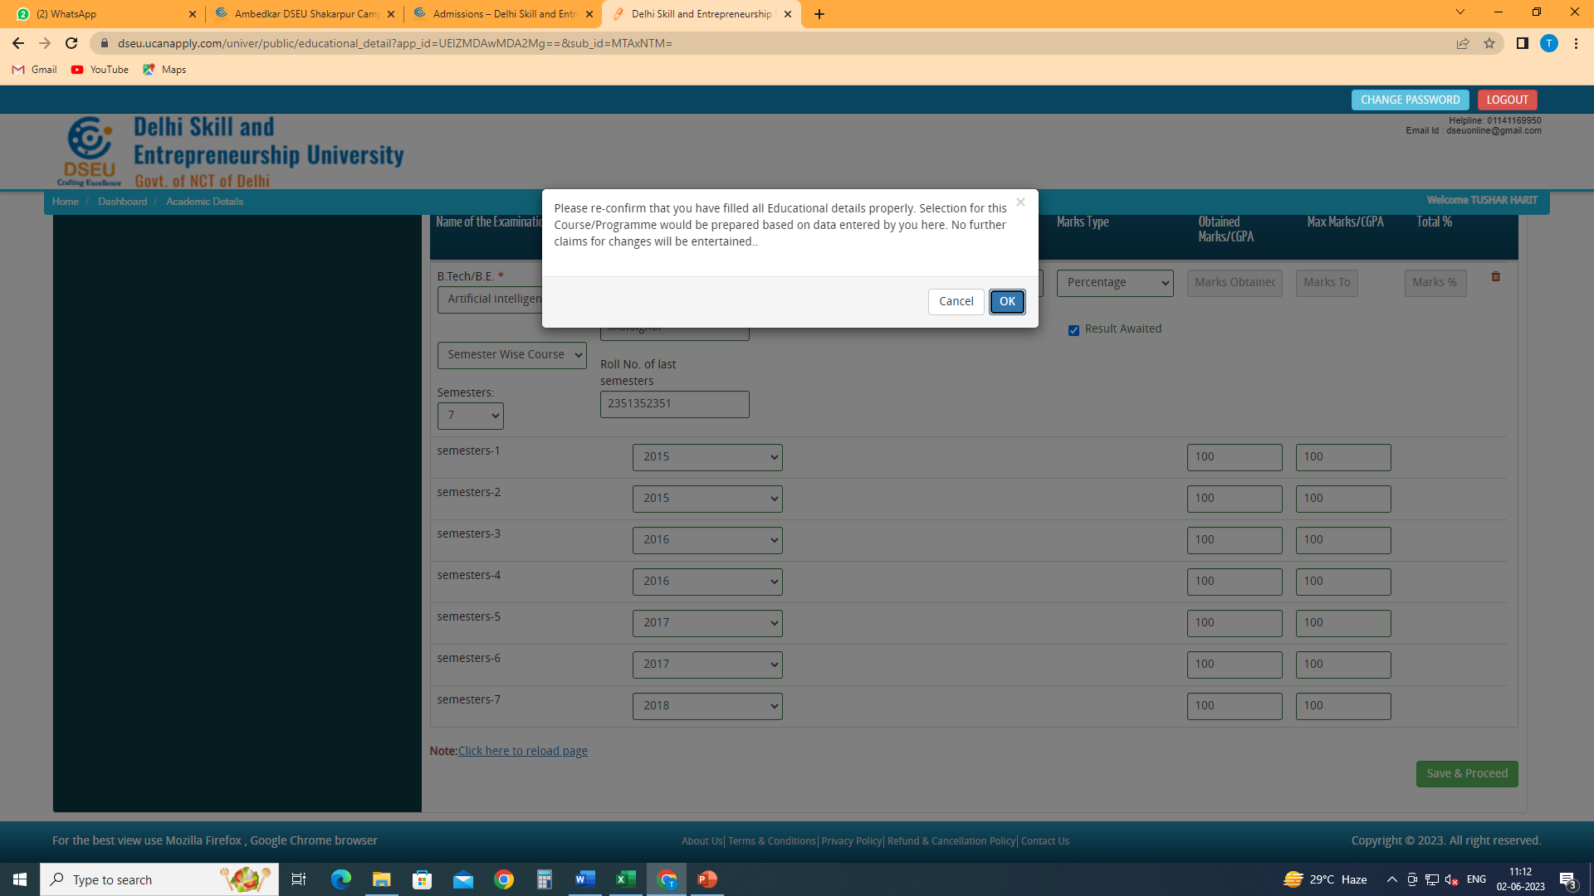
ok

Slide 28
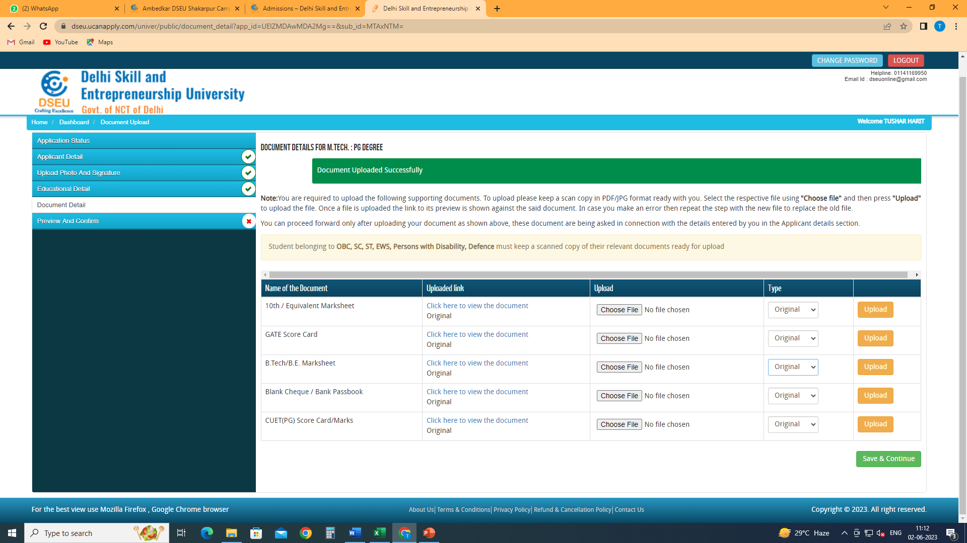
Upload clear and legible scanned copies of the required documents

Slide 29
Save and proceed.
Preview the form, check all the details carefully. Click on I confirm the above box and proceed to the payment gateway. Pay registration fee.
Take a printout of the final application form after payment and keep it handy for future reference.

