Slide 1
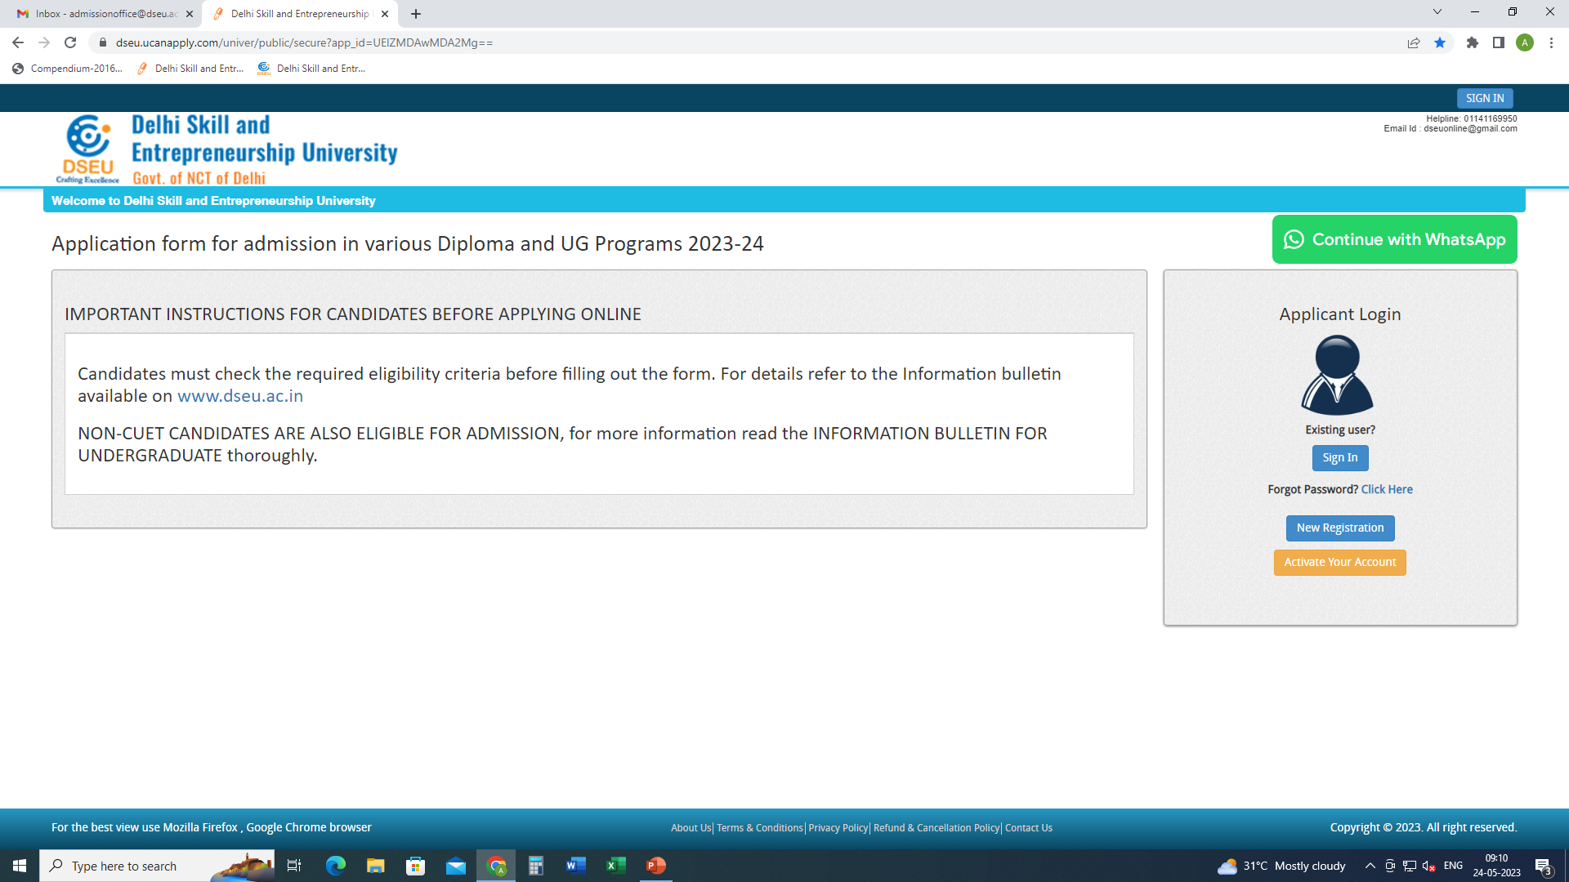
Step 1- Registration.
Enter Details.
Confirm
Step 2
Activate account.

Slide 2
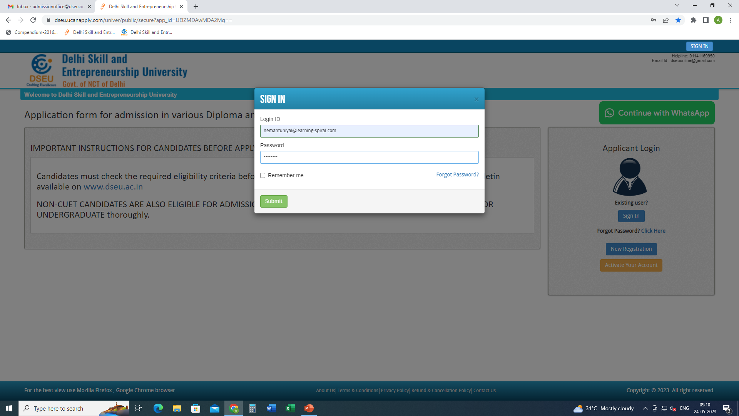
Step 3- Sign In.

Slide 3
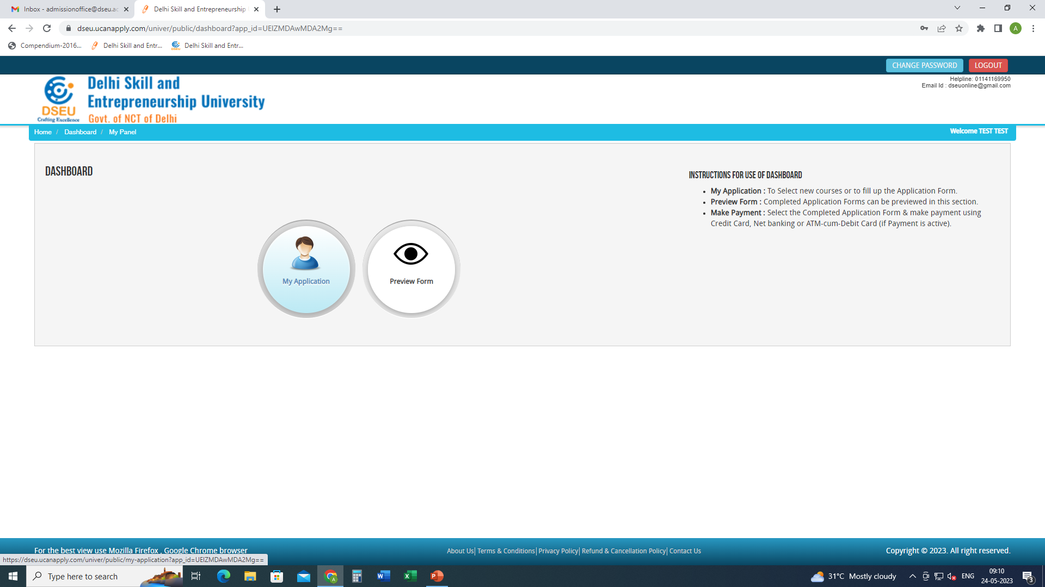
Step 4- My application

Slide 4
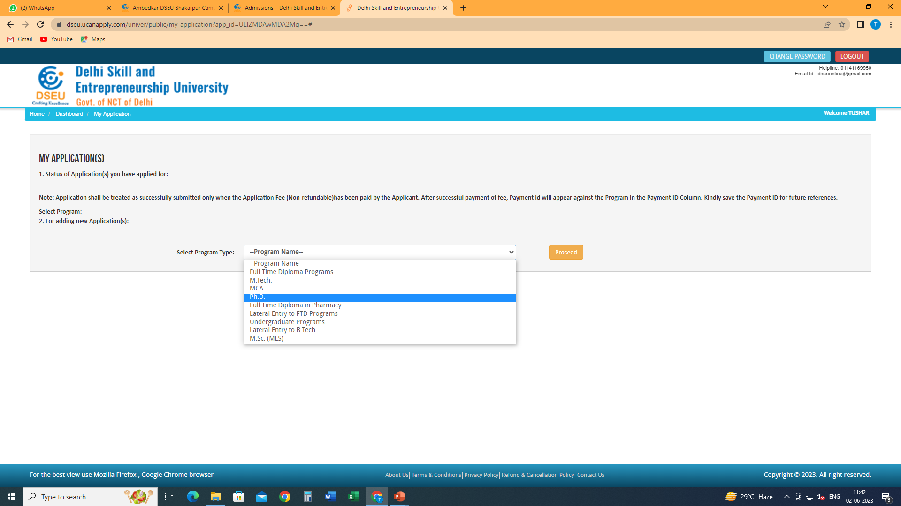
Select Program

Slide 5
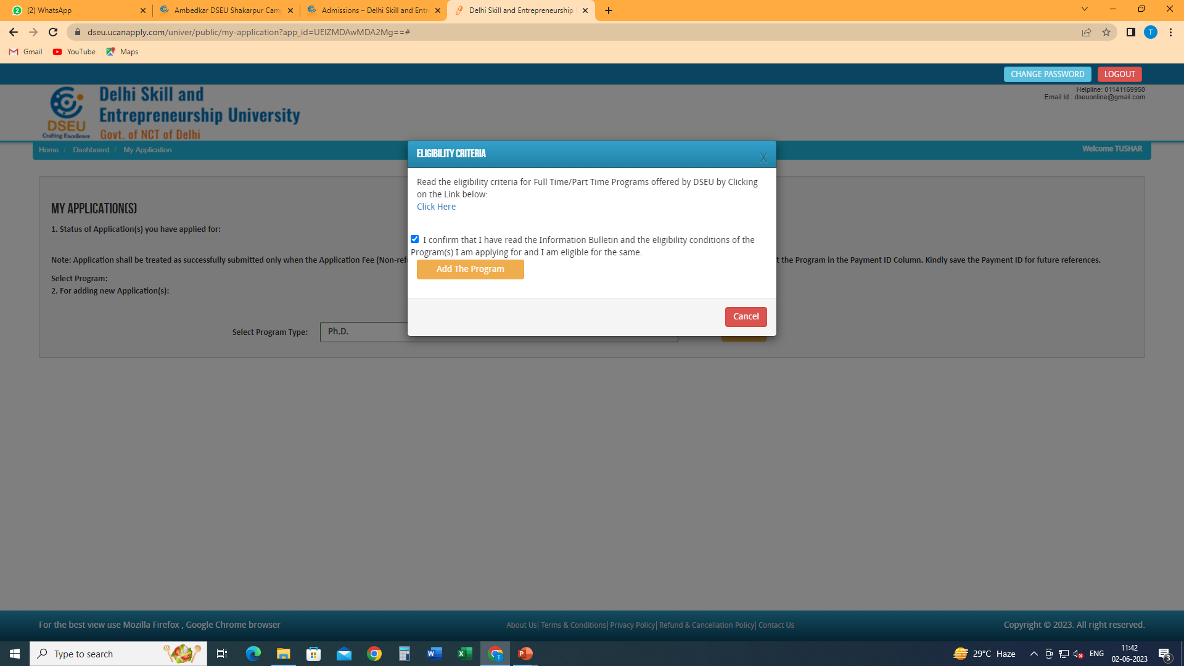
Check this box
Click on Add the Program
Click here to check the eligibility of MCA

Slide 6
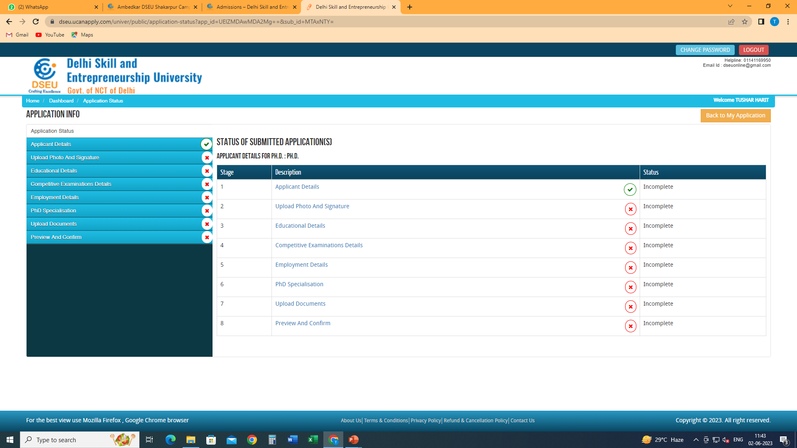
Click on applicant detail and fill the required information

Slide 7
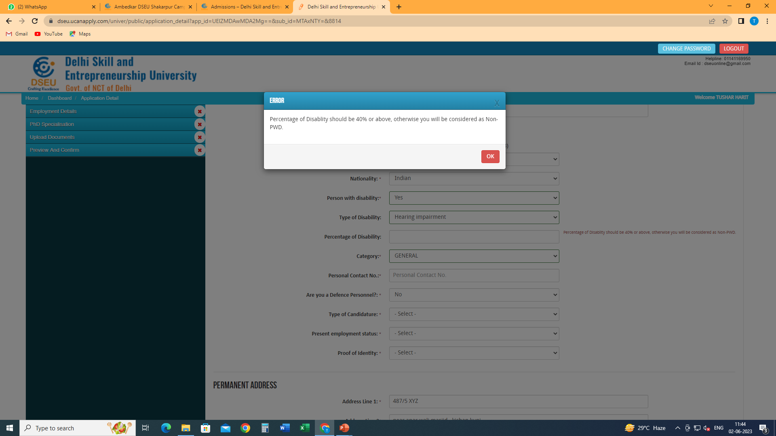
In case of persons with disability

Slide 8
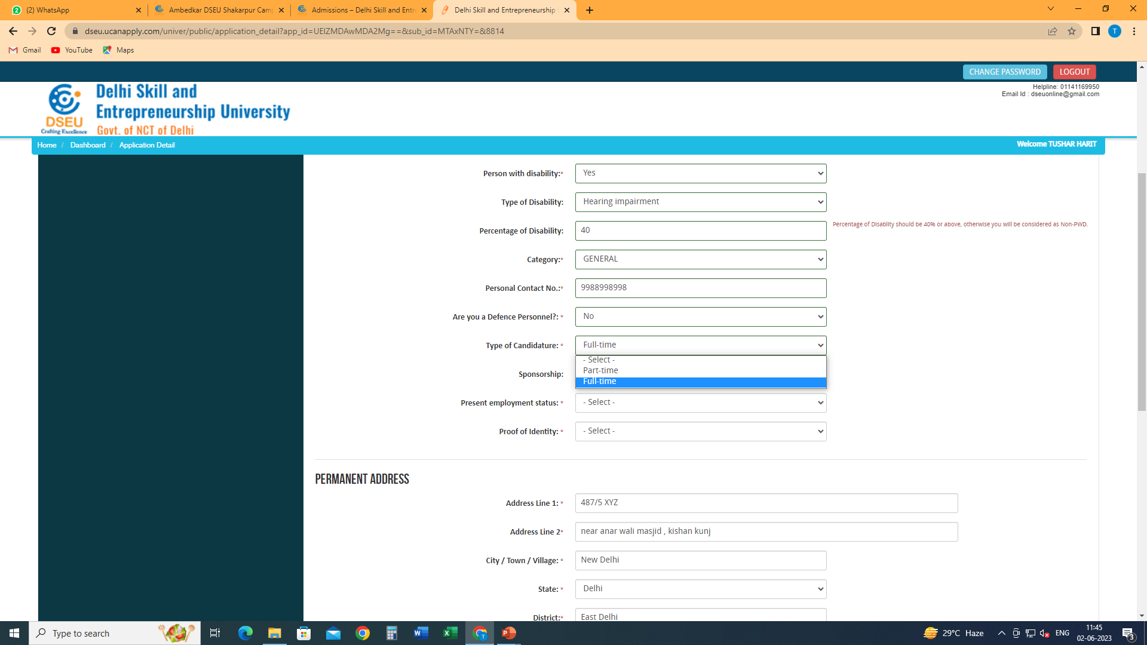
Fill in other information
Select type of candidature from the drop down

Slide 9
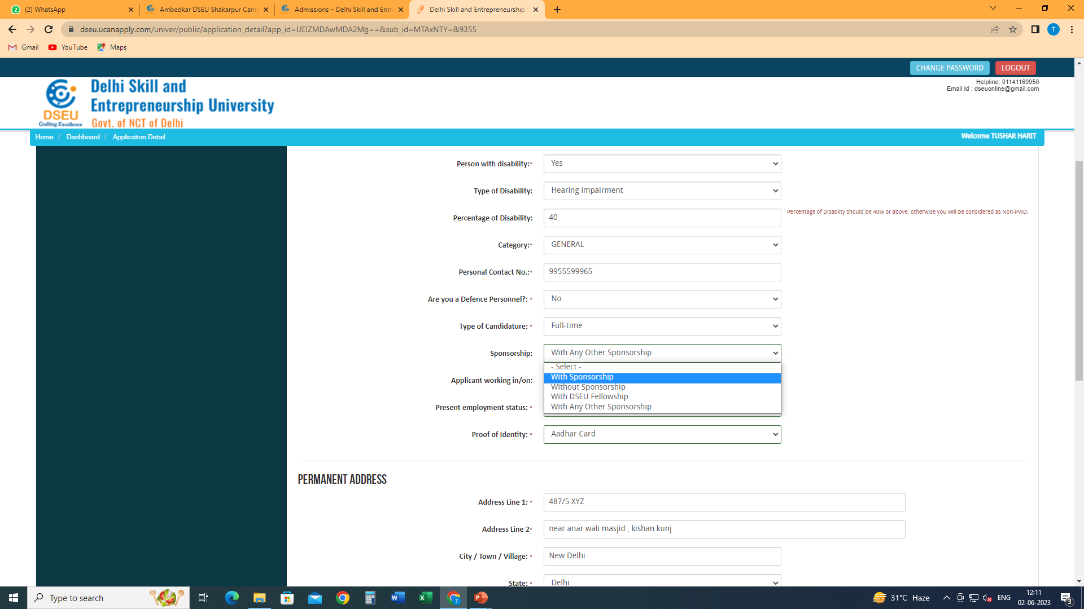
Select sponsorship from the drop down (if any)
In case of “with any other sponsorship”
Please refer to the information bulletin for more information regarding sponsorship

Slide 10
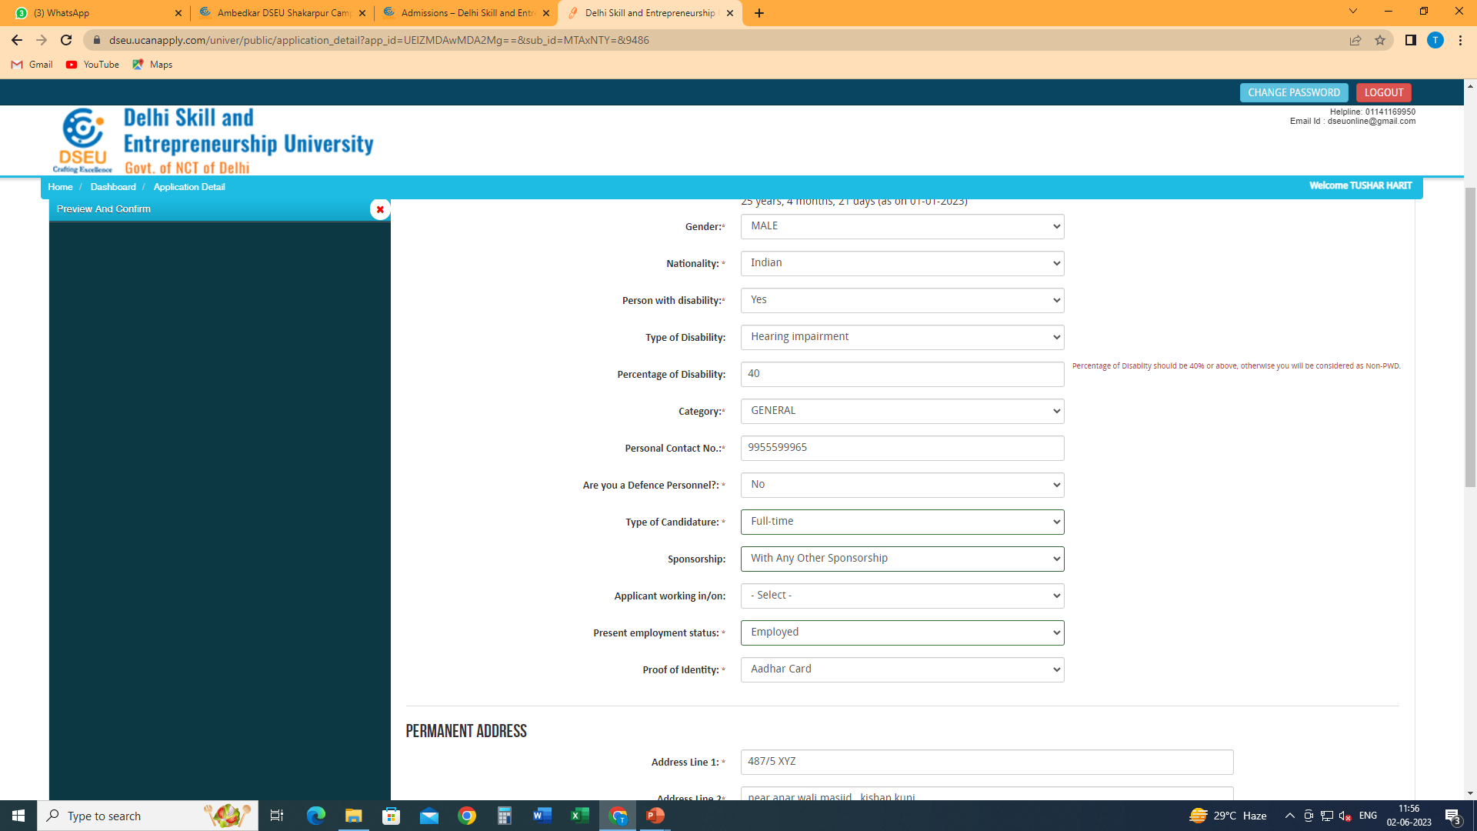
Give the information that is required by choosing in the drop down menu

Slide 11
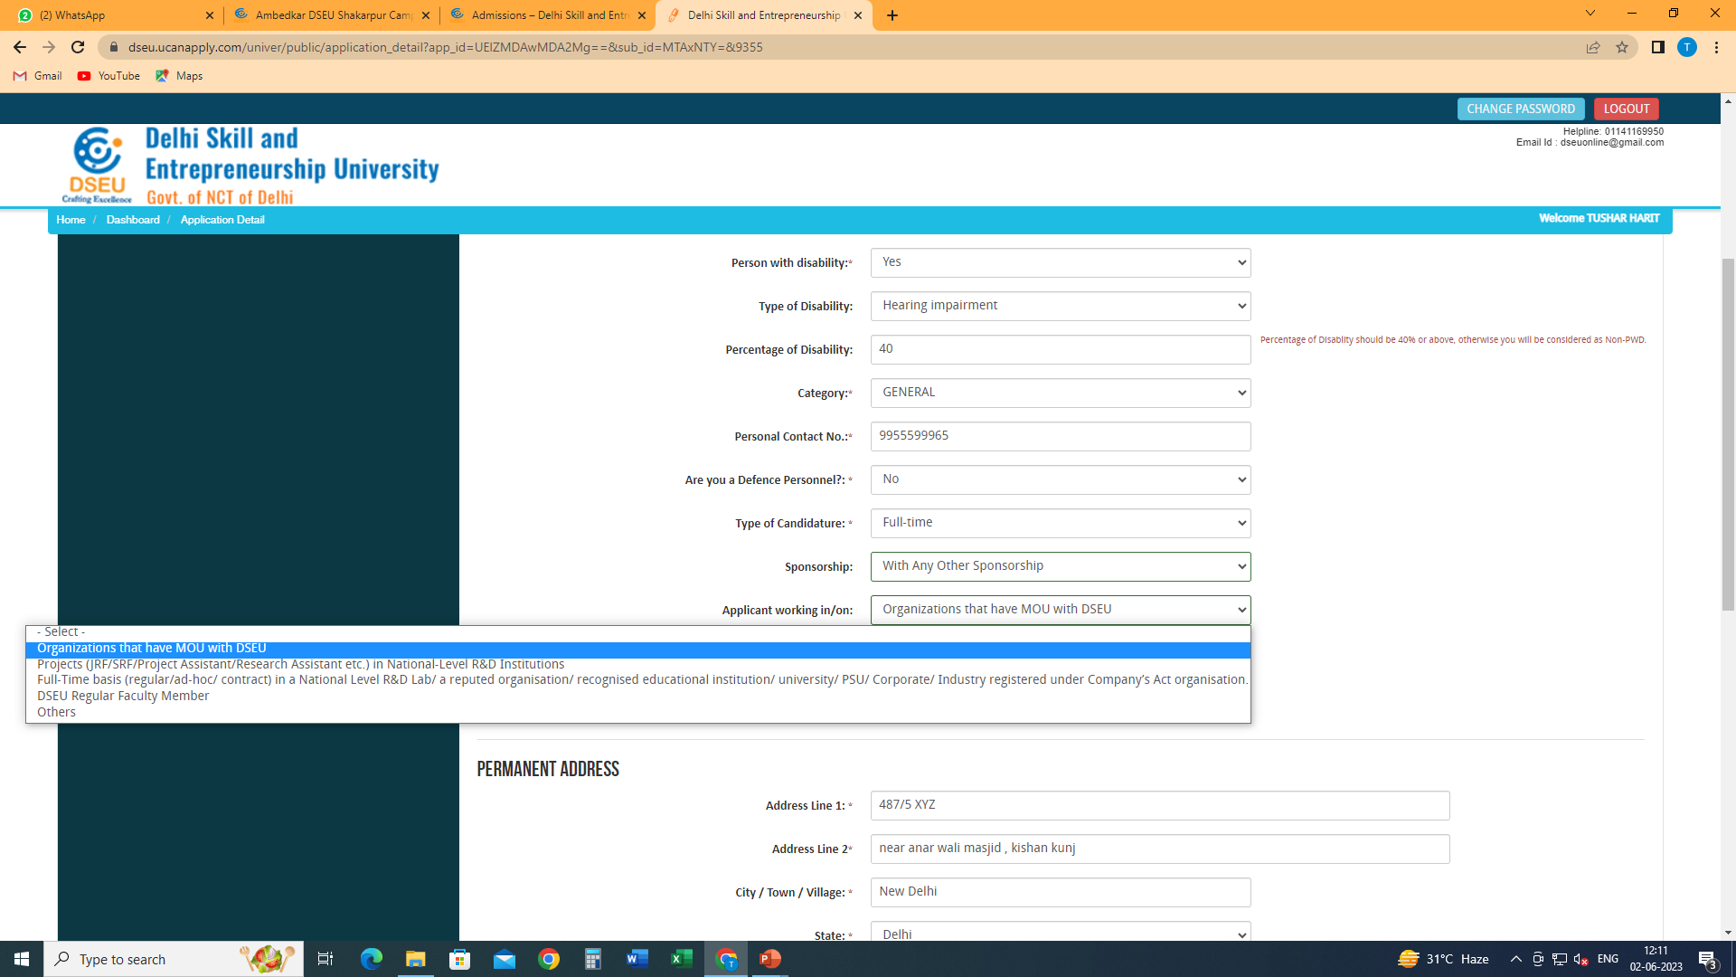

Slide 12
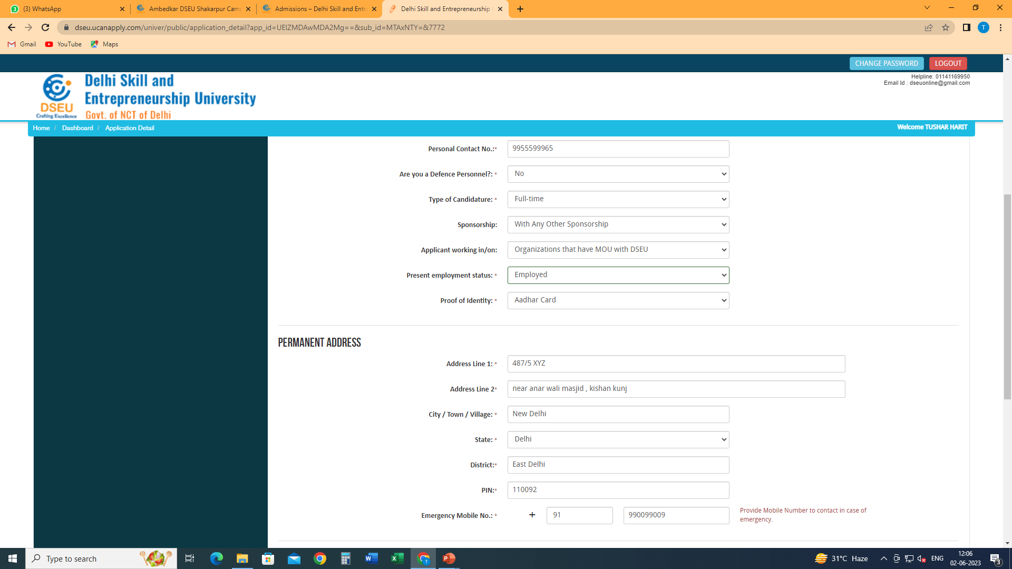
Fill in other details
And click on save and proceed

Slide 13
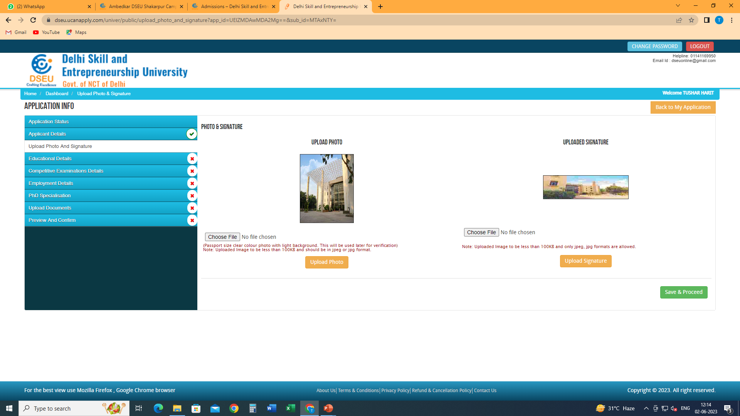

Slide 14
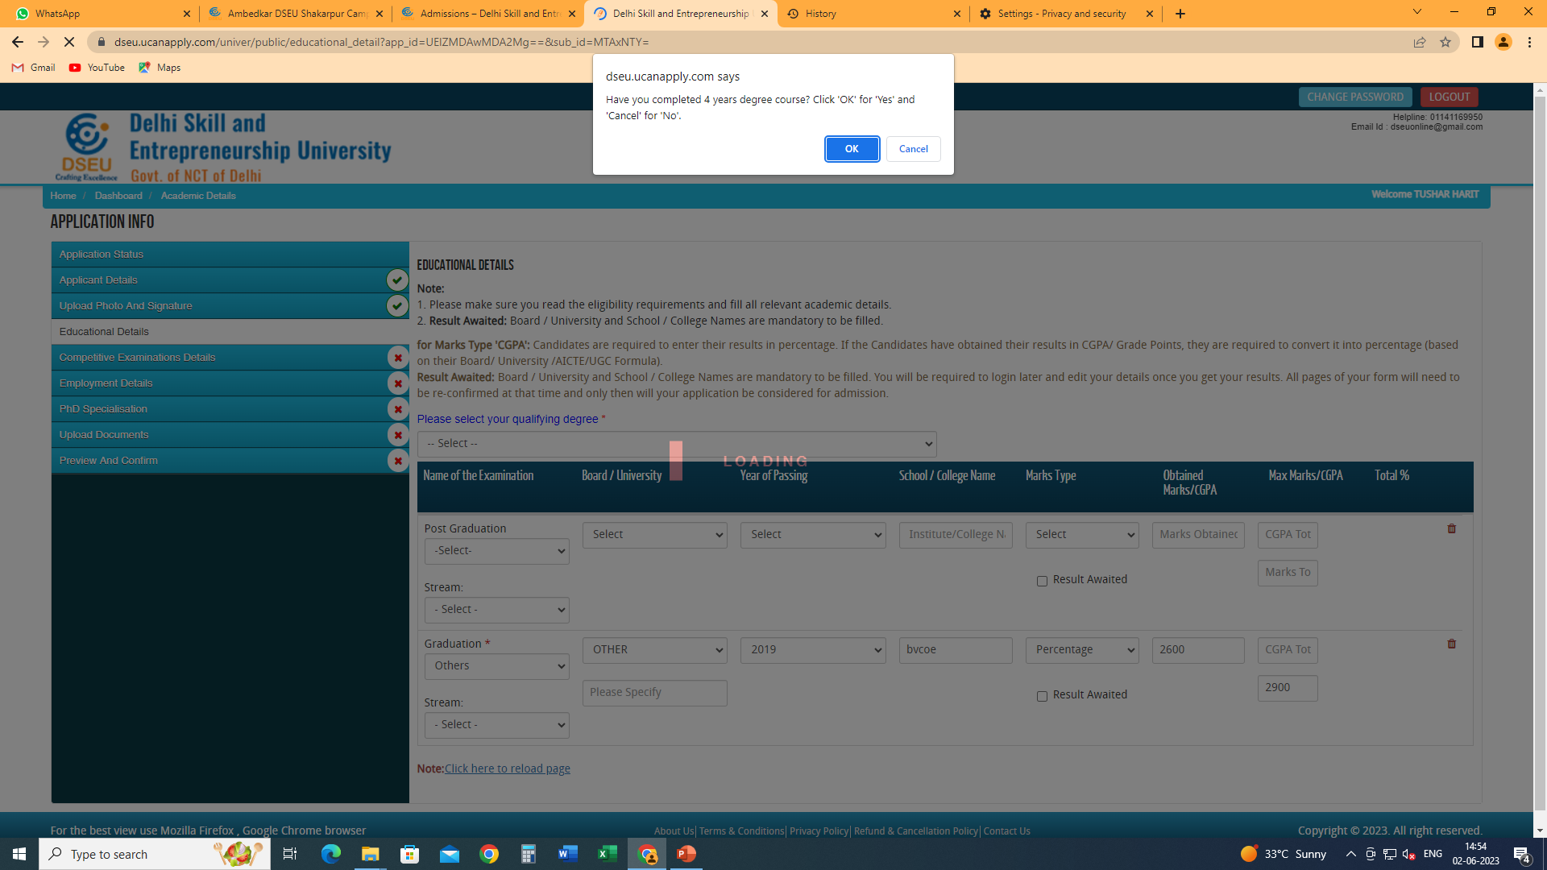
Please proceed as the case may be

Slide 15
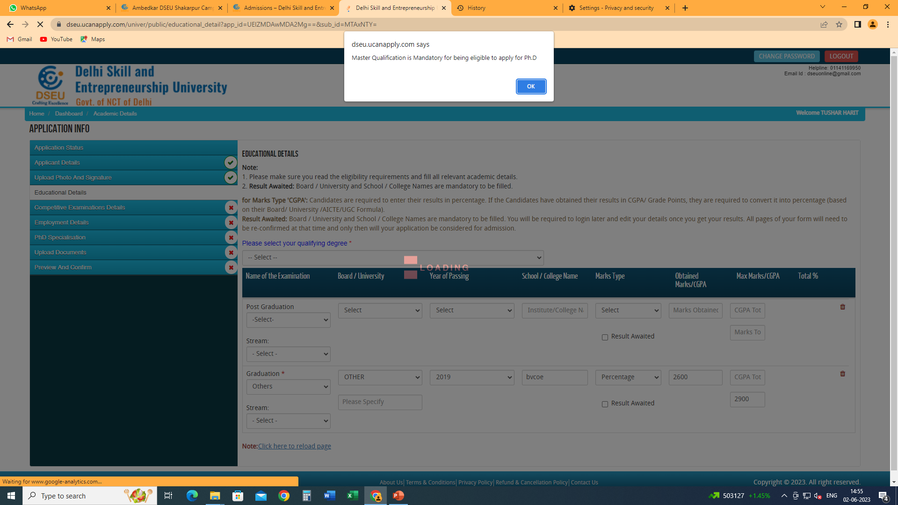

Slide 16
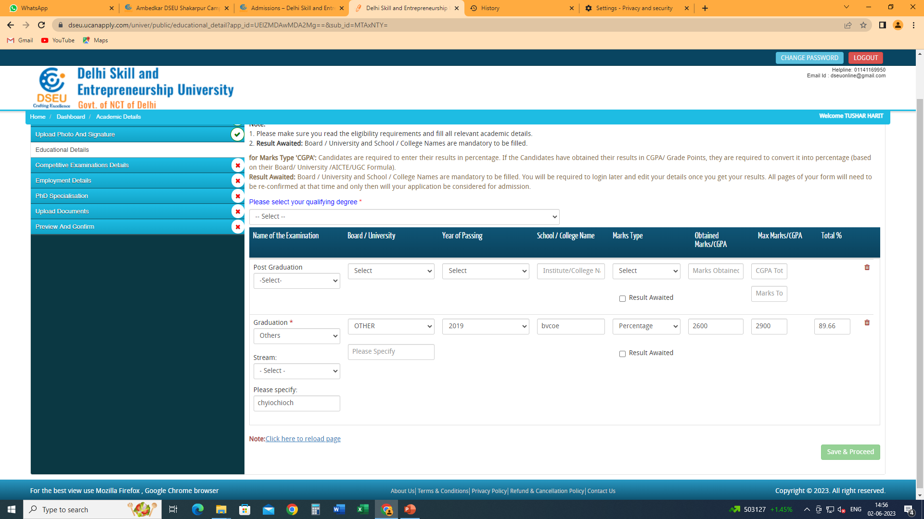
Select your qualifying degree- 4 year UG or PG and give details accordingly
Please refer to information bulletin for eligibility criteria and more information

Slide 17
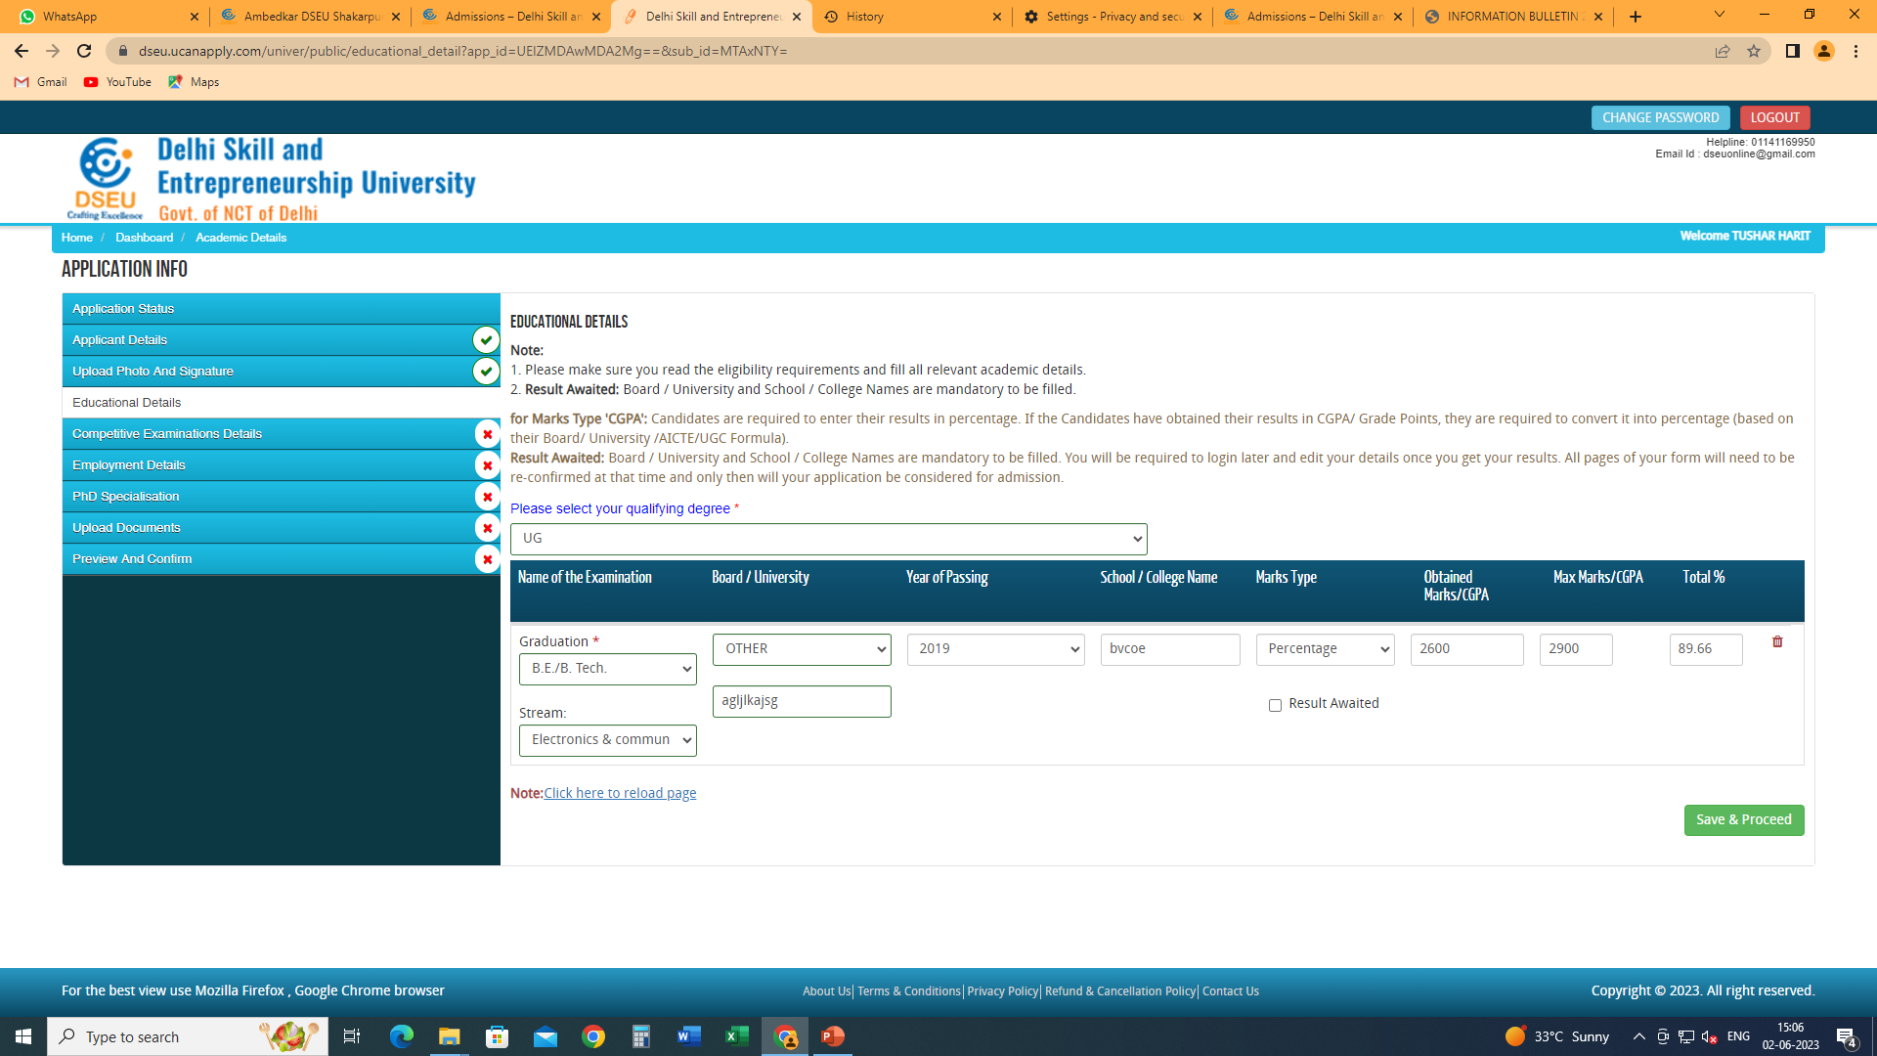
If your program or university does not appear in the drop down menu then select others and specify the same.
Then save and proceed

Slide 18
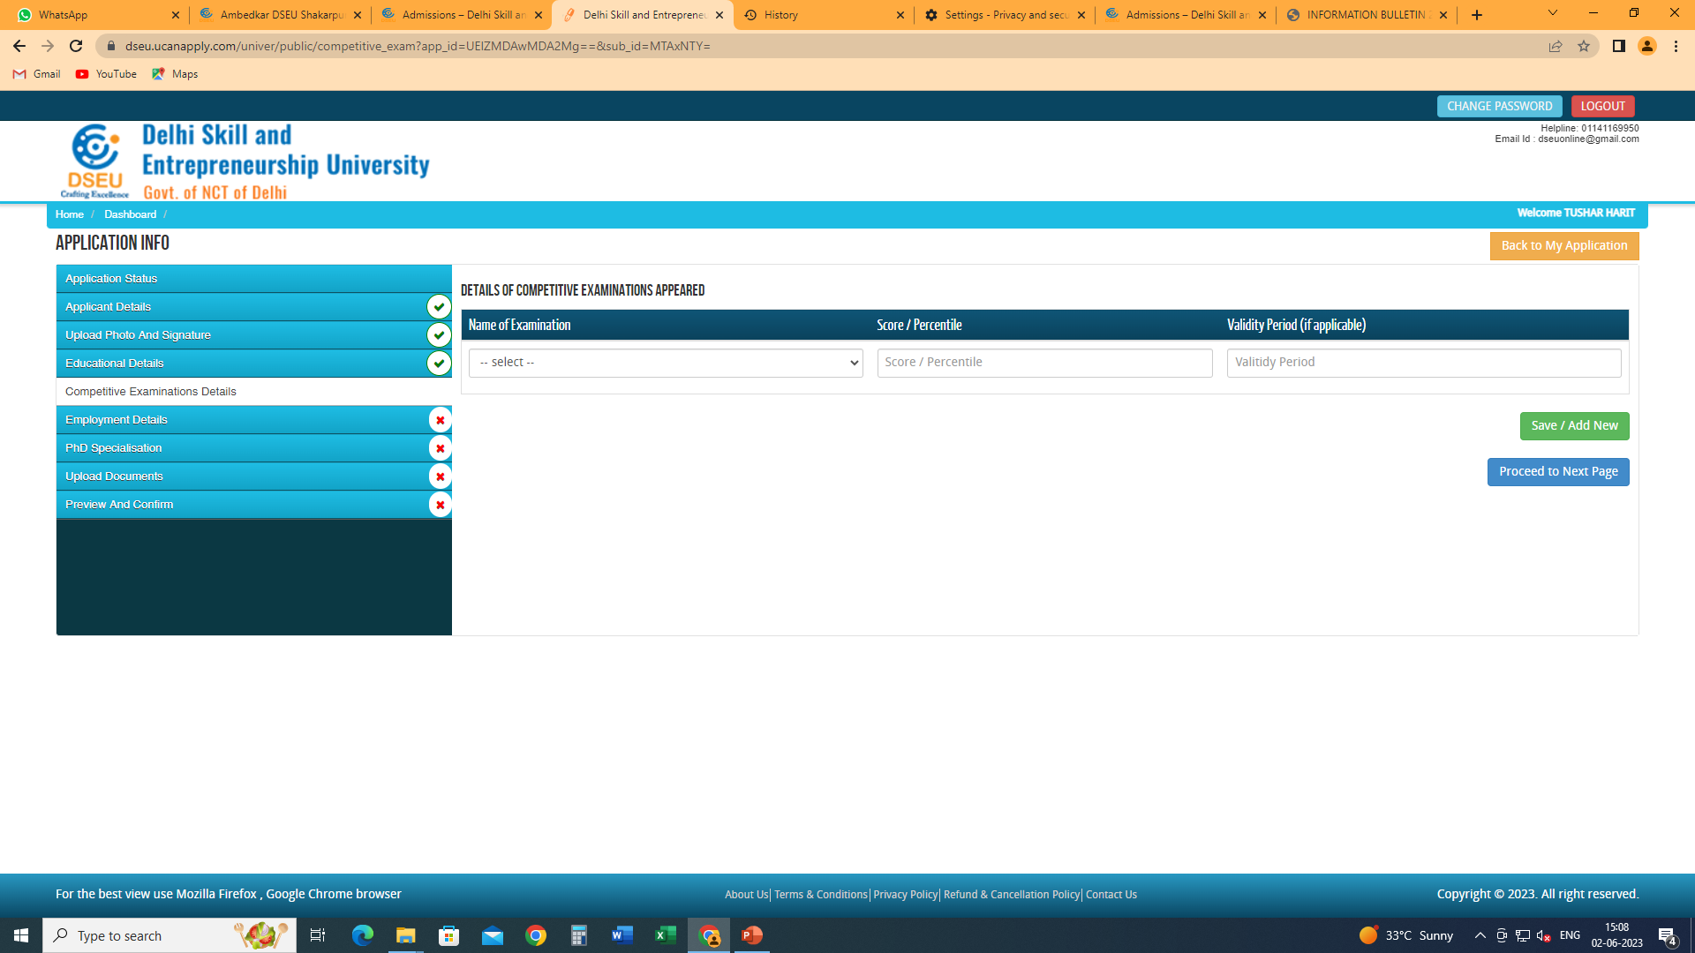
Give details of the competitive examinations that you appeared in
Click on the “Save/Add New” to add a new row.
Then click on proceed to next page.

Slide 19
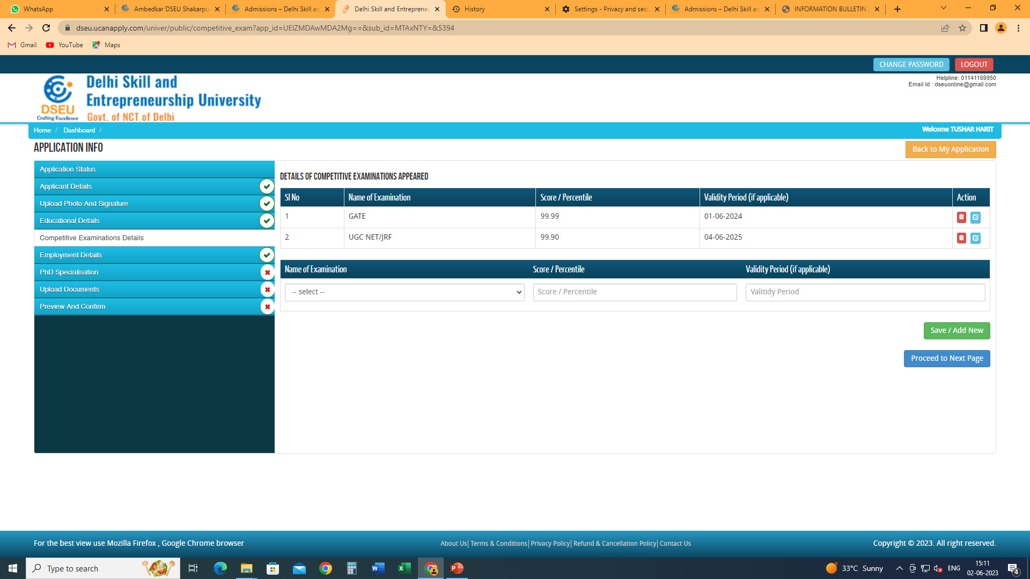
Proceed to next page

Slide 20
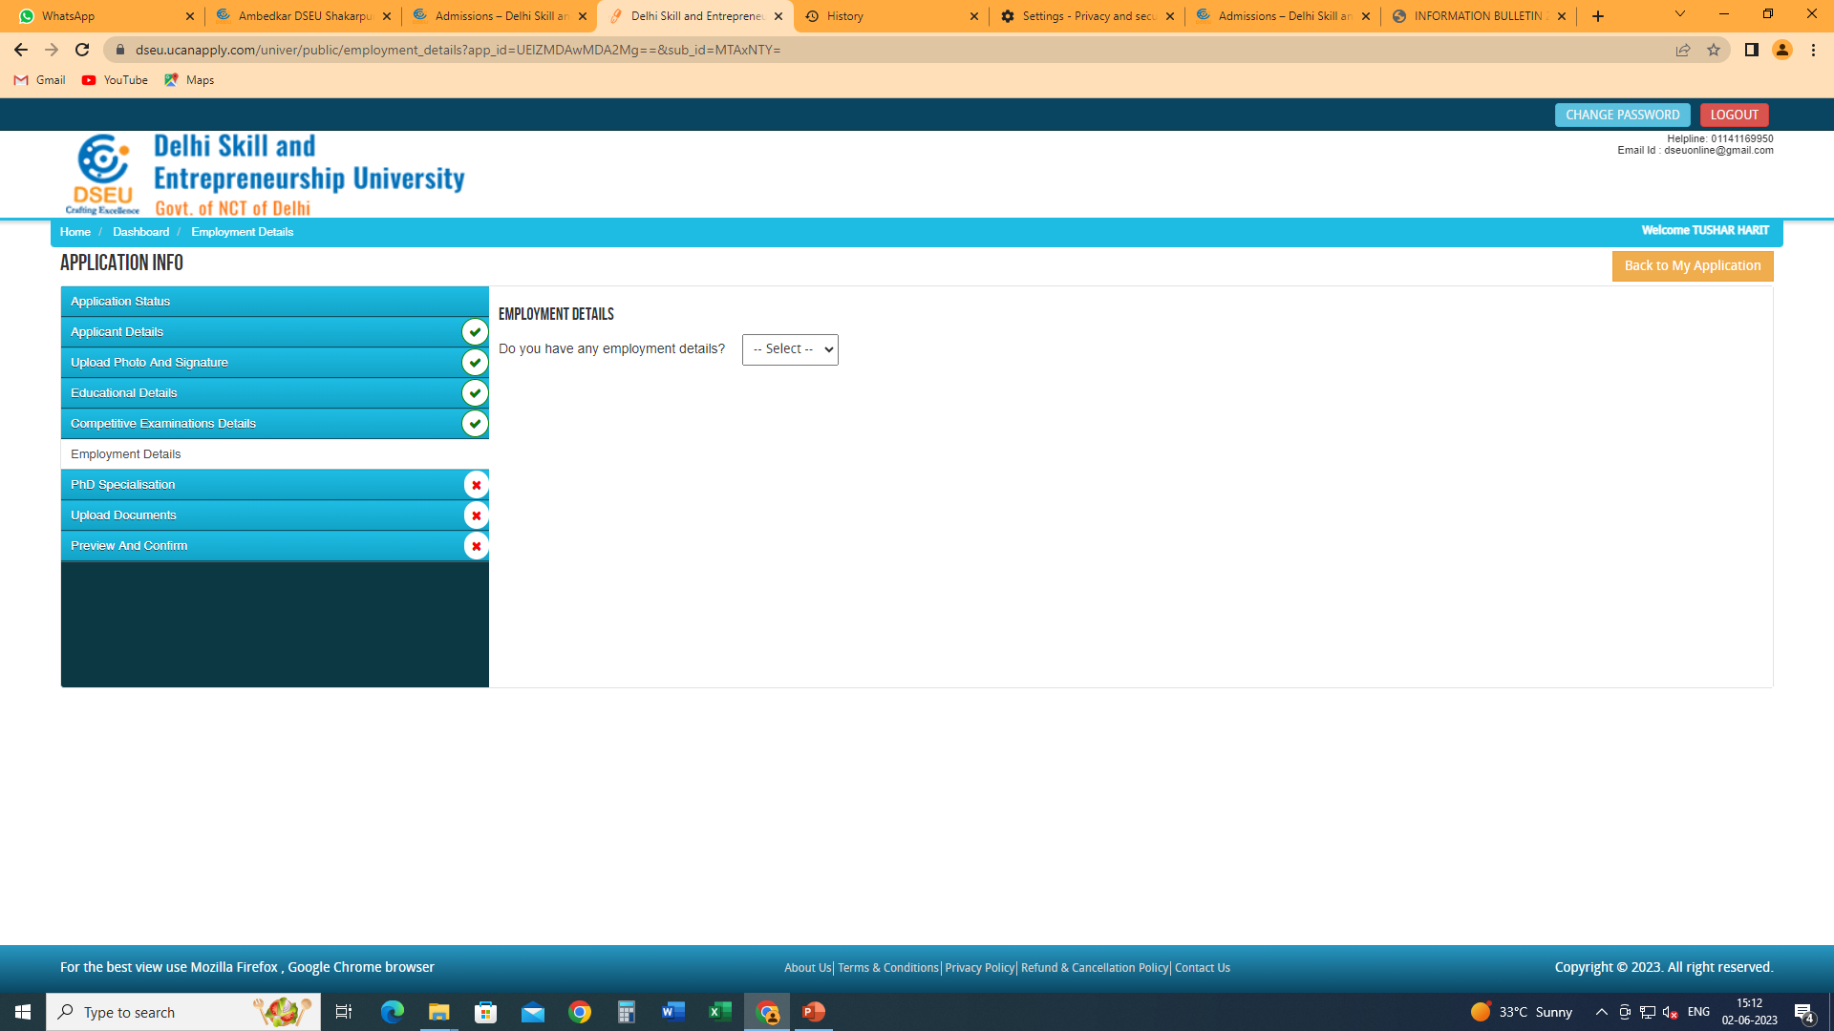
Give employment details if applicable.

Slide 21
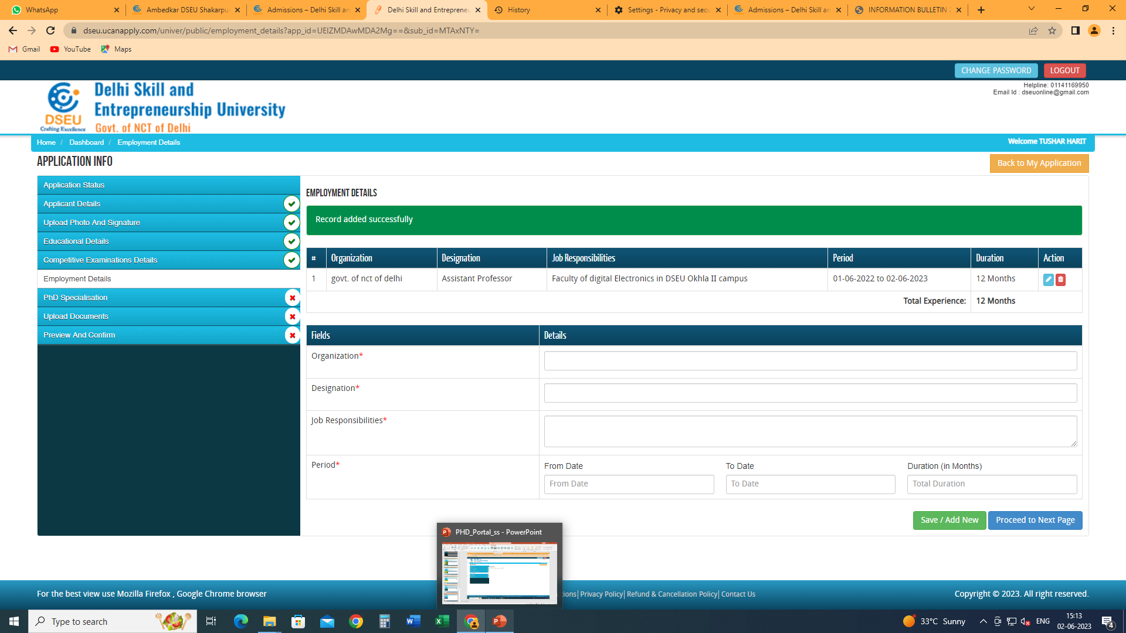
Click on save / add new to add more
Finally click on proceed to next page

Slide 22
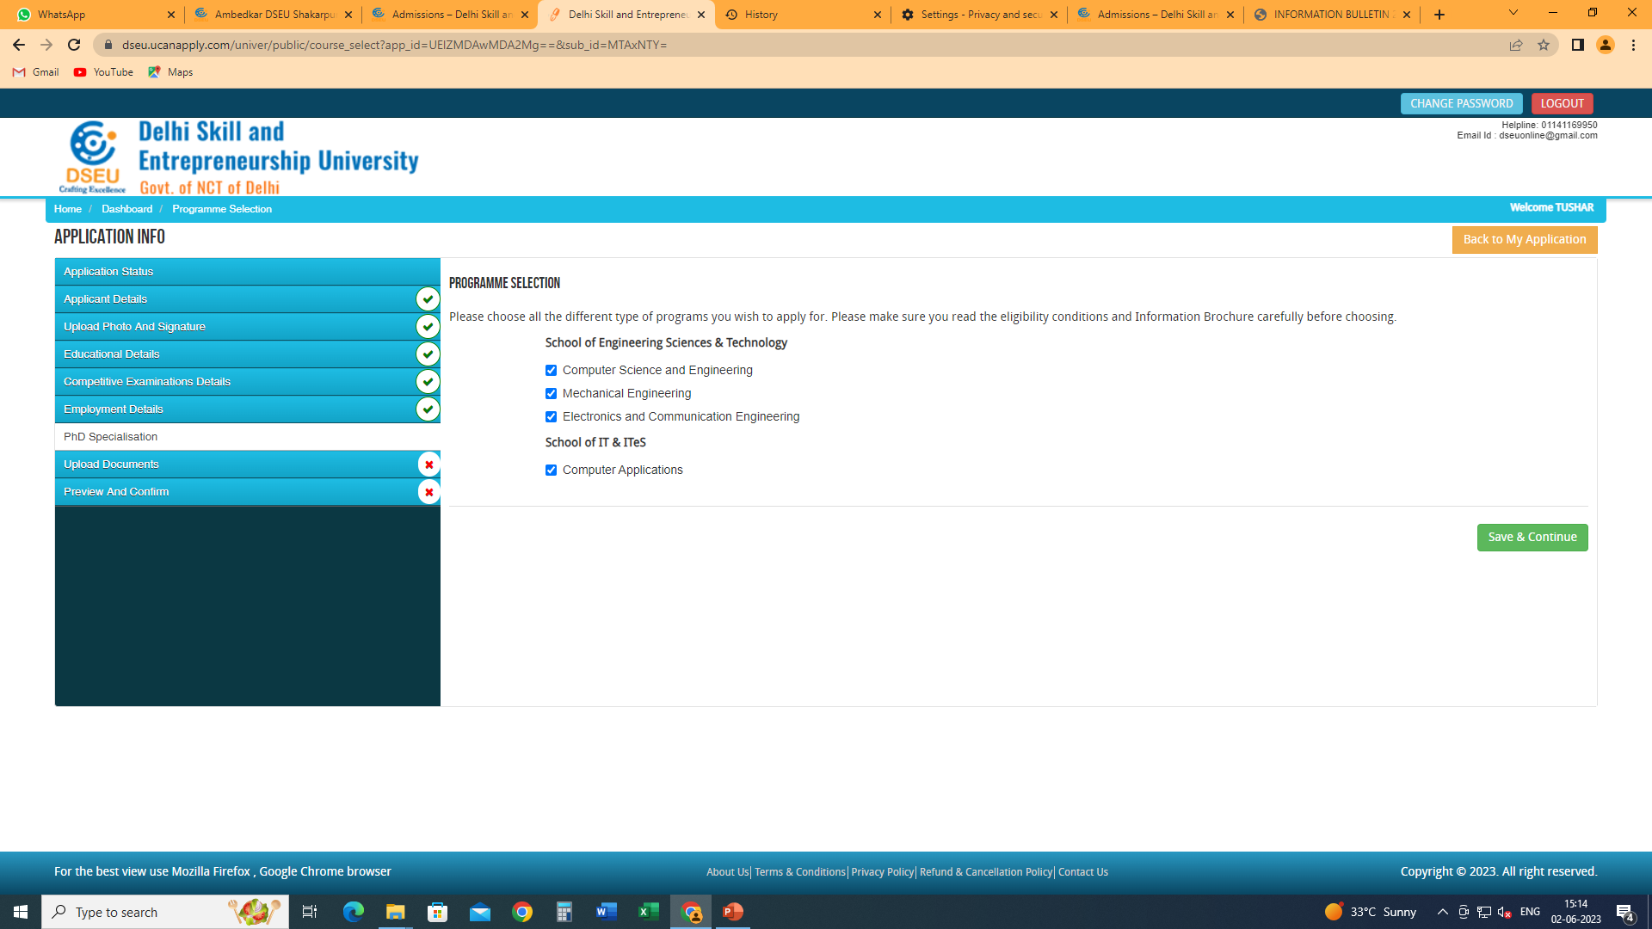
Choose the type of program you wish to apply for.
You can choose all or only one, provided you meet the minimum eligibility criteria for the program you have chosen. The eligibility criteria is mentioned in the Information Bulletin. Refer to it.

Slide 23
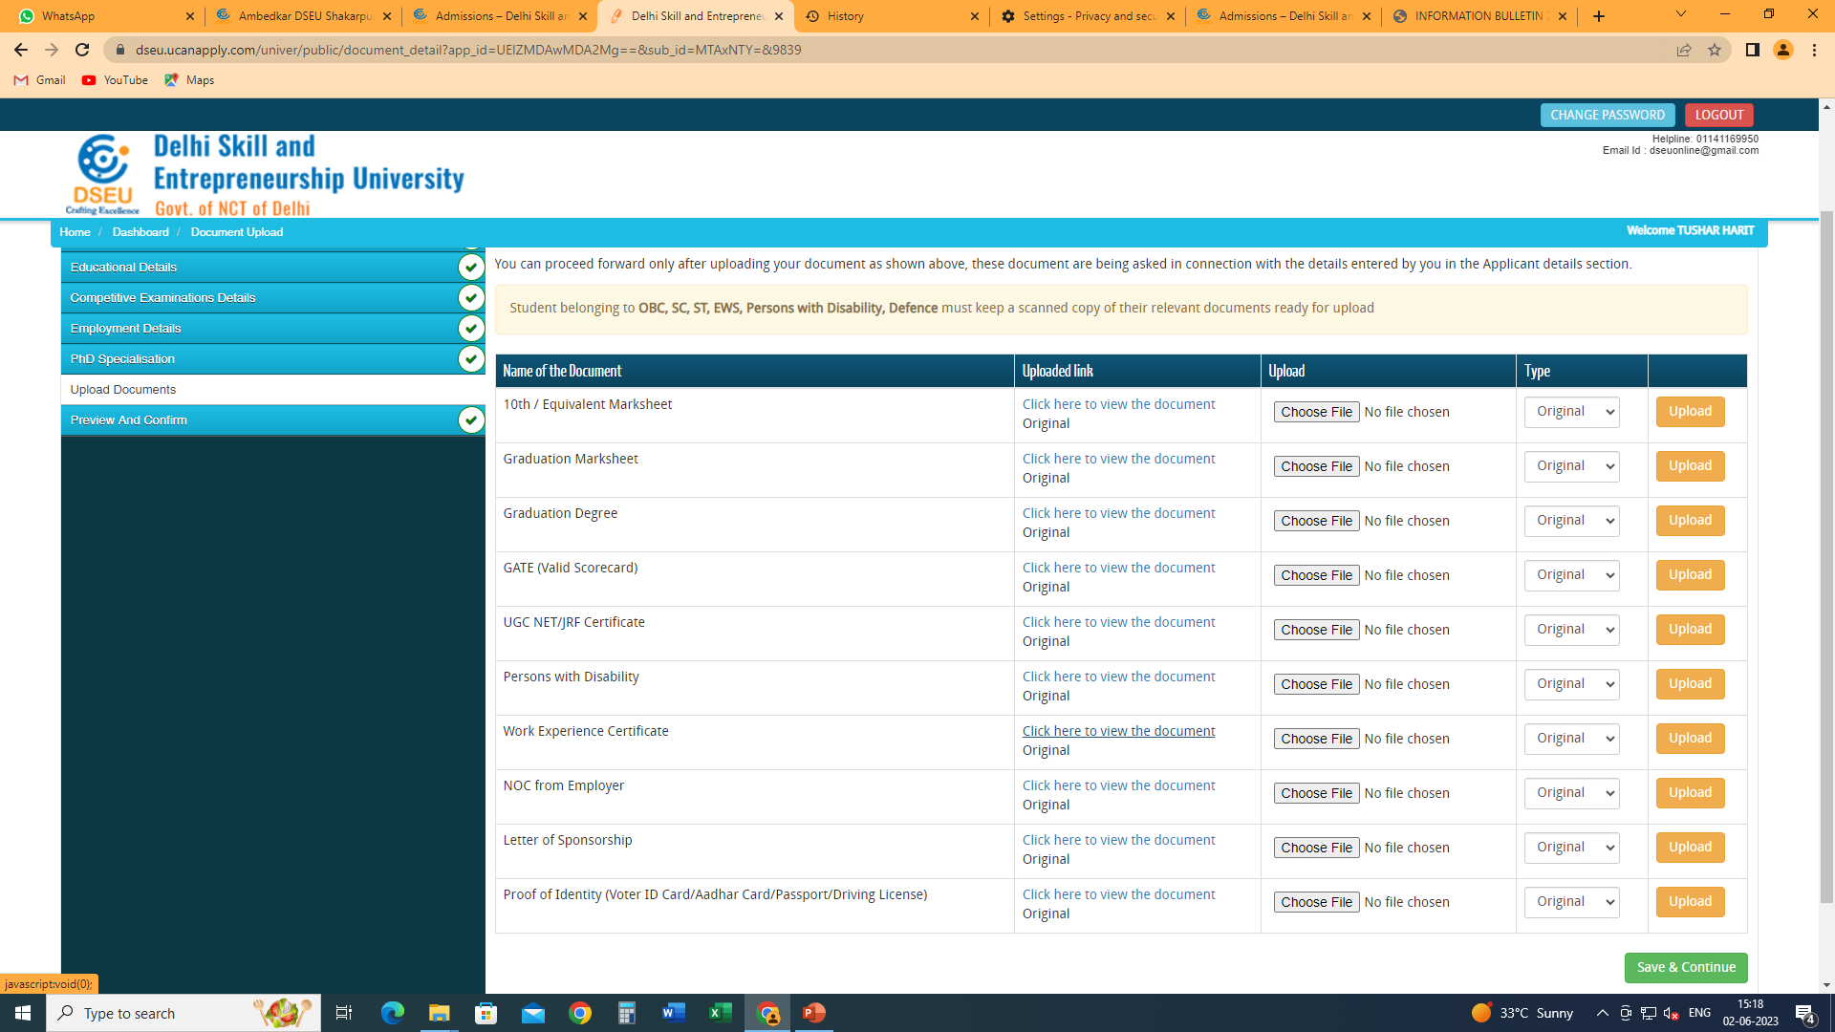
Upload clear and legible scanned copies of all the required documents

Slide 24
Click on save and continue Preview the application form and check details carefully. Submit the form and pay the fee. Save a copy of the final application form for any future reference.

