Slide 1
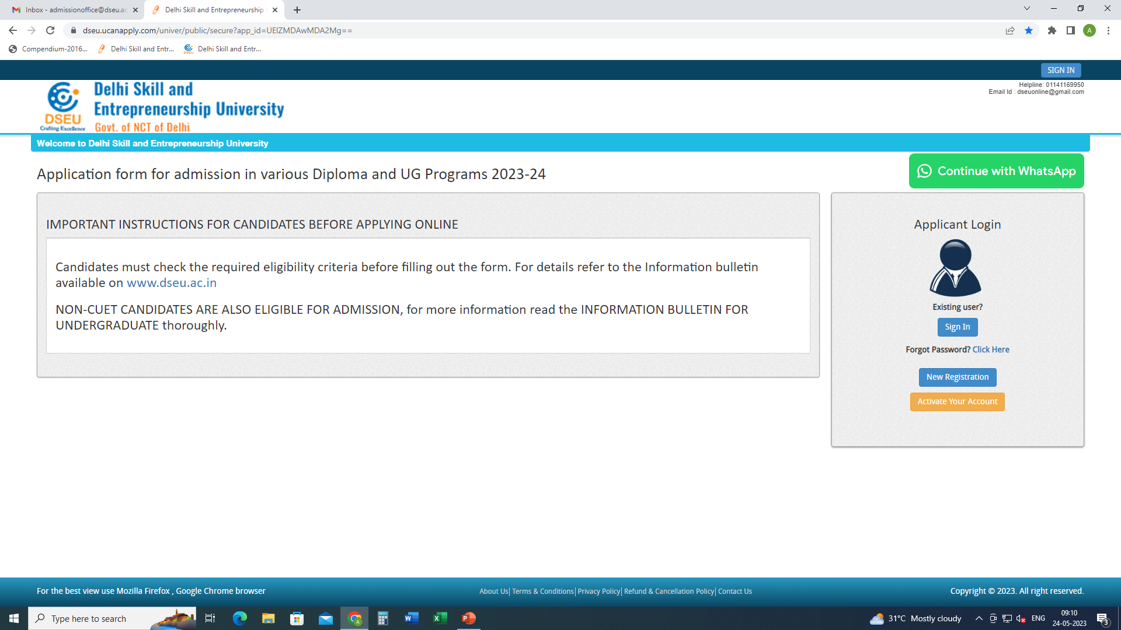
Step 1- Registration.
Enter Details.
Confirm
Step 2
Activate account.

Slide 2
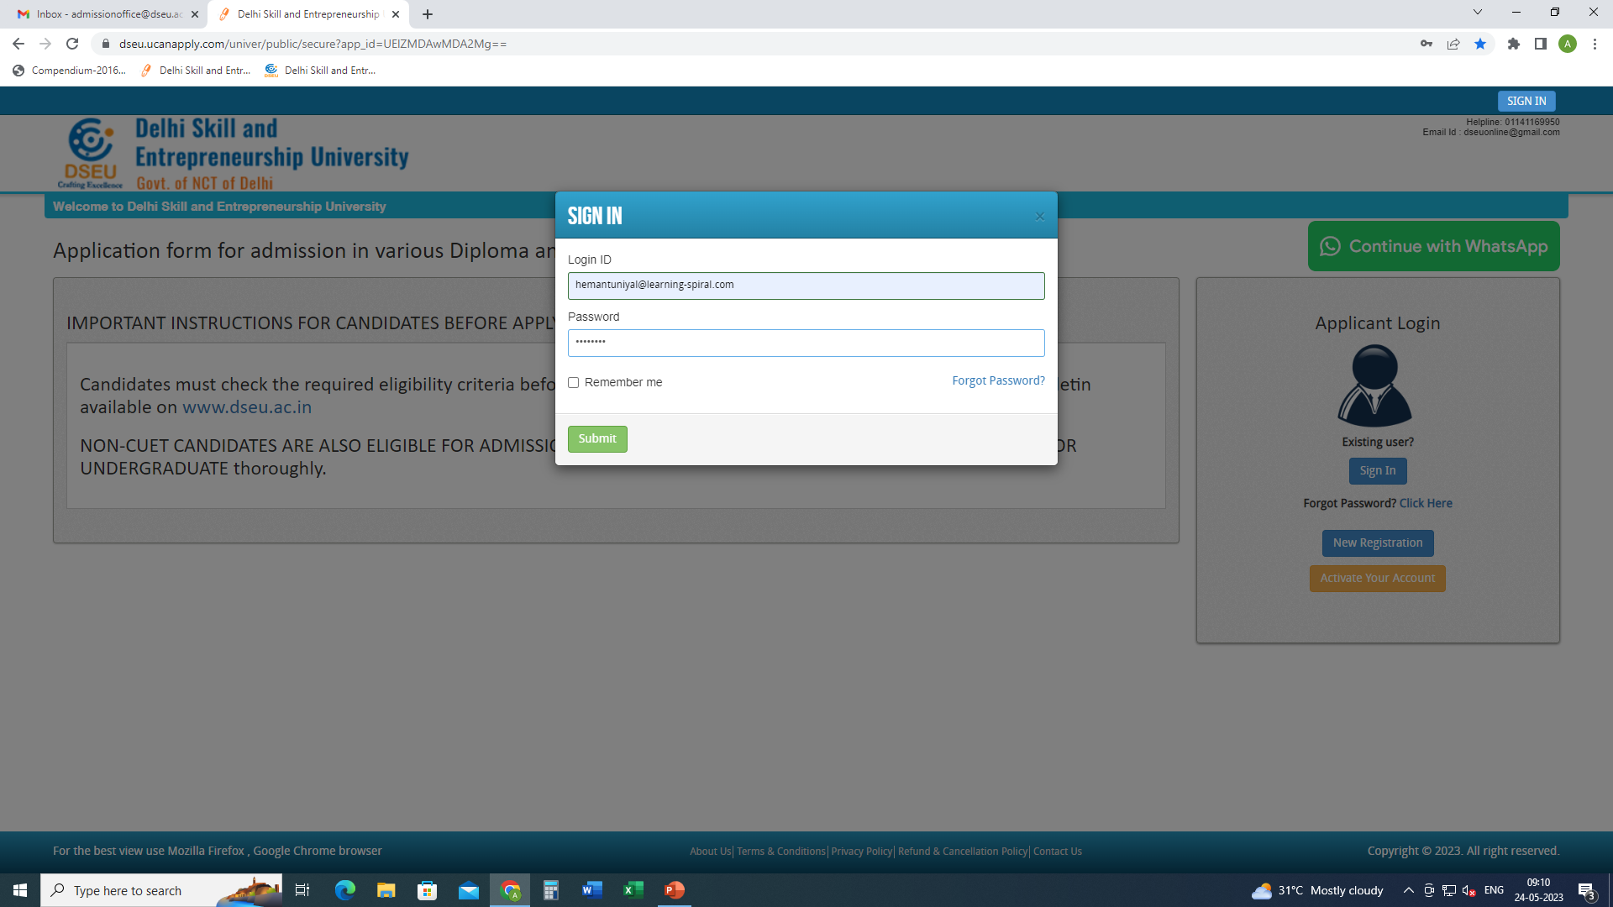
Step 3- Sign In.

Slide 3
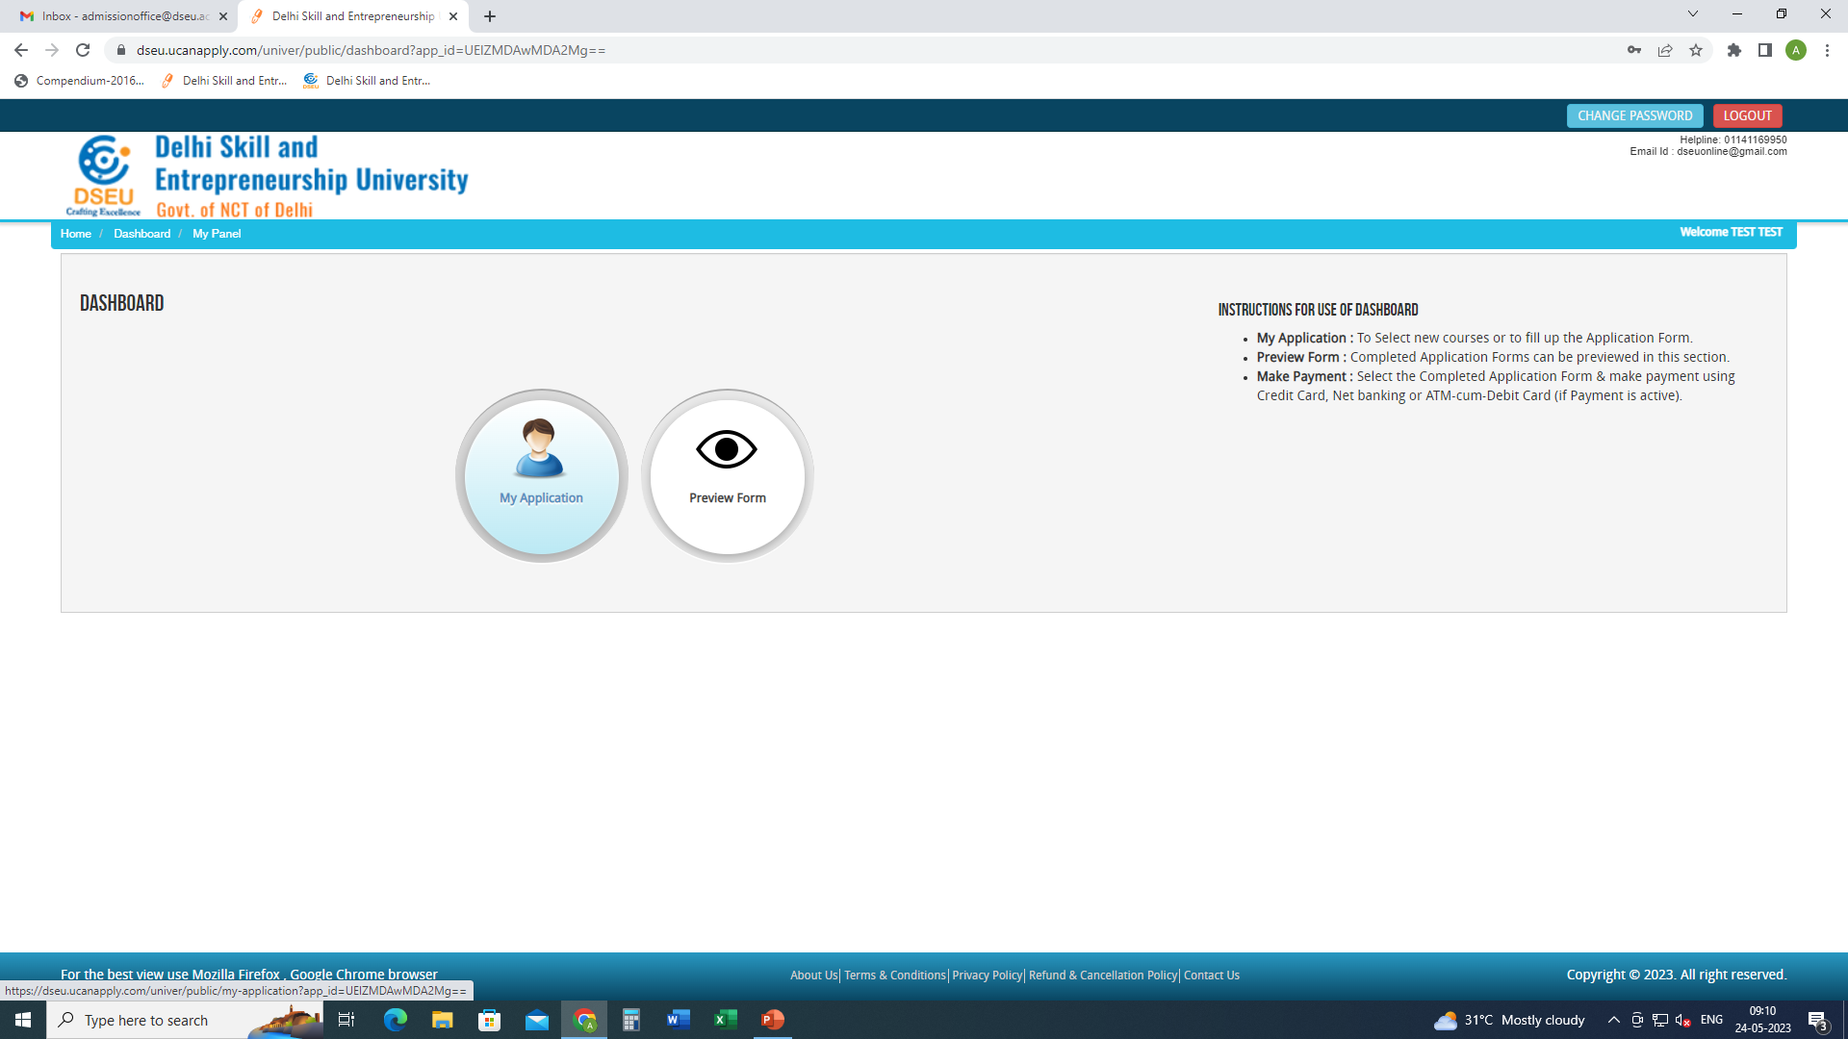
Step 4- My application

Slide 4
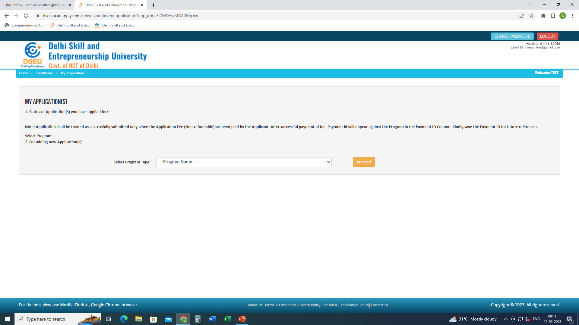
Select Program

Slide 5
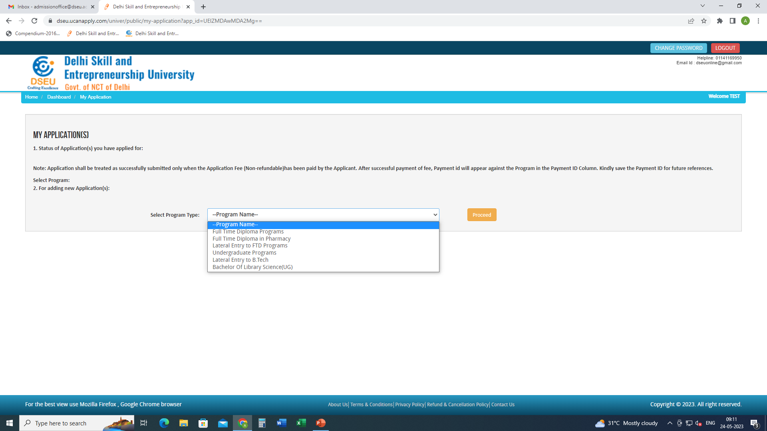

Slide 6
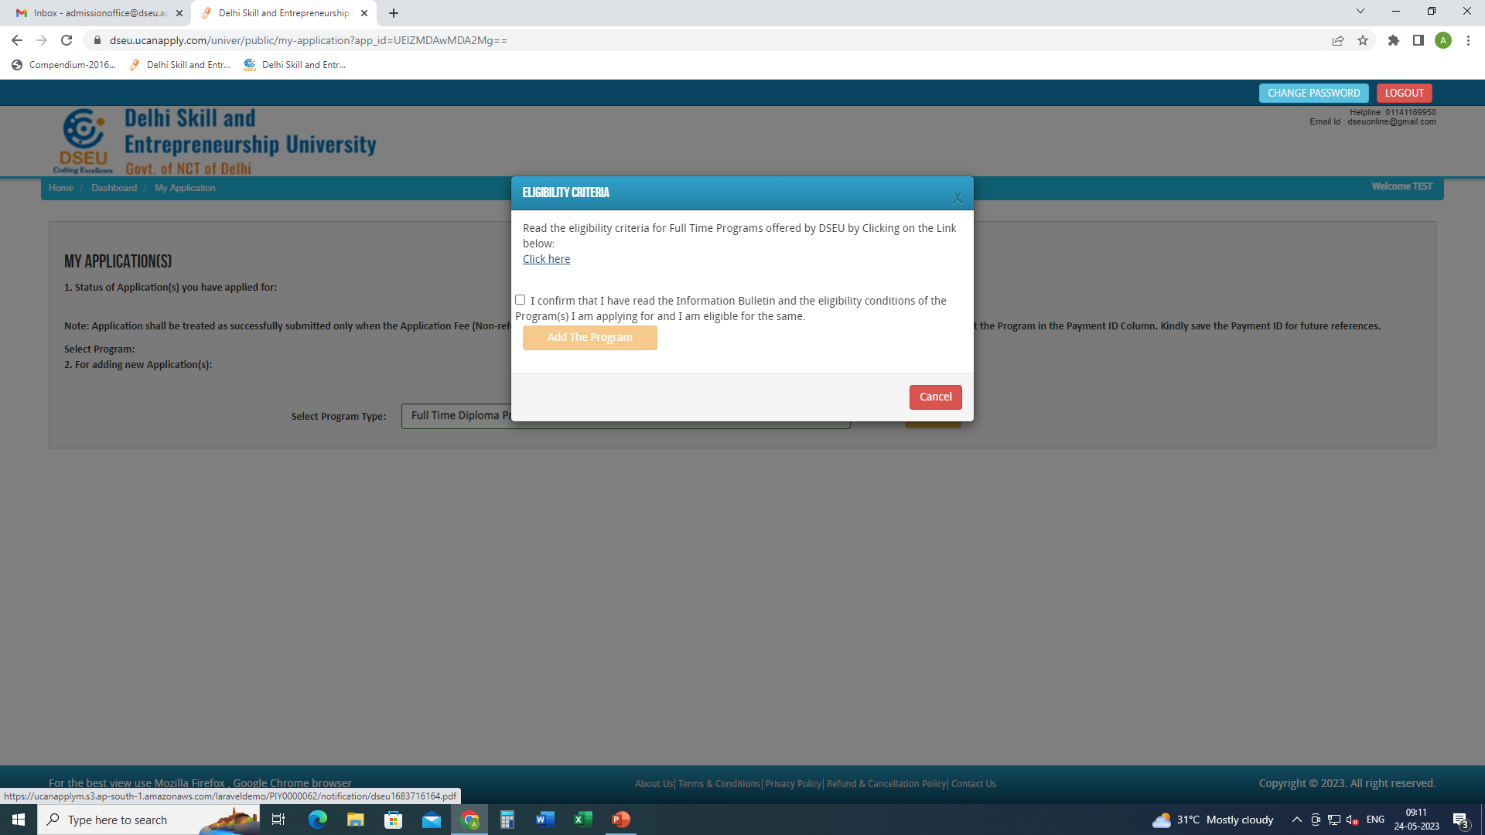
Click to check the eligibility conditions for the program selected.
Check the box
And
Add the program
Confirm and add the program

Slide 7
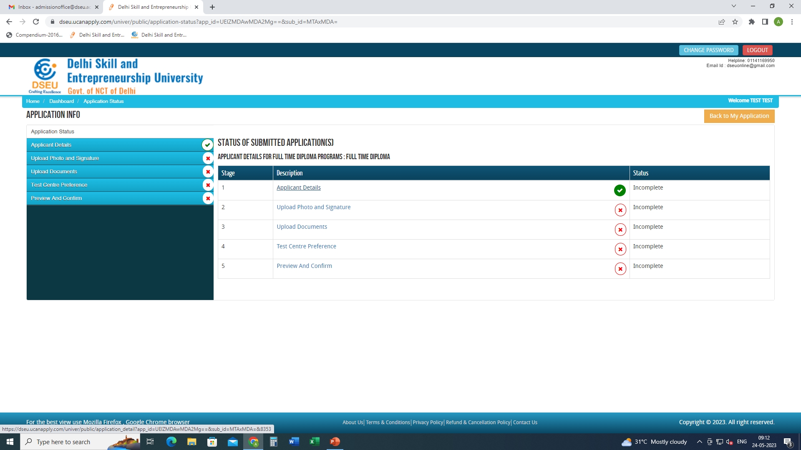
Click applicant details and fill the required information.

Slide 8
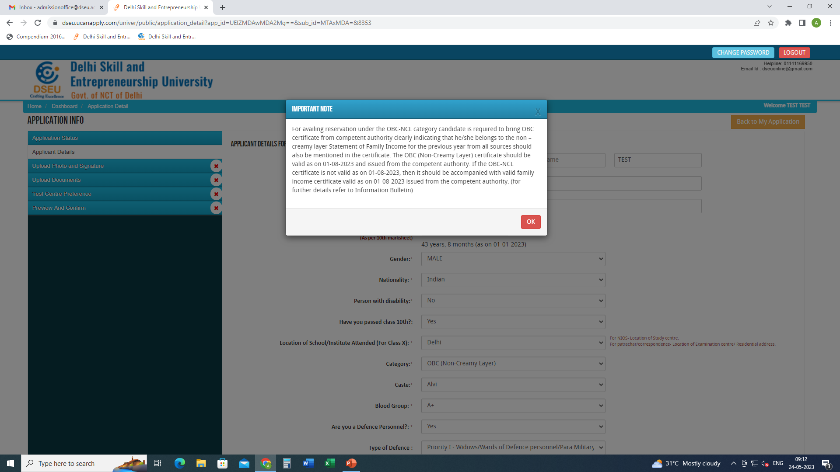

Slide 9
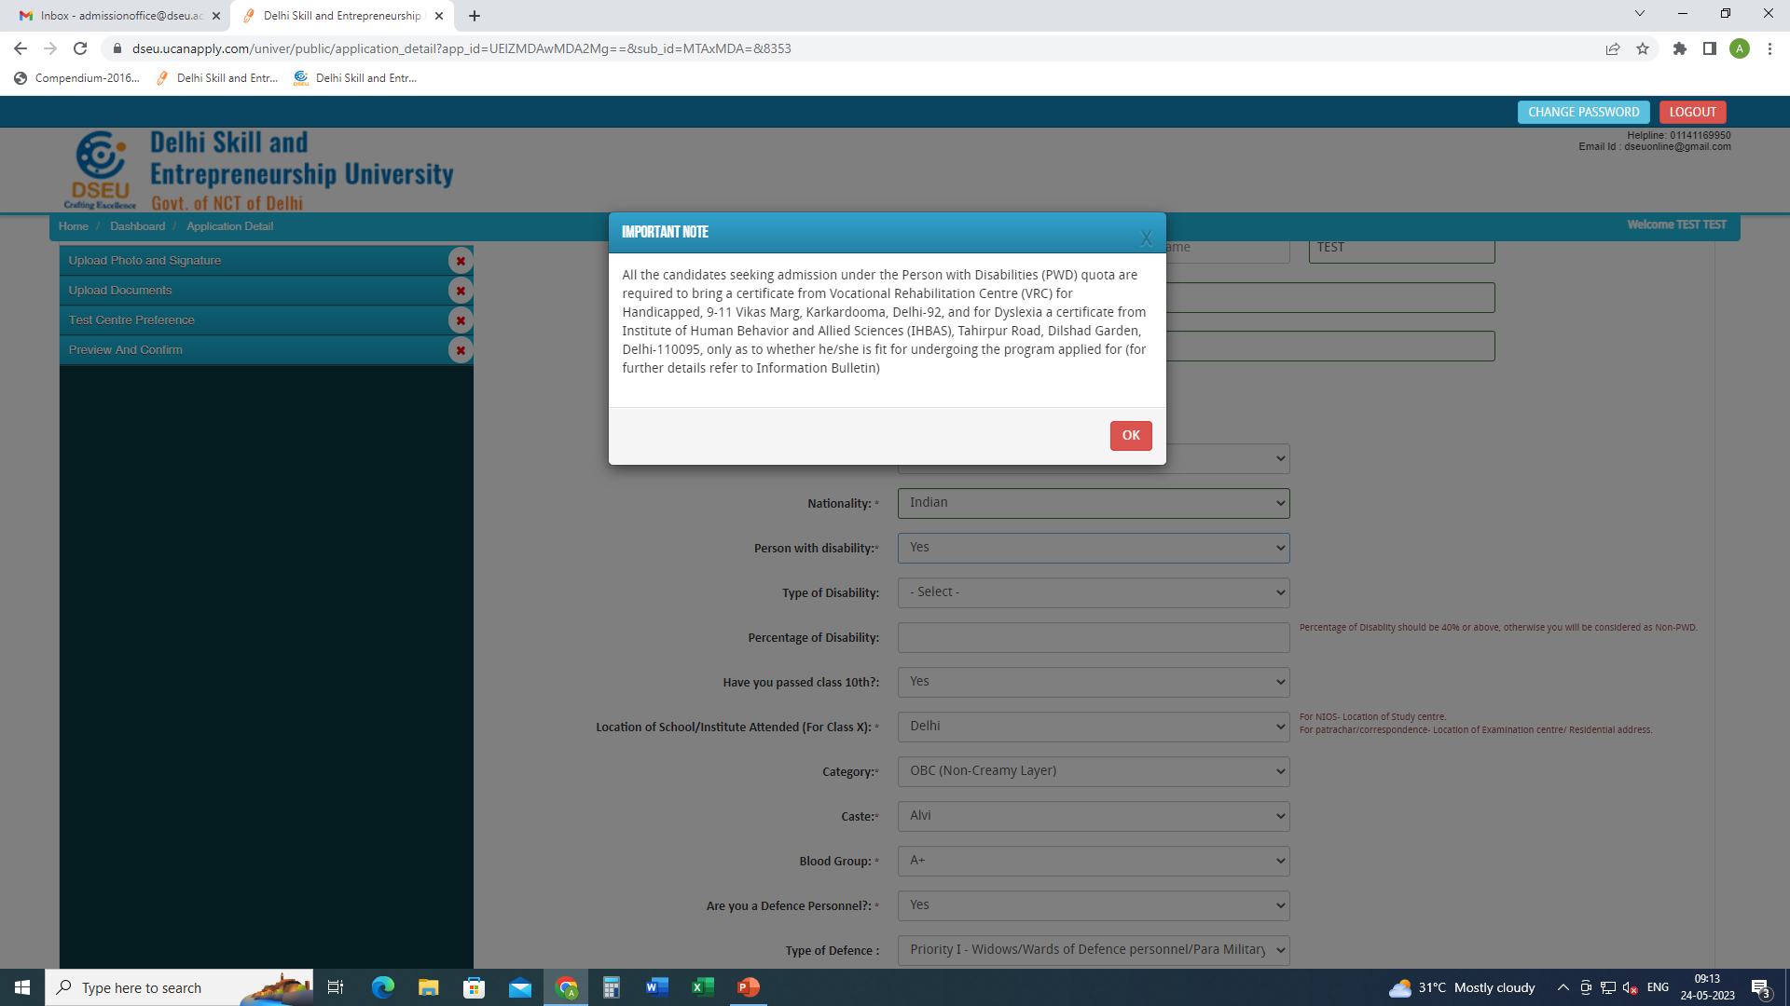
If selected ‘Yes’ in Person with Disability

Slide 10
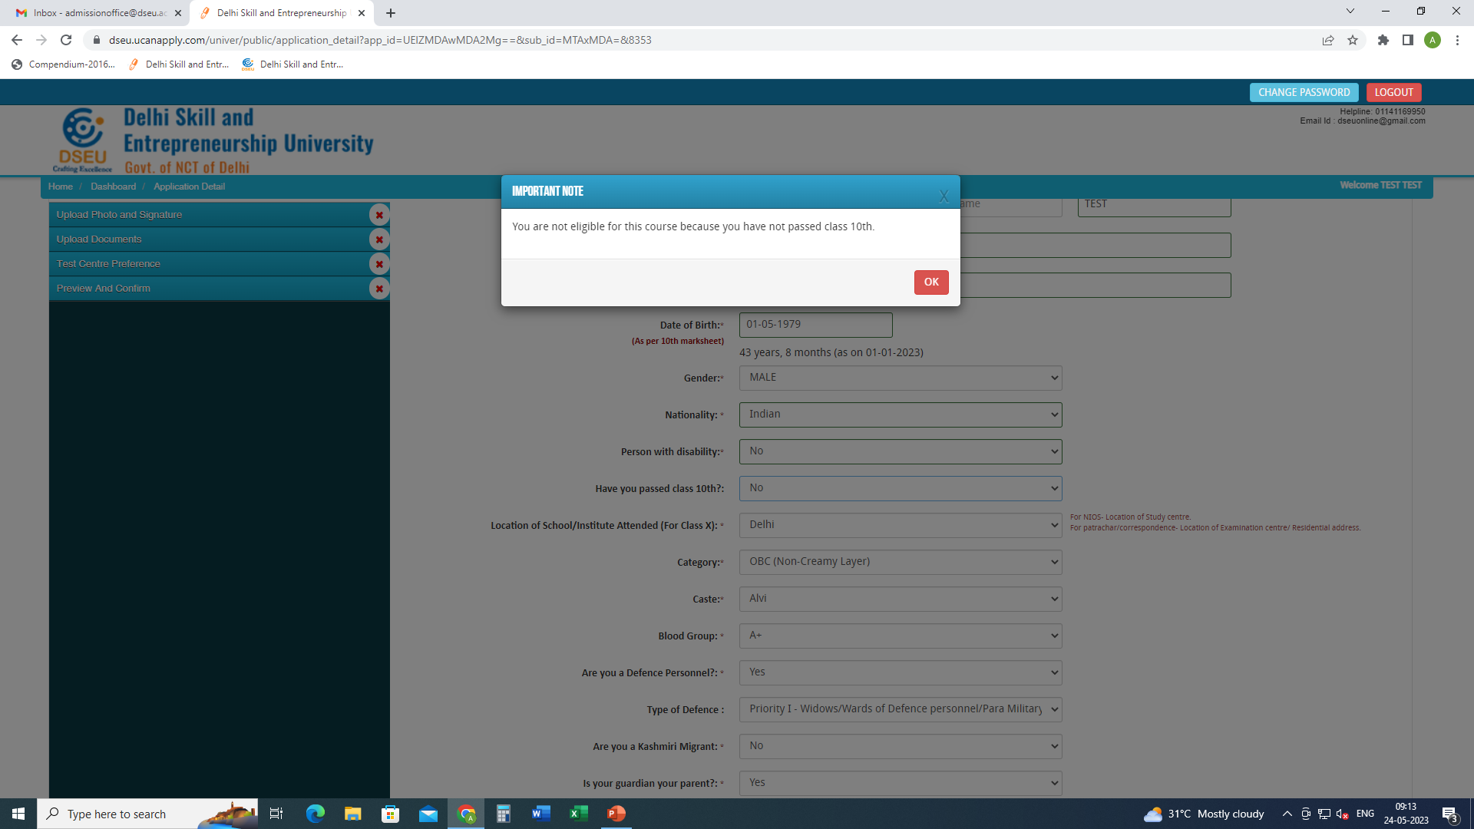
If selected ‘NO’ in Have you passed class 10th

Slide 11
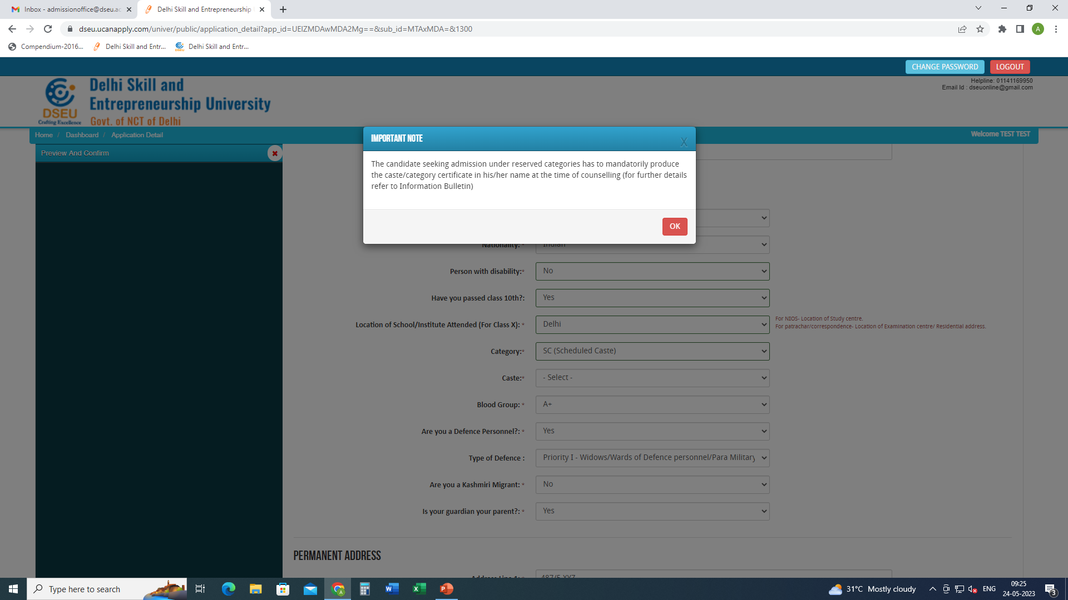
For Delhi SC candidate
Choose caste from the Drop Down

Slide 12
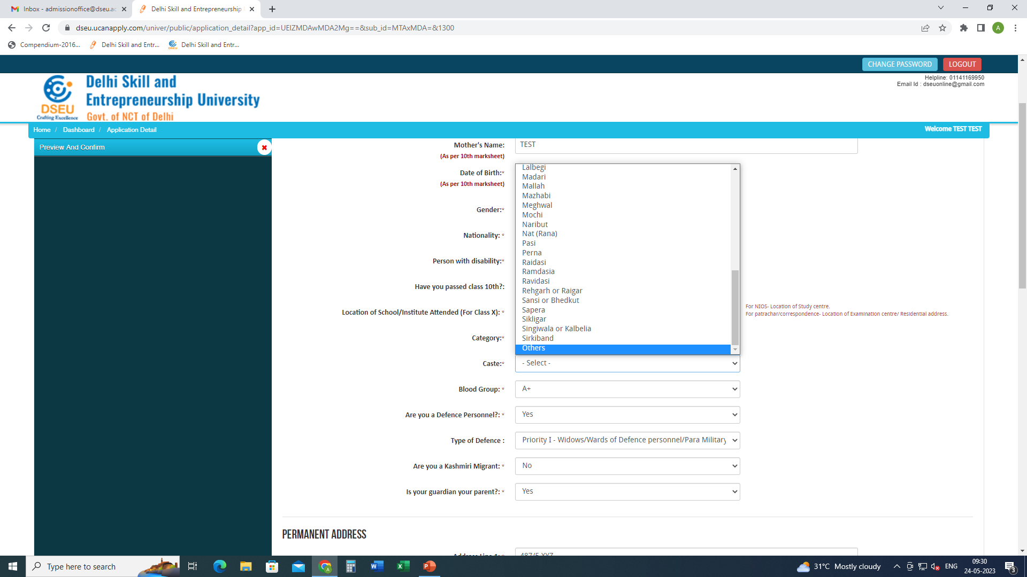
If caste is selected as others

Slide 13
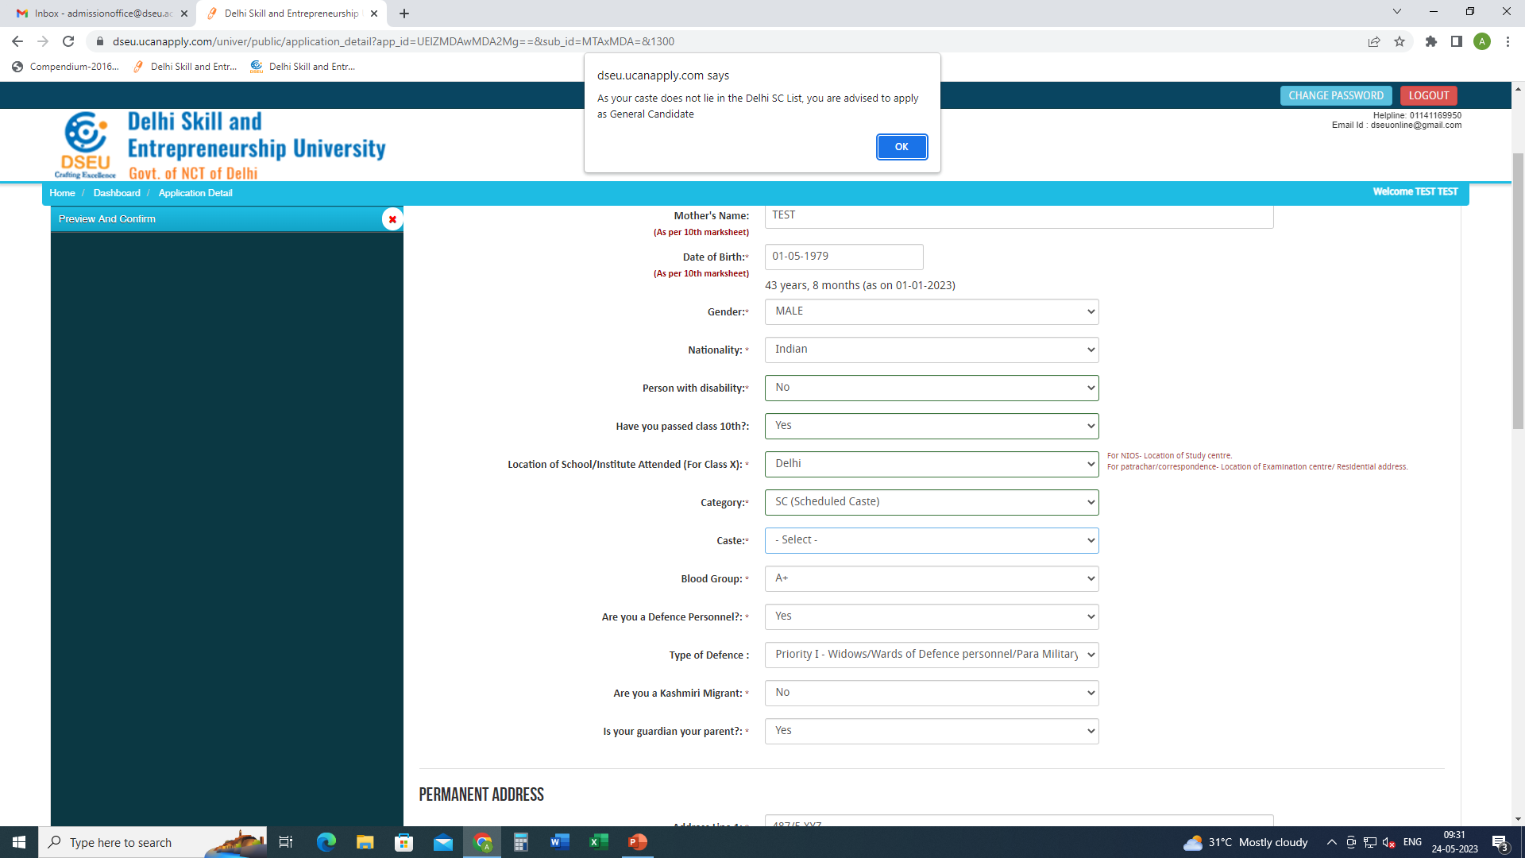
Pop up will ask the candidate to apply as General Candidate

Slide 14
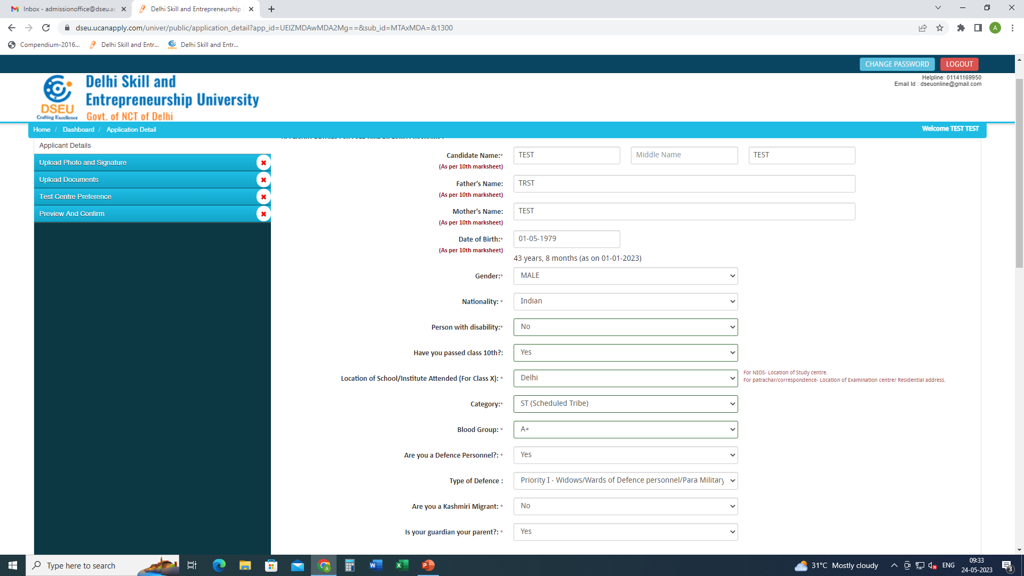
For ST Candidate there will be no pop up and the system will allow him to proceed further.

Slide 15
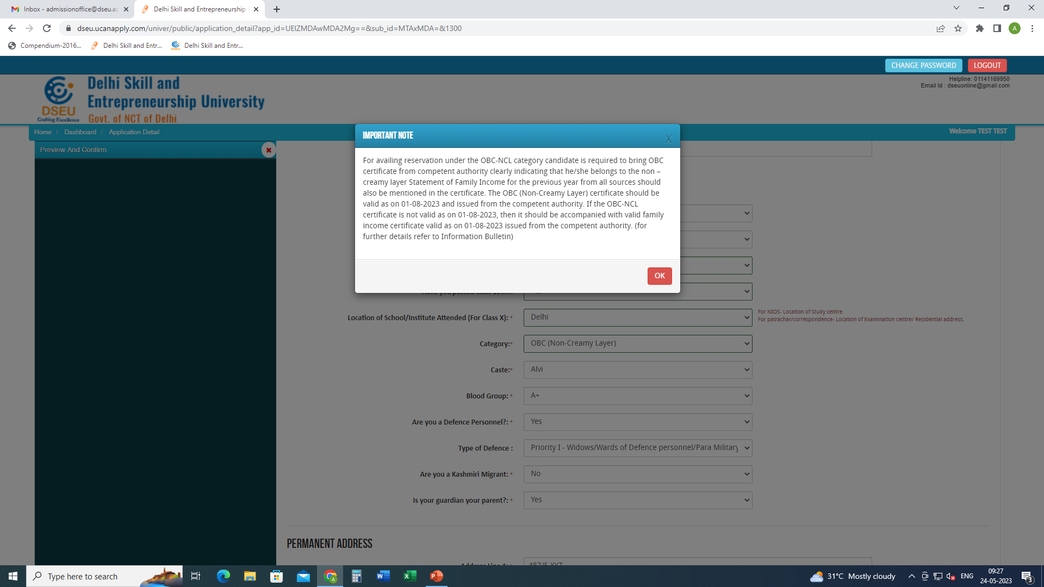
For Delhi- OBC Candidate
Choose caste from the Drop Down

Slide 16
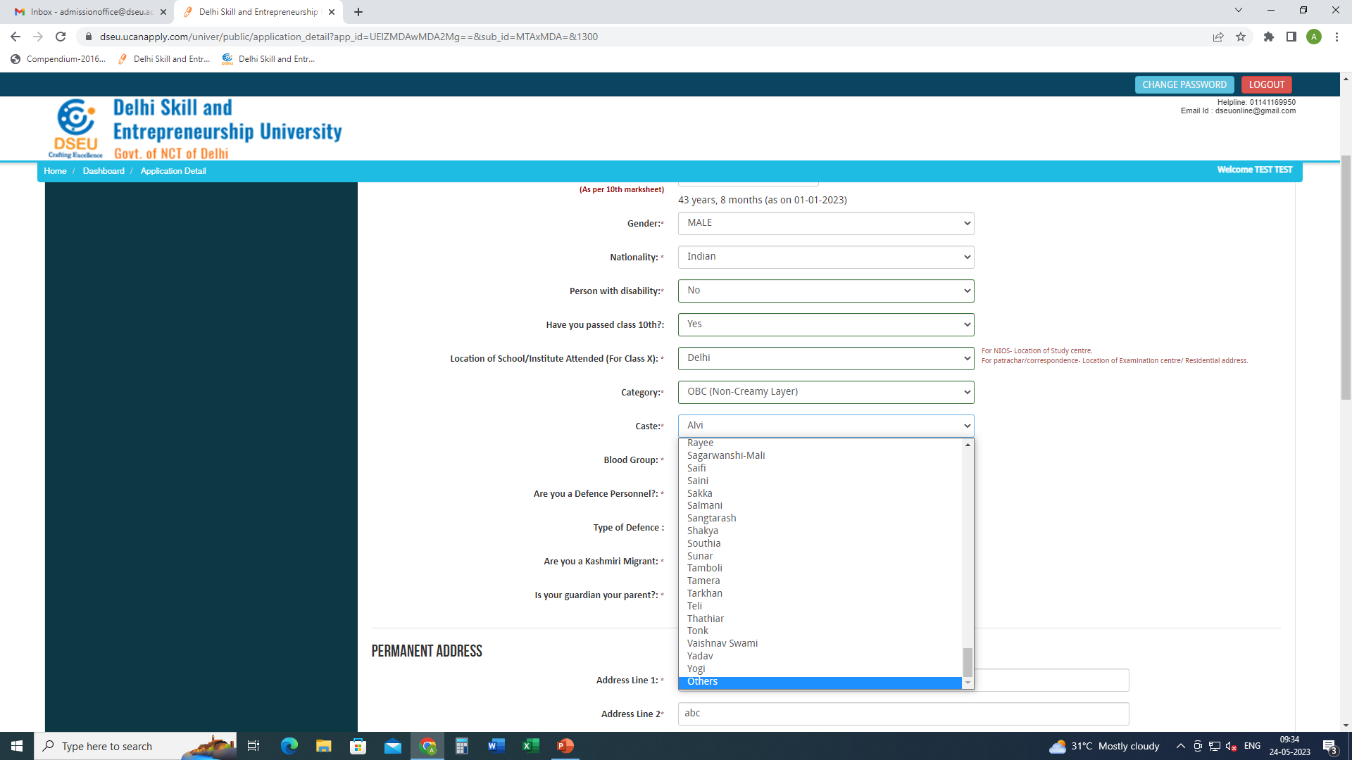
If caste is selected as others then

Slide 17
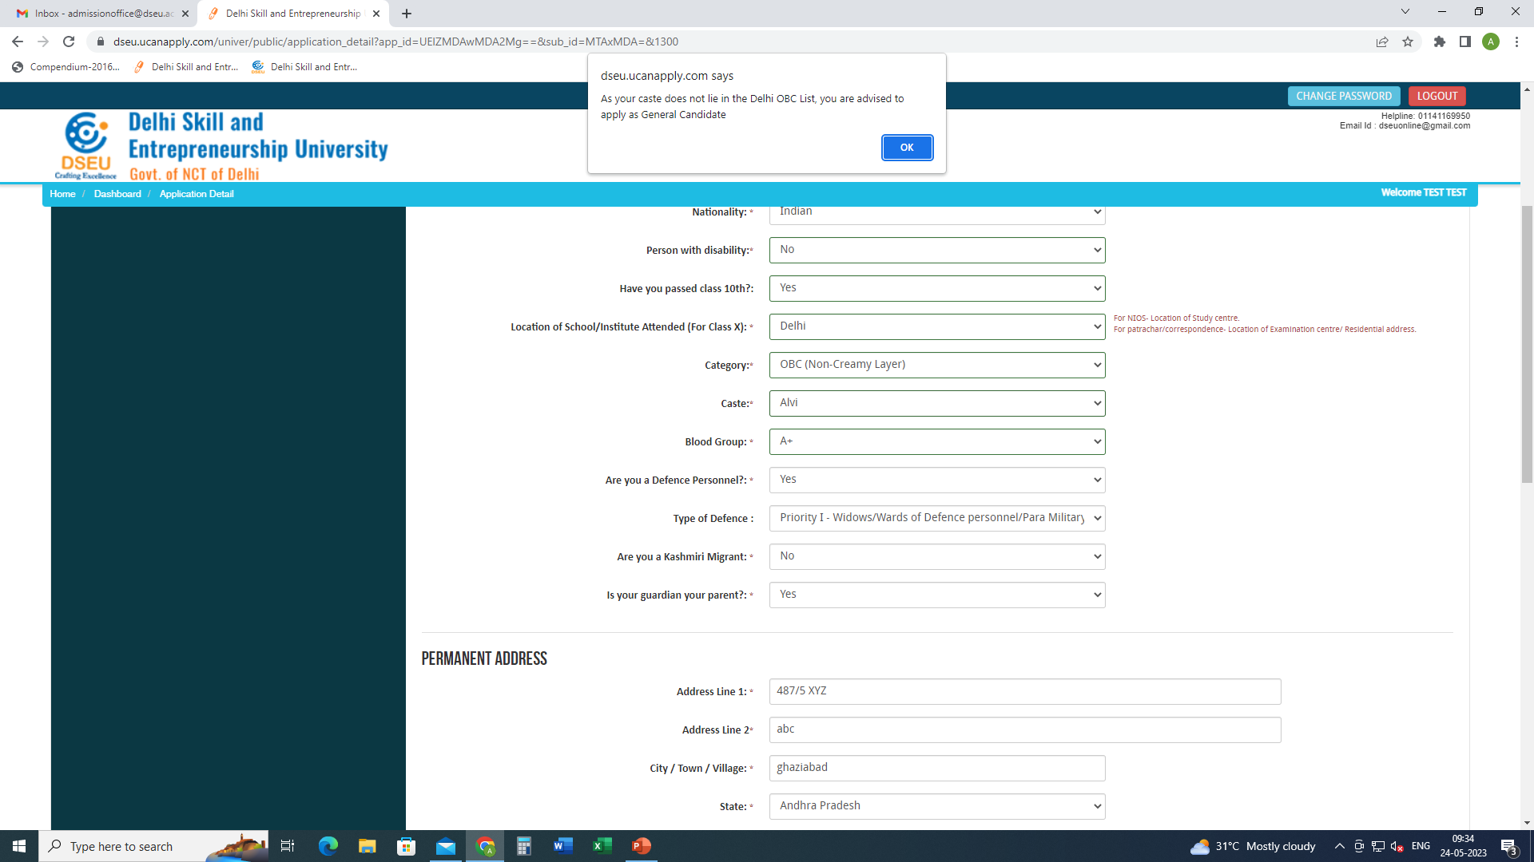
Pop up will ask the candidate to apply as General Candidate

Slide 18
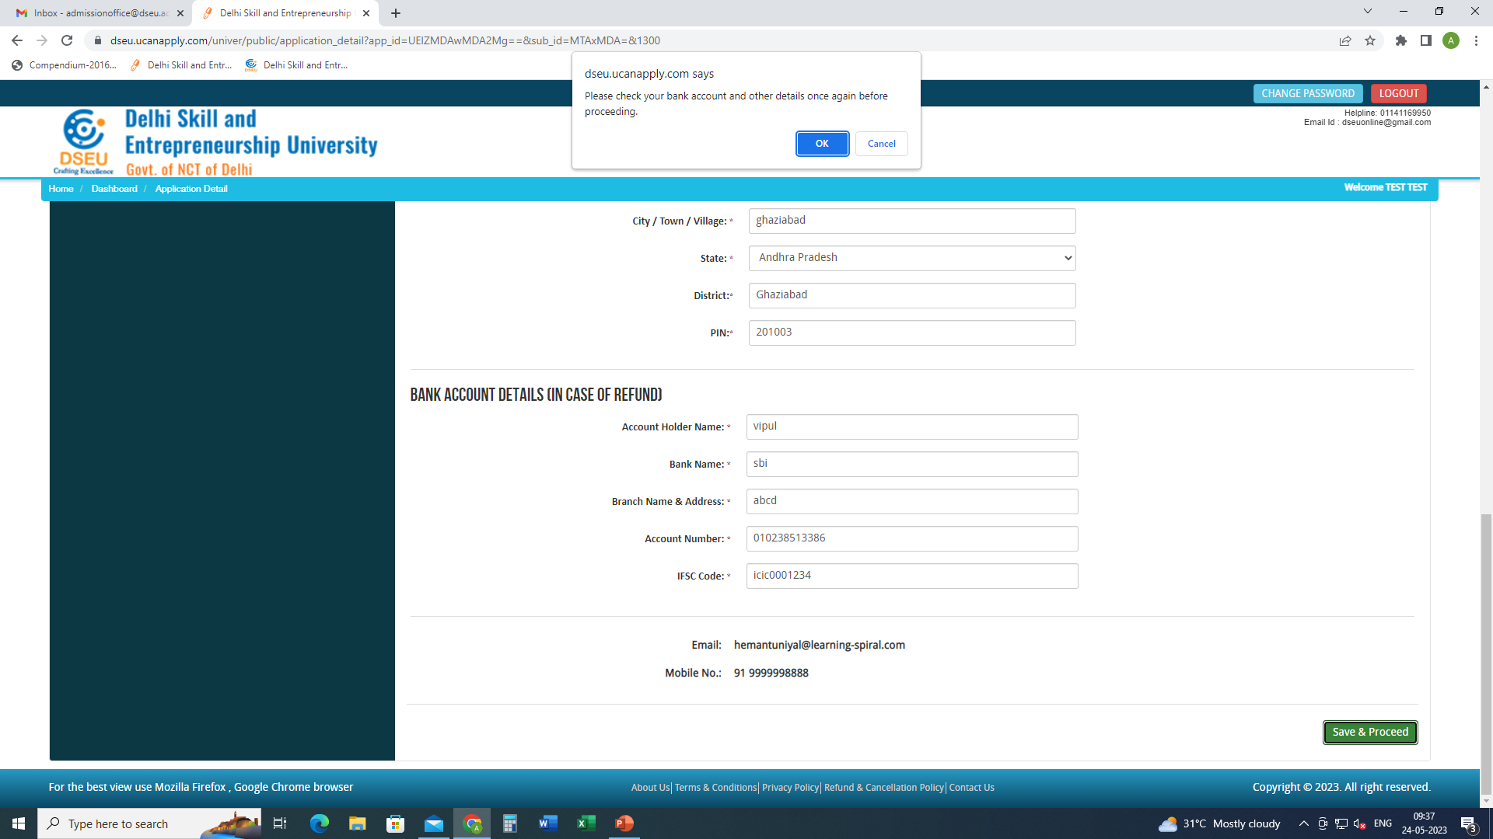
Fill in the other required information. Save and proceed
Fill other required information.
Fill bank details
Save and proceed.
Click save and proceed

Slide 19
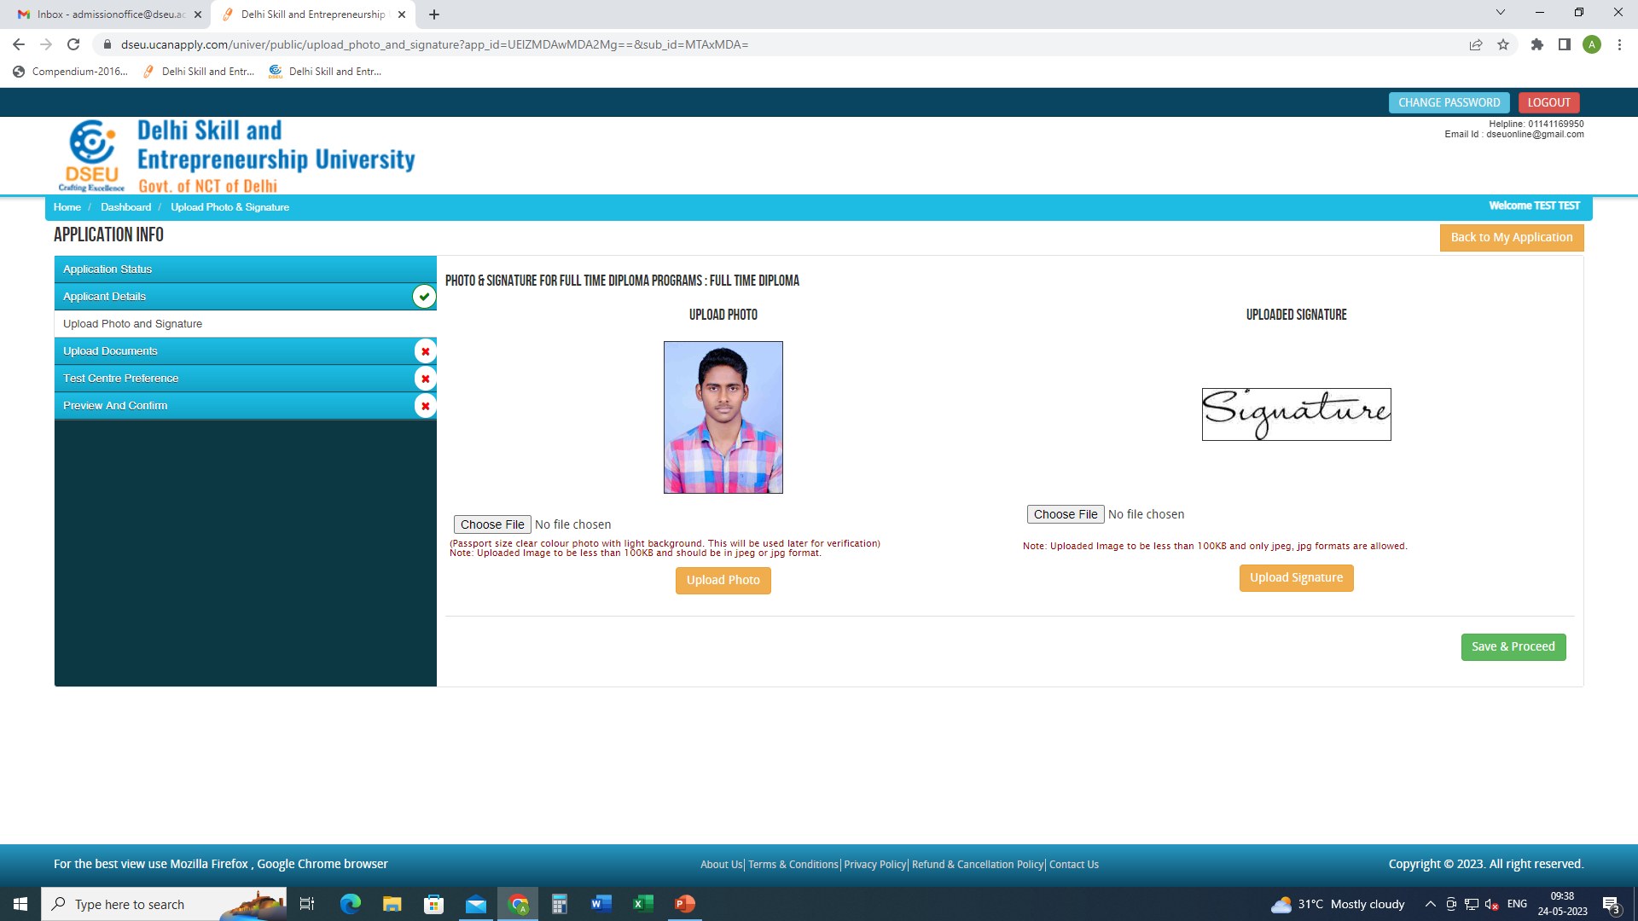
Upload photo and signature.
Save and proceed

Slide 20
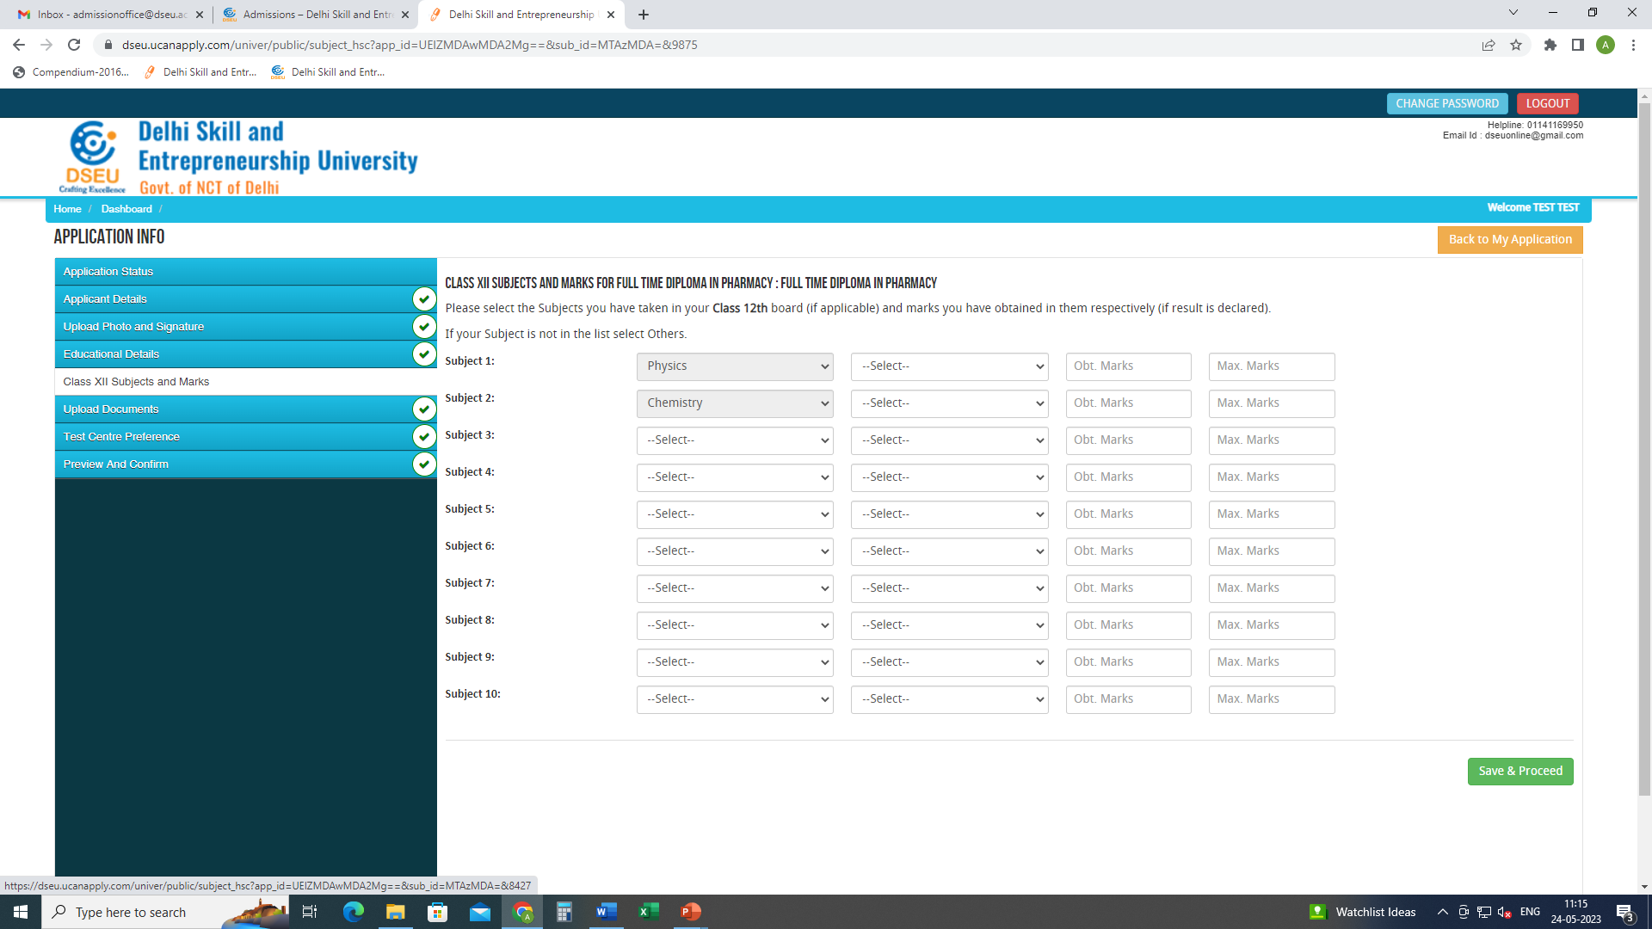
In case of Full Time Diploma in Pharmacy only, the candidate has to enter the subjects and marks of Class XII.
Save and proceed

Slide 21
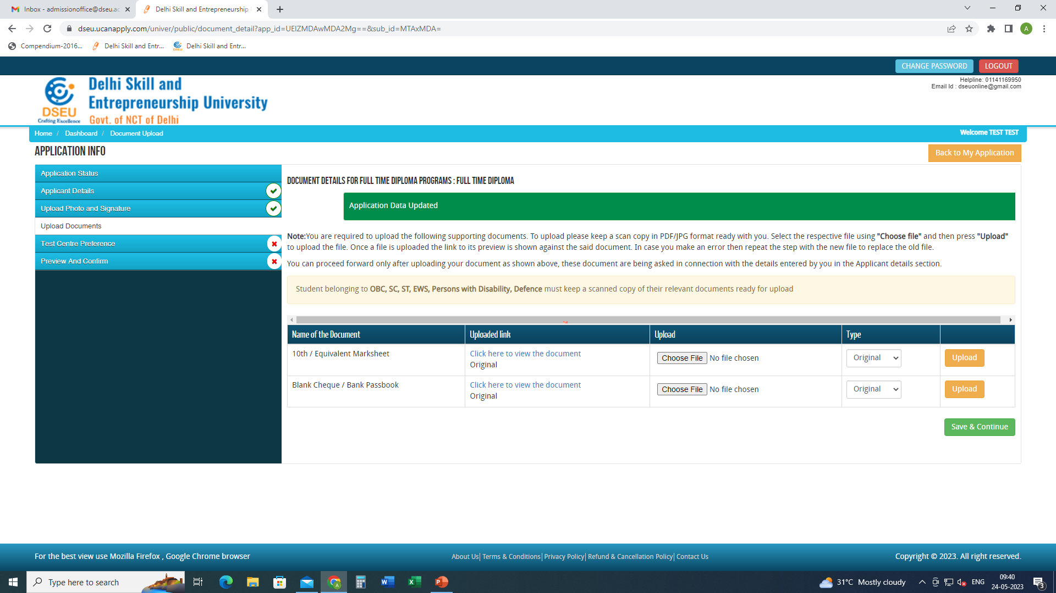
Upload Documents and save and proceed

Slide 22
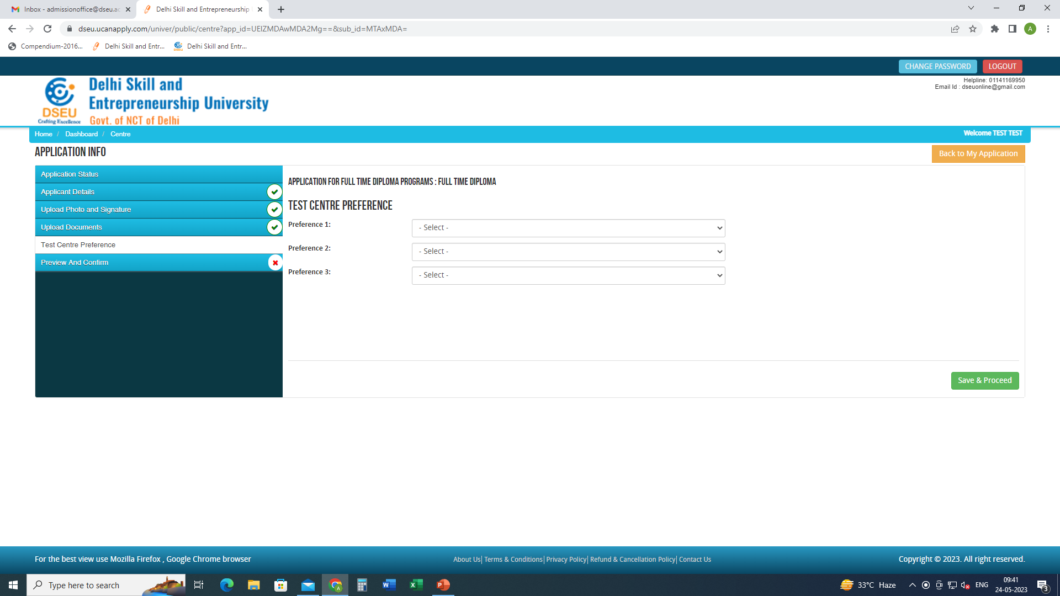
Give test centre preference and save and proceed

Slide 23
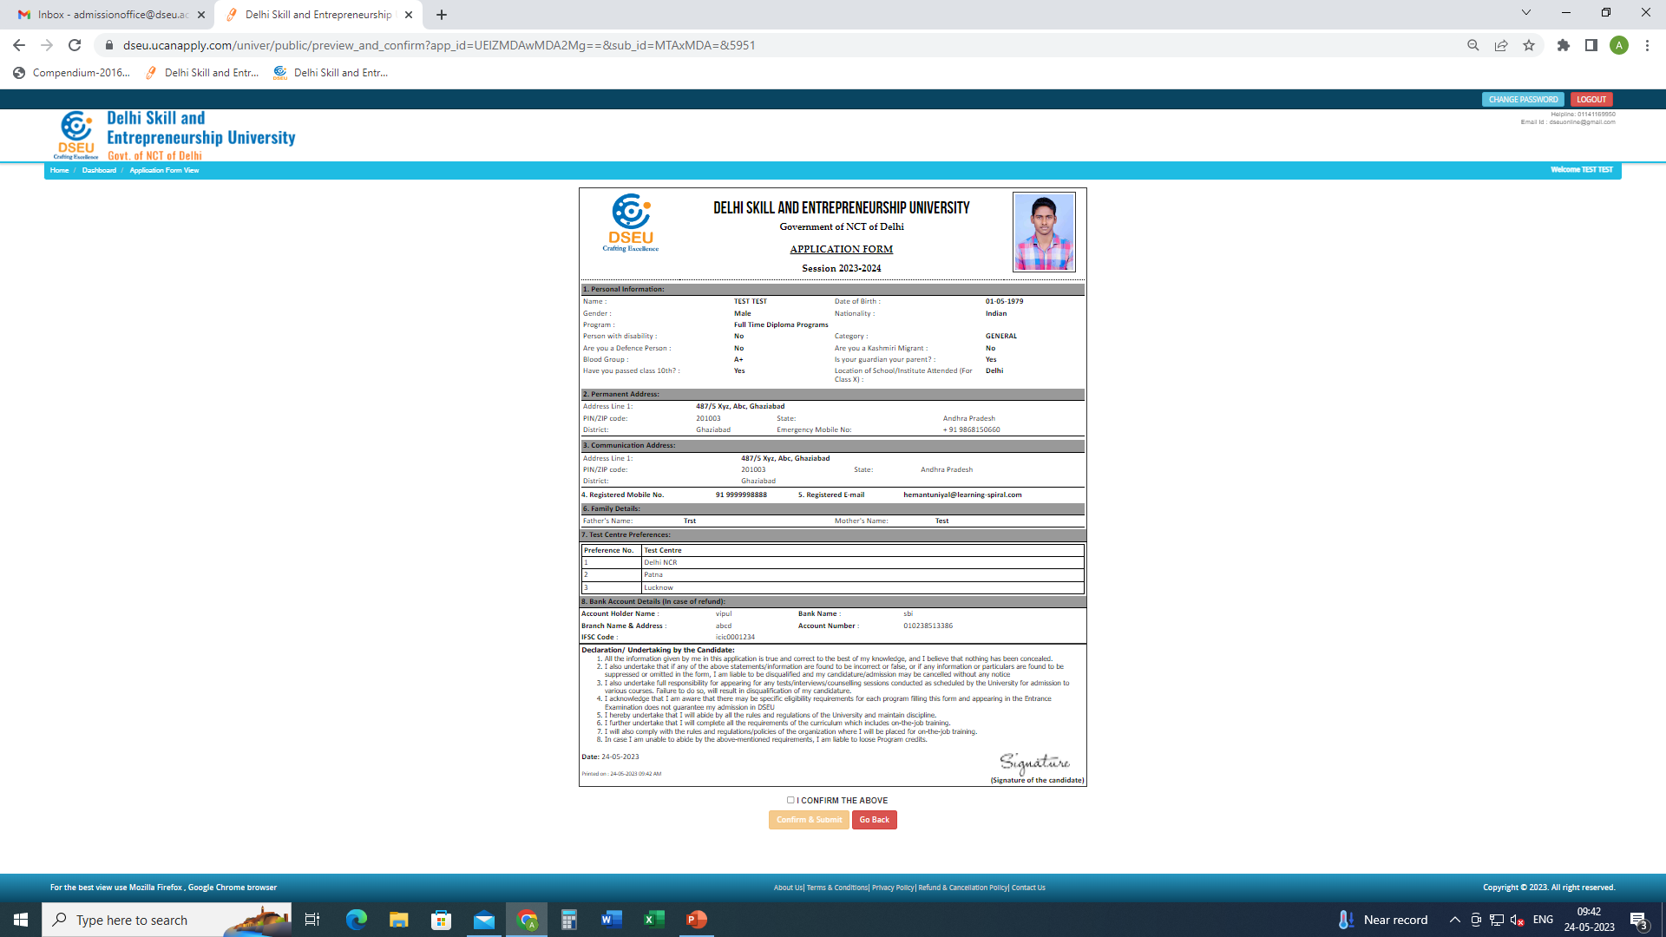
Preview the application form and check details carefully.
If correct.
Check the “I CONFIRM THE ABOVE” box
If not “Go Back” and correct the details.
Click “confirm and Submit”

Slide 24
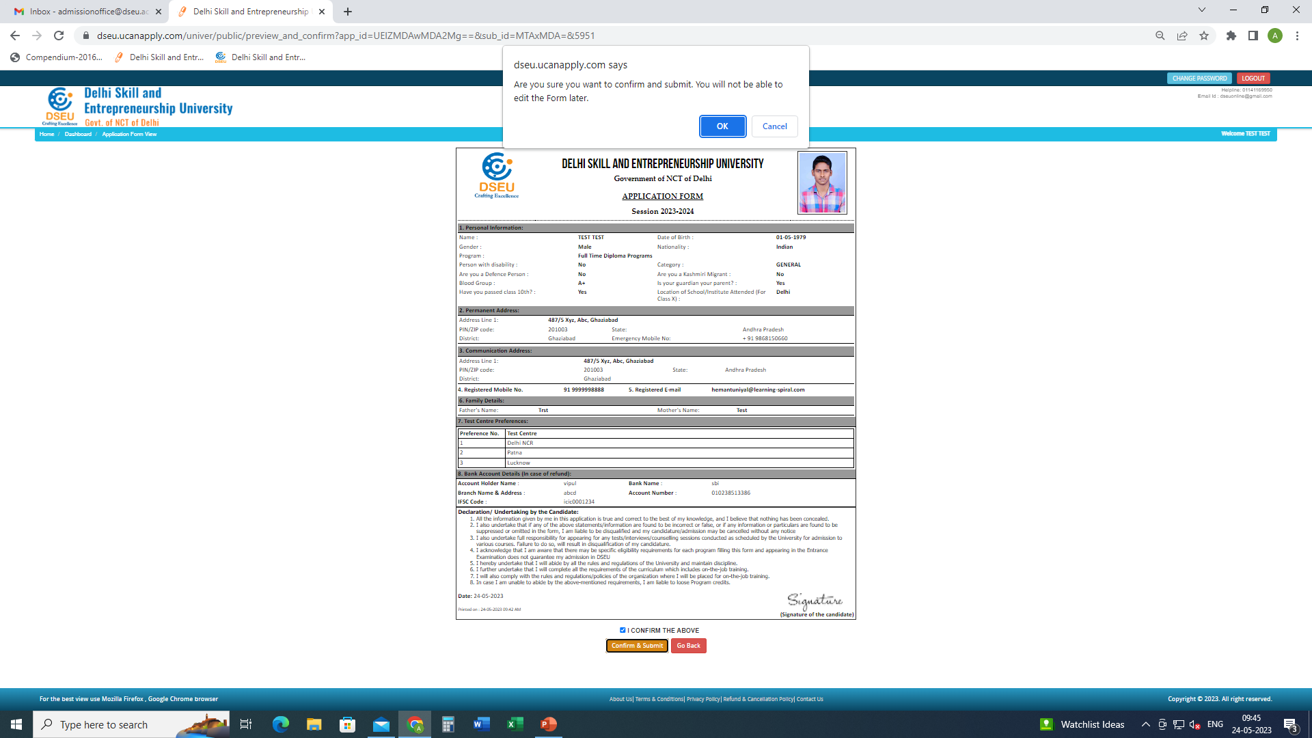
When you click “confirm and submit” pop up will show Up.
OK.

Slide 25
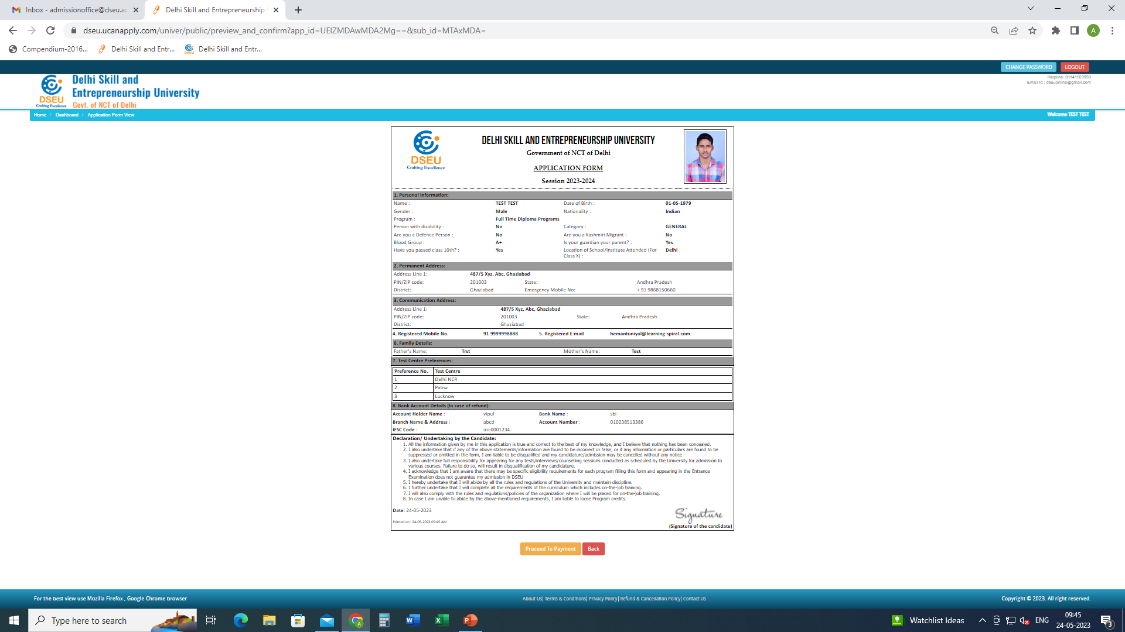
Proceed to payment and pay 900 registration cum counselling fee. After successful payment. Print the final application form for future reference.

Slide 26
Lateral Entry to FTD Programs Login and add the program. (NO need for new registration if already registered. However if not registered, registration is required)

Slide 27
Fill the details.
Everything same as FTD shown above.
Select the qualifying exam.

Slide 28
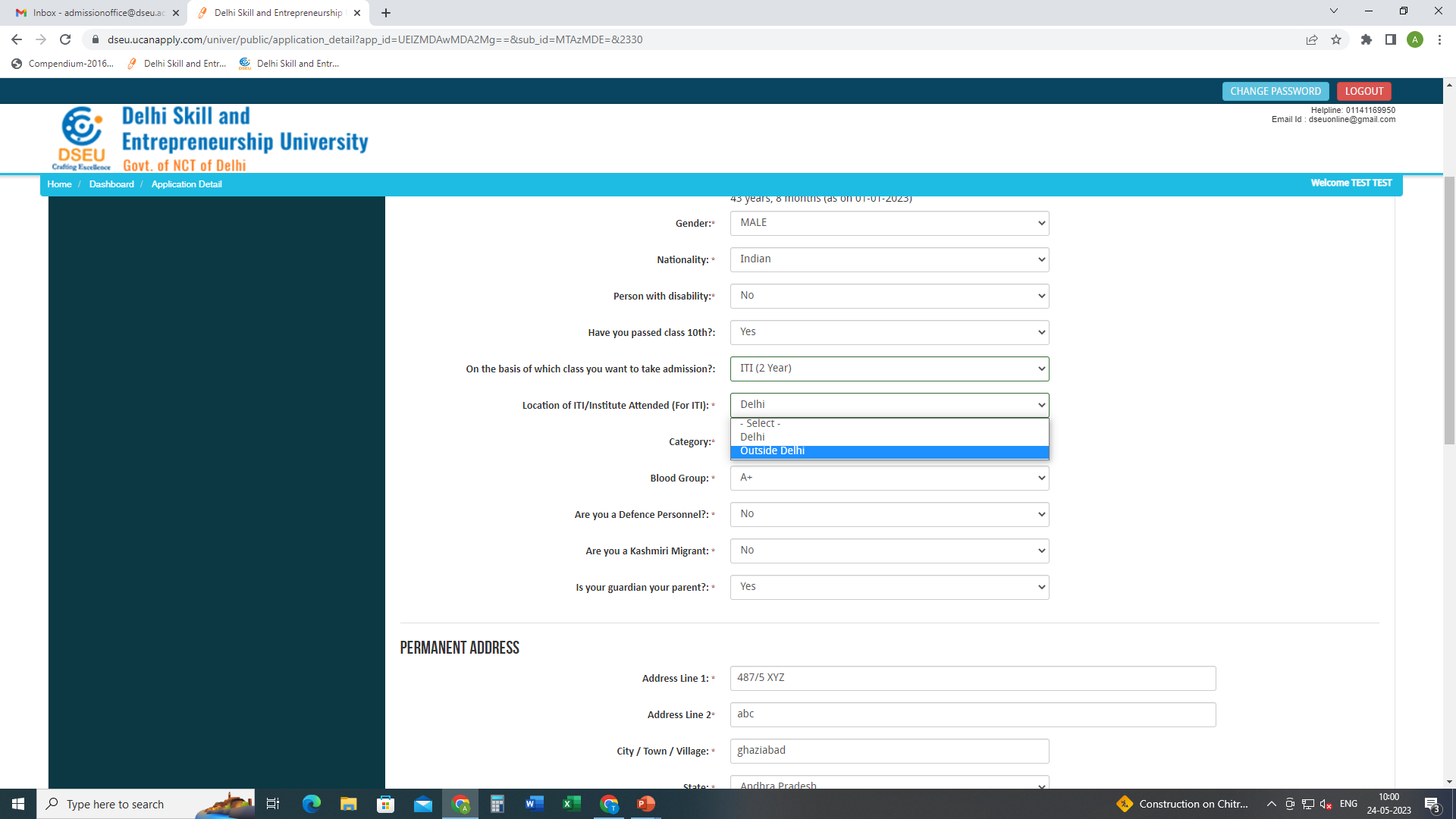
Choose the location of ITI / Institute attended.

Slide 29
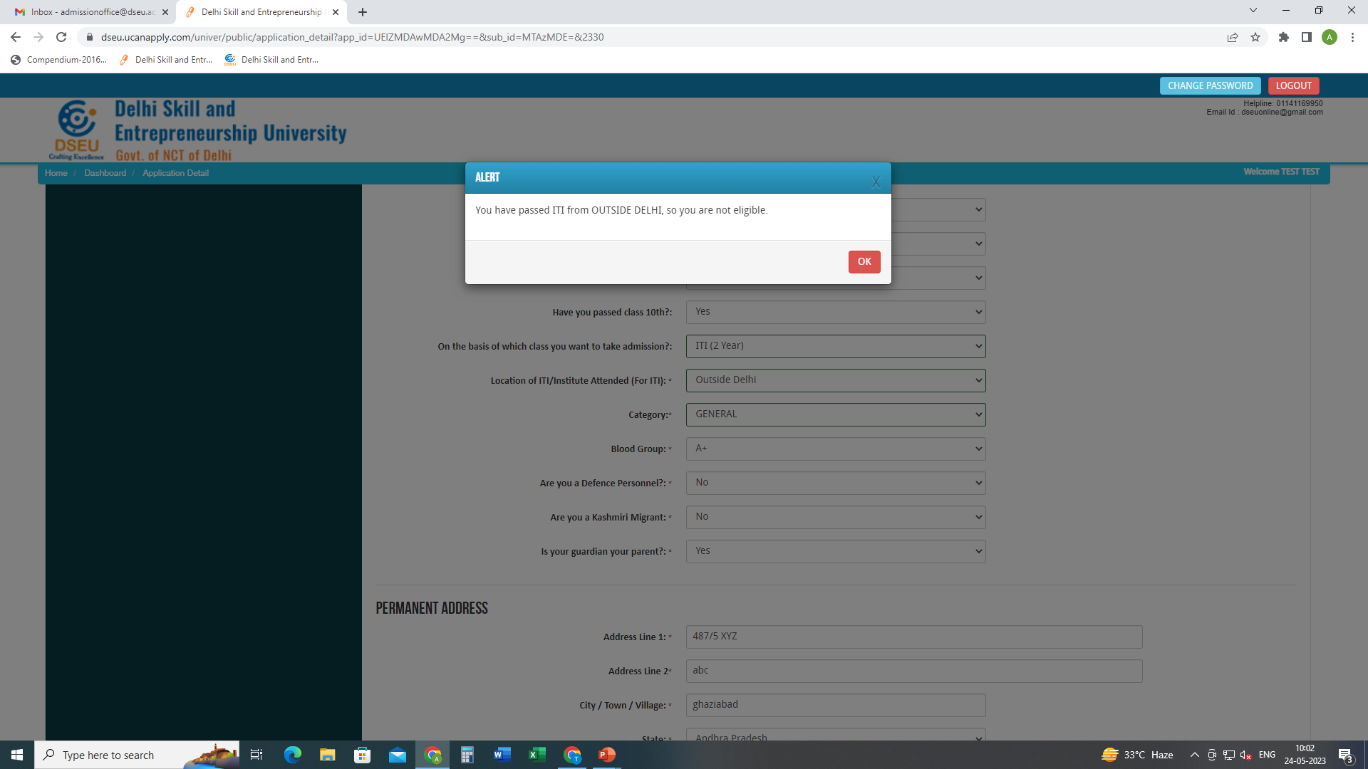
If chosen as ‘Outside Delhi’
Pop will show up

Slide 30
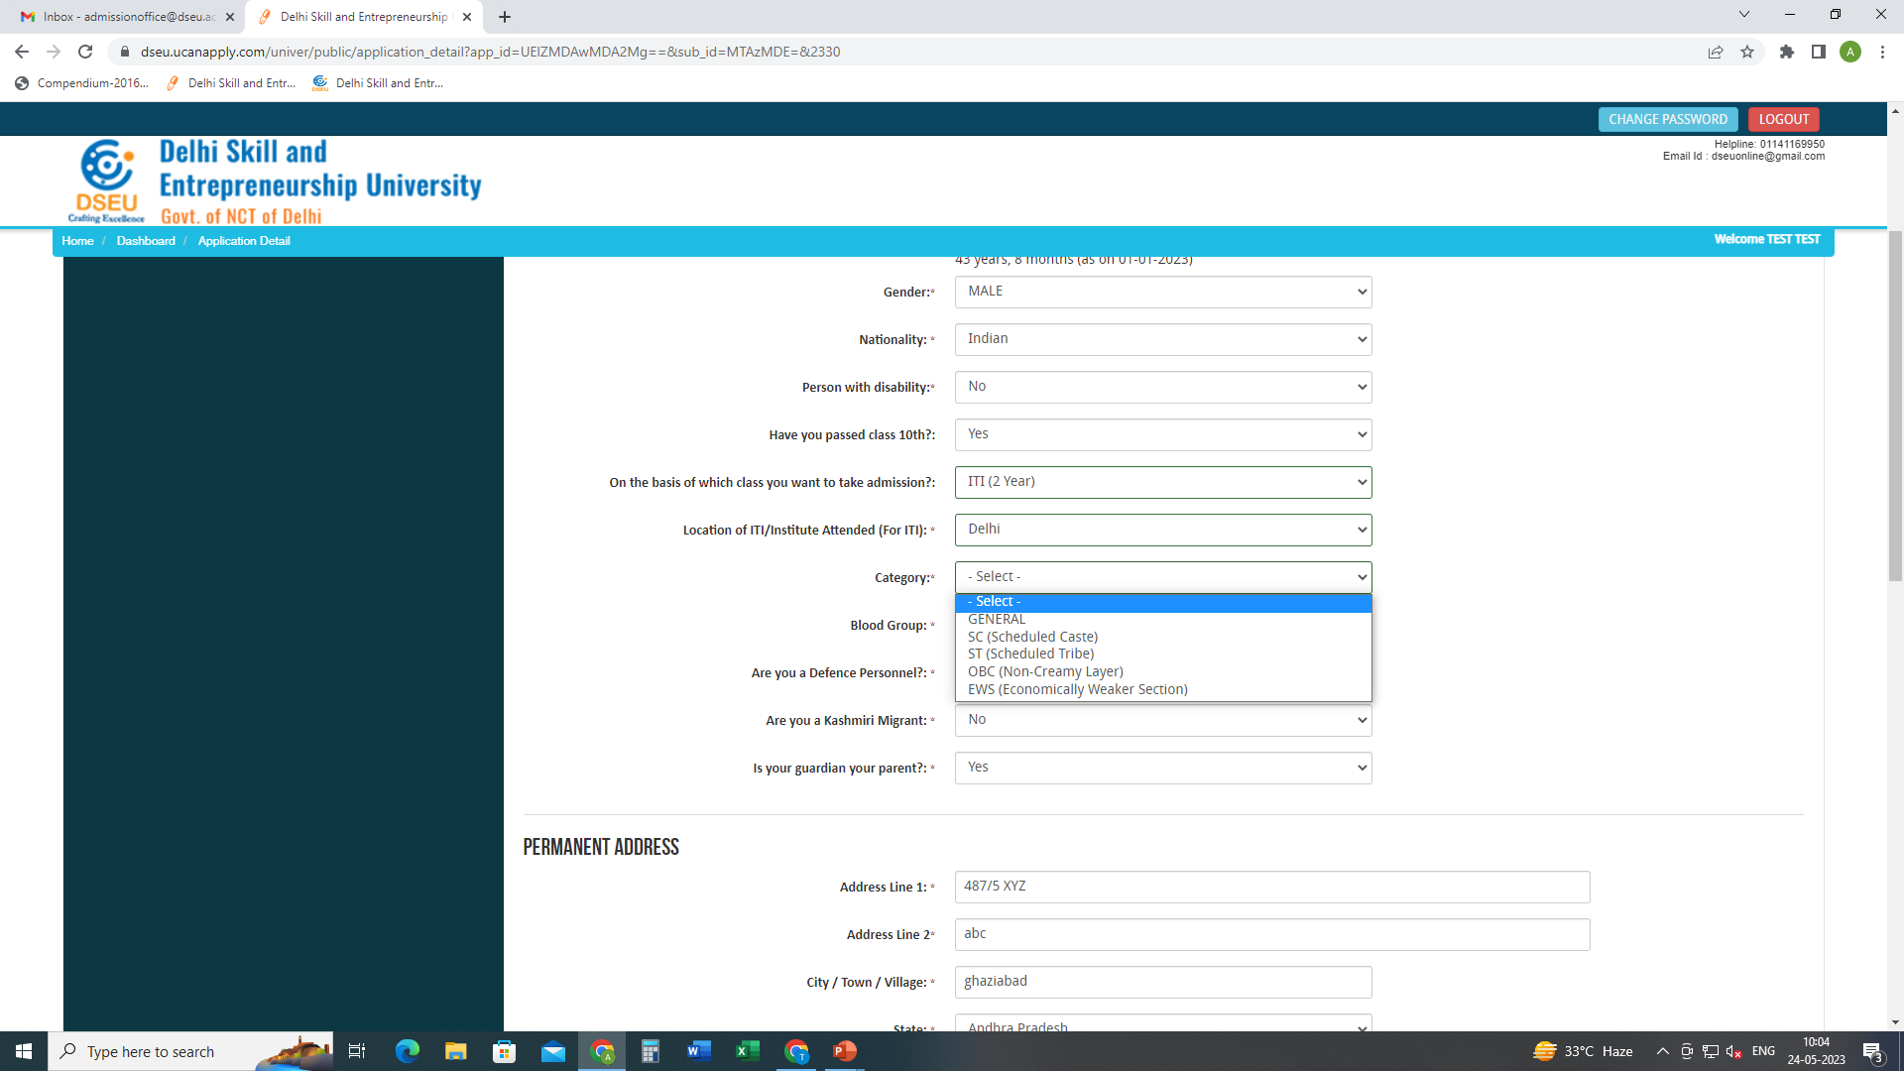
Select Category

Slide 31
If selected ‘SC’

Slide 32
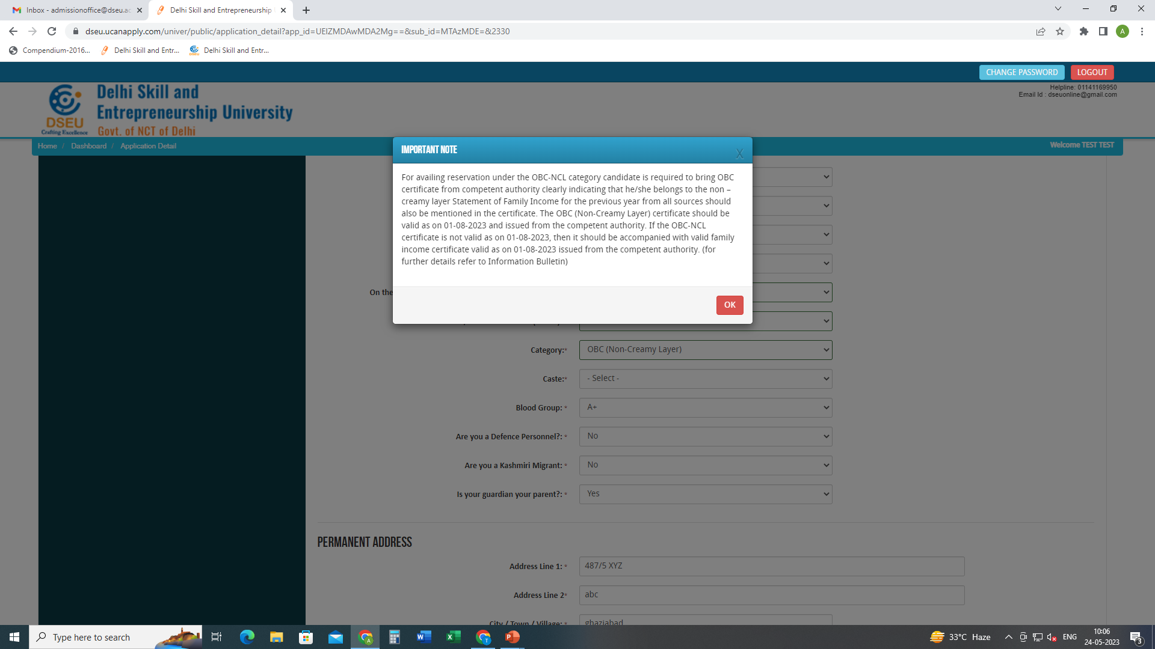
If selected ‘OBC’

Slide 33
Fill other details. Save and proceed upload Photo and Signature Save and Proceed

Slide 34
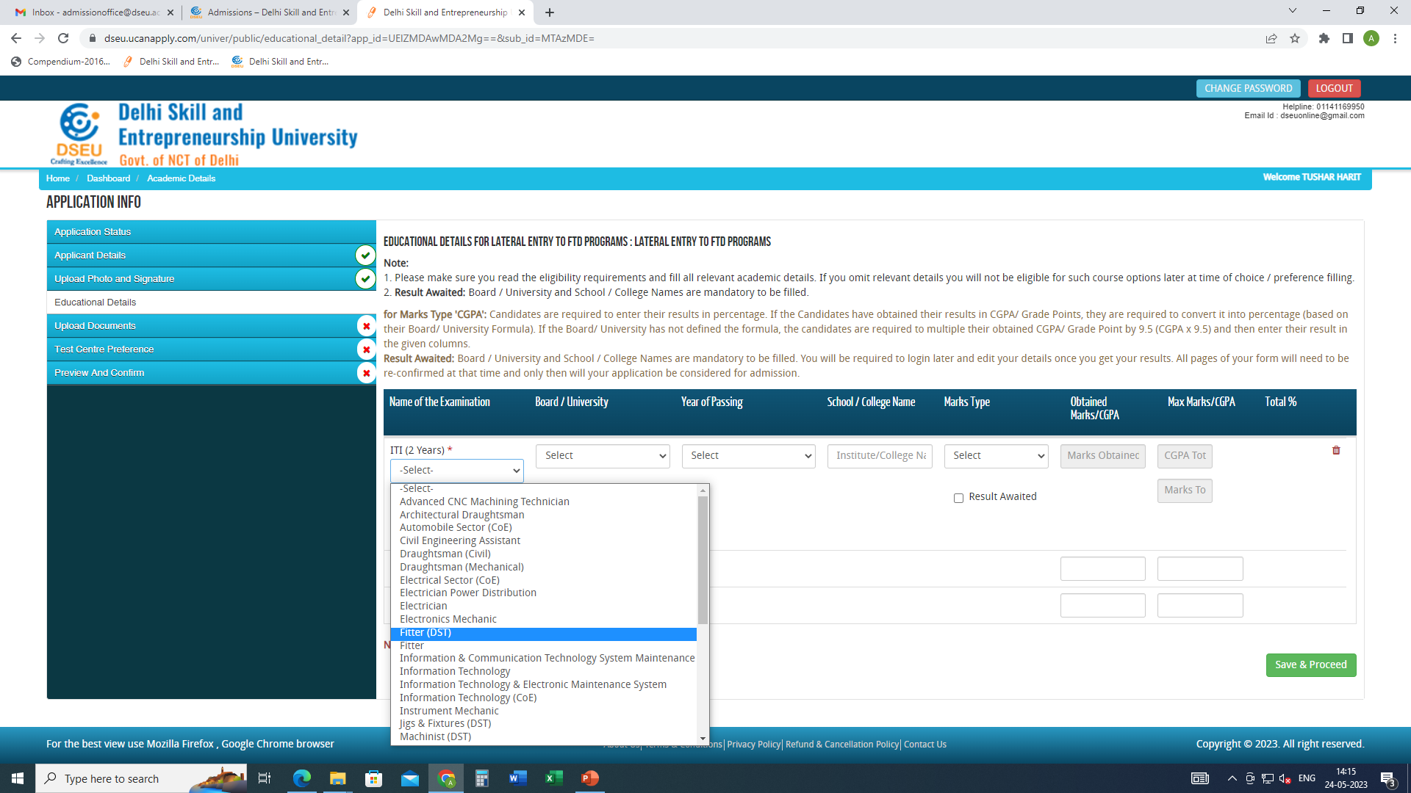
Choose ITI trade from the drop down menu as shown
Fill other details
Save and proceed
Fill the education details.

Slide 35
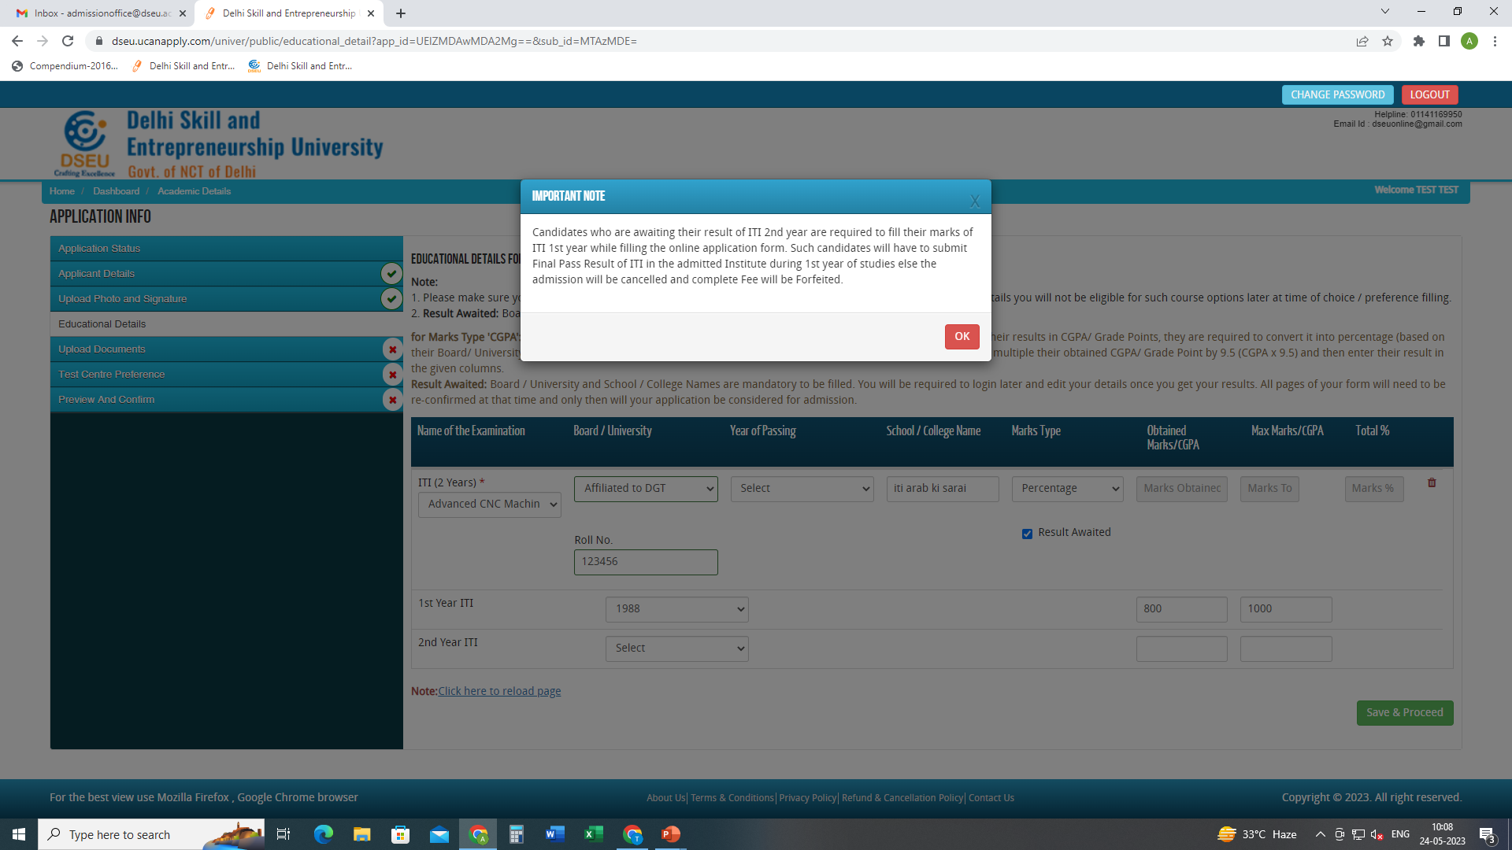
If result is awaited pop up will show up.

Slide 36
-Fill all the required information -save and proceed -upload required documents -save and continue -give test preference -preview and confirm( check details carefully) -pay registration fee -print final application form for future reference.

